Slide 1
Alien P.R.O.B.E RFID Solution for WKU PTS
Nicholas Johnson, Cy Dixon, Alex Godsey, Michael Lynch
Client: Kevin Werner
CS 496- Senior Project

Slide 2
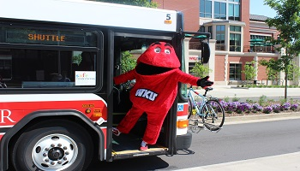
Problem – WKU Parking and Transportation Services (PTS)
WKU PTS wants a more efficient solution to parking enforcement on its campus and other lots, but has been facing issues related to the following:
Current solutions revolve around manually checking car tags
Current RFID solutions for tag scanning have no good interfaces to interact with
Future LPR(License Plate Recognition) solutions will not be entirely accurate
Kentucky is one of 21 states that do not require 2 license plates

Slide 3
Solution – Alien P.R.O.B.E Mobile App
Alien P.R.O.B.E (Precision RFID Operational Bridge for Efficiency) is an Android app that aims to aid in the process of a PTS employee’s job in scanning and verifying vehicles in the surrounding parking lots of WKU.
App connects with existing WKU PTS RFID scanning equipment
App needs to store the USERID from the RFID Tag from the RFID Equipment
Store and obtain geolocation and time of scan data with the RFID tags
Connect to the equipment with the Alien PROBE application

Slide 4


Development Process
Alien PROBE was developed in Android Studio, the official IDE for Android Apps.
We also used the Alien Technologies provided SDK(Software Development Kit) for developing for the Alien ALR-F800 reader.
We also used the following tools:
GitHub (For Version Control)
Discord (For Communication)
Overleaf (LaTeX Documentation)

Slide 5
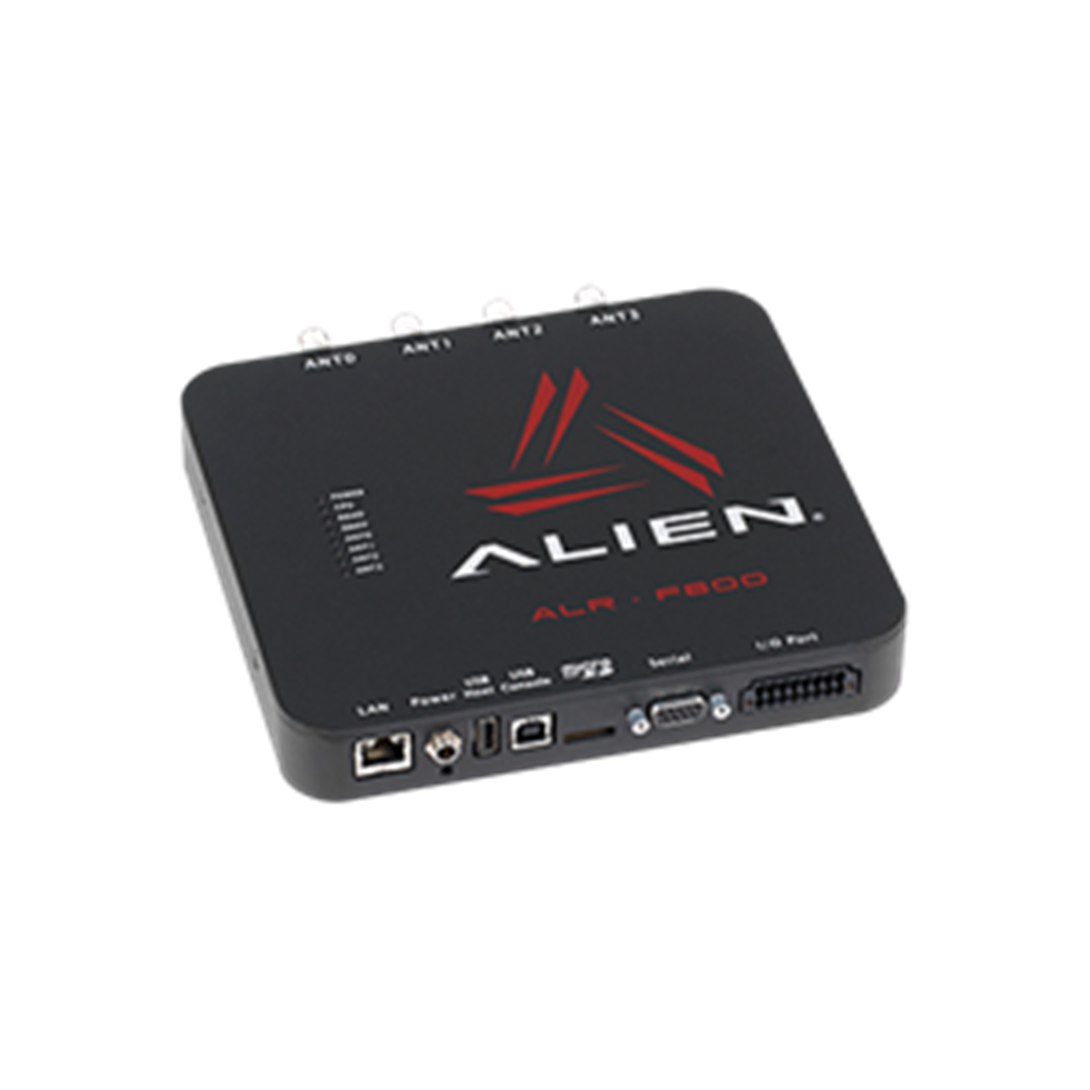
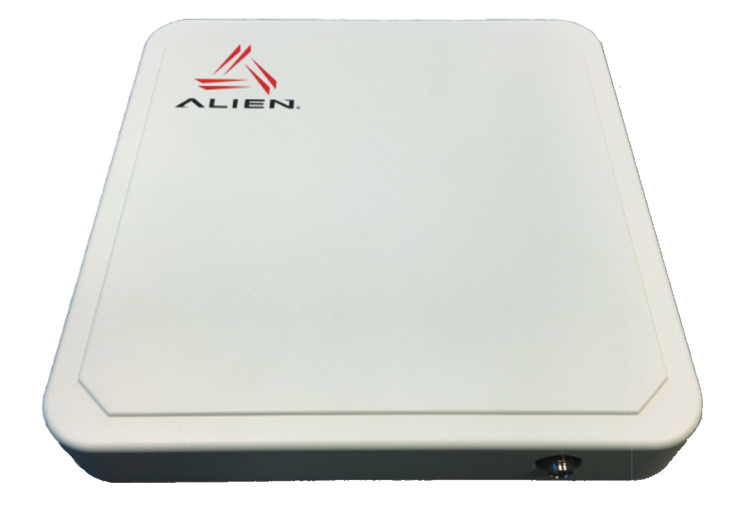
Equipment
Alien RFID ALR-F800 Reader
Alien ALR-8698 RFID Ultra-band Antenna

Slide 6
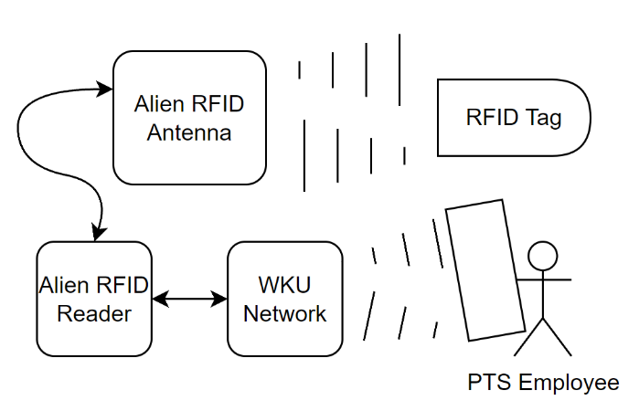
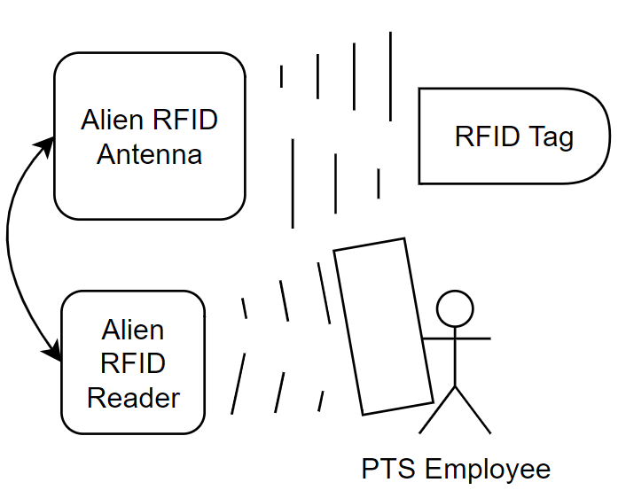
Deployment Diagram
Network Mode
Bluetooth Mode

Slide 7
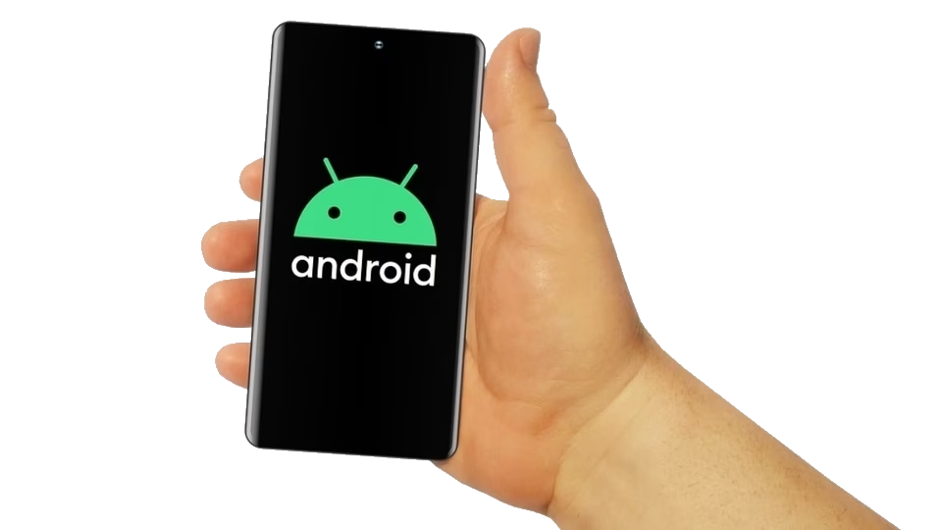
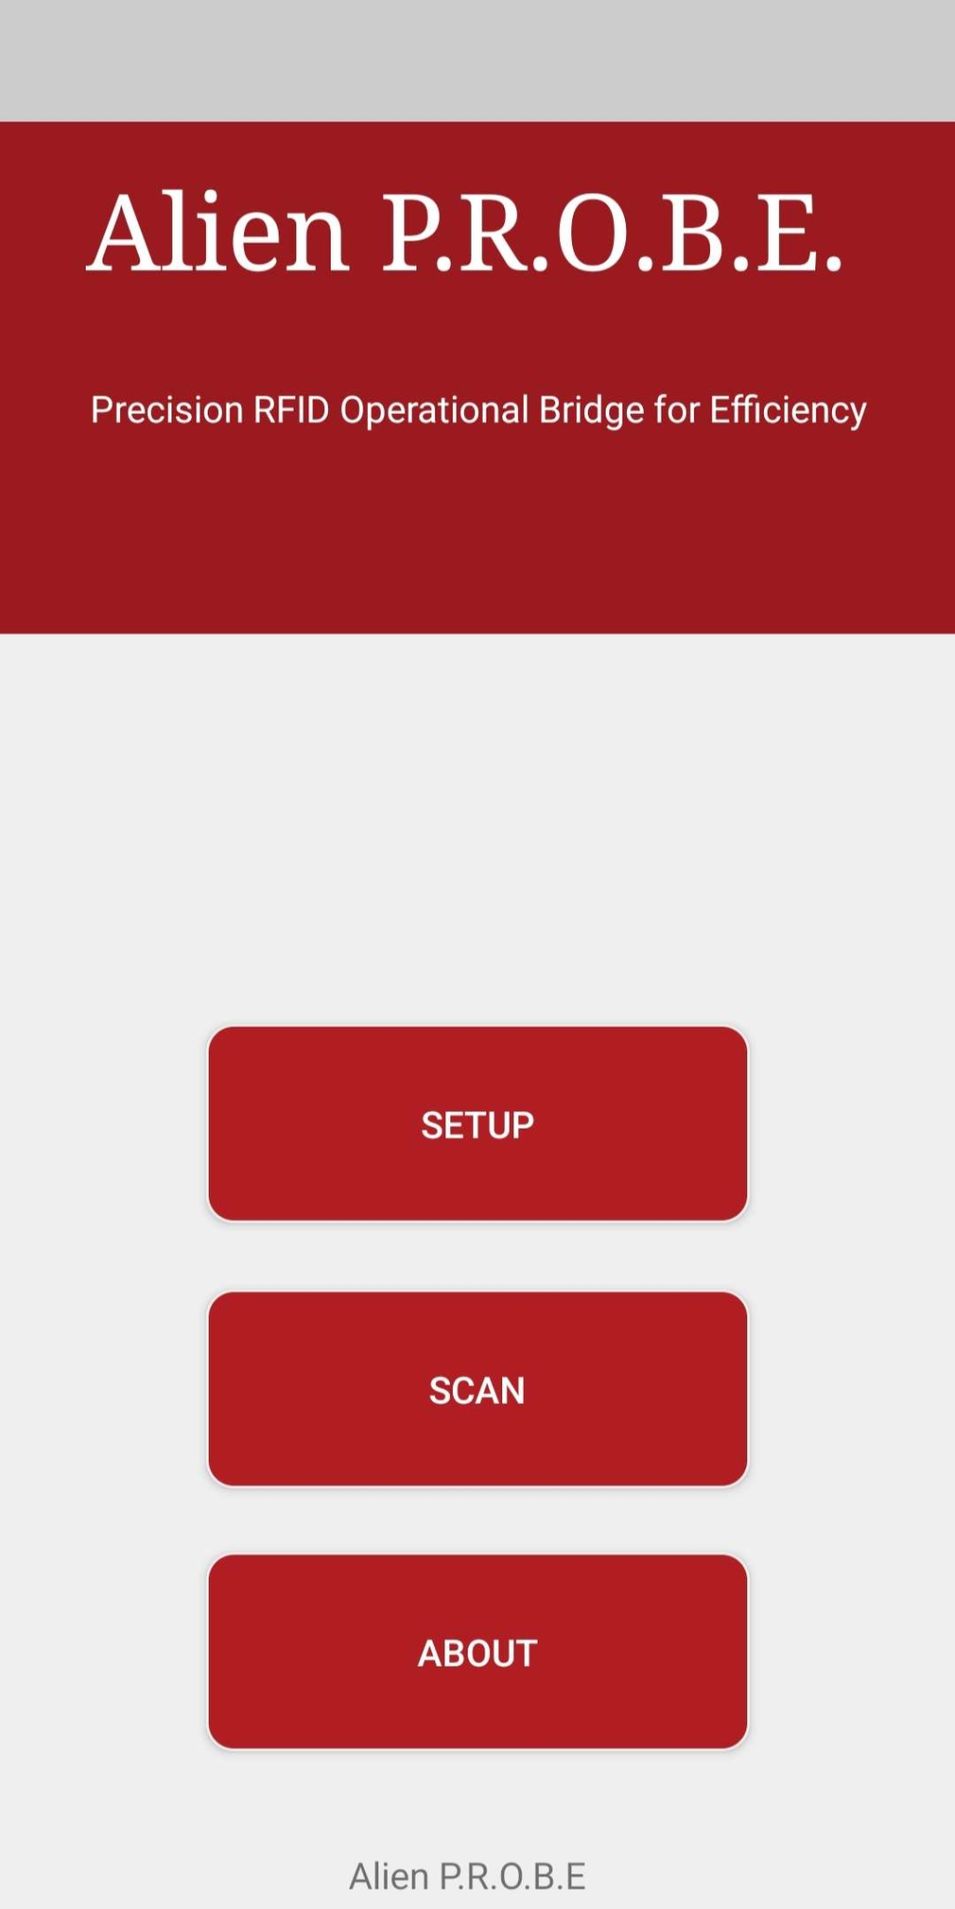
Performance Requirements
Android version 11 (SDK 30) and up.
A phone that can run the app.
Very minimal requirements
Processor that can run app smoothly.
Minimum 2-4 GB of RAM
Enough Storage
App Size is around 30mb.

Slide 8
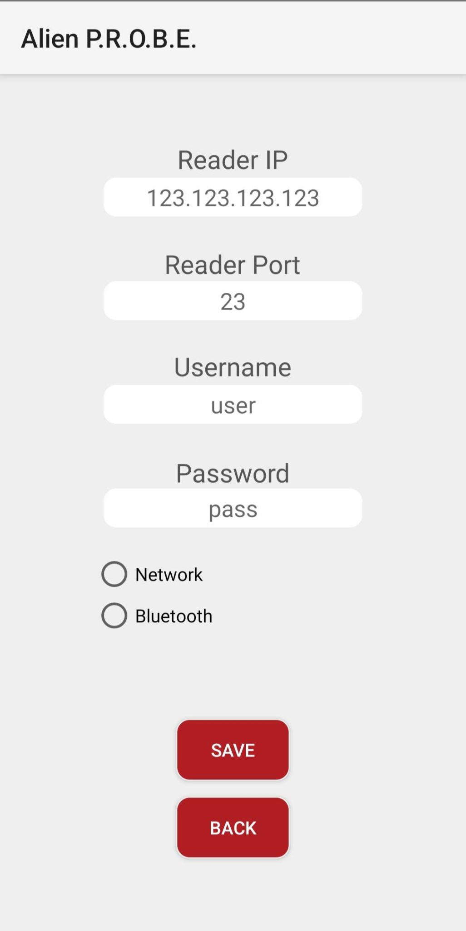
Security Issues - User Types / Authentication
One User
Location - Operator must allow location permissions for Geolocation
Network - Must have proper credentials for network mode, need to be on the same network as the reader, and need the app installed on target device.
Bluetooth Mode - Not fully implemented, but the user must be in proximity of the Alien F800 reader, must have the Alien P.R.O.B.E app, and ask for permissions while connecting to the reader.

Slide 9
Future Work
Implement Bluetooth functionality for an easier connection between the Alien Reader and Android Device.
Implement a solution to check if the stored geolocation with the scanned parking pass matches the correct location/parking lot where they should park.
Geofencing
SOAP Data calls with the WKU Database

Slide 10

Demo

Slide 11

Questions?

