Slide 1
Escape Room Simulator
Anna Carvalho, Cymbre Spoehr, Kit Bazner

Slide 2
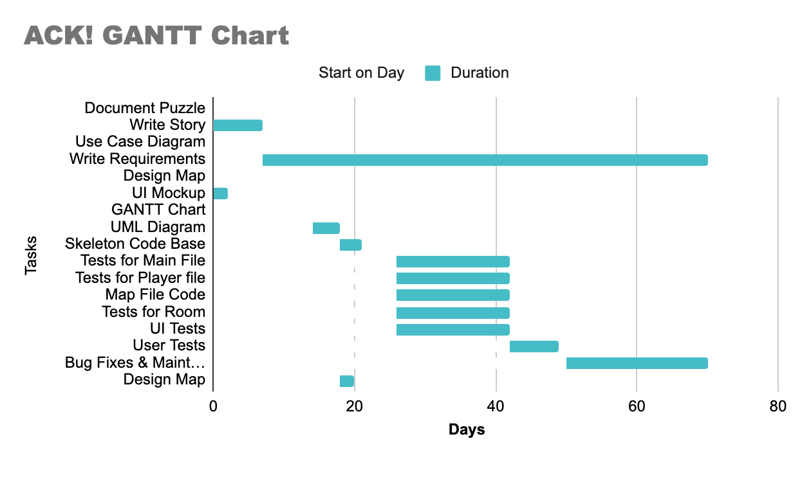

Slide 3
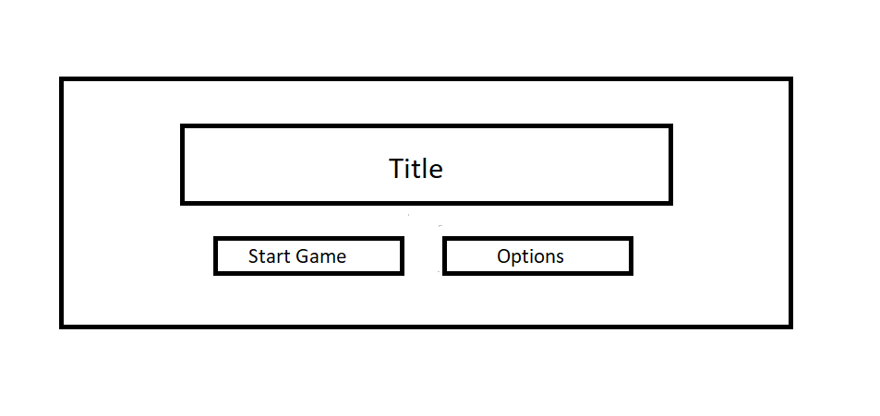

Slide 4
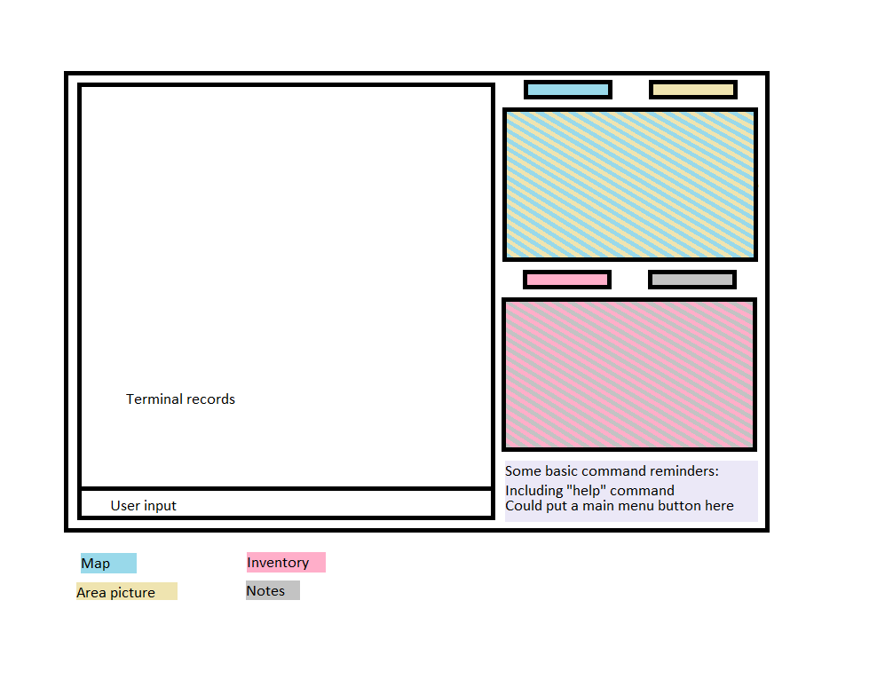

Slide 5
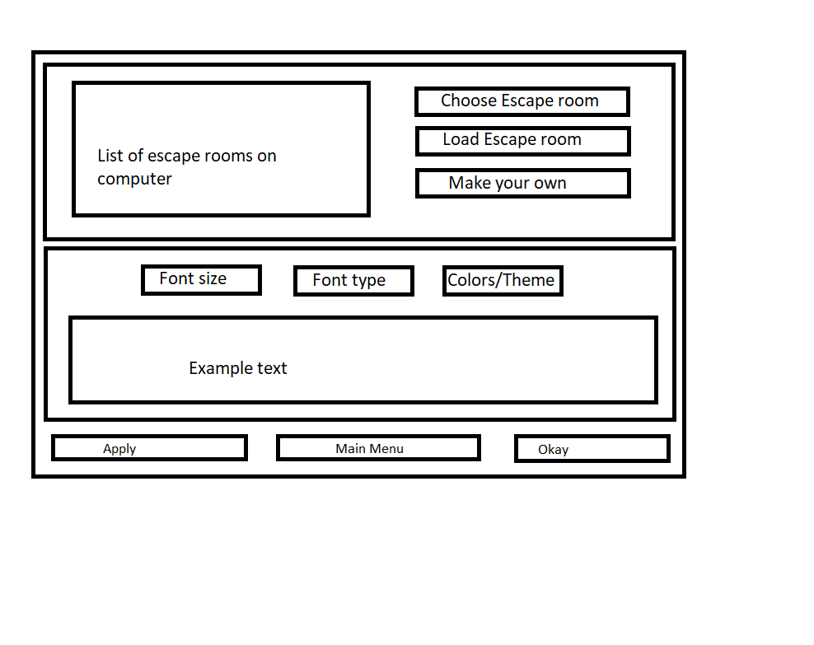

Slide 6
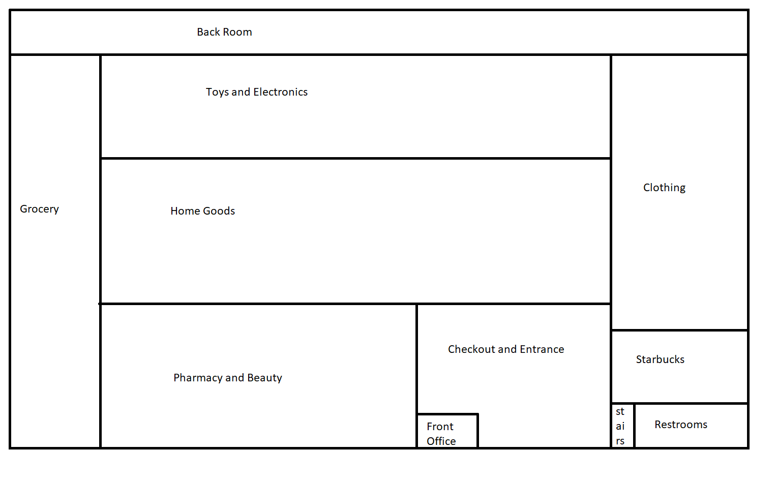

Slide 7
