Slide 1

SAT
SUN
MON
TUE
esapareciendo, como el agua del agua.
chat
We
suck
THU
FRI
SAT
SUN

Slide 2
+
TACET
e amé
cerca de
osita
escribí
ace
Z

Slide 3
+
TACET
e amé
cerca de
osita
escribí
ace
Z

Slide 4
I just wanted to design sth. for
The Father's Day
but 1 hour later here is just #D9D9D9

Slide 5
2 hours later I make it
just like the pic. 1
= )

Slide 6
wú
尤
匕
禾
日

Slide 7
wú
稽
稽

Slide 8
P 1
CUTLINE
#000000
#FFFFFF

Slide 9
//Empty
Flo{ ❀ }r

Slide 10
F
//E
{ nothing }
❀

Slide 11
icko

Slide 12
⊰
tranger

Slide 13
CYMURUS
lown
ields
ockeries
the
ndying
ick of _
- m u r d e r .
- u r t h e s t r o n g e s t m i n d o f m e.
c ʃ

Slide 14
CYMURUS
lown
ields
ockeries
the
ndying
ick of _
c ʃ

Slide 15
CYMURUS
lown
ields
ockeries
the
ndying
ick of _
c ʃ
- m u r d e r .
- u r t h e s t r o n g e s t m i n d o f m e.

Slide 16
#
FADE

Slide 17
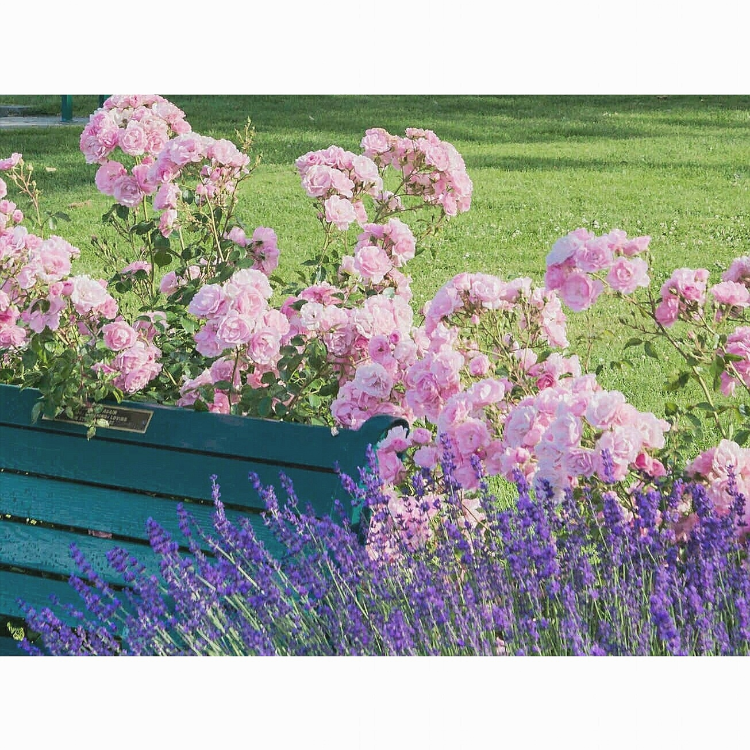
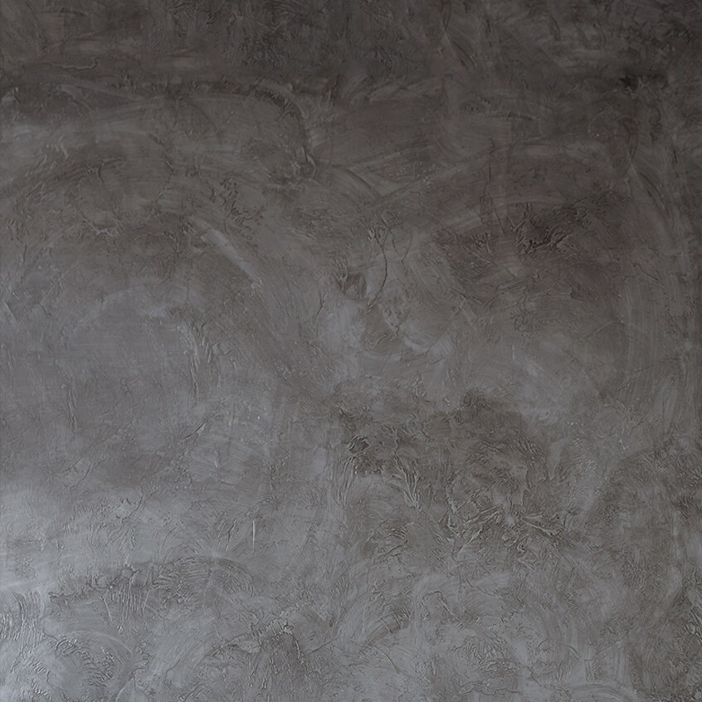
犭
昔
🐾

Slide 18
y
c
F
{ }
{ }
murus

Slide 19
{ }
murus

Slide 20
∮
∞
( y, c, f ) dy dc df =

Slide 21
↑
Y0 + C0 + F0 + ycf
♣

Slide 23
’
ack 0ff
x

