Slide 1
BroadcastReceiver与Service
cuiyang
2012.07.23

Slide 2
Outlet
Handler
BroadcastReceiver
Service
BroadCastReceiver进阶
Service进阶

Slide 3
Handler
Handler
一个可以向指定线程发送消息并可以处理消息的通信类
附属于某个Thread, 为某个Thread服务
使用场景:
进程之间的通信
使某个消息可以延时处理
消息类型
Message
Runnable
发送方式
public final boolean sendMessage(Message msg)
public final boolean sendMessageDelayed(Message msg, long delayMillis)
public final boolean post(Runnable r)
public final boolean postDelayed(Runnable r, long delayMillis)

Slide 4
Handler
传统OS(Windows)的消息传递:
Thread2
消息循环
Thread1
Message
Message
发送者
接收者
消息队列
派发
Thread1和Thread2可以处于不同的进程.
发送者和接收者一般是不同的.
OS会根据需要自动帮助线程建立消息队列.

Slide 5
Handler
Android的消息传递:
Thread
消息循环
Message
派发
消息队列
发送者&接收者
Message
消息的发送和接收可以使不同的线程，但必须是同一个进程
发送者和接收者是相同的，是同一个Handler.
线程如果需要接收消息，必须要手动建立消息队列.

Slide 6
Handler
Handler的创建
Handler与线程
默认会将Handler与当前线程绑定，看源码:
private Handler mHandler = new Handler() {
public void handleMessage(Message msg) {
if (msg.what == BACService.SERVICE_MSG_SDCARD_CHANGED) {}
}
};
public Handler() {
mLooper = Looper.myLooper();
if (mLooper == null) {
throw new RuntimeException(
"Can't create handler inside thread that has not called Looper.prepare()");
}
mQueue = mLooper.mQueue;
mCallback = null;
}

Slide 7
Handler
Handler发送消息
Message的创建一定要用obtainMessage()方式,不要自己new
Handler接收消息
Override Handler::handleMessage(Message msg);
Message msg = mHandler.obtainMessage(MSG_SVC_STARTUP);
mHandler.sendMessageDelayed(msg, mRegistry.getFirstCheckInDuration());
private Handler mHandler = new Handler() {
public void handleMessage(Message msg) {
if (msg.what == BACService.SERVICE_MSG_SDCARD_CHANGED) {}
}
};

Slide 8
Handler
创建线程的消息循环:
消息的派发，源码:
Looper.prepare();
Looper.loop();
public boolean sendMessageAtTime(Message msg, long uptimeMillis)
{
MessageQueue queue = mQueue;
if (queue != null) {
msg.target = this;
sent = queue.enqueueMessage(msg, uptimeMillis);
}
return sent;
}

Slide 9
Handler
HandlerThread
自动创建消息循环的线程类
Looper.loop(): 实现了消息泵和消息循环
Messenger
实现了跨进程的消息发送.
原理 : AIDL
备注:
消息的传递是异步的

Slide 10
BroadcastReceiver
BroadcastReceiver
用于接收Broadcast(广播消息)的Component.
Android四个Component之一.
广播消息(Broadcast)并非是真正的消息(Message).
广播消息
数据类型: Intent(四个Component统一的数据类型).
消息类型:
按接收顺序 : 顺序广播，非顺序广播
按接收方式: Sticky, 非Sticky
消息的发送
Context(ContexImpl)
BroadcastReceiver类型
静态注册, 动态注册
安全，权限

Slide 11
BroadcastReceiver
Context的概念
访问应用程序资源,环境，信息 的接口
Intent的真正操作类(应用程序端)
Context的子类
Application
Activity
Service
Context功能
sendBroadcast
registerReceiver
startService
Other: 获得资源，theme, 权限检查
装饰模式
ContextImpl -> Context
ContextWrapper -> Context

Slide 12
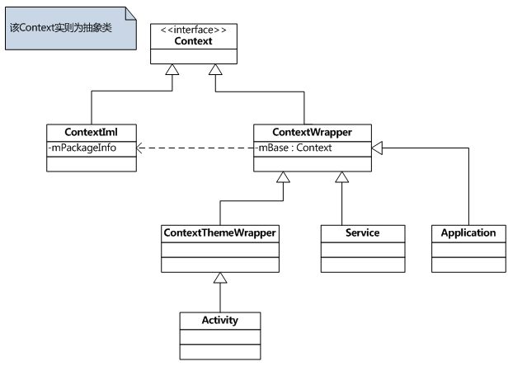
BroadcastReceiver
Context

Slide 13
BroadcastReceiver
发送Broadcast
sendBroadcast(newIntent("android.intent.action.BOOT_COMPLETED"));
接收Broadcast
private final BroadcastReceiver mReceiver = new BroadcastReceiver() {
@Override
public void onReceive(Context context, Intent intent) {
if (Intent.ACTION_MEDIA_EJECT.equals(intent.getAction())) {
} else if (Intent.ACTION_MEDIA_UNMOUNTED.equals(intent.getAction())) {}
}
}; /* 动态注册, 两种注册方式 之一 */
IntentFilter filter = new IntentFilter();
filter.addAction(Intent.ACTION_MEDIA_EJECT);
filter.addAction(Intent.ACTION_MEDIA_UNMOUNTED);
filter.addDataScheme("file");
filter.addDataPath("mnt/sdcard", PatternMatcher.PATTERN_LITERAL);
registerReceiver(mReceiver, filter);

Slide 14
BroadcastReceiver
两种BroadcastReceiver的注册方式
AndroidManifest.xml(静态注册)
程序动态注册:
<receiver android:name=".SysMetricCollectorReceiver" >
<intent-filter>
<action android:name="android.intent.action.BOOT_COMPLETED" />
<action android:name="android.intent.action.ACTION_SHUTDOWN" />
</intent-filter>
</receiver><! AndroidManifest.xml中注册-->
private final BroadcastReceiver mReceiver = new BroadcastReceiver() {
@Override
public void onReceive(Context context, Intent intent) {
if (Intent.ACTION_MEDIA_EJECT.equals(intent.getAction())) {
} else if (Intent.ACTION_MEDIA_UNMOUNTED.equals(intent.getAction())) {}
}
};
IntentFilter filter = new IntentFilter();
registerReceiver(mReceiver, filter);/* 动态注册 */

Slide 15
BroadcastReceiver
两种注册方式比较
比较 | 静态注册 | 动态注册
注册方式 | AndroidManifest.xml | registerReceiver()
运行线程 | 主线程(UI线程) | 任何线程
创建销毁 | 由底层(ActivityThread)负责 | App负责创建, 销毁
对应Context | ReceiverRestrictedContext | 注册时用的Context
Broadcast类型 | 顺序?
是否可以再注册BroadcastReceiver | 不可以. ReceiverRestrictedContext没有实现 | 可以，有效期和所使用Context生命周期一致
注册类的要求 | public class | 任何可见类(private, 内部类均可)

Slide 16
BroadcastReceiver
Broadcast分类(sticky, non-sticky)
Normal(non-sticky)
默认的Broadcast
通过Context::sendBroadcast(Intent intent)发送
BroadcastReceiver在onReceive()中接收
Sticky
这种Broadcast会在发送后驻留在系统
通过Context::sendStickyBroadcast(Intent intent)发送
通过Context::registerReceiver()的返回值接收其中一个被 监听Intent
在BroadcastReceiver在onReceive()中接收所有的被 监听Intent
如果能够控制监听的Intent, 那么可以 传null给registerReceiver()
见AMS:: broadcastIntentLocked()处理
Sticky举例
IntentFilter ifilter = new IntentFilter(Intent.ACTION_BATTERY_CHANGED);
Intent batteryStatus = mContext.registerReceiver(null, ifilter);

