Slide 1
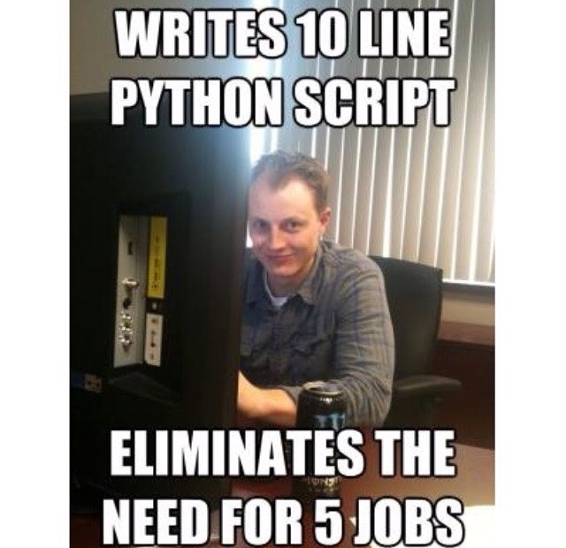

Slide 2
How do I create classes?
In python, its pretty safe to say that you will always need a initializer,
__init__() <- this is a way of saying, I know that every object I make will need to have these variables, often called the “constructor”
You most likely want to use a __repr__() & __str__() definition as well
Does anyone know why?
This will be part of the lab

Slide 3
Private members vs. Public Members
When we have classes, we want to make sure we separate what we as the “class designer” can do with our class and what the person using the class can do
If I need to store information in a class, the person using the class doesn’t need to know if I'm using a list or a dictionary, right?
How do I do that? With private members in python we use the “__” convention.

Slide 4
Python with multiple Files
Please review Chapter 11 & 12 if you still feel fuzzy, because they never go away!
Here we’ll have a python file that actually doesn’t run anything, (NO main) but just has a bunch of code we want to use in another file.
That’s typically what that “import [insert python name] “ is.

Slide 5
This weeks Lab
Part A, is an already created class definition,
A lot of it will be trying to understand what the code is doing, much like we’ve done before.
Part B, will be implementing your own class
Hint 1: don’t start from scratch, use what you have learned from Part A and modify or build off of it.
Hint 2: in the pdf, but I’ll reiterate it, write one method, call it, test it, than move on to the next one.

