Slide 1
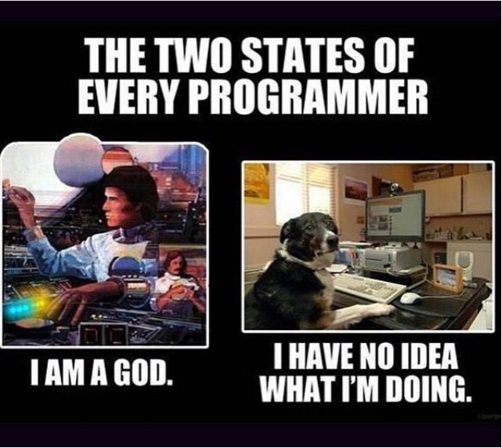

Slide 2
Big OOP concept – inheritance
Think about this, I have cars, Every car has wheels, a plate, someone who owns, where it was made, etc…
But a Ford Car is very different, from a Tesla Car
So if I have a “Base Class” which basically describes the things I know every car will have
And have a Ford Class that is specific to ford cards, and a Separate Tesla Class which only allows tesla cars to have and do specific things

Slide 3
Set up
Car – Parent/Base/Super Class
Ford – Sub/ Child Class
Tesla – Sub/Child Class
Mustang – Sub/Sub (Grand Child)
i.e. Every Ford is a Car, not every Car is a ford
Every Mustang is a Ford, not every Ford is a Mustang

Slide 4
This Lab
Very similar to last lab, we should error check with the “right” species, we need to hold all the acceptable types, how? (use a collection)
How should our string work if the user input’s a name or doesn’t?
Test the generic pet class at this point
The Dog Class, remember it “inherits” all the things that a Pet gets, than we add specific things that only a dog can do, like chasing.
The Cat Class, exactly the same thing.

