Slide 1
Local Variables // namespace // scope
Scope: the living time for variables.
• When you create a function, the variables you create inside the function only exist within that function, unless you return those said variables.
• Those variables are Local, they only exist in the functions namespace, not in the main namespace of your code

Slide 2
Return vs. Print
return is only with functions, it means give me back a value that I want, that only exists in the functions namespace, it wont necessarily print to the python console, nowhere does it have to, all it means is return it back to whatever namespace I call it in.
print – just print to the console by default

Slide 3
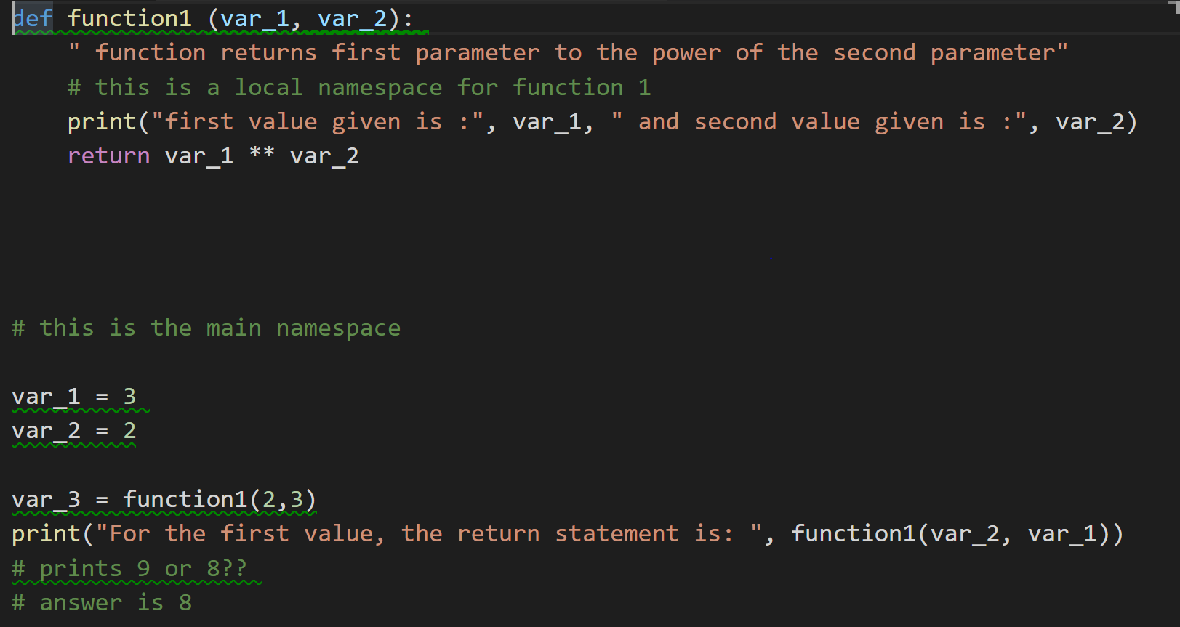

Slide 4
Important functions
Range Function – typically used in a for loop
Enumerate – typically used in a for loop
for i in range (including starting val, ending val excluding, increment):
# start at the first parameter defaulted at 0
# end at second parameters but don’t include defaulted to the end
# increment the i, at the third parameter, defaulted at 1
value = “CSE231 Exam”
for number, character in enumerate(value):
# tacks on a number to any object we are iterating through

Slide 5
Keywords
continue – use it in a for & while loop
Means skip that iteration and go straight into the next iteration of the loop
pass – use it in a if, for, while, basically any control statement
Means do nothing, in python you get an error if you use an “if statement” with nothing in the indent, pass lets you put nothing it in without getting an error
Literally means Do nothing, helpful for sectioning off code you are working on
break – use it in a for & while loop
Means completely end my closest loop immediately

Slide 6
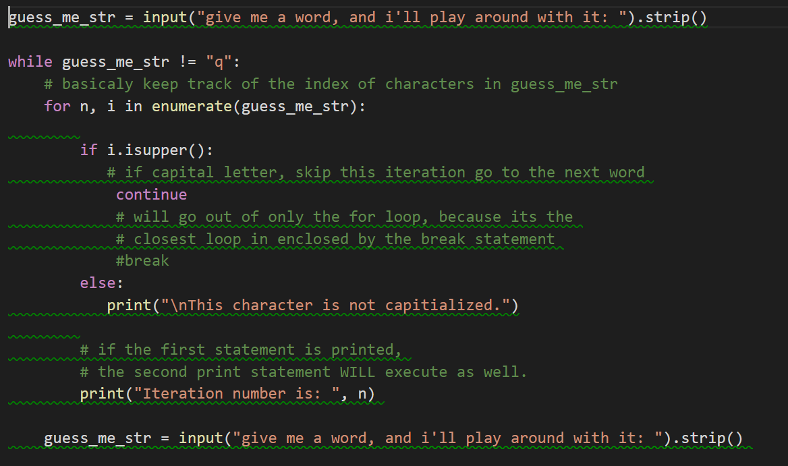

Slide 7
String slicing
Think of strings as a collection, they hold characters, each character in a string is indexed.
String slicing, is basically taking a substring, of the string I have, or just a single character
Much like the range function
string_variable[starting val including: ending val excluding: increment]
S = “CSE231 Exam”
S[0] = “C”
S[:S.find(“ “)] # prints “CSE231” # no space because it finds the index and exclusive
S[::-1] # prints “maxE 132ESC” # take the default values for first & second value, and go in backwards order
S[-1] # prints “m” # just give me the very last character

Slide 8
Boolean Logic
Just talking about values, every value is considered true to python, except for absence of a value( 0, “” , [], (), {}) - something to consider when using the “or” keyword
And – both statements must be true to be considered true,
Basically, if you write “if ‘a’ == ‘a’ and False:” this will ALWAYS execute as false
Exam Fun:
print(2 and 1 ) # prints last value always (1) REMEMBER BOTH STATEMENTS ARE TRUE
print (2 or 1 ) # prints first value always (2)
print(0 or 1 and 2) # evaluate it like order of operations, here the “or” evaluates than it becomes 1 “and” 2, remember “and” takes the last value if both are true so it prints (2)
print(0 and 1 or 2) # 0 and 1 is false, but false or 2 is true with “or”, so it prints (2)

Slide 9
