Slide 1


Slide 2
Presentation
Project Overview
Motivation
Concept and Design (C/P/S)
Research and Domains
Precedents
User Scenario and User Testing
Process and Methodology
Documentation
Conclusion and next steps

Slide 3
Project Overview
Non-linear, interactive story about problems with psychiatric care
Shareable website made with Twine (Choose-your-own-adventure)
Strives to incite dialogue and awareness about mental illness and psychiatric practice

Slide 4
Motivation
“Never give up on someone with a mental illness.
When ‘I’ is replaced with ‘We’, illness becomes
wellness.”
- Shannon L. Alder

Slide 5
Concept and Design
Problem – Lack of access to timely psychiatric care; shortage of psychiatrists
Audience – Empathetic, social media user with friends and/or family affected by mental illness
Solution – Instill empathy in readers; encourage sharing and donation to NAMI

Slide 6
Research and Domains
Primary topics
Medical Sciences
Business and Economics
Peripheral topics
Psychology/Sociology
Insurance and Health Care
Legislation
Politics

Slide 7
Precedents
Depression Quest – Distinct in that:
DQ has no ending
My project focuses on more acute illnesses
A Beautiful Mind – John Nash
Janssen Schizophrenia Simulation

Slide 8
User Scenario

Slide 9
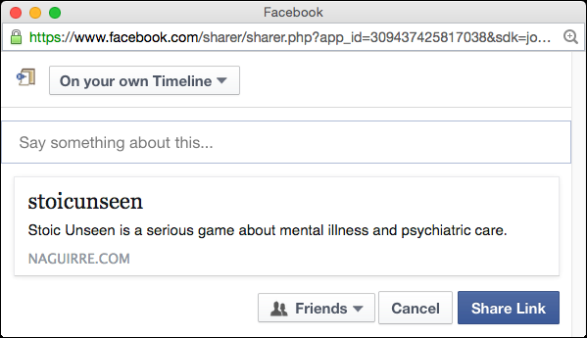

User encounters Stoic Unseen from a Facebook/Social Media post. It catches his/her attention.
!

Slide 10
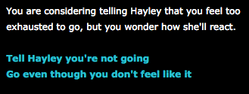
The user plays through the game, making difficult decisions and empathizing with the protagonist
Hmmm…

Slide 11


At the end of the game, the user realizes that events depicted in the game reflect the reality that some live.
The user should feel compelled to spread awareness by sharing the link. They might also donate to NAMI.

Slide 12
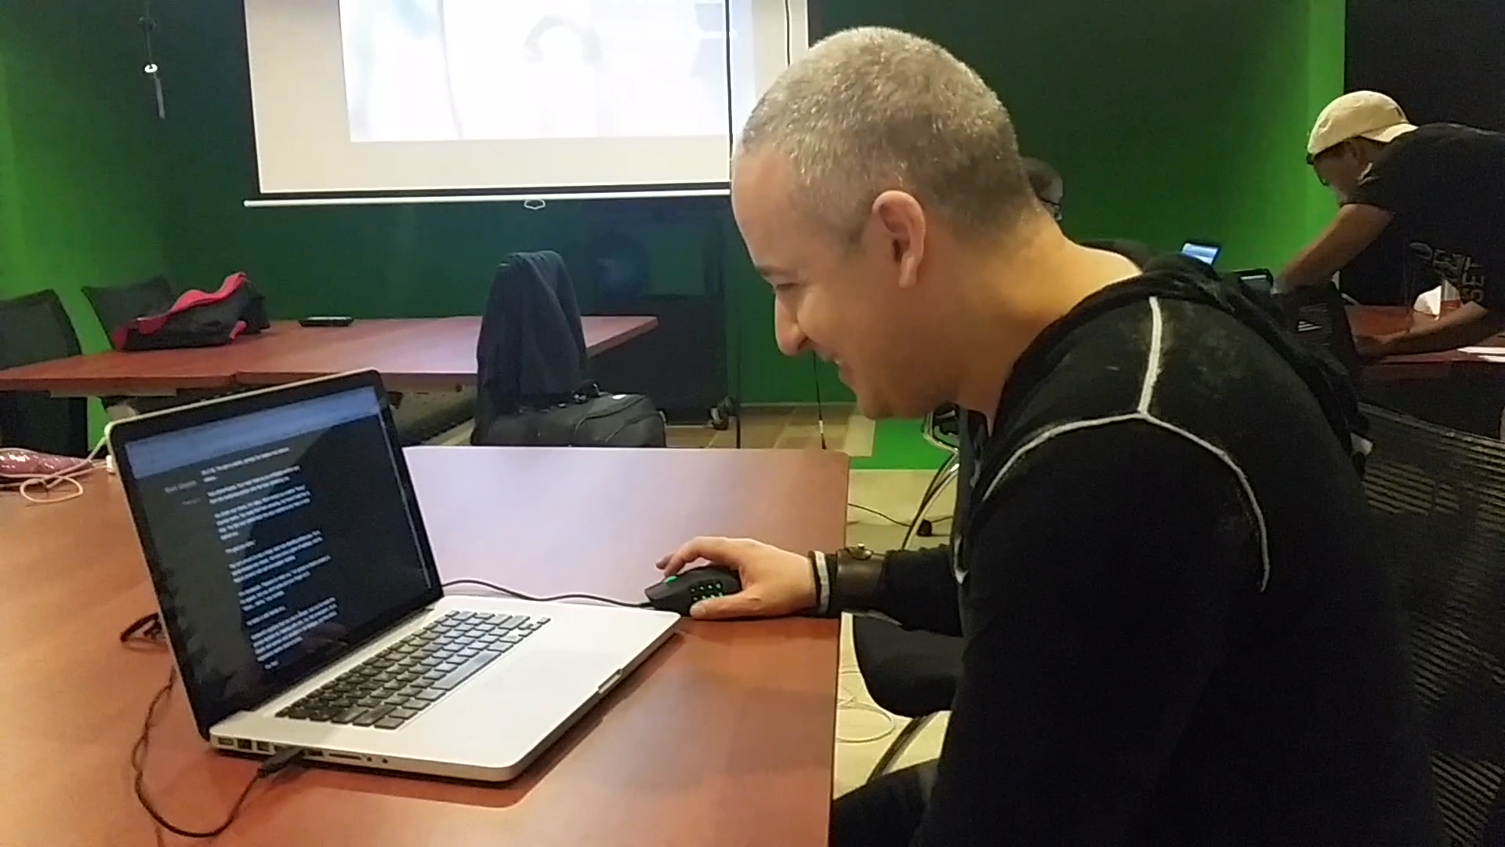
User Testing
Done at various phases of the project
Done both locally and remotely

Slide 13
Process and Methodology
Let’s look at the WordPress documentation

Slide 14

Documentation
WordPress
Progress in phases
Early prototypes
Documentation of errors and problems
GitHub
Versioning control for Twine story
Shareable for other Twine authors

Slide 15
Thank you!
Please read and share.

