Slide 1

Rural E-Commerce
CP301 Developmental Engineering Project, CSE
Team number - 2
Team Members - Aman Pandey
Amit Srivastava
Rakshit
Mentor - Dr. Shashi Shekhar

Slide 2
The Problem
During the field trips in the previous semester, we interacted with the local farmers and got to know one of the major problems they were facing out of which one was:
Farmers face a lot of problems nowadays as they are not able to sell their yields to retailers at a reasonable price.
The reason being that they know only about very few retailers. These retailers buy their yields at a very less price.
Further the involvement of third party in farmer-retailer transaction leads to a lot of hassle.
Further, in this Covid situation, it has become a prominent issue to go and personally contact retailers to buy/sell items.

Slide 3
Critical Analysis of the Problem Constraints
For now, we need to limit this to the villagers of Ropar,Punjab region. Extension of this project to other regions will depend on the success of our developed solution.
The villagers in our concerned area mostly speak Punjabi as we found during the field trips. So, if we want to propose a consistent and a good solution, we need to address this language gap.
The proposed solution must be simple enough to be understood by the villagers and gain their support.
The villagers rely on the nearby sellers / buyers for goods / services.
It is found that the solutions presented in rural areas have more tendency to be successful if developed/backed by the government. So a government endorsement would certainly help for better reach.
The solution should benefit the villagers in terms of both their time saved as well as monetary benefits. Only then it would be a success.

Slide 4
Existing Solutions
There are a few government and private bodies that have already created an app that allows farmers and fishermen to sell their produce online, find out about market prices, and reach out to experts. Similar apps for self help groups are very few; and their penetration is even lower.
Example : Kisan Suvidha
Launched in early 2016, this app serves as a common interface for farmers and agricultural stakeholders providing regular updates on weather, market prices, etc. It also enables farmers to avail information on plant protection and advisory from government officials.

Slide 5
Our Approach to the problem
We plan to design a platform dedicated to farmers where they can exhibit and sell their agricultural output at a reasonable price to different buyers without any third party involved.
The farmers will be able to see the selling/buying prices of the respective goods in their neighborhood.
They can also buy seeds and other products from various sellers available on the platform.
Since big machines such as harvester or Happy Seeder are costly, farmers can also rent equipment from others. This is somewhat like an e-commerce service similar to amazon but focussed and personalized for the farmer market.
The app will also allow bidding of products/items.
A chat system is also available so that buyers and sellers can communicate freely.
Artisans and craftsman can use the platform for selling their products as well.

Slide 6
How we are different from the current solutions
All the existing solutions that we came across seemed to provide a platform only for buying/selling of goods.
The concept of renting items is missing in all the existing solutions. Our app tries to solve this problem by providing this feature.
Our app also supports the feature for bidding on items.
Our app is not same as popular e-commerce apps such as amazon and flipkart. The main users in those apps are everyday consumers but our app focuses on farmers/villagers.
Our app tries to benefit villagers as per their geographical locations. For example, our app not only suggests the best prices available but also the location of nearest sellers. So, a farmer can choose good prices at convenient distance.
Implemented two separate methods for buying/selling:
One where sellers have already listed their prices and then buyers chooses accordingly.
One where buyers ask for what they want, and then sellers will contact them with the prices at which they want to sell.

Slide 7
Progress Timeline
Till Mid-sem
Built the basic infrastructure for the app.
Login and registration part is done.
The sellers pages are also ready.
Anyone can now install this app and login/register successfully and can be a seller at that platform. However, the part where these buyers and sellers will communicate is to be developed.
Post Mid-sem
Completed the app functionality for buyers as well.
Added the functionality of renting machinery. (Suggested By Dr. Shashi S Jha)
Implemented bidding system in the app. (Suggested By Dr. Shashi S Jha)
Added multiple ways for communication using chat services like SMS, Whatsapp, email.
Implemented our own chat based system.
Added support for punjabi and hindi languages to bridge the language gap.
GPS location support has been added to visually represent users.

Slide 8
Technical Aspects
Platform Used for app development: Android Studio
Backend: Dart, Flutter
Front end: XML
Database: FireBase
Sign-in options: Google account or email.
Android Version Support : Android 4.4+ (KitKat)

Slide 9
Technical Aspects: Initial Approach
Initially, we used psql as a database and python sockets for creating server.
This approach was code-heavy and had several drawbacks.
We were using our PCs as servers which would not be feasible in the long run.
Psql was used as a database for storing buyer/seller informations and this database also resides on our system.
Further, we don’t have much knowledge about security aspects in databases as well as server/client communications hence could not guarantee protection from data leak.
So, this approach was rejected and we moved to a new approach.

Slide 10
Technical Aspect: Current Approach
Now, instead of creating our own server and our own database, we let some available online platform handle it.
We are currently using firebase. Firebase is a Backend-as-a-Service provided by google.
It uses NoSQL database.
It provides us with all the necessary things like:
Authentication
Real time database
File storage platform.

Slide 11
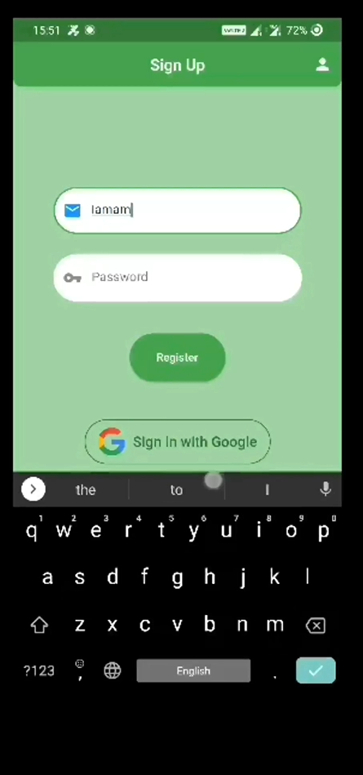
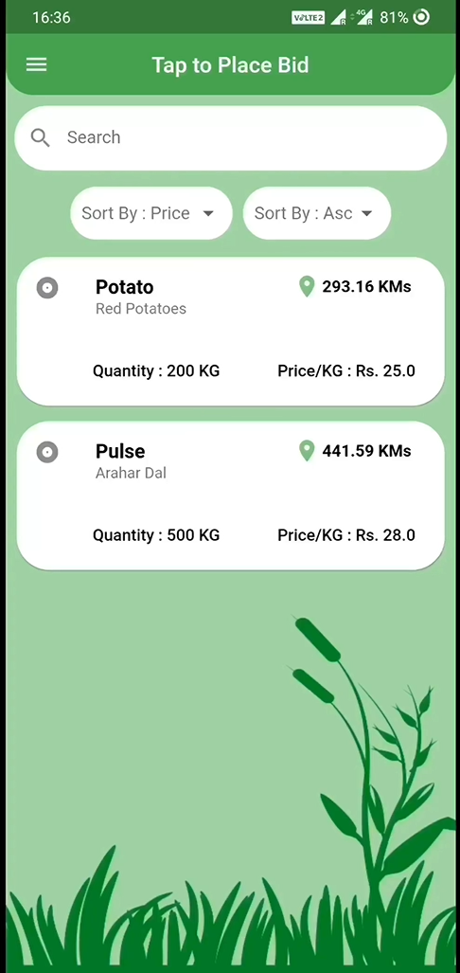
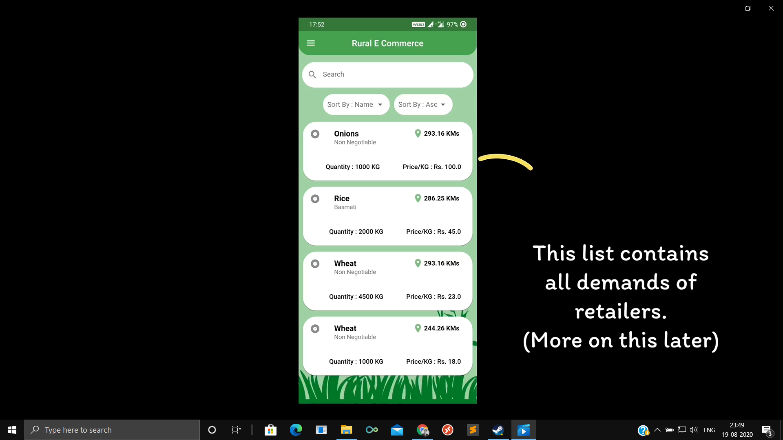
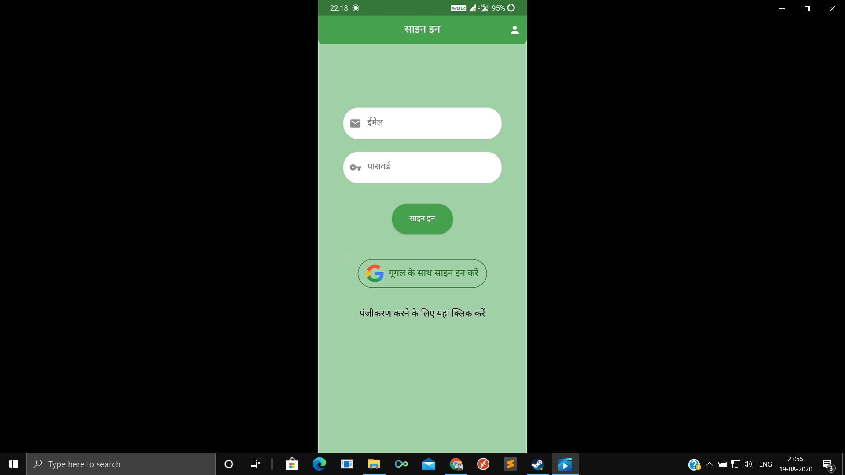
Some screenshots of our app:

Slide 12
Difficulties faced so far
Lack of previous knowledge regarding android development. It took time to learn to build apps using this platform and also there were many difficulties. Luckily, it is a popular development platform, so there is a lot of support available on the web.
Lack of proper teamwork due to the current circumstances in our country. There was not proper communication which could have been if we were together in the campus.
Due to this Covid situation, we were not able collect a lot of feedbacks and hence collected some feedback from our local farmers. This led to some changes such as addition of whatsapp and our own chat-based system for communication .
Amazon and flipkart uses their own delivery system for verifying a transaction and hence can delete an item from the database. Since we don’t have this luxury we were not able to maintain a clean database due to deletion being dependent on users of the app.
Lack of proper internet connectivity.

Slide 13
Work ahead:
Since we were not able to perform a widespread survey, hence this can be done to improve the functionality.
We can use an API to fetch local prices of respective goods.
We can add notification for when a particular item relating to our user is put in the database.
We can implement a deadline for items that are added in the database. These items will automatically get deleted after the deadline thus maintaining a clean database.
We can improve the UI/UX of the app with some picture based representation of the items.
We can incorporate the payment module for transactions digitally.

Slide 14
THANK YOU

