Slide 1
Resource Allocation Algorithm using Secondary Memory
Advisor : Dr. Viswanath Gunturi
Amit Srivastava (2017CSB1189)
Gyan Prakash Singh (2017CSB1077)

Slide 2
Resource Allocation: In many settings, there are a large number of possible perfect matchings on the same set of objects. We need to find the minimum cost perfect matching.
We have a very large graph (which is too big to fit into RAM) on which we would like to conduct min-cost bipartite matching.
There is a state of the art algorithm in min cost bi-partite matching which might scale up to large graphs.
Applications :
1. Match jobs to machines.
2. Match personnel to tasks.

Slide 3
Minimum Cost Perfect Bipartite Matching
Given:
Bipartite Graph G(V = X ∪ Y, E)
For every edge e 𝞊 E, C_{e} is the cost of the edge.
|X| = |Y| = n
There exist a perfect matching.
C_{e} ≥ 0 ∀ e 𝞊 E.
Goal:
We need to find the minimum cost bipartite matching.
Approach:
Maintain optimality condition at each step

Slide 4
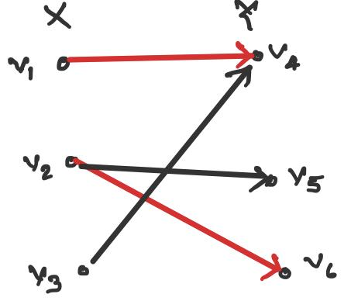
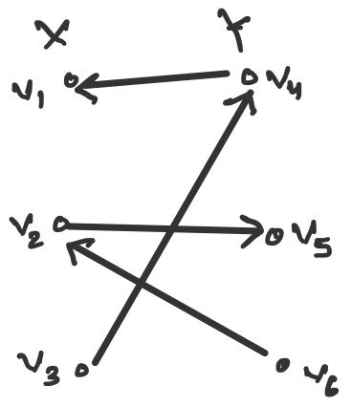
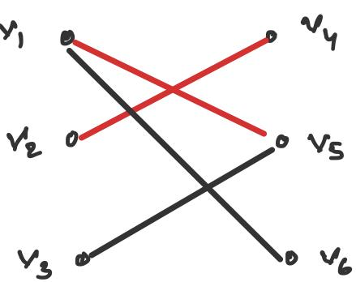
G
G_{M}
Residual Graph: If (x, y) ∉ M, then (x, y) is in G_{M}. If (x, y) ∈ M, then (y, x) is in G_{M}
Alternating Path: Edges belong alternatively to the matching and not matching.
Augmenting Path: An alternating path that starts from and ends on free vertices.

Slide 5
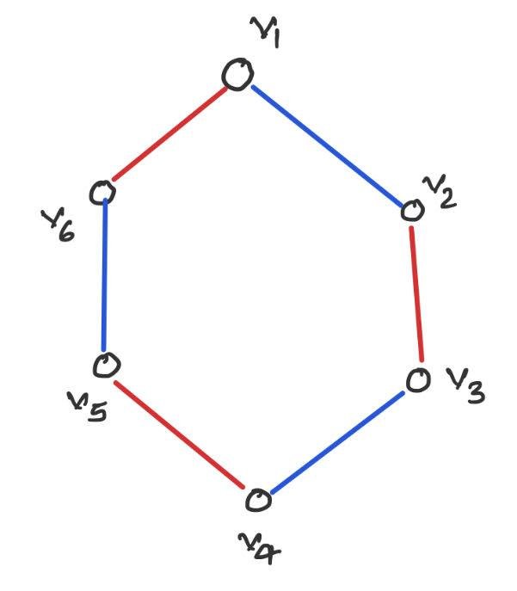
Alternating Cycle
Negative Cycle
Cycle C of G is M-alternating if every other edge of C is in Matching M (in Red).
Observation:
Cycle C will always be of even length.
We can toggle the matching without change in cardinality.
Cycle C of G containing M alternating path is said to contain negative cycle if..,
∑_{e 𝞊 C ⋂ M} C_{e} > ∑_{e 𝞊 C - M} C_{e}

Slide 6
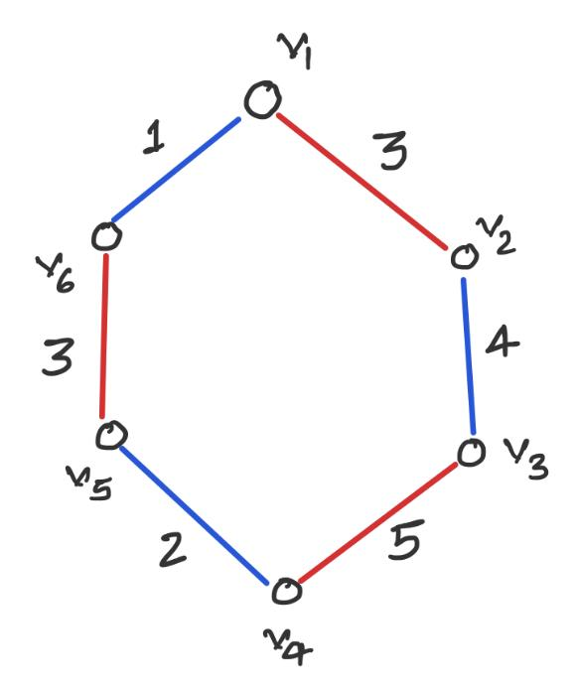
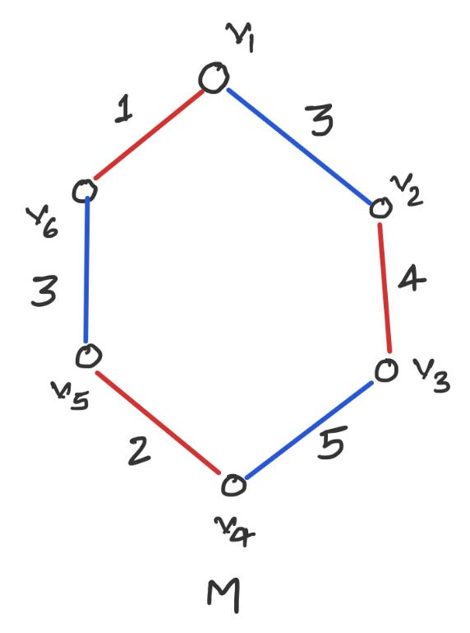
Theorem 1 : A perfect matching M is minimum cost
iff there is no negative cycles.
M
Proof(1) by contradiction :
i) Let the perfect matching M be min cost
and it contains negative cycle C.
ii) Create M’ by removing the edges of cycle C
that are included in M and adding the edges
that are not included in M.
We denote this operation by ‘⊕’ i.e. M’ = M ⊕ C.
Cost of M’() < Cost of M.
Hence M is not min cost.
M’ = M ⊕ C

Slide 7
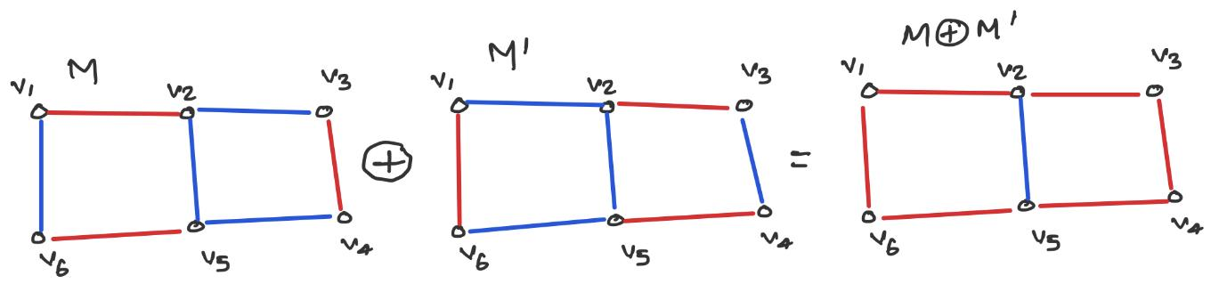
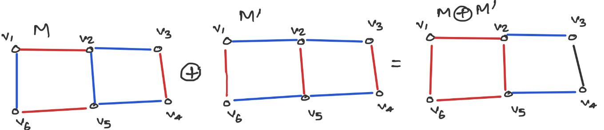
Proof(2)
Let M be perfect matching with no negative cycles. Let M’ be any other matching.
Consider M ⊕ M’, it represents Union of Vertex Disjoint Sets.
M ⊕ M’ will have vertex degree 0 or 2.
Find cycle in M ⊕ M’ and toggle around that cycle in M to obtain M’
Cost of M’ ≥ Cost of M.

Slide 8
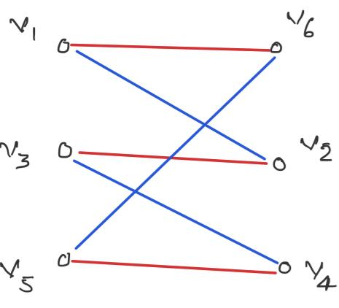
Invariants
Invariants:
All reduced costs C^{p}_{e} ≥ 0 at all time for all e 𝞊 E.
Every edge e 𝞊 M is tight.
Define potential of vertex : p(v) for all v 𝞊 V
Reduced Cost : C^{p}_{vw} = C_{vw} + p(v) - p(w)
If M is a perfect matching and invariants 1 & 2 holds then M is optimal.
Proof : Let C be M alternating cycle.
∑_{e 𝞊 C ⋂ M} C_{e} = ∑_{e 𝞊 C ⋂ M} C_{e}^{p} - ∑_{v 𝞊 X} p(v) + ∑_{v 𝞊 Y} p(v) …(i)
∑_{e 𝞊 C - M} C_{e} = ∑_{e 𝞊 C - M} C_{e}^{p} - ∑_{v 𝞊 X} p(v) + ∑_{v 𝞊 Y} p(v) ...(ii)
By invariant 1, ∑_{e 𝞊 C - M} C_{e}^{p} ≥ 0 and by invariant 2, ∑_{e 𝞊 C ⋂ M} C_{e}^{p} = 0.
Hence (ii) ≥ (i)

Slide 9
Lemma 1. Let p be compatible prices for matching M. Let d be shortest path distances in G_{M} with costs c^{p}. All edges (x, y) on shortest path have c^{p+d}(x, y) = 0
Lemma 2. Let p be compatible prices for matching M. Let d be shortest path distances in G_{M} with costs c^{p}. Then p' = p + d are also compatible prices for M.
Proof :
Let (x,y) be some edge on shortest path.
If (x, y) ∈ M, then (y, x) on shortest path and d(x) = d(y) - c^{p}(x, y).
If (x, y) ∉ M, then (x, y) on shortest path and d(y) = d(x) + c^{p}(x, y).
In either case, d(x) + c^{p}(x, y) - d(y) = 0. By definition, c^{p}(x, y) = p(x) + c(x, y) - p(y).
Substituting for c^{p}(x, y) yields: (p(x) + d(x)) + c(x, y) - (p(y) + d(y)) = 0. c^{p+d}(x, y) = 0
Proof :
If (x, y) ∈ M, then if (y, x) on shortest path then by Lemma 1, c^{p+d}(x, y) = 0, else if not on shortest path c^{p}(x, y) = 0 and it was in any previous shortest path, so d(y) = d(x).
If (x, y) ∉ M, (x, y) is an edge in G_{M} ⇒ d(y) ≤ d(x) + c^{p}(x, y).
By definition, c^{p}(x, y) = p(x) + c(x, y) - p(y).
Substituting for c^{p}(x, y) yields: (p(x) + d(x)) + c(x, y) - (p(y) + d(y)) ≥ 0. c^{p+d}(x, y) ≥ 0

Slide 10
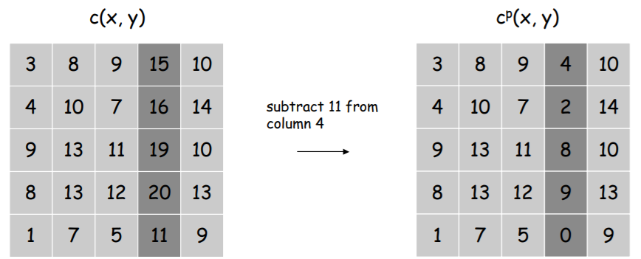
Lemma 3. Let M' be matching obtained by augmenting along a min cost path with respect to c^{p+d}. Then p' = p + d is compatible with M'.
Another perspective: Adding (or subtracting) a constant to every entry in row x or column y does not change the min cost perfect matching(s).
Proof :
By Lemma 2, the prices p + d are compatible for M.
Since we augment along a min cost path, the only edges (x, y) that swap into or out of the matching are on the shortest path.
By Lemma 1, these edges satisfy c^{p+d}(x, y) = 0. Thus, compatibility is maintained.

Slide 11
Algorithm
Start with M equal to the empty set
Define p(x) = 0 for x 𝛜 X, and p(y) = min_{e into y} c_{e} for y 𝛜 Y
While M is not a perfect matching..,
Compute shortest path distances d
P ← shortest alternating path using reduced cost & Dijkstra’s Algo.
Augment along P to produce a new matching M’.
foreach v ∈ X ∪ Y: p(v) ← p(v) + d(v).
Endwhile;

Slide 12
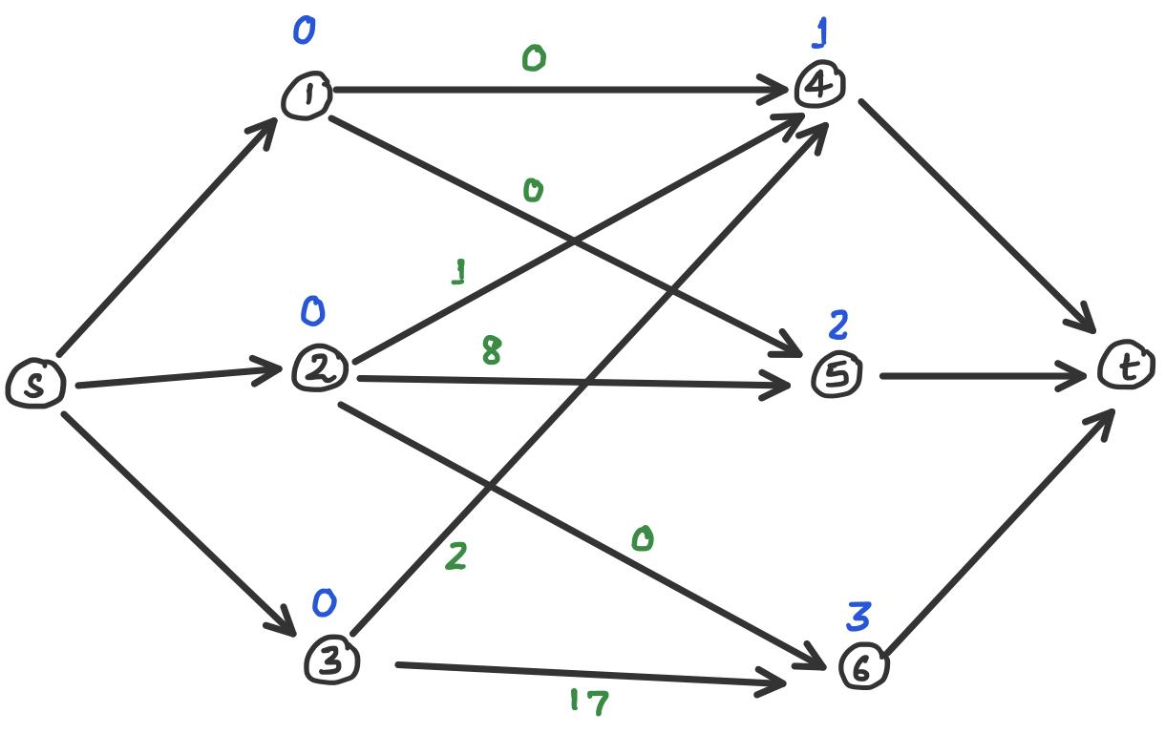
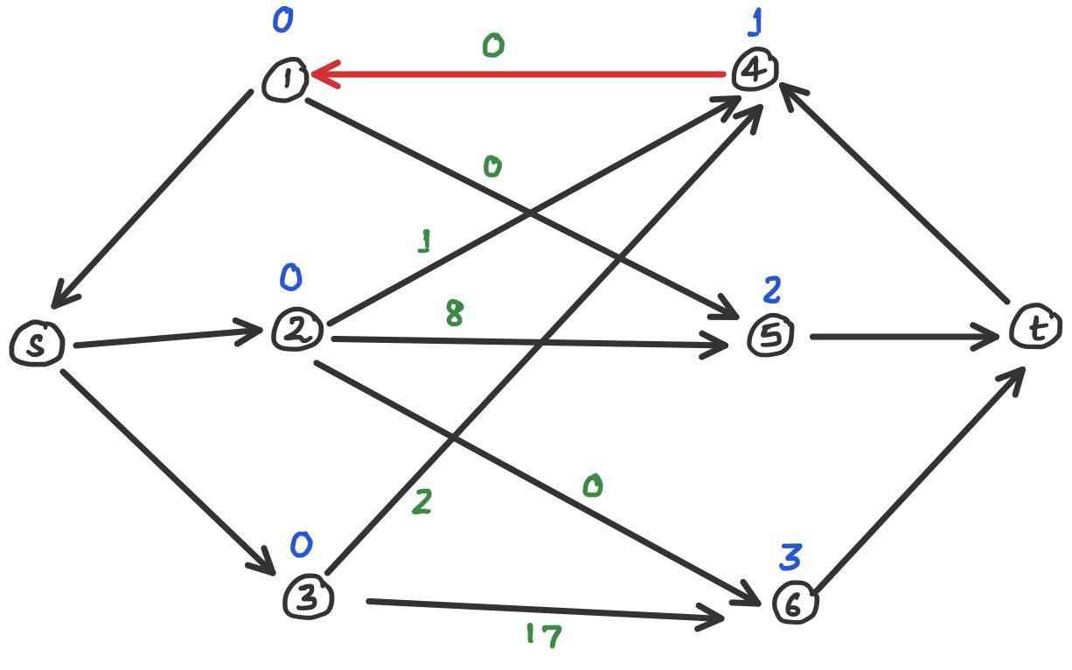
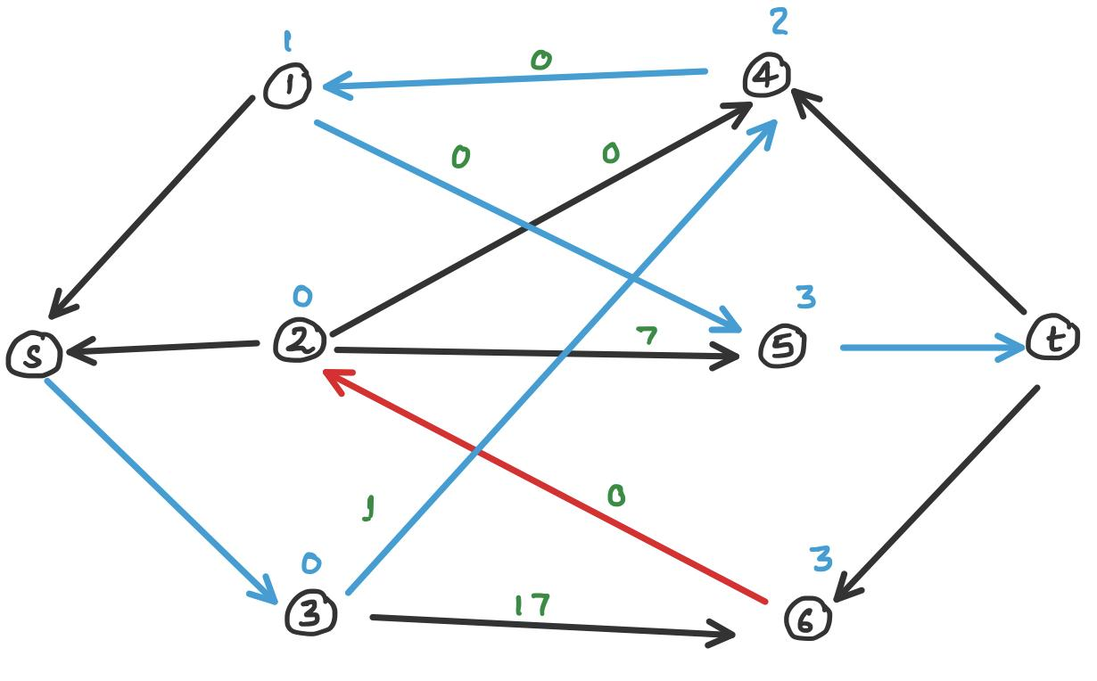
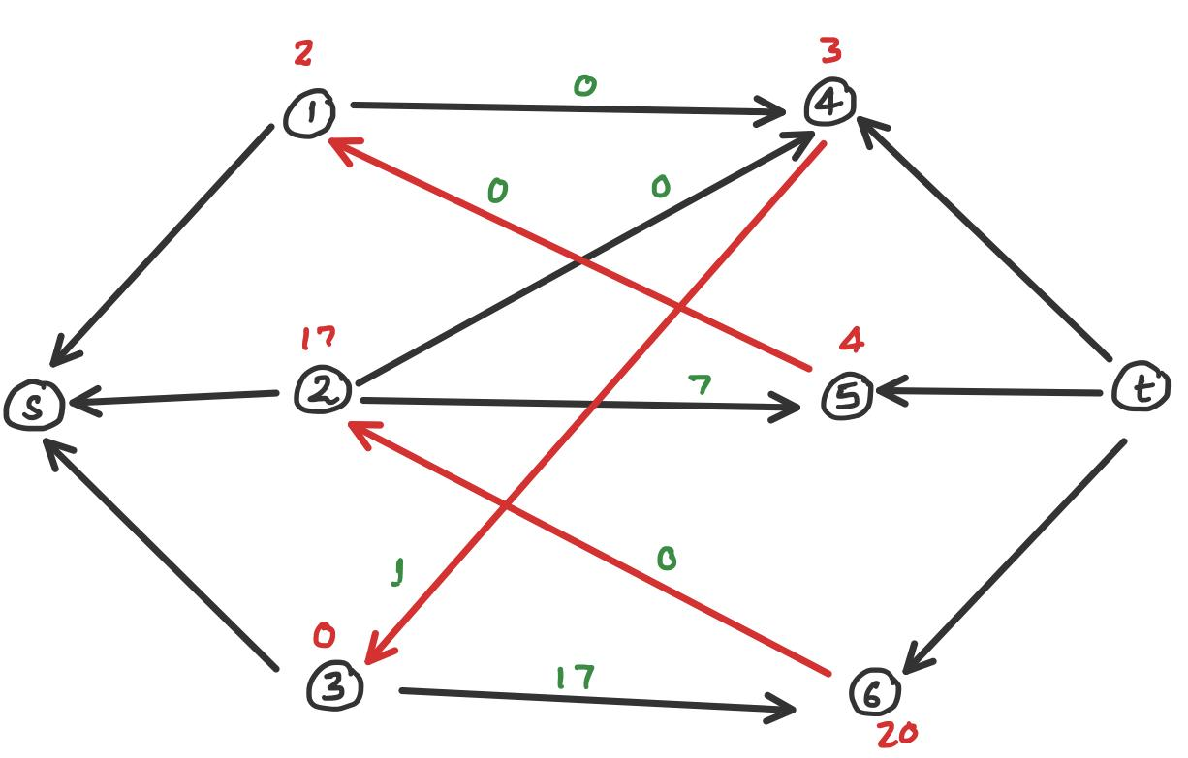
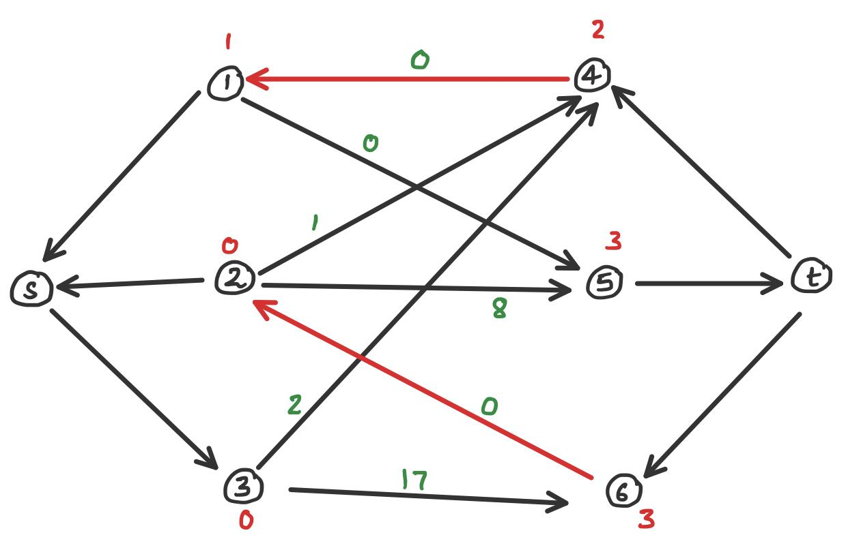
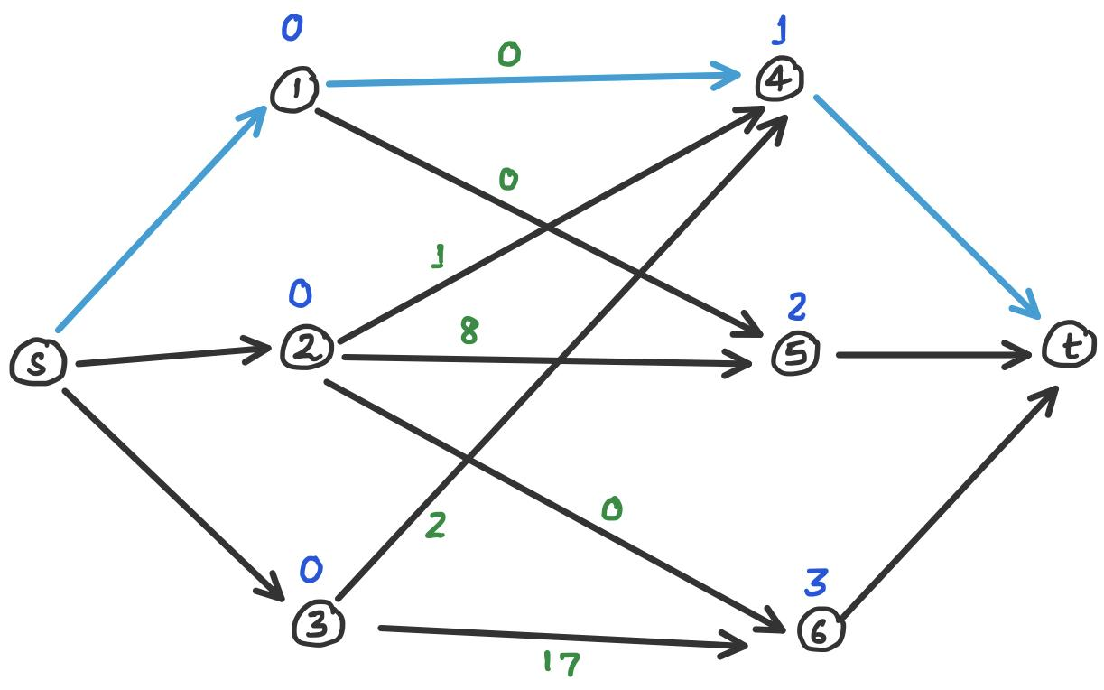
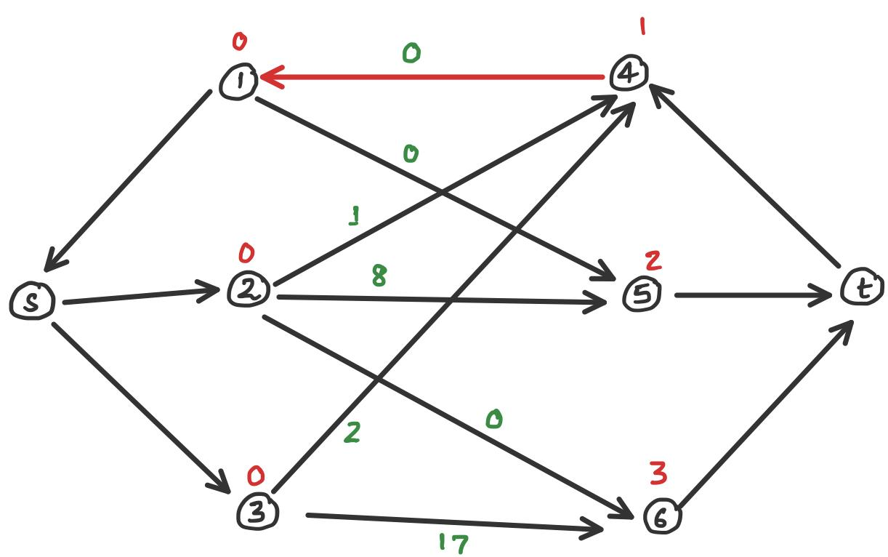
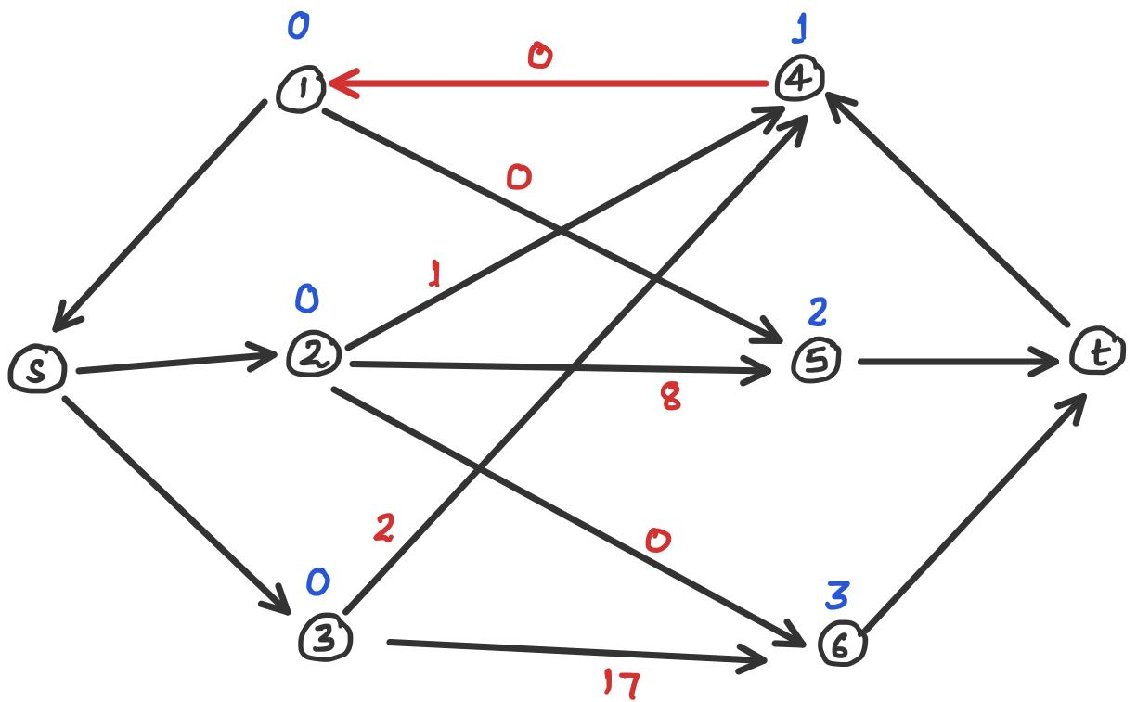
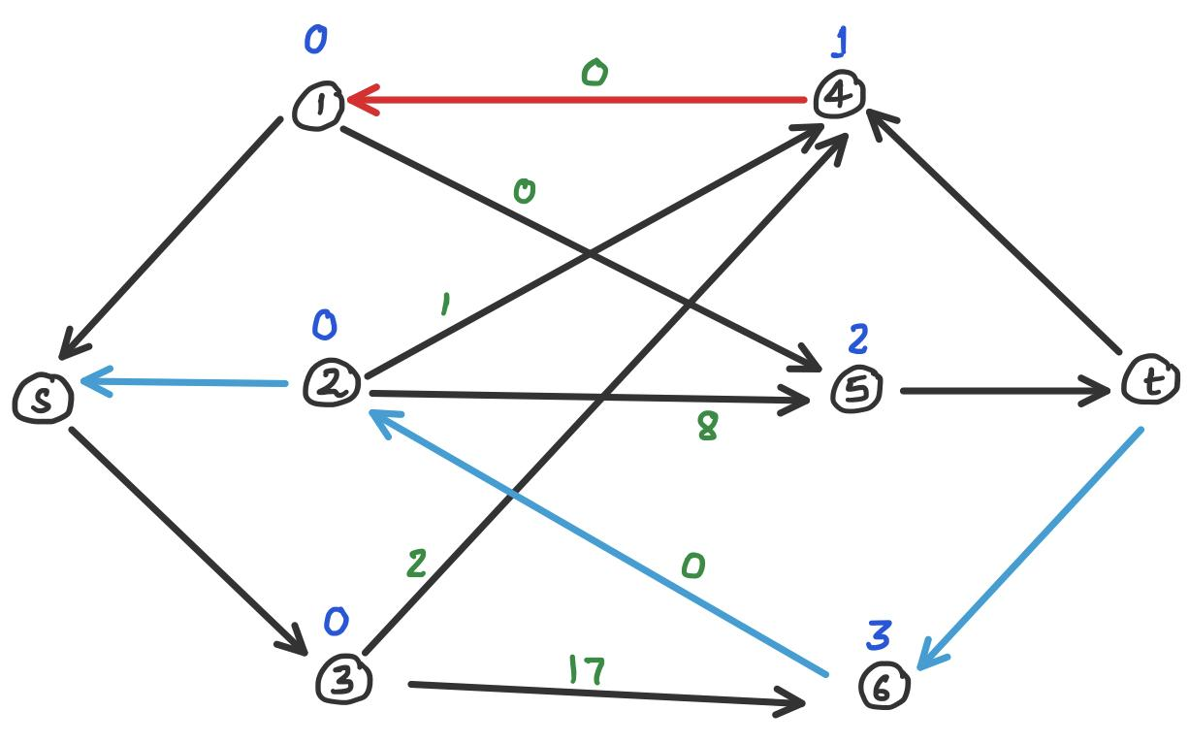
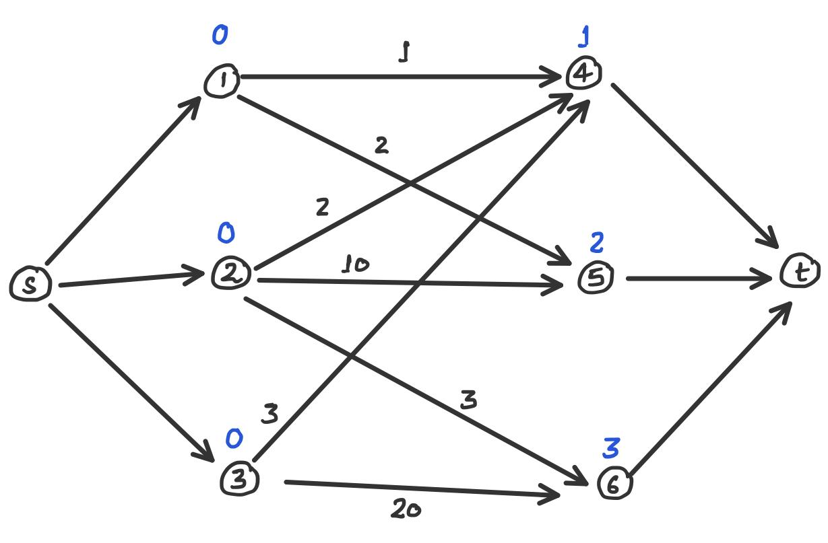
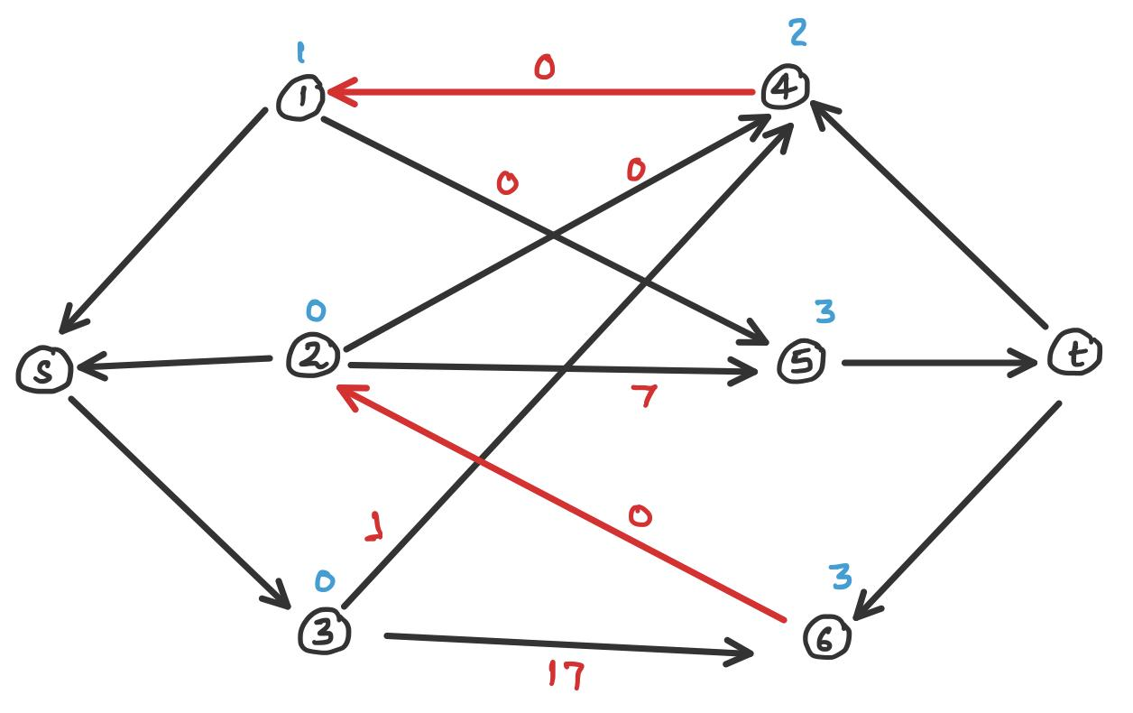
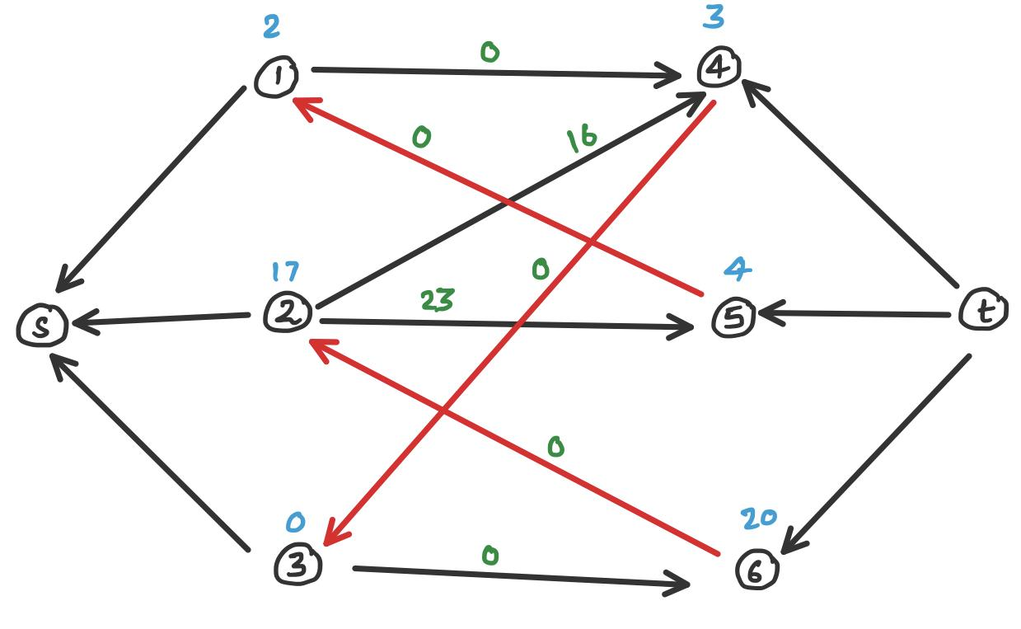
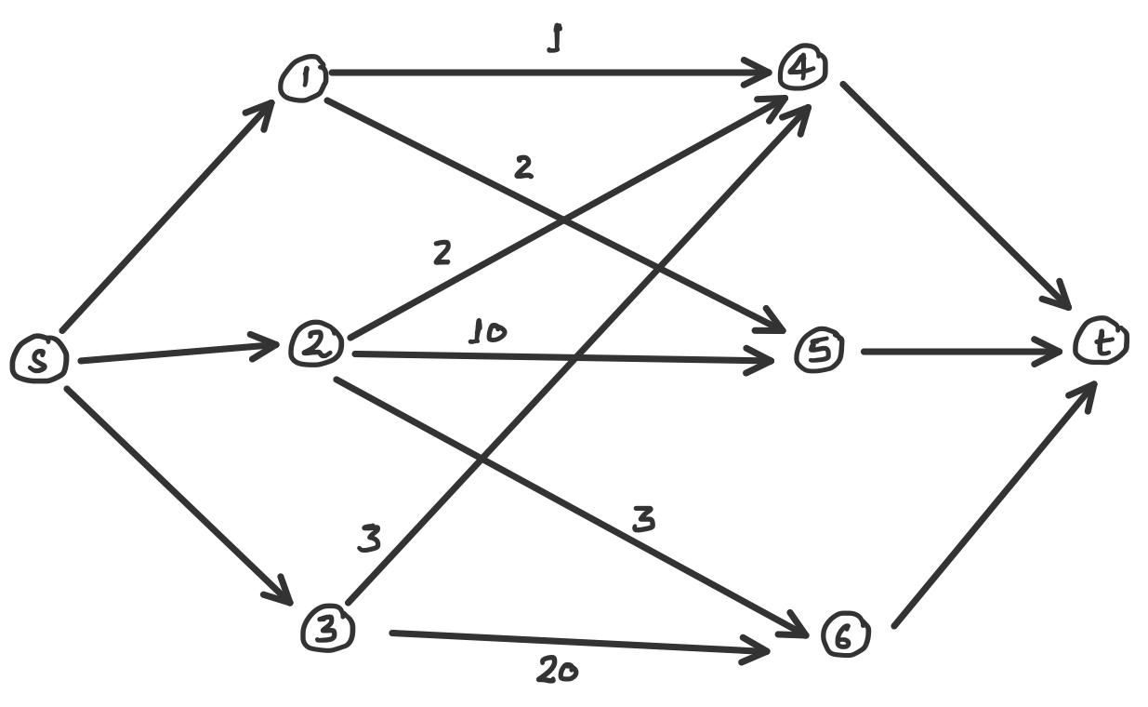
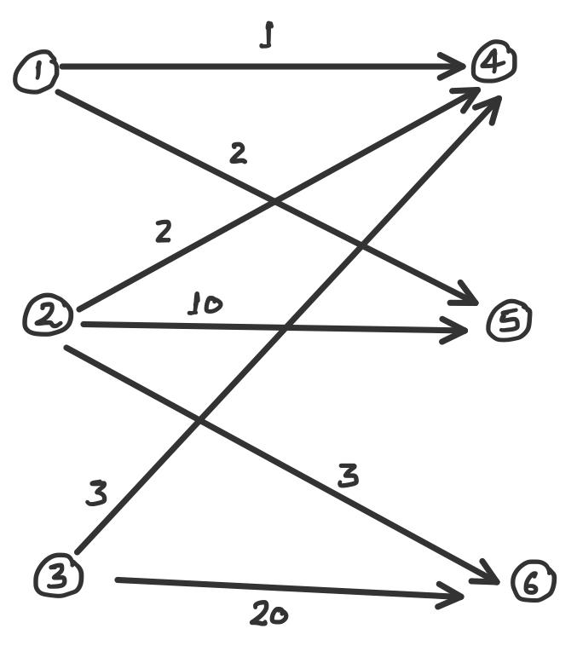
Example
Vertex v | Shortest Path d(v)
1 | 0
2 | 0
3 | 0
4 | 0
5 | 0
6 | 0
Vertex v | Shortest Path d(v)
1 | 1
2 | 0
3 | 0
4 | 1
5 | 1
6 | 0
Vertex v | Shortest Path d(v)
1 | 1
2 | 17
3 | 0
4 | 1
5 | 1
6 | 17

Slide 13
What Next ?
We have understood & implemented resource allocation (SSPA) algorithm without considering size of graph.
Change this algorithm so that it can be used for large graph ?

Slide 14
Thank You!

