Slide 1
All-in-one Time Banking
Brandi, Cyn, Al, Faith

Slide 2
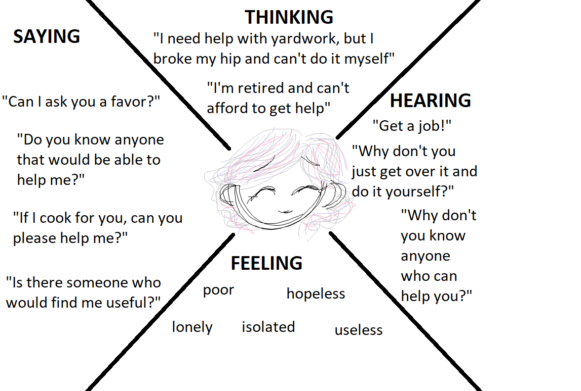
The Problem
“It takes a village to raise a child”
People in communities always need help
Lower income communities suffer from lack of capital to get needed services
Harder to connect with neighbors as people drift from in-person social spaces
Volunteer work is harder to justify for those lacking resources for their day-to-day lives

Slide 3
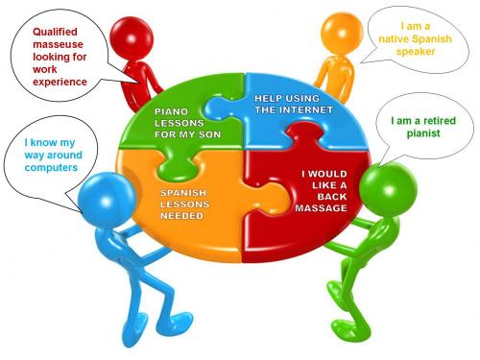
Our Solution
Timebanking: People are paid in time credits based on hours worked for their services
Eliminates need for money
Allows one to use volunteer time to benefit other parts of their lives
Encourages neighbors to help each other
Meet new people with desired skills for tasks and projects
http://www.sharing4good.org/article/timebanking-%E2%80%93-power-social-networks

Slide 4

User Requirements
Create profile
User login
See time balance
Make requests
Choose volunteer
Offer service

Slide 5

How to Implement with Tech
Firebase
Javascript
HTML
CSS

Slide 6
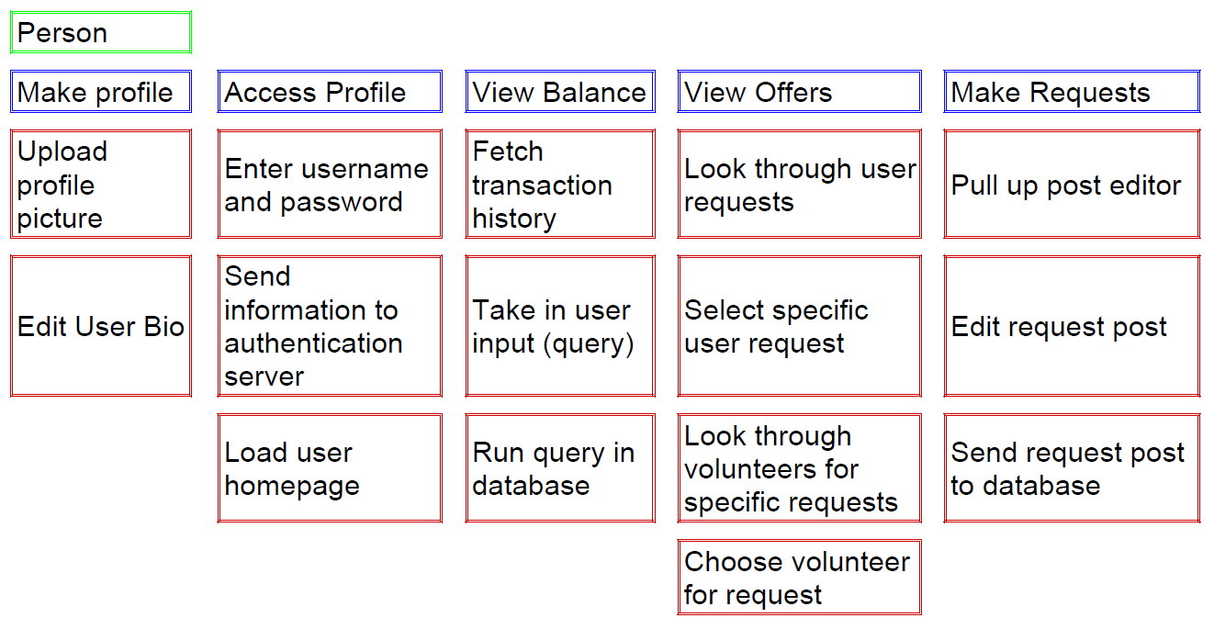
Story Map: Requirements > Software Features

Slide 7
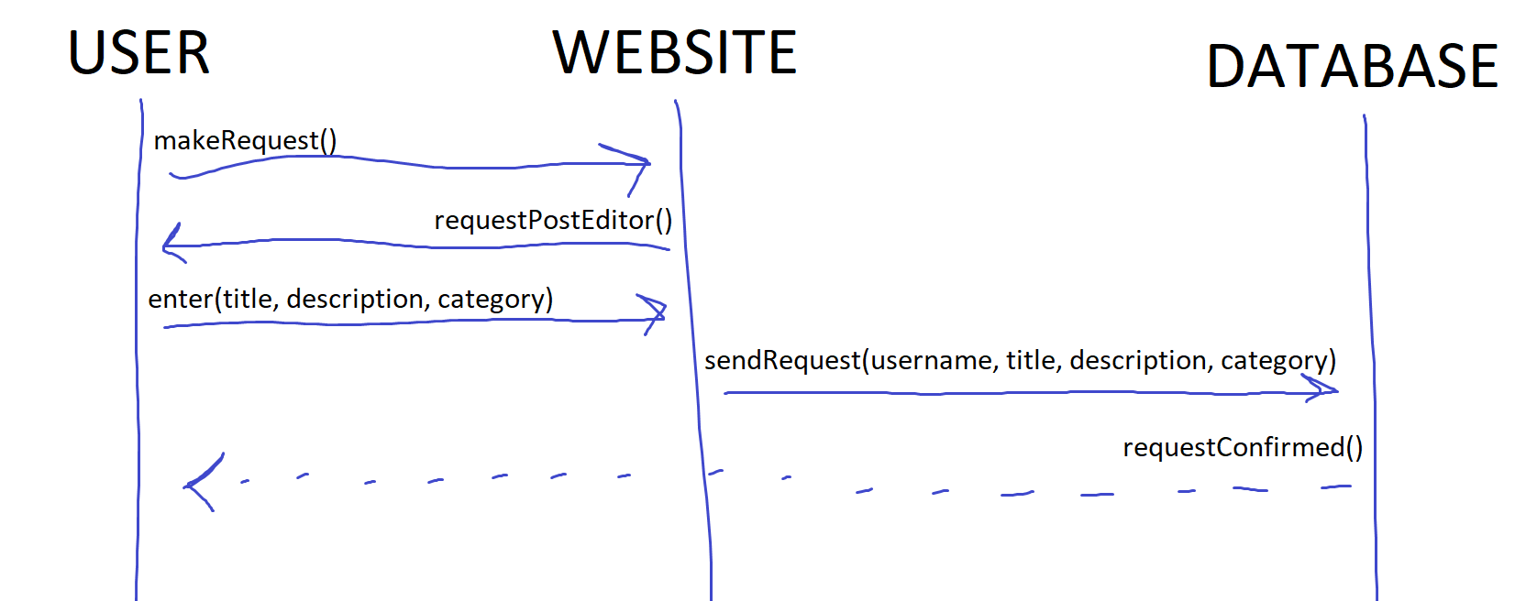
How Interfaces Interact: System Sequence Diagram

Slide 8
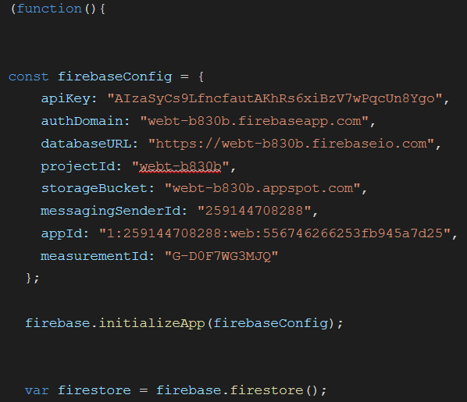
Tech Considered
Used: HTML, Firebase, Javascript, Database Design, NoSQL, IDEs
Tech we ended up not using: Spring-boot, REACT, Django

Slide 9

Stretch Goals
Include Charities as entities
Categorize services
Use user location
Organize charity events and their impact for a community’s timebank
Phone App

