Slide 1

NUnit
Amiee Phillips
Damien Moeller
Christian Norfleet

Slide 2
Outline
What unit testing is
Tools for unit testing
Advantages and Disadvantages
What is NUnit
Tool Demo

Slide 3
Unit testing
Unit testing is a methodology used to test individual components of a program to make sure it works before integrating it into the system.
Keeps testing low-level so that errors are found early in development.

Slide 4
Disadvantages
Advantages
Find errors early in development.
Narrow down errors to individual component.
Reduce the cost of changes.
Steep learning curve
Time consuming
Testing may not be able to find certain errors.

Slide 5
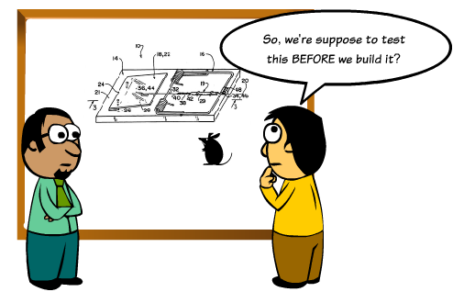
Unit Testing Tools
Nunit
Anteater
MozUnit
TestNG
Jmockit
Emma
Quilt

Slide 6
NUnit
Initially ported from JUnit.
Unit testing framework for all .Net languages.
Best used as Visual Studio plug-in.
Most current version is 3.0
Developed by Charlie Poole, Rob Prouse, James W. Newkirk, Alexei A. Vorontsov, Michael C. Two, and Philip A. Craig.
Free and open source.

Slide 7
TOOL DEMO

Slide 8

Conclusion
Testing leads to more productivity and increased consumer confidence.

Slide 9
Thanks for listening!

