Slide 1

Paradigm
Team
Christian Norfleet
Cavaughn Browne
Aimee Phillips
Damien Moeller

Slide 2
Test Suite Software
Built to assist lower level CMPS students test their programs for unexpected output and exception handling.

Slide 3
Functional Requirements
The system must be able to...
Read source code files.
Give sets of test cases for input source file code.
Produce test variables and test drivers.
Compare expected results to program's produced results.
Produce a template for a testing report document based on current session test.
Save testing report document.

Slide 4
Non-Functional Requirements
Must be extendable to reading more languages over time.
Must be scalable to allow for other types of testing methods.
Must be able to run on Windows Operating Systems.
Source code must be in C++ (.cpp and .h).

Slide 5
User Environment
Windows system with Microsoft Visual Studio, and a USB/CD drive.

Slide 6
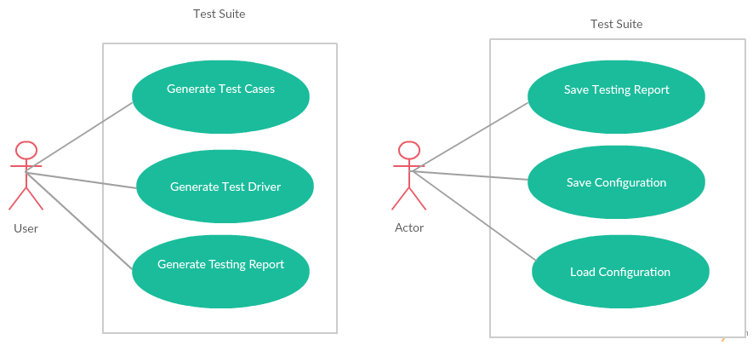
Use Case Diagram

Slide 7
Organization
Communication mostly over Slack with software management over GitHub. In person meetings happen before customer review for group contribution and peer review.

Slide 8
Development Tools
Code and UI design in Visual Studio 2015.
Documentation created in Open Office and Microsoft Office.
Diagrams made in Paint and creately.com.

Slide 9
UI Diagram

Slide 10
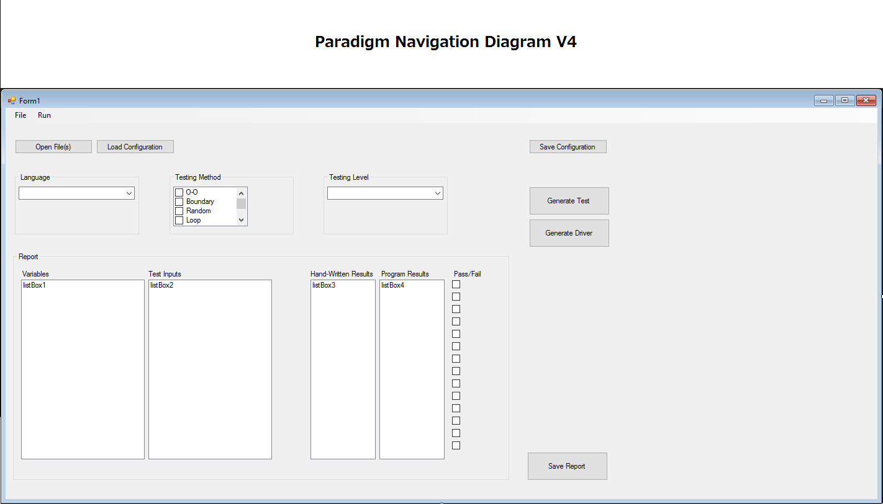

Slide 11
Entity Relationship Diagram

Slide 12
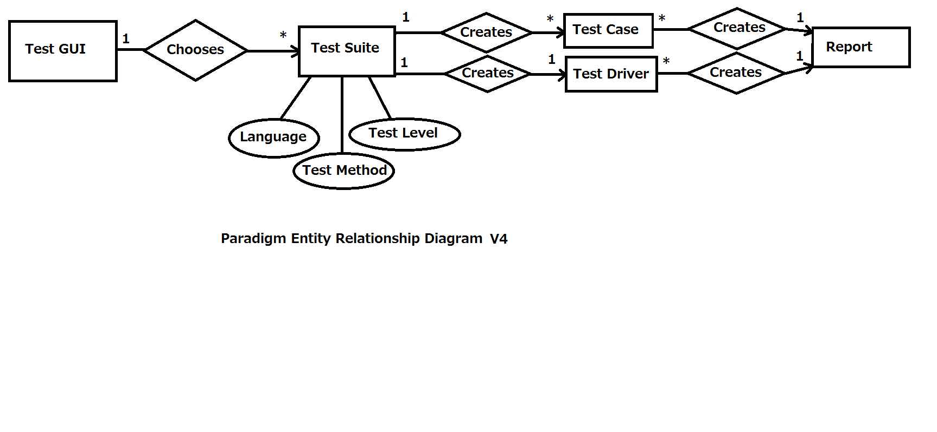

Slide 13
Class Diagram

Slide 14
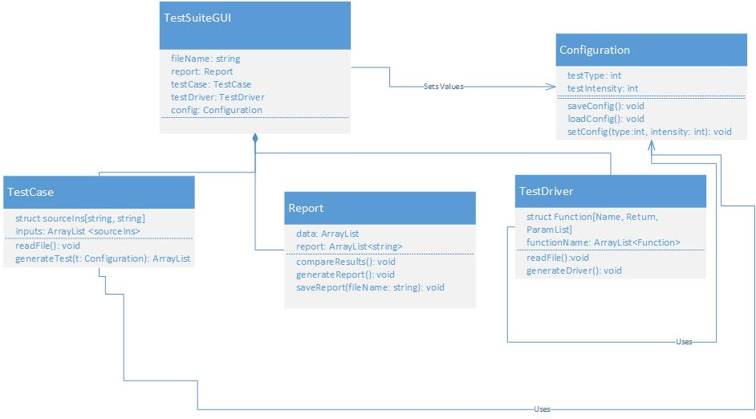

Slide 15
Sequence Diagram

Slide 16
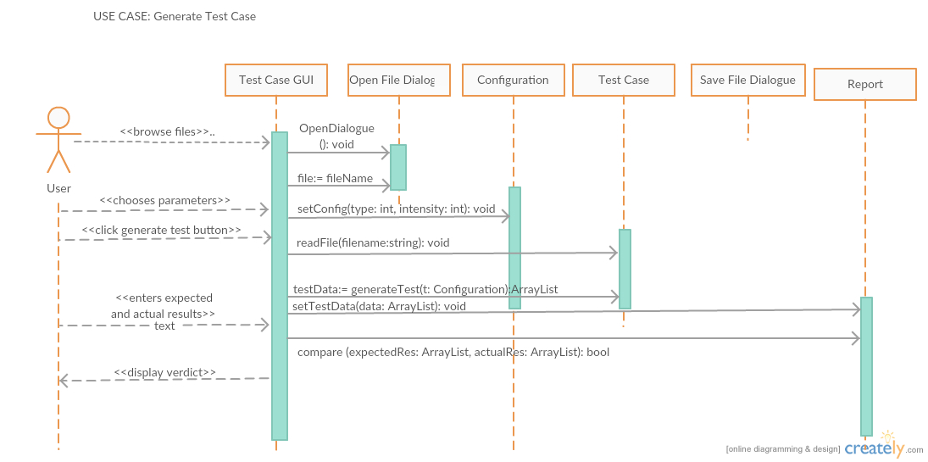

Slide 17
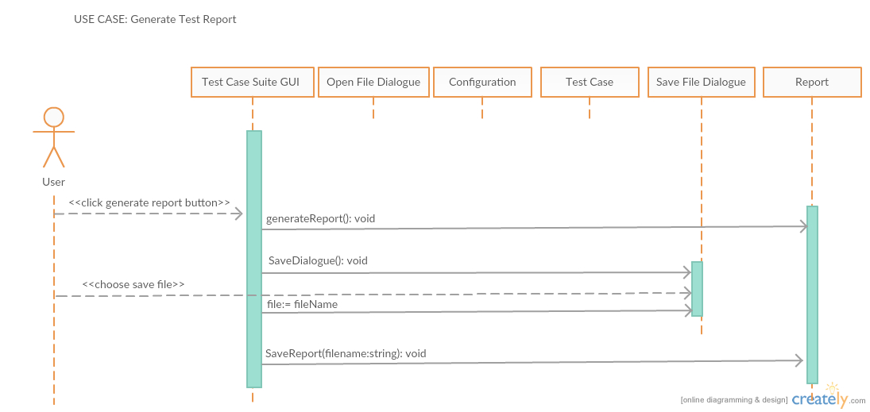

Slide 18
Thank you for listening!
Any questions?

