Slide 1
Capstone Information
Program: CPA
Team Members: Nicholas Lee Cynthia Cheng Thomas Craig Chris Banks
Client: Circumference
Name of Project: Sched
Project Description: The purpose of this project was to develop an automated scheduling web application for field services

Slide 2
Client Requirements
Project Goal
Requirements
Create a scheduling web application for field services and improve automated scheduling process
Primary user would be the Dispatcher scheduling work for field Technicians and Resources
Booking interface that allowed Dispatchers create, update, view, delete Work Orders
Dispatchers can schedule and dispatch Technicians and Resources to fulfill Work Orders
The process would utilize a Gantt chart where Dispatchers can drag Work Orders into Technician and Resource schedules

Slide 3
Tech Requirements
ASP.net
MS Server Database
jsGantt Improved
Notes:
ASP.net using C# and MVC
SQL Server DB hosted on Azure
jsGantt Improved, an open source javascript library that creates Gantt charts
https://jsganttimproved.github.io/jsgantt-improved
Credit for Icons:
Smashicons - https://www.flaticon.com/authors/smashicons
Flaticon is licensed by Creative Commons BY 3.0
http://creativecommons.org/licenses/by/3.0/

Slide 4

Project Innovations
Recommendations of Technicians and Resources based on client outlined parameters for scheduling of Work Orders
Single dashboard view, allowing Dispatchers to toggle different information they may want to view while completing scheduling
An interactive visual experience for Dispatchers via being able to drag, drop, and move Work Orders on a Gantt chart to complete scheduling

Slide 5
Obstacles and lessons learned
jsGantt Improved Limitations
Bridging the Gap between List and Chart
An open source javascript library that creates a Gantt chart however required many changes to meet client requirements
We could display the Work Orders that needed to be scheduled and could view the Gantt Chart but how do we link the two?
What we did
What we did
We updated and enhanced code to be used as a scheduler allowing multiple Work Orders to be assigned to Technicians and Resources, displayed in combined rows which displayed significant Work Order information on hover over time slots and drag functionality, allowing updating of Work Order time with a simple drag and drop
We used Droppable to be able to grab data from the Work Order List and move it into the Gantt chart for scheduling
We updated the draggable work orders to highlight Technicians and Resource that match Work Order requirements and matched the look and size of the time slots in the Gantt Chart, giving Dispatchers instant visual feedback
Notes:
We were unable to complete the automated scheduling process however recommendations promotes Technicians and Resources to the Dispatcher based on weighted client parameters (cost 50%, distance 30%, kpi 20%) provides a base to selection of Technicians and Resources for the automated process in the future

Slide 6

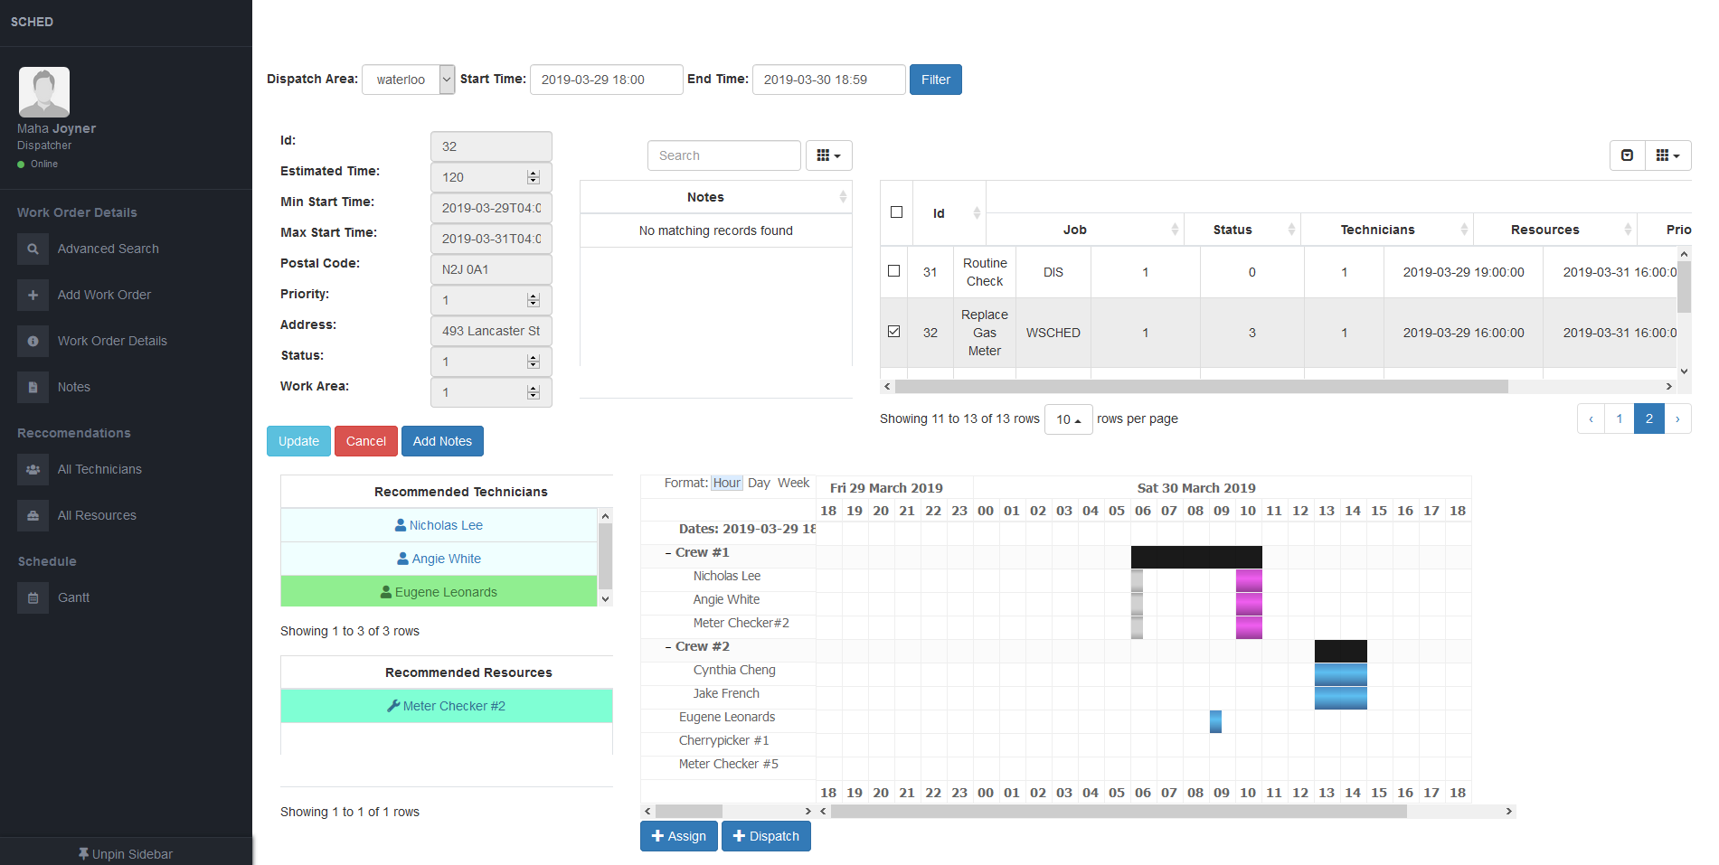
Our solution
Field Service Scheduler
Notes:
Screenshots here

Slide 7

Thank You

