Slide 1
Basic Details of the Team and Problem Statement
PSID: KVH-013
Problem Statement Title: Tool for Monitoring Ground Personnel
Team Name: Team Nautilus
Team Leader Name: Arnab Chakraborty
Institute Code (AISHE): 4167
Institute Name: Yeshwantrao Chavan College Of Engineering

Slide 2
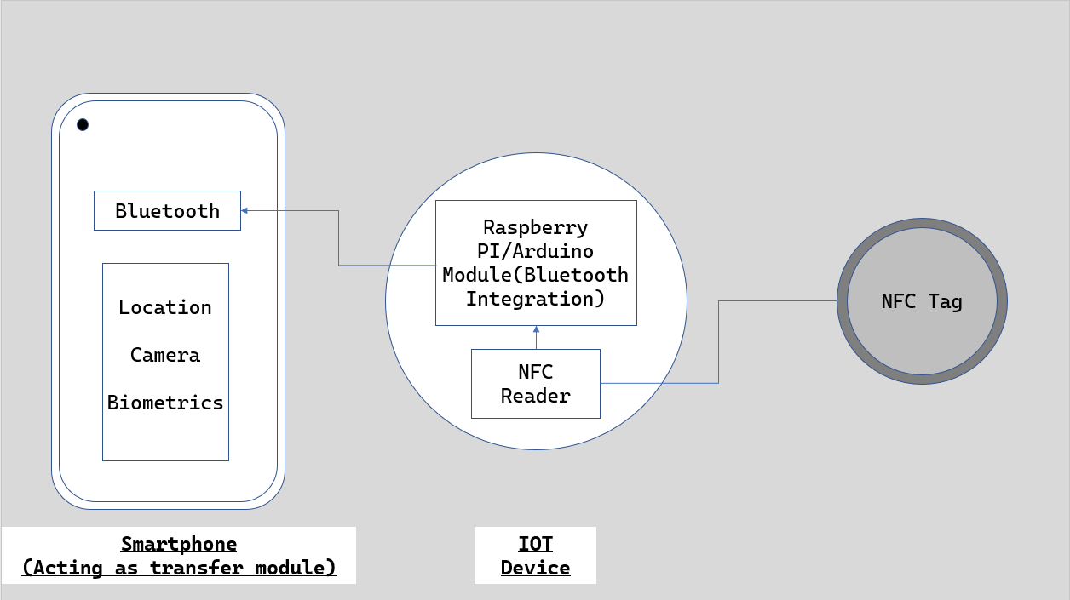
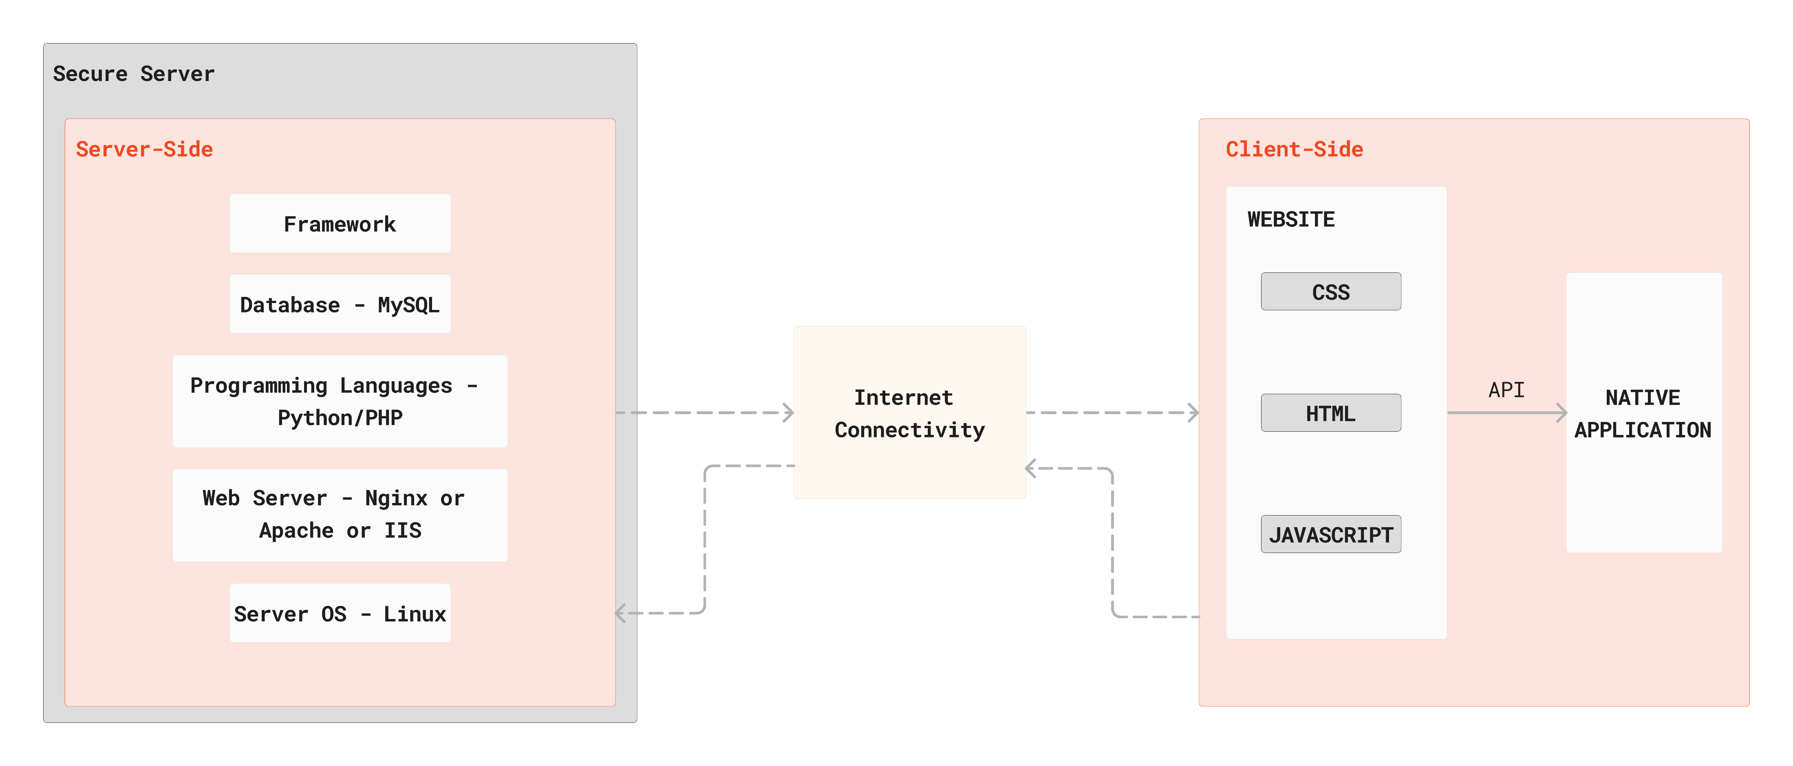
Idea/Approach Details
Describe your idea/Solution/Prototype here:
Requirements :- Headquarters will have to equip officers with NFC tags and IOT Devices.
Description :-
Scanning of NFC tags containing unique identification by IOT device.
Transfer of unique ID from IOT device to smartphone using Bluetooth.
Processing of data on the smartphone.
Transfer of location data from smartphone to server.
Scanning of live image using smartphone camera or biometric data using smartphone fingerprint reader.
Processing of image or biometric data at the server for verification purposes.

Slide 3
Idea/Approach Details
Describe your Dependencies / Show stopper here
Dependencies →
Availability of relevant hardware : Not all modern devices are equipped with NFC reading capabilities. Proprietary hardware(IOT Devices) may be required.
Connectivity : Internet connectivity may not always be available in rural or isolated areas so live tracking becomes difficult in that situation.
Maintenance : In case of loss or damage to the NFC tags or reader or the transfer module during a critical time, a backup is always required and proper maintenance of hardware is also required.
Showstoppers →
Range : NFC devices have a very short range of communication i.e. 4cm-10cm so the hardware is also limited to only that range. This solution can eliminate the problem arisen due to that limitation.
Authentication : Officers cannot falsify identity or location by forfeiting the possession of NFC tags to another person due to the availability of 2 Factor Authentication using Biometrics/Image Processing.
Interconnectivity : As the IOT device doesn’t store the data of an individual officer, it can interpret the data from nearby NFC devices and send the data of multiple officers at once providing seamless interconnectivity.
Security : As the data stored is military data, it is highly sensitive. To protect this data, the main database will be completely offline so it won’t be accessible remotely while the required data will be fetched from a proxy server. This database will be further stored on a hardened Linux operating system. To ensure maximum security, 3 Factor Authentication will be required to access any data in the database.
Flexible Model : During times of crisis, squadron leader or headquarter will be able to exempt officers from ID verification. Our flexible model allows for such changes to take place.
Describe your Use Cases here
Officers will register on the website and download the smartphone application and login so that their information can be stored in the database. Registering will require the officers to at least provide 10 unique images of themselves.
Headquarters will provide officers with NFC tags that contains the unique key required to identify the officers.
During Bandobast situations, officers will be provided with an IOT Device and asked to link their smartphones to the IOT device.
As the IOT Devices are equipped with NFC readers, they’ll continuously keep fetching data from the NFC tags and send it to the smartphone using Bluetooth and the smartphones will keep sending location data of the officer to the server using internet.
Officers will be asked to verify their biometric data using the two factor authentication method embedded in the application using the phone camera which will verify the likeness of an officer using an AI image processing model or using the fingerprint reader found in smartphones which can verify the biological data of the officer. Officers will be required to authenticate their identity at regular intervals during a bandobast.
Image processing, data processing and database management will all be done on the server side.
This data will directly be sent to the headquarters.
In case an officer forfeits their smartphone, NFC tag or IOT device, a warning notification will be sent to the squadron leader. This warning notification will also be sent in case an officer fails to verify their identity at regular intervals. After multiple warning signals, a final notification will be sent to the headquarters who will be able to take action for the officers transgression as per their requirements.
On the application side an officer will only be able to see their own data, the squadron leader will be able to see the data of all officers at the bandobast and the headquarters will be able to read, write data of the officers and track their locations.
The application will require location, biometrics and camera permissions to function.
Server side will be maintained by an IT professional and a database administrator.

Slide 4
Team Member Details
Sr. No. | Name of Team Member | Branch (Btech/Mtech/PhD etc): | Stream (ECE, CSE etc): | Year | Position in team (Team Leader, Front end Developer, Back end Developer, Full Stack, Data base management etc.)
1 | Aditya Dawale | B.Tech | CSE(AIML) | 2nd | Management
2 | Rutuja Balbudhe | B.Tech | CSE(AIML) | 2nd | Frontend Dev.
3 | Gaurang Jodh | B.Tech | CSE(AIML) | 2nd | Backend Dev.
4 | Jayushna Mahadule | B.Tech | CSE(AIML) | 2nd | Frontend Dev.
5 | Ashutosh Joshi | B.Tech | CSE(AIML) | 2nd | Backend Dev.
6 | Arnab Chakraborty | B.Tech | CSE(AIML) | 2nd | Team Leader
Sr. No. | Name of Mentor | Category (Academic/Industry): | Expertise (AI/ML/Blockchain etc): | Domain Experience (in Years )
1 | Dr. Lalit Damahe | Academic | Computer Science | 15
2

