Slide 1
Clock Gating with Synopsys Power Compiler
Ryan Child

Slide 2
Clock Gating in Power Compiler
Applies to groups of flip-flops with shared synchronous control signals
Load-enable
Set/Reset
Toggle
Synchronous load-enable registers

Slide 3
Load-enable registers
New data clocked in only when load-enable is active
Implemented in DC with MUX
DATA IN
1
DATA OUT
D
Q
0
CLK
LOAD-ENABLE

Slide 4
Load-enable registers
Wastes power if throughput is low
When load-enable is not active, the same value has to be clocked into the flip flop every clock cycle
Mux, clock net, and FF all consuming power
Instead of re-loading every clock cycle, we can “gate” the clock with the load-enable signal
DATA IN
D
Q
DATA OUT
CLK
LOAD-ENABLE

Slide 5
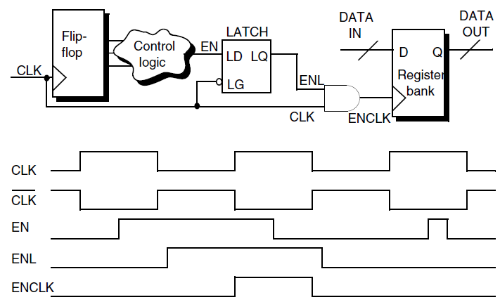
Latch-based clock gates
But load-enable is the output of combinational logic; will have glitches
So, generally use a latch-based clock gate
Synopsys Power Compiler User Guide

Slide 6
Clock Gating with Power Compiler
Clock gating parameters are set with the set_clock_gating_style command
set_clock_gating_style
[-sequential_cell none | latch]
[-minimum_bitwidth minsize_value]
[-setup setup_value]
[-hold hold_value]
[-positive_edge_logic {cell_list | integrated [active_low_enable] [invert_gclk]}]
[-negative_edge_logic {cell_list | integrated [active_low_enable] [invert_gclk]}]
[-control_point none | before | after]
[-control_signal scan_enable | test_mode]
[-observation_point true | false]
[-observation_logic_depth depth_value]
[-max_fanout max_fanout_count]
[-num_stages num_stages_count]
[-no_sharing]
[-instances {instances_list}]
[-power_domains {power_domain_list}]
[-designs {designs_list}]

Slide 7
Clock Gating Requirements
Enable condition
Enable signal cannot be static logic 1 or 0
Setup condition
Latch-free gates only: enable signal must come from same clock domain as gated register
Width condition
Gated register must be at least as wide as the minimum_bitwidth

Slide 8
Clock Gating with Power Compiler
After setting the clock gating style, compile with the -gate_clock flag.
dc_shell> read_verilog design.v
dc_shell> create_clock –period 10 clk
dc_shell> set_clock_gating_style –sequential latch –minimum_bitwidth 4
dc_shell> compile_ultra –gate_clock
dc_shell> report_clock_gating
dc_shell> report power

Slide 9
Gating multiple FFs
minimum_bitwidth
The more flip-flops we can gate with one clock gate, the greater the power savings
max_fanout
Gating too many FFs with one clock gate can lead to placement issues and timing violations
Can result in clock gates with same enable signal
no_sharing
Used with max_fanout
Clock gates not shared between register banks

Slide 10
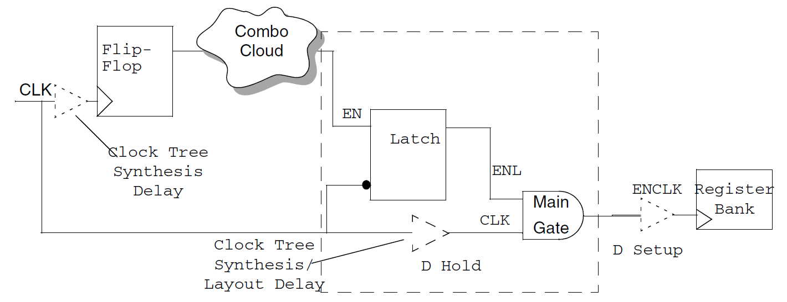
Setup and Hold
Usually defined by the technology library
Can be altered after clock tree synthesis
Synopsys Power Compiler User Guide

Slide 11
Choosing Gating Logic
-positive_edge_logic [gate list] [cell list]
-negative_edge_logic [gate list] [cell list]
Used for latch-free designs
[gate list] is a 1 or 2-gate list that specifies a gate: AND, NAND, OR, NOR, and an inverter or buffer to put in the clock path before/after the gate.
[cell list] is a list of integrated cells
Choice of gating logic depends on technology library, and whether the registers are negative or positive edge

Slide 12
Choosing Gating Logic
{buf and}
{and inv}
DATA IN
D
Q
DATA OUT
CLK
LOAD-ENABLE
DATA IN
D
Q
DATA OUT
CLK
LOAD-ENABLE

Slide 13
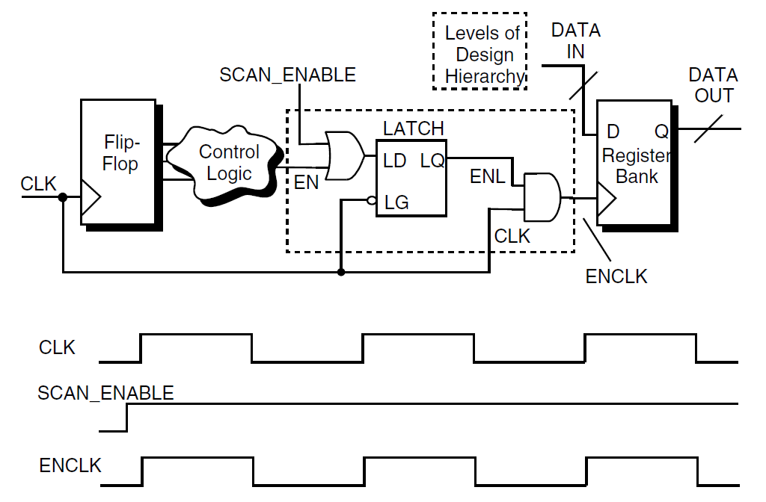
Clock Gates with DFT
-control_point before | after
-control_signal scan_enable | test_mode
Synopsys Power Compiler User Guide

Slide 14
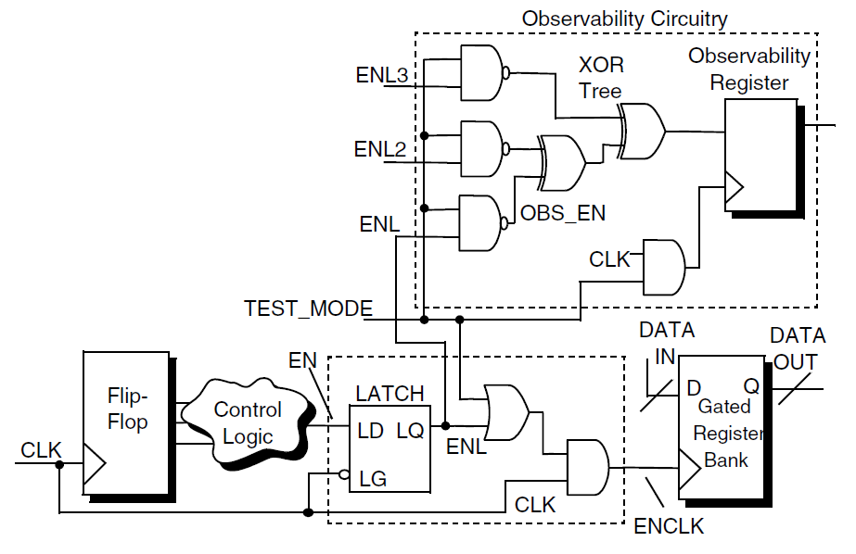
Clock Gates with DFT
-observation_point
-observation_logic_depth
Synopsys Power Compiler User Guide

Slide 15
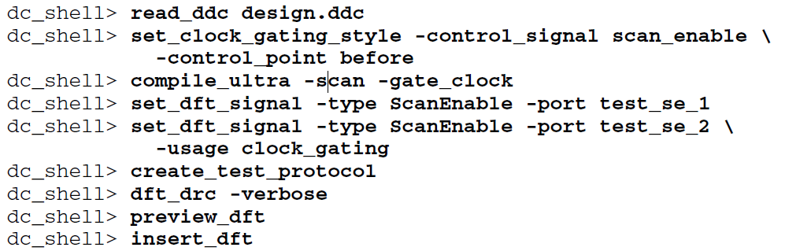
Clock Gates with DFT
Specify “-usage clock_gating” with set_dft_signal to connect to signal to clock gate test pin
Synopsys Power Compiler User Guide

Slide 16
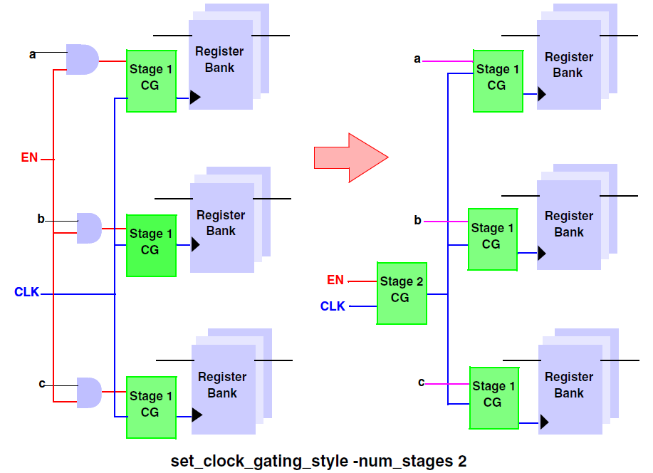
Multiple Clock Gate Stages
Gate the clock gates (-num_stages = 2)
Gate the clock gates of the clock gates (-num_stages = 3)
Synopsys Power Compiler User Guide

Slide 17
Other Clock Gating Commands
set_clock_gating_objects
set_clock_gating_registers
insert_clock_gating
set_clock_gate_latency / reset_clock_gate_latency
remove_clock_gating
rewire_clock_gating

Slide 18
Custom Clock Gates
Set attributes on a library cell with Library Compiler:
clock_gating_integrated_cell
dont_use
is_clock_gating_cell
clock_gate_enable_pin

Slide 19
Clock Gating Techniques
RTL
Compile_ultra –gate_clock on RTL design
Gate-level
Compile RTL to gate-level, compile again with –gate_clock
Power-driven
Uses switching activity annotations to determine whether to add clock gates
Set power_driven_clock_gating variable to true before adding clock gates

Slide 20
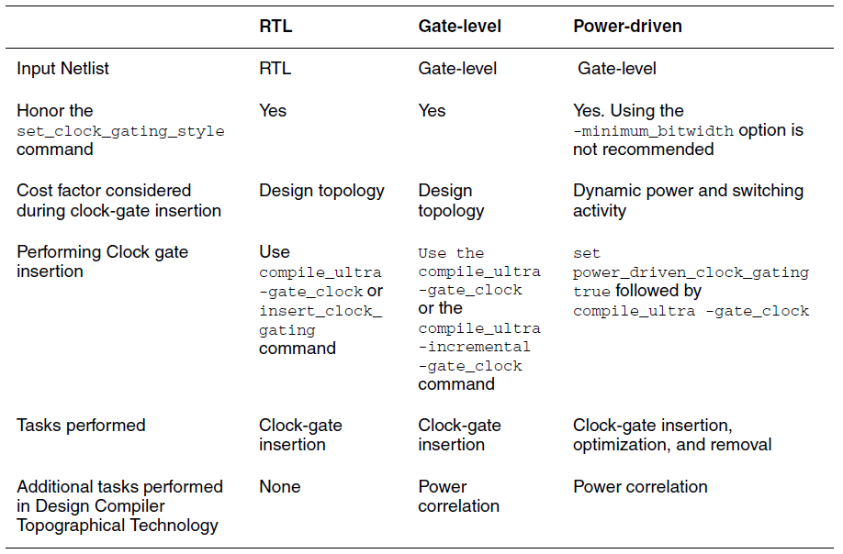
Clock Gating Techniques
Synopsys Power Compiler User Guide

Slide 21
4-bit register example
module test ( rst, clk, load, d, q);
input [3:0] d;
input rst, clk, load;
output reg [3:0] q;
always @(posedge clk)
if (rst) begin
q <= 4'b0000;
end else if (load) begin
q <= d;
end else begin
q <= q;
end
endmodule

Slide 22
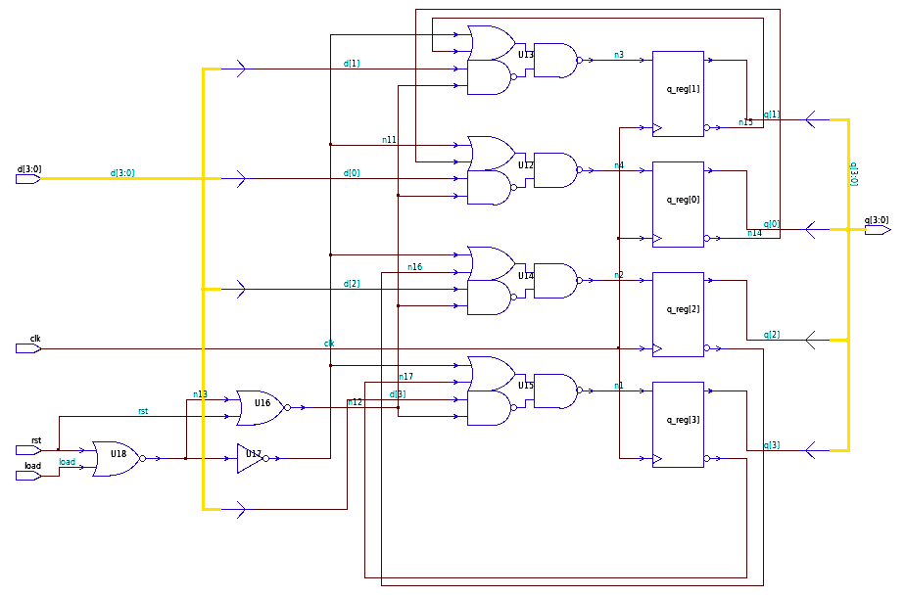
Without clock gating

Slide 23
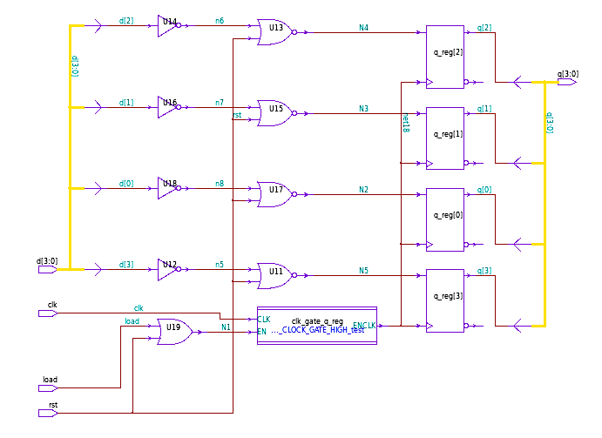
With clock gating

Slide 24
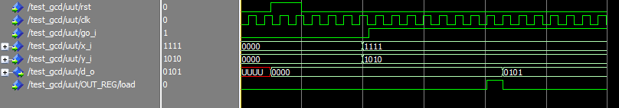
GCD Calculator
Output register can benefit from clock gating
Load-enable signal only active for one clock cycle when calculation is finished

Slide 25
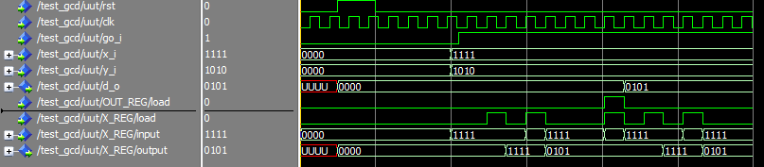
GCD Calculator
Less savings from operand registers
They are frequently loaded with new values throughout the calculation

Slide 26
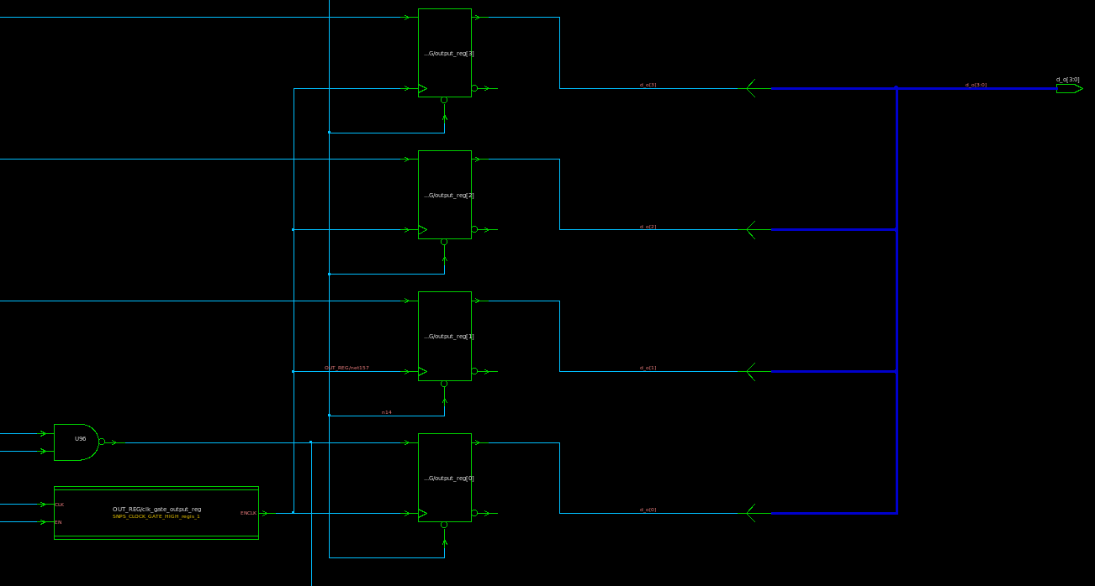
GCD Calculator – output gate

Slide 27
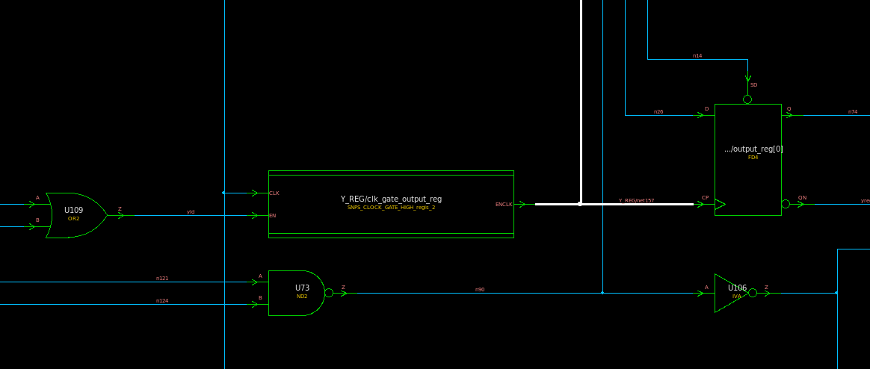
GCD Calculator – Y gate

Slide 28
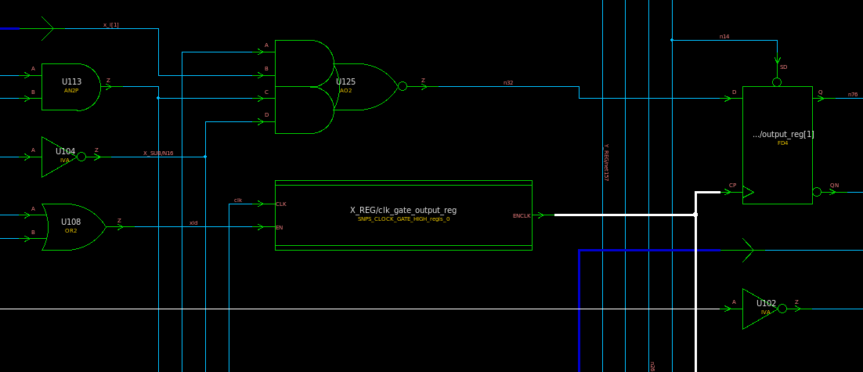
GCD Calculator – X gate

Slide 29
GCD Calculator Power Analysis
 | RTL | Gate-level | Power-driven | None
Class.db | 12 / 3.912 uW | 4 / 3.919 uW | 4 / 3.919 uW | 0 / 3.172 uW
Lsi_10k.db | 12 / 2.542 uW | 4 / 3.673 uW | 4 / 3.673 uW | 0 / 3.102 uW
Saed90nm_typ | 12 / 21.328 uW (20.91%) | 12 / 22.428 uW (16.83%) | 12 / 22.428 uW (16.83%) | 0 / 26.966 uW
FFs gated / Total power reported by report_power

Slide 30
GCD Calculator
class.db and lsi_10k libraries not characterized for internal or static power
Internal and static power reported for these libraries is 0, and switching power increases, so it appears as if total power increases
To get an accurate power analysis, must use libraries characterized for internal power, i.e. saed90nm_typ

Slide 31
GCD Calculator Flow
set target_library saed90nm_typ.db
set link_library [concat "*" $target_library]
set symbol_library saed90nm_typ.sdb
set_clock_gating_style -sequential latch -min 4 -max_fanout 16
analyze -library WORK -f vhdl GCD_Calculator.vhd
elaborate -library DEFAULT gcd
current_design gcd
create_clock clk -p 25
set_fix_hold clk
set_clock_transition 0 clk
saif_map –start
compile_ultra -gate_clock
read_saif -auto_map_names -input gcd_rtl.saif -instance test_gcd/uut
report_saif -rtl_saif
report_clock_gating
report_power -analysis_effort high

Slide 32
GCD Calculator Power Report
****************************************
Report : power
-analysis_effort high
Design : gcd
Version: F-2011.09-SP1
Date : Fri Dec 9 01:10:13 2011
****************************************
Library(s) Used:
saed90nm_typ (File: /home/childrn/vlsi_testing/project3/saed90nm_typ.db)
Operating Conditions: TYPICAL Library: saed90nm_typ
Wire Load Model Mode: enclosed
Design Wire Load Model Library
------------------------------------------------
gcd 8000 saed90nm_typ
SNPS_CLOCK_GATE_HIGH_regis_0
ForQA saed90nm_typ
SNPS_CLOCK_GATE_HIGH_regis_1
ForQA saed90nm_typ
SNPS_CLOCK_GATE_HIGH_regis_2
ForQA saed90nm_typ
Global Operating Voltage = 1.2
Power-specific unit information :
Voltage Units = 1V
Capacitance Units = 1.000000ff
Time Units = 1ns
Dynamic Power Units = 1uW (derived from V,C,T units)
Leakage Power Units = 1pW
Cell Internal Power = 12.3289 uW (79%)
Net Switching Power = 3.3275 uW (21%)
---------
Total Dynamic Power = 15.6564 uW (100%)
Cell Leakage Power = 5.6719 uW
Internal Switching Leakage Total
Power Group Power Power Power Power ( % ) Attrs
--------------------------------------------------------------------------------------------------
io_pad 0.0000 0.0000 0.0000 0.0000 ( 0.00%)
memory 0.0000 0.0000 0.0000 0.0000 ( 0.00%)
black_box 0.0000 0.0000 0.0000 0.0000 ( 0.00%)
clock_network 2.0640 0.4352 5.8748e+05 3.0866 ( 14.47%)
register 6.0413 1.0535 2.4126e+06 9.5075 ( 44.58%)
sequential 0.0000 0.0000 0.0000 0.0000 ( 0.00%)
combinational 4.2236 1.8388 2.6717e+06 8.7341 ( 40.95%)
--------------------------------------------------------------------------------------------------
Total 12.3289 uW 3.3275 uW 5.6719e+06 pW 21.3282 uW

Slide 33
Additional Optimizations
Width could be extended from 4 bits to 16 or 32 for greater power savings per bit
Power-characterized technology library should be obtained from manufacturer for optimal power analysis and clock gating

