Slide 1
HTTP and Servlets Intro

Slide 2
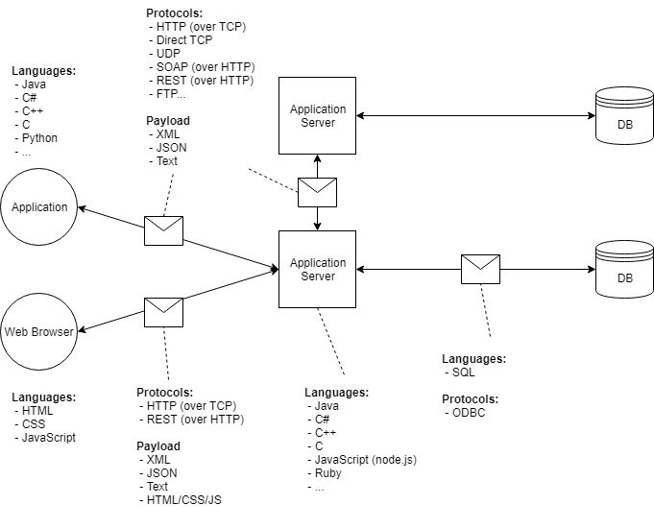
Client-Server-Database Architecture

Slide 3
Types of Client-Server Architecture
Tiers:
Usually on different machines
2 tier architecture –
Presentation tier
Data tier
Business logic is in either or both tiers
Thin client fat server
Fat client thin server
Cons:
limitations in performance (one or both tiers are doing heavy lifting)
security (direct communication between client and database)
portability.
Pros:
Easier to build
3 tier architecture –
Separation of concerns:
presentation tier
application tier
data tier
Loose coupling
More complex
n-tier architecture
Multiple business logic tiers
More scalable, robust, and flexible

Slide 4
How the Internet Works
Delete something in browser
http is stateless: know each other only through messages
self-descriptive messages
Browsers and servers generally do not keep open connections to each other.
Browser → Request → Server
Browser ← Response ← Server
Connection is closed
HTTP is a protocol. It defines how communication happens.
Other protocols: FTP, SMTP, HTTPS, Telnet
Browser sends HTTP request to URL.
HTTP request arrives at server.
Server finds requested resource (page, file, or program). Server may forward request to program
Server returns requested resource in HTTP response
Browser renders (draws) response to screen, or downloads file

Slide 5
HTTP Requests are composed of:
Verb
Indicates the executing HTTP method.
URI
Specifies the endpoint where resource is located.
HTTP Version.
Request Header
META-DATA (information) of the Request as key-value pairs such as: format supported by client, browser type, etc.
Request Body
Message content or resource representation.

Slide 6
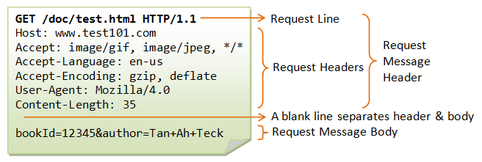
Structure of HTTP Requests
HTTP Requests have a head (filled with “headers”) and a body
Request Line: method, path, protocol
“Accept” headers: What types of data can be in the response. Restrictive. No match: no response/404.

Slide 7
Request Methods
GET
Get resource
POST
Add to collection of resources
PUT
Update resource but replace it entirely
PATCH
Update a part of a resource
DELETE
Delete resource
OPTIONS
Request communication permissions
HEAD
Request headers that would be returned if it was actually a GET request
Get the meta-data, but not the actual data

Slide 8
HTTP Request Verbs/Methods
HTTP request verbs or methods indicate the action that a client hopes to perform.
Characteristics of requests: (Basically a request either is or isn't each of these)
idempotent
"identical request can be made once or several times in a row with the same effect while leaving the server in the same state"- MDN
GET, PUT, DELETE, HEAD, OPTIONS
Not POST
safe
doesn't alter server's state
read-only
GET, HEAD, OPTIONS
cacheable
Determines if there is a chance that the response to the corresponding method can be cached or stored to be retrieved and used later, rather than making a new request to server
GET, HEAD can be cachable
allowed in html forms
GET, POST
request has a body

Slide 9
GET requests
Used to “retrieve” data from the server
Parameters will be included in the URL after ‘?’
Whenever an HTTP request is generated from typing a URL into an address bar, or clicking a link, it’s a GET request.
URLs typically have a character limit depending on browser and server settings. Generally < 2000 characters is safe
Demonstrate this

Slide 10
Types of HTTP Request Cont.
POST requests:
Used to send data to a server
Parameters are only in the “body” of the request, do not appear in URL
Data is sent as key-value pairs
HTTP POST requests typically have a maximum size depending on the server configuration (~2-10 MB)
What if I need to send a bigger file?
Multipart POST requests: used to break data up across multiple requests to respect size limits.
Server must be configured to accept multipart requests.

Slide 11
Status Codes
Part of a server’s response to a request
100s: informational codes
100: Continue
200s: success codes
200: OK
201: Created
300s: redirections codes
301: moved permanently
400s: client errors codes
401: unauthorized
404: not found
409: conflict
500s: server errors codes
500: internal server error

Slide 12
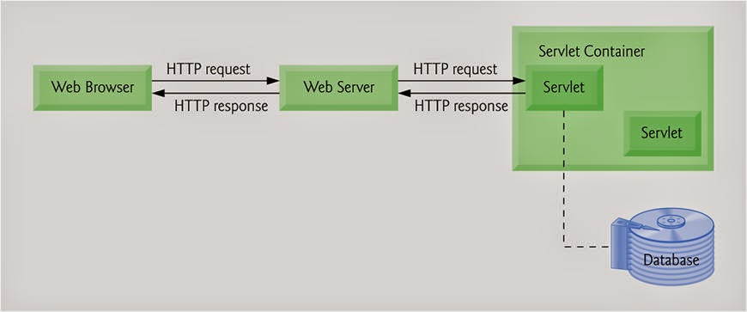
Servlet Intro
Application server: used to generate dynamic content
Web server: serves static content
A Servlet is a Java class that takes incoming requests, processes them, and generates a response to send back to the user.
The Servlet container is the component of an application server that manages Servlets.
Servlets allow Java to generate static (pre-defined) webpages with dynamic content
Tomcat is our application server

Slide 13
Getting Started
Download tomcat (https://github.com/cynthia-enciso/RAP-210517/blob/master/environment-setup/tomcat-install-windows.md)
In eclipse, change your window’s perspective
Window > show view > other > server
Create a new tomcat server
Make a new Maven project, make sure the packaging is war, not jar!
Right click on project > Java EE tools > generate deployment descriptor stub
Go to src folder > webapp > WEB-INF > web.xml
Use the correct xml tag from next slide
Configure project’s build path > add library > server runtime
Add in your servlet mapping
Run your program > run on server

Slide 14
Updated web app tag
<web-app xmlns="http://xmlns.jcp.org/xml/ns/javaee"
xmlns:xsi="http://www.w3.org/2001/XMLSchema-instance"
xsi:schemaLocation="http://xmlns.jcp.org/xml/ns/javaee
http://xmlns.jcp.org/xml/ns/javaee/web-app_3_1.xsd"
version="3.1">

Slide 15
Servlet Container Configuration
Have server set up
Have runtime library
Create maven project
Using annotations
@WebServlet( “PATH”)
or deployment descriptor (web.xml):
XML file that specifies which servlets should map to which paths
<web-app xmlns="http://xmlns.jcp.org/xml/ns/javaee"
xmlns:xsi="http://www.w3.org/2001/XMLSchema-instance"
xsi:schemaLocation="http://xmlns.jcp.org/xml/ns/javaee http://xmlns.jcp.org/xml/ns/javaee/web-app_3_1.xsd"
version="3.1">
<welcome-file-list>
<welcome-file>index.html</welcome-file>
<welcome-file>index.htm</welcome-file>
<welcome-file>index.jsp</welcome-file>
<welcome-file>default.html</welcome-file>
<welcome-file>default.htm</welcome-file>
<welcome-file>default.jsp</welcome-file>
</welcome-file-list>
<servlet>
<servlet-name>welcome</servlet-name>
<servlet-class>
com.revature.ExampleXMLMappedServlet
</servlet-class>
</servlet>
<servlet-mapping>
<servlet-name>welcome</servlet-name>
<url-pattern>/welcome</url-pattern>
</servlet-mapping>
</web-app>
Why use apache tomcat? It takes care of a lot of things for us, like managing servlets and dealing with headers

