Slide 1
SQL Continued

Slide 2
Milestone 1: model classes created (if you wanted to add more to your models, great, if not, I’ll take just the creation), db tables created
Milestones: expect feedback Wednesday/Thursday at the latest
Milestone 2: make any corrections, flesh out your models, properties, getters/setters, constructors, methods you might need, and start setting up user input.
brynportella is mentioned, my git username is cynthia-enciso
QC this Friday over last four weeks, again what we go over this week I will let them know about

Slide 3
Transactions
A Transaction is a unit of work performed against a database. It is the propagation of one or more changes to the database.
Ex: UPDATE, DELETE, INSERT
In practice, you will group multiple operations together, and then execute them all at once.

Slide 4
ACID: Properties of a transaction
Atomicity – Ensures that all operations either successfully complete or none will, and the transaction will be aborted and the changed reverted.
Consistency – Ensure that the database properly changes states in a way that is consistent with the database’s rules (constraints). No transaction should have any adverse effect on the data residing in the database/table. Referential integrity and constraints are maintained.
Isolation – Enables transactions to operate independently of each other
Durability – Ensures that the result or effect of a committed transaction persists, even in the case of system failure.
Transactions are stored in secondary storage
These properties ensure that the database is reliable!

Slide 5
Transaction Isolation Levels
Isolation levels measure the degree to which two transactions will interact with each other over the same data.
As our applications become more complex, we must account for transactions that may occur at the same time.
The higher the isolation level, the more careful the system is to avoid conflicts; however, locking overhead can increase processing time and decrease concurrency.

Slide 6
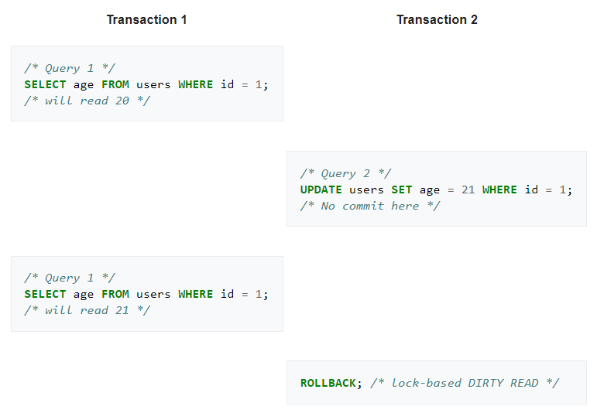
Transaction Problems
Dirty Read – When a transaction reads data that has been added by a different transaction, which has not yet been committed.

Slide 7
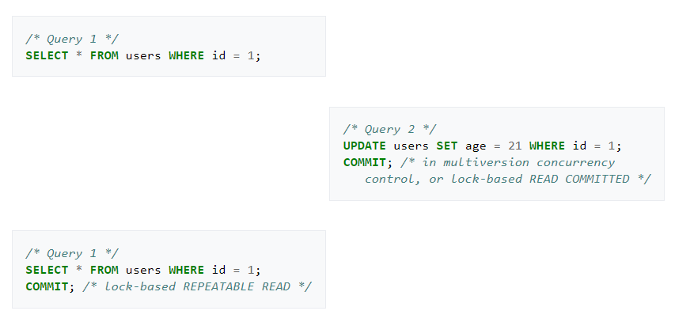
Non-repeatable read – Transactions re-read data that it has previously read, and finds another committed transaction has modified or deleted data

Slide 8
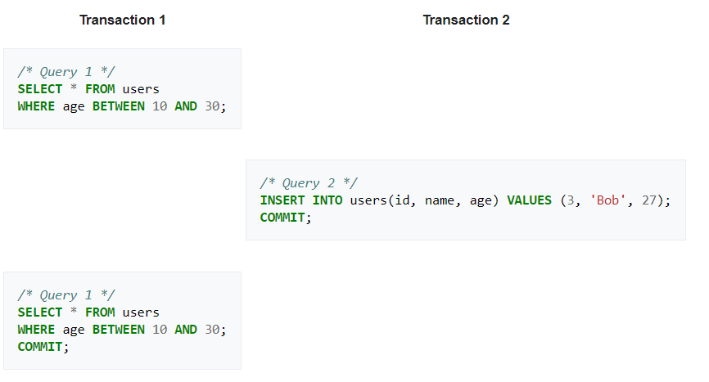
Phantom Read – Transaction returns a query to find that the number of records that satisfies a certain condition has changed.

Slide 9
Transaction Solutions
Read Uncommitted – Allows the application to read uncommitted data
*Read Committed – You can only read data that has been committed – prevents Dirty Read
Repeatable Read – Prevents non-repeatable read (prevents data that is read from being modified)
Serializable – prevents phantom reads (different amount of records returned from same query). If two transactions might cause a collision, they are allowed to commit only one at a time.
*Default level

Slide 10
Transaction Control Language
Allows us to manage the transactions that are saved to the database
BEGIN; … COMMIT;
We can group multiple transactional commands together.
SAVEPOINT name_of_savepoint; can be used to more granularly control transactions.
ROLLBACK; or ROLLBACK TO …;

Slide 11
PL/Pg SQL
Procedural Language/SQL is a programming language supported by postgresql that provides a means to write code in SQL that more reminiscent of a programming-type language
For example:
functions, sequences and triggers
As well as ways to handle exceptions
PL/pgSQL closely resembles Oracle’s PL/SQL Language

Slide 12
Functions
Functions are a series of operations and/or statements which can be referenced and executed as a batch when invoked. (Think, methods in Java).
Functions cannot be used to execute transactions (CRUD operations).
Stored Procedures, which were introduced in postgresql 11, provide that functionality.
If you drop, then recreate a function, the new function is not the same entity as the old. You will have to drop existing rules, triggers, views, etc… which reference the old function.
To change a function definition without breaking old references use the CREATE OR REPLACE statement
https://www.postgresqltutorial.com/postgresql-create-function/

Slide 13
Syntax - Functions
CREATE OR REPLACE FUNCTION count_emp_salary_in_range(min_sal INTEGER, max_sal INTEGER)
RETURNS INTEGER AS
$$ DECLARE
sal_count INTEGER;
BEGIN
SELECT count(*) INTO sal_count FROM employees
WHERE emp_salary BETWEEN min_sal AND max_sal;
RETURN sal_count;
END;
$$ LANGUAGE PLPGSQL;

Slide 14
Sequence
A Sequence is an object that will maintain a counter for you.
A counter can be used to automatically increment a value.
You can use the built-in ‘NEXTVAL’ function to reference the next value of a given sequence.
nextval(‘sequnce_name’)
You can use a sequence directly within an insert statement, or you can create a custom function and trigger which can reference the sequence to be utilized given a particular event.

Slide 15
Syntax Examples - Sequences
CREATE SEQUENCE user_id_seq START WITH 1000 INCREMENT BY 1;
INSERT INTO users VALUES (nextval(‘user_id_seq’), ‘Example Name’);
DROP SEQUENCE IF EXISTS user_id_seq CASCADE;

Slide 16
Triggers
A Trigger is an object that we can create that waits for actions to occur on a specific table that the trigger was made for.
A trigger can be coded to react to events which correspond with transactional CRUD operations (non-select).
These events are:
INSERT
UPDATE
DELETE
TRUNCATE
Triggers can be configured to occur “BEFORE” or “AFTER” the event in question.

Slide 17
Syntax Example - Triggers
CREATE TRIGGER user_id_trigger
BEFORE INSERT ON users
FOR EACH ROW
EXECUTE PROCEDURE user_id_func();
CREATE TRIGGER purchase_time_trigger
BEFORE INSERT ON orders
FOR EACH ROW
EXECUTE PROCEDURE insert_current_datetime_func();

Slide 18
CREATE OR REPLACE FUNCTION emp_id_func()
RETURNS TRIGGER AS
$$ BEGIN
IF NEW.emp_id IS NULL THEN
NEW.emp_id:=NEXTVAL(‘emp_seq’);
RETURN NEW;
END IF;
END;
$$ LANGUAGE PLPGSQL;

Slide 19
Stored Procedure
https://www.postgresqltutorial.com/postgresql-create-procedure/
Do not return a value
Take in some input
Perform some transaction or set of transactions
Executed using the CALL command–
CALL stored_proc_name(argument_list);
CREATE OR REPLACE PROCEDURE percentage_raise(current_sal INT, increase DEC, employee_id INT)
LANGUAGE plsql
AS $$
BEGIN
UPDATE employees
SET sal = current_sal * increase
WHERE id = employee_id;
COMMIT;
END;$$

