Slide 1
Threads

Slide 2
Concurrency
Concurrency refers to breaking up a task or piece of computation into different parts that can be executed independently, out of order, or in partial order without affecting the final outcome.
One way of achieving concurrency is by using multiple threads in the same program.
Operating systems use concurrency to manage different programs.
GUI (Graphical User Interfaces) are run simultaneously with other processes. Otherwise other processes would prevent the GUI from working and vice versa.

Slide 3
Multi-Core Processing
Most computers CPU’s that have multiple cores or processors, which means calculations can be done in parallel.
You can also have multiple CPUs as well
Multi-core systems can run different processes simultaneously on different processors entirely, which enables true parallelization.
A process is a program running on your computer
A process is made up of one or more threads
Each process has its own memory space
Even without multiple cores, concurrency can be achieved with time splicing
Time splicing – performing short bursts of different processes and switching between them rapidly.

Slide 4
Threads
A thread is a subset of a process that is also an independent sequence of execution
Your application is a process and it can have multiple threads of execution
Threads act as a line of program execution or as a “path of execution”.
Threads are managed independently by a scheduler.
All threads are given their own call stack which store local variables and references
Remember that stacks keep track of variables and method calls
All threads share the same heap.
There is one main user thread starting off
There are several daemon or system threads running in the background, like the garbage collector
https://docs.oracle.com/javase/7/docs/api/java/util/TimerTask.html
https://docs.oracle.com/en/java/javase/11/docs/api/java.base/java/util/concurrent/ScheduledExecutorService.html

Slide 5
Multithreading
Multithreading extends the multitasking of applications by subdividing operations in a single application into individual, parallel threads.
Multithreading can increase efficiency immensely
Very useful in multi-user scenarios
Multithreading can be accomplished through time slicing
Best practices:
Generally, it is best to avoid implementation of multithreading yourself if possible.
Although multithreaded applications can provide better performance due to non-blocking execution, you should always measure (or attempt to estimate) performance benefit you will get using threads versus the increased complexity and bugs that may be generated.
Multithreading can also be accomplished using frameworks, tools or libraries that have implemented the problem you are trying to solve on your own.

Slide 6
Thread Class Methods
Frameworks will be using these tools
And you would just use the framework
Some important thread methods include:
getters and setters for id, name and priority
interrupt() – used to explicitly interrupt a thread’s operations
isAlive(), isInterrupted(), isDaemon() – used to test the state of a thread
join() – used to wait for the thread to finish execution
start() – used to begin thread execution after instantiation.
Additionally, some important static methods include:
Thread.currentThread() – returns the thread that is currently executing
Thread.sleep(long millis) – causes the currently executing thread to temporarily stop for a specified number of milliseconds.
The word "daemon" actually comes from the Greek language, meaning an "inner or attendant spirit"
We’re going to be learning what is built into Java to handle threads and how do these things work
User thread, higher priority
Daemon thread: services user threads, background tasks, lower priority
setDaemon: if all threads are just daemons, JVM exits.

Slide 7
Thread Lifecycle
At any given time a thread can be in one of the following states:
New – newly created thread that has not started executing
Runnable – either running, or ready for execution but waiting for resource allocation
Blocked – thread waiting to acquire a monitor lock to enter or re-enter a synchronized block/method
Waiting – waiting for some other thread to perform an action within any time limit
Timed_Waiting – waiting for some other thread to perform a specific action for a specified time period
Terminated – has completed execution.

Slide 8
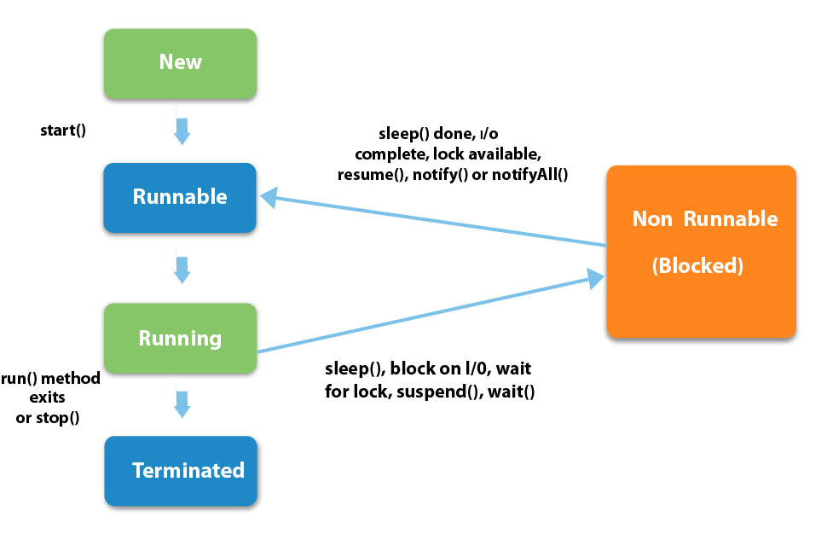
Thread Lifecycle

Slide 9
Thread Priority
Threads can be configured with a priority number, which signifies which order the threads are to run.
If a thread has a low priority and there are other threads with higher priority, the first thread is at risk of starving
The Thread class contains a few static variables to determine priority (range from 1-10):
MIN_PRIORITY – (typically 1)
NORM_PRIORITY – (defaults to 5)
MAX_PRIORITY – (typically 10)
Managing threads manually is challenging, which is why it is ideal to rely on a framework or library to manage them for us

Slide 10
Creating a Thread – Three* methods
There are three options to create a thread:
Create a class the implements the runnable functional interface
Implement the run()method of this class
Pass an instance of your class to a Thread constructor
Invoke the start() method on the thread
Create a class that extends Thread
Implement the run() method
Instantiate the class
Invoke the start() method
Create a Lambda* (this is an extension of the interface method, since lambdas are used to provide an implementation of an interface)

Slide 11
Creating a Thread – Implement Runnable
Implement the run() method of this class
Pass an instance of your class to a Thread constructor
Invoke the start() method on the thread
public class RunnableExample implements Runnable {
@override
public void run() {
System.out.println(“Implemented Runnable interface”);
}
}
public class Simulator {
public static void main(String[] args) {
Thread myRunnable = new Thread(new RunnableExample());
myRunnable.start();
}
}

Slide 12
Creating a Thread – Extend Thread
Implement the run() method
Instantiate the class
Invoke the start() method
public class ExampleThread extends Thread {
@override
public void run() {
System.out.println(“Extended Thread Class”);
}
}
public class Simulator {
public static void main(String[] args) {
Thread myThread = new ExampleThread();
myThread.start();
}
}

Slide 13
Problems with Threads
Although multi-threading can offer a great deal of efficiency, there are a number of problems and considerations which must be kept in mind before the implementation of custom threads for instance:
Race Conditions
Thread Starvation
Producer-Consumer Problem

Slide 14
Race Conditions
Race Condition: the condition where two or more threads try to change the same data at the same time
i.e. if thread 2 sets a value to null, then it should be completed after thread 1 performs operations that requires the information.
Race conditions can be solved using synchronization, to limit access to a resource to only one thread at a time.
Synchronization: locks objects or methods so that they cannot be changed by more than one method at a time
Methods can have a synchronized modifier
Objects can be thread safe: any method working on this particular object becomes synchronized when necessary

Slide 15
Synchronization Problems (Thread Contention)
The term ‘deadlock’ describes a situation where two (2) or more threads are blocked, waiting for each other.
Deadlock will cause a program to stall or fail since the threads cannot progress.
The term ‘livelock’ describes a situation where two or more threads are attempting to respond to another thread, which needs to respond back, which continues indefinitely.
Livelock causes a program to stall due to an infinite loop of code attempting to respond to each other without a means to proceed further.
Imaging two people scooting over in a hallway, but they keep scooting into the other person’s path
Both of these scenarios lead to ‘Thread Starvation’.
Thread starvation is also the result of a thread being unable to get resources it needs to complete because resources are being taken by higher-priority or “greedy” threads
Note: Neither deadlock or livelock have a strict, built-in solution. It is up to the developer to design a program in such as way as to avoid these situations.

Slide 16
Producer-Consumer Problem
The producer-consumer problem is a class example of a multi-process synchronization problem.
Producer – an entity which creates or populates an area with data, known as the queue.
Consumer – an entity which takes and removes data from an area, known as the queue.
Problem: The producer should produce data when the queue is not full. If the queue is full, then the produce should not be allowed to put any data into the queue. The consumer should consume data only when the queue is not empty. If the queue is empty, then the consumer should not be allowed to take any data from the queue.
Solution: use of the wait() and notify() methods can be used to communicate between producer and consumer threads.
The wait() method is used to pause the producer or consumer thread based on the size of the queue.
The notify() method sends a notification to the waiting thread

Slide 17
Producer-Consumer Problem
public synchronized void produce() {
while (messages.size() == MAX_SIZE) {
wait(); // when queue is full, wait...
}
/* when the queue has space, the Producer
* produces data and adds to queue
*/
messages.add(data);
notify();
...
}
public synchronized String consume() {
while (messages.isEmpty()) {
wait(); // when queue is empty, wait...
}
/* when the queue has data, the Consumer
* consumes data and removes it from the queue
*/
messages.remove(data);
notify();
...
}

