Slide 1
SQL Introduction

Slide 2
SQL
Structured query language
Became a standard of the American National Standards Institute (ANSI)
Major commands are SELECT, UPDATE, DELETE, INSERT, WHERE
Language used to work with relational databases
Relational: relationships are defined in the form of tables
Data has pre-defined relationships

Slide 3
RDBMS
Relational Database Management System
Program that allows you to create and work with a relational database
Majority use/support SQL
Examples:
Oracle
MySQL
SQLServer
PostgreSQL
https://www.postgresql.org/docs/10/sql.html
Most RDMSs have their own proprietary extensions to the SQL standard

Slide 4
DBeaver
Application that gives us a UI to work with the RDBMS
Otherwise we would be using our shell’s CLI
Written in Java
Can be used with many RDBMSs
Not just postgres
Generates ER diagrams

Slide 5
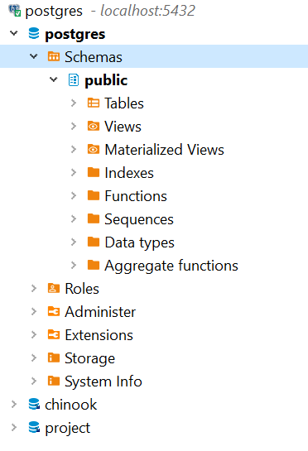
DB Structure
Postgres server
(can manage more than one db)
Schema (like a package)
Database
cluster

Slide 6
Sublanguages of SQL
DDL
Data definition language
Defining a schema (creating a table), etc.
All DDL operations cannot be rolled back, which means that any change made by these are permanent.
DML
Data manipulation language
C.R.U.D. operations performed on data/records
Insert, select, update, delete commands
DQL
Data query language
Select
TCL
Transaction control language
Transaction: one or more changes
All or nothing
Savepoint, Rollback, Commit
DCL
Data Control Language
Grant/revoke use of commands to groups or users

Slide 7
Datatypes Intro
Depends on the RDBMS
Boolean
Timestamp
Can include time zone
Date
Time
Can include time zone time zone
Binary, money, ENUMs, arrays, and more!

Slide 8
Datatypes: Characters
Varchar(n)
Useful for if you want to make sure data is of a specific length or less
If not given a length specifier, it behaves like text
Char(n)
slowest, varchar or text recommended instead
If not given a length specifier, it holds 1 character
Text
No length specified

Slide 9
Datatypes: Integers
Smallint (2 bytes)
Integer(4 bytes)
Default to use
bigint(8 bytes)
Smallserial (2 bytes, autoincrementing)
Serial (4 bytes, autoincrementing)
Bigserial (8 bytes, autoincrementing)

Slide 10
Datatypes: Floating-point/Decimals
Numeric and decimal
Used for decimal numbers and used to perform exact calculations
You can specify the precision and scale
Precision: amount of digits (to the left and right of decimal)
Scale: count of decimal digits in fractional part
Ex) 92.456 has a precision of 5 and a scale of 3
If you don’t specify, stores any number as it is (with its current precision and scale)
Real (4 bytes, like a float in Java, inexact)
Double precision (8 bytes, like a double in Java, inexact)
Stored as approximations, might have slight discrepancies
Faster than numeric/decimal types
NUMERIC(precision, scale)

Slide 11
Example
Data is organized in tables
Tables have rows and columns.
Columns define the type of information.
An individual record is stored in each row.
Students
id | name | gpa
1 | ‘Anna Smith’ | 4.0
2 | ‘Bob Johnson’ | 3.7
3 | ‘Nicole Doe’ | 3.9

Slide 12
Data Definition Language
Create
Alter
Drop
Truncate
***Rename
In PostgreSQL just ALTER TABLE name RENAME TO new_name;
ALTER TABLE name RENAME column TO new_name;
Comment

Slide 13
Helpful Resources (Beyond the documentation)
https://www.techonthenet.com/postgresql/tables/create_table.php
https://www.postgresqltutorial.com/
https://www.tutorialspoint.com/postgresql/postgresql_syntax.htm
Sample db to play with: https://github.com/lerocha/chinook-database

