Slide 1
Joins, Views, Indexes, and Set Operations

Slide 2
ALIASES
Can give alternative names for columns and tables.
May use the AS keyword.
Alternatively, may just specify the alias immediately after the database object name.
SELECT MAX(gpa) AS grades, graduation FROM students AS School GROUP BY graduation HAVING MAX(gpa)<= 2.0 ORDER BY graduation ASC;
SELECT MAX(gpa) grades, graduation FROM students School GROUP BY graduation;

Slide 3
Joins
Equi joins
It is a simple sql join condition which uses the equal sign as the comparison operator. Two types of equi joins are SQL Outer join and SQL Inner join.
Inner Join (a.k.a. ‘natural’ join)
All the rows returned by the sql query satisfy the sql join condition specified.
Join based on same column names and datatypes
Outer Join
This sql join returns all rows from both tables which satisfy the join condition along with rows which do not satisfy the join condition from one of the tables.
Full, Left and Right joins are all considered types of outer joins
Non equi joins (a.k.a. theta joins)
It is a sql join condition which makes use of some comparison operator other than the equal sign like >, <, >=, <=

Slide 4
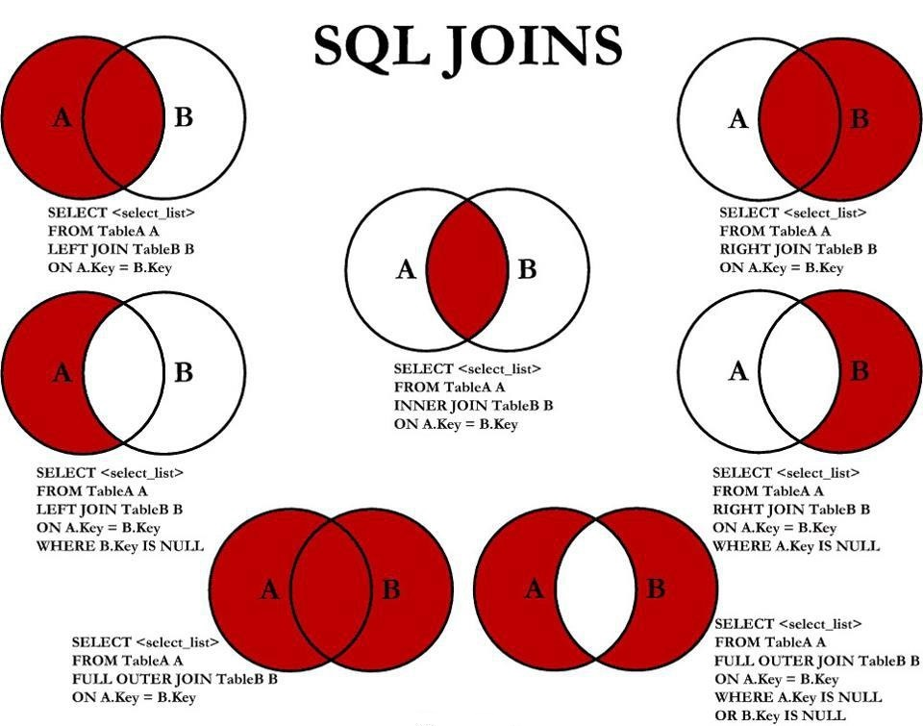
Joins
right
left
Inner/natural join
left outer join
Right outer join
Full outer join where only data with null returned
Full outer join where all data returned

Slide 5
Set Operations and Unions
Set operations are used to manipulate two result sets, or the results of two select statements.
Postgresql supports the UNION, INTERSECT and EXCEPT operations.
We can optionally use the ALL keyword with a set operation to select all duplicate values.
query1 UNION [optional ALL] query2
query1 INTERSECT [optional ALL] query2
query1 EXCEPT [optional ALL] query2

Slide 6
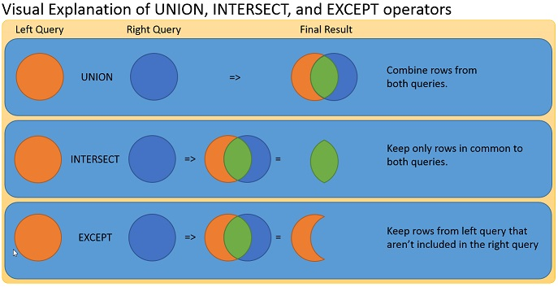
Unions

Slide 7
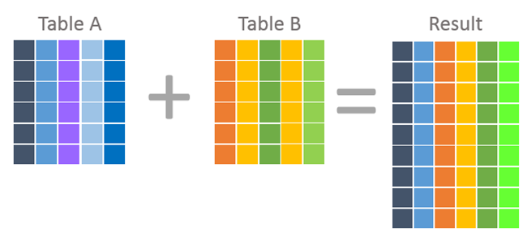
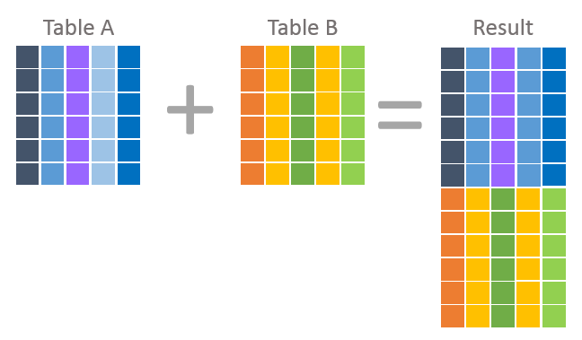
Joins vs Unions
Join statements will return a result which combines columns from each table
Unions will return a result which combines rows from each table

Slide 8
VIEWS
View of a query
CREATE VIEW my_view AS QUERY;
Then you can run queries on this view of the table.
You want to use these frequently.
They provide an interface through which to access your underlying tables.
Can be DROPed and can CREATE OR REPLACE in instances where the view may already exist.

Slide 9
Indexes
Indexes use an underlying data structure to speed up the process of querying commonly used columns
If you are querying a column very often, you might want to create an index
Otherwise, don’t create unnecessary indexes as they can cause more overhead
Two types: clustered and non-clustered
Clustered changes the records in memory, so you can only use one on any given table
Non-clustered sorts without physically moving data, so you can have multiple of these on any given table
All postgres indexes are non-clustered

Slide 10
DCL
Regulates access to data (security)
Protected by imposing restrictions (such as user permissions)
Core commands:
GRANT – give permissions to user/role
REVOKE – revoke permissions to user/role
Database admin is a predefined role

