Slide 1
Arrays, Loops, and Methods

Slide 2
Arrays
Arrays are collections of multiple values of the same type.
int[] : an array of integer values
String[] : an array of String references
Arrays have a fixed length, determined at creation
int[] myArray = new int[10]; // size-10 int array
This is because arrays reserve memory space. One int is 4 bytes, so an array of 10 ints reserves 40 bytes (plus some overhead). Reserved space is (usually) adjacent in memory.
Arrays can be pre-populated with values
int[] otherArr = {1, 5, 6}; // size-3 int array
Arrays are accessed by index, starting at ‘0’, through length-1.
System.out.println(otherArr[1]); // print 2nd element

Slide 3
Arrays continued
Can be created using literal notation:
{ 1, 90, -3}
{"Hi", "Hello", "Howdy"}
And using a constructor:
new int[3];
new String[3];
Can contain primitives or objects
Datatype[] variableName
Datatype variableName[]
String[] myArray= new String[5];
String[] another = {"Hello", "Hello", "Fun", "Another String"};
index
0 | "Hello"
1 | "Hello"
2 | "Fun"
3 | "Another string"
4 | 6

Slide 4
While Loops
while(conditional expression){
//Instructions }
So long as the condition is true continue the instructions
Be careful of infinite loops- they will not cause a compilation error
int x = 0;
while(x<3){
System.out.println(x); x++; }
Prints:
0 1
2

Slide 5
Do-While Loops
do{
//Instructions }while(conditional expression);
So long as the condition is true continue the instructions
Be careful of infinite loops- they will not cause a compilation error
Do-while loops will always run once
int x = 0;
do{
System.out.println(x); x++; }while(x<3);
Prints:
0 1
2

Slide 6
For Loops
for(initialization; condition; update){
//Instructions }
So long as the condition is true continue the instructions
Be careful of infinite loops- they will not cause a compilation error
The initialization statement is considered part of the loop's block
for(int x = 0; x<3; x++){
System.out.println(x); }
Prints:
0 1
2

Slide 7
Looping over Iterable Objects
for(variable : iterableObject){
//Instructions }
Variable takes on the value of each element in the iterableObject
This prevents an infinite loop
You typically define the variable within the parentheses
int[] myArray= {1,2,7};
for(int x : myArray){
System.out.println(x); }
Prints:
1 2
7

Slide 8
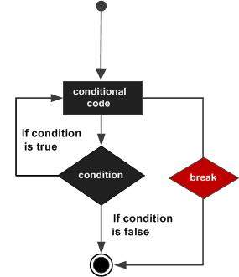
Break
The break statement is used to transfer control out of the enclosing statement. This statement can be used with while, do/while, for loops and switch statements.

Slide 9
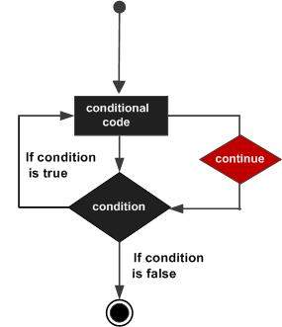
Continue
The continue statement is used to finish execution of the current, enclosing statement. This statement can be used with while, do/while, for loops and switch statements.

