Slide 1
Collection Framework Java

Slide 2
The Collection Interface
The Collection interface defines a set of behaviors common to all collections in Java
Except Maps…
https://docs.oracle.com/javase/8/docs/api/java/util/Collection.html
Collection-interface-collections can are generally different types of Lists, Sets, and Queues
List, Set, and Queue are their own interfaces as well

Slide 3
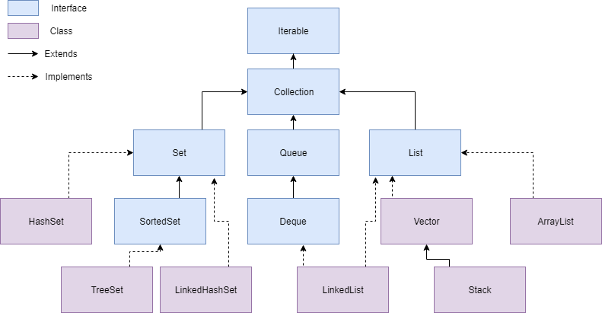
root
Ordered: how elements are stored
Sorting: placing elements depending on comparisons

Slide 4
Java Maps
Maps in Java do not implement the Collection interface or the Iterable interface
However, the keySet() and values() methods both return Iterable collections of all the keys and values in the Map, respectively.
You can iterate over a keyset to facilitate iterating through a map intuitively.

Slide 5
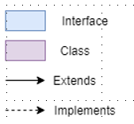
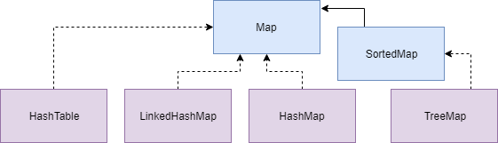
Map
Notice that Iterable is not extended.
Considered part of the Collections Framework but not the inheritance hierarchy

Slide 6
Collection vs Collections
Collection is an interface that declares mandatory behavior for collections
Collections is a utility class filled with static methods that can be run with Collection subclasses.
https://docs.oracle.com/javase/8/docs/api/java/util/Collections.html

Slide 7
Iterators
How do you traverse (retrieve each element in) a collection?
Lists: you can use the size() element to get the total number of elements, and get(int index) from 0 … size()
Sets and Queues don’t use an index though…
An Iterator is an interface that specifies the behavior of blindly moving through each element in a collection
Calling the iterator() method of a Collection returns an Iterator object capable of unidirectional “blind” navigation
Unidirectional: Can only move to the “next” element
Blind: no sorting is guaranteed, no telling what the “next” element is going to be

Slide 8
Iterable
The Iterable interface specifies the behavior for being able to return an Iterator.
Implementing classes must define the .iterator() method that returns an Iterator type object.
Implementing Iterable is mandatory for using an “enhanced for” loop
The Collection interface extends the Iterable interface. All Java collections are iterable/have iterators

Slide 9
Iterator/Enhanced For Loop Example
public void iterate(HashSet<String> someSet) {
Iterator<String> iter = someSet.iterator();
while (iter.hasNext()) {
String currentString = iter.next();
System.out.println(currentString);
}
}
public void enhancedFor(HashSet<String> stringSet) {
for(String s : stringSet)
System.out.println(s);
}

Slide 10
Comparing Collection Elements
When you need to sort a collection, you need to compare two elements at a time to evaluate which comes before or after the other.
Java has two interfaces for this: Comparable, and Comparator
Comparing two objects, A and B produces an int…
If A comes before B, the result should be less than 0
If A has the same place as B, the result should be 0
If A comes after B, the result should be greater than 0.
The specific output value is never guaranteed!

Slide 11
Comparable vs Comparator
Comparable is implemented by the object itself. It defines a single method for comparing an object against another
public interface Comparable<T> { int compareTo(T other); }
Comparator is implemented by a 3rd party class, and can define a single method for comparing two objects.
public interface Comparator<T> { int compare(T objectA, T objectB); }
Comparable defines a default comparison behavior for an object. Comparator defines custom behavior.

Slide 12
Comparable Example
public class Student implements Comparable<Student> {
int studentID;
String fist;
String last;
// The natural ordering of students is by
// Student ID.
public int compareTo(Student other) {
return this.studentID – other.studentID;
}
}

Slide 13
Comparator Example
public class Student implements Comparable<Student> {
int studentID;
String first;
String last;
}
public class NameComparator implements Comparator<Student> {
// Comparing students by their name involves sorting by
// last name, then first name. This is equivalent to
// reversing the full names and sorting alphabetically.
public int compare(Student stud_A, Student stud_B) {
String fullA = stud_A.last + “ “ + stud_A.first;
String fullB = stud_B.last + “ “ + stud_B.first;
return fullA.compareTo(fullB);
}
}

