Slide 1
Testing with JUnit and Mockito

Slide 2
Basics of Testing
Testing is a very broad term that encompasses many different strategies, levels and techniques.
Testing for expected behavior
Software testing can be done either:
Manually (by a human using the system)
automated by writing tests with code.
Generally, when we discuss software testing, we are referring to this approach.
You’ve probably already performed manual testing by simply running your application code, providing some user input, and manually observing the resulting behavior.
This kind of testing is effective but does not scale well as the size of an application increases to 100, 1000s or tens of thousands of lines of code.

Slide 3
Basics of Testing (cont…)
Any time you develop software, testing should be considered as a crucial component to your development process.
Testing should not be:
Optional
An afterthought
Strictly about ‘code coverage’
When creating and executing tests you should make sure that you:
Clarify any ambiguity in the requirements of the system
Ensure software meets expectations and helps achieve business objectives
Can easily identify areas that do not meet requirements
Quickly and easily make changes to the application and tests if needed
Assume product quality.
By testing, you ensure that the quality of your application even (or especially) as you refactor / add more complexity

Slide 4
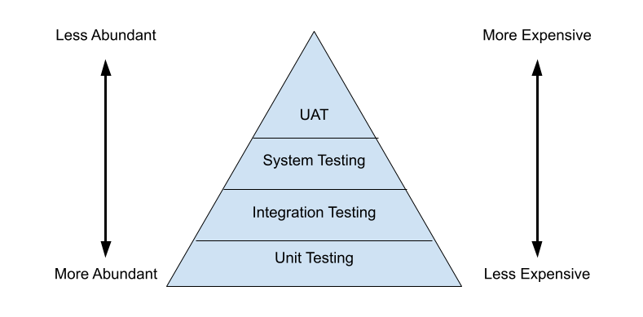
Testing Pyramid
Slower to test
System testing: end-to-end
Faster to test
When determining costs for tests, it is useful to keep the ‘Testing Pyramid’ in mind.
This is a visual representation of the cost vs abundance of tests based on certain “levels” of testing.
More tests exist at lower levels of the pyramid, than the top, because they exist at a lower level of abstraction.

Slide 5
Testing “Levels”
Unit Testing
Most Micro-level of testing
Test each component in isolation (without dependencies)
Usually requires mocking data
Unit testing tools include JUnit and Mockito
Integration Testing
Test components with dependencies
Check that certain components work with one another correctly
Logically related modules are tested as a group
Checking for errors in the interfacing between related larger units
Integration testing tools include selenium and protractor
System Testing
Test the entire application as a whole
Ensure the entire application works without errors
Usually done by team that isn’t dev team
User Acceptance Testing (UAT)
Test that all requirements are met
Simulate an end-user to guarantee that users can perform all the tasks required
Generally, UAT is handled by a physical user
Two forms of UAT exist: Alpha and Beta
Alpha Testing – First round of UAT (normally in-house builds and teams)
Beta testing – Generally, testing done ‘out-of-house’
Mocking db connection
Testing if connection works

Slide 6
Unit Testing
Unit Testing is the testing of individual software components in isolation from the rest of a system.
This is done by writing tests which execute the code on the individual units we want to inspect.
When the code under scrutiny deviates from an expected outcome or behavior, the test will fail.
If the test passes, this means that application performs as expected (unless there is a problem with the test itself).
Unit testing should never manipulate actual databases or use real data. It is the process of testing the functionality, without changing the actual environment.
In Java the most common unit testing framework is called JUnit.

Slide 7
Unit Testing
New Code
Once a developer adds more code, they need to write unit tests for the new code to ensure it is working properly
Alternatively, Tests can be written first if utilizing Test Driven Development
Refactoring
As projects grow and requirements change, code made need to be updated
Refactoring involves updating code on a later date and testing to make sure everything is still running smoothly or quickly find what causes tests to fail.
What is a Test Case?
A test case is a set of conditions or variables under which a tester will determine whether an application is working correctly
Once we break up our code into a unit, we can come up with test cases that will determine if the unit is working correctly.

Slide 8
JUnit
JUnit is an open-source java framework designed for the purpose of writing and running unit testing.
JUnit allows for the creation of both application code and test during development.
JUnit also provides a graphical user interface (GUI) which makes it possible to write and test source code quickly and easily.
JUnit shows test progress in a bar that starts green if testing is going fine, but turns red when a test fails.
Opinionated, wants code written in a certain way

Slide 9
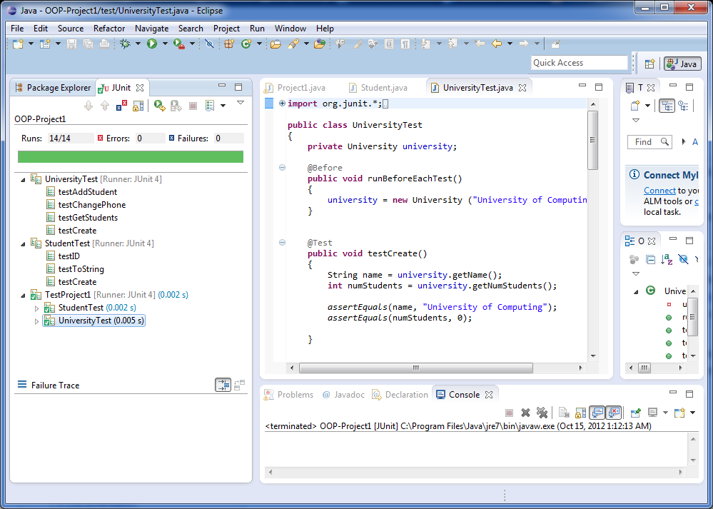
Junit Interface

Slide 10
JUnit Annotations
JUnit uses several annotations within the org.junit package that developers can use to create tests and setup test environments:
@Test – declares a method as a test method
@BeforeClass – declares a setup method that runs once, before all other methods in the class
@Before – declares a setup method that runs before each test method is run
@After – declares a ‘tear-down’ method that runs after each test method
@AfterClass – declares a ‘tear-down’ method that runs once, after all other methods in the class
@Ignore – declares that the proceeding test will not be run.
Used to check other test cases within a test class before refactoring individual test cases.
Annotations:
give info to ide and compiler so they understand something about the code that follows

Slide 11
JUnit Assertions
assertEquals() – Test to see if a return value is the same as an expected result
assertNotEquals() – Test to see if return value differs from an expected result
assertNull() – Test to see if an object/variable/etc… reference is null
assertNotNull() – Test to see if an object/variable/etc… has a non-null reference
assertArrayEquals() – Test to see if the values of an array match a provided array.
assertTrue() – Test to see if something is true
assertFalse() – Test to see if something is false

Slide 12
Stubs vs Mocks
Stubs provide a predetermined answer or response rather than recreating the behavior it is replacing.
A test mock is an object that mimics the behavior of a real object.
The primary goal of using a test mock is to verify the behavior of an object under test.
This approach to testing is also called Behavior Verification.
Tools such as Mockito give developers the ability to easily mock classes.
Test mocks are used to inject behavior where needed and verify the behavior of the code.

Slide 13
Mocks vs Stubs
// TEST STUBS:
public class Example {
public int sum(int... nums) {
int sum = 0;
for (int i : nums) {
sum += i;
}
return sum;
}
}
//Equivalent method stub:
public int sum() {
return 1;
}
// TEST MOCKS:
public class Example {
public int sum(int... nums) {
int sum = 0;
for (int i : nums) {
sum += i;
}
return sum;
}
}
//test mock:
public int ExampleMock extends Example {
// Override inherited methods here!
}

Slide 14
Mockito
Mockito is a mocking framework for unit tests in java that provides support for test stubs and test mocks.
It provides a simple API which allows for readable tests and simple verification errors.
Due to its simplicity, it is one of the most popular mocking libraries for Java.
Mockito eliminates the need to manually mock objects. All the developer has to do is specify the type they would like to mock and Mockito will create the requested mocks at runtime.
Mockito uses built-in annotations which make it easy to learn and use. Ex: @Mock
Provides simple behavior verification. For instance, keeping track of the number of times a method is called uses Mockito’s Verify() method.
Other mocking frameworks include: EasyMock, and JMockit.

Slide 15
Mockito Features
Mockito utilizes a simple annotation system for easy mocking:
@Mock – Annotation used to create mock classes
@InjectMocks – Annotation used to inject mocked classes into another class
initMocks() – Method used to initialize the mocked classes. For Mockito 4 and lower, this method must be invoked before mocks can be used.
Method Stubbing:
when() – The when method allows you to return canned/dummy results. This ensures that internal systems are preserved during unit testing.
Behavior Verification
verify() – Allows for the verification that code has been invoked correctly.
Include before class declaration:
@RunWith(MockitoJUnitRunner.class)

Slide 16
Test Driven Development
When developing software, it is important to ensure that most, if not all, of the code being written is tested to verify the functionality of the code.
One way to ensure this, is to follow a process called ‘test-driven development’ or TDD.
The TDD process consists of writing unit tests first, before the application code has been written. Then, code can be written to make the test pass, and the process can be completed for each piece of functionality required.

Slide 17
TDD Process
To follow a TDD process you would:
Write a unit test
Run the test => the test will fail
Fix the test by writing application code
Retest the code.
If the code fails: refactor the application code and test again
If the code does not fail: Repeat for the next test
Following the TDD process can be useful to ensure that a valid unit test always exists for any class or method that is written.
Later, when refactoring code, the unit tests give us confidence that we can change the source code without breaking functionality.
If we mess up somewhere, when the unit tests are run, we can pinpoint exactly where the problem lies.
This makes debugging much easier.

Slide 18
Logging

Slide 19
Logging Basics
What is Logging?
Logging refers to the act of recording granular events within an application, such as transactions with a database, exceptions or debugging events.
Generally logs are maintained by writing them to a file.
Logging ensures that developers can access important information about applications to which we do not have direct access.
Without logs, it is difficult to impossible to know what went wrong when an application crashes, or monitor the performance of an application

Slide 20
Logging with Log4J 2
Log4j is a reliable, fast and flexible logging framework for Java supported by Apache. It is commonly used to record application events and write them to a file.
We will explore the log4j 2, an updated version of the log4j architecture.
Log4j has a simple class architecture made of the following main components:
Logger – logs the messages
Appender – publishes logs to destination(s)
Layout – formats logging information
Configuration – stores settings
We don’t see this component in a configuration file, but we do see it in an XML file
Filter – used to filter logs that do not meet some threshold or are not required.

Slide 21
Configurations
Log4j 2 can be configured with a configuration file, or programmatically
Through a configuration file*
Log4j supports configuration using 4 different file formats:
XML file
JSON file
YAML file
*Properties file
Programmatic implementation can be done using:
A factory design pattern and creating a ConfigurationFactory with Configuration implementation
Calling APIs exposed in the configuration interface
Calling methods on the internal Logger class
*We will explore file configuration using a properties file.

Slide 22
Configurations – Maven
Maven Configurations:
<!-- https://mvnrepository.com/artifact/org.apache.logging.log4j/log4j-core -->
<dependency>
<groupId>org.apache.logging.log4j</groupId>
<artifactId>log4j-core</artifactId>
<version>2.14.0</version>
</dependency>

Slide 23
Configurations – properties file
name = PropertiesConfig
appenders = console, file
rootLogger.level = ALL
rootLogger.appenderRef.stdout.ref = STDOUT
appender.console.type = Console
appender.console.name = STDOUT
appender.console.layout.type = PatternLayout
appender.console.layout.pattern = %d{yyyy-MM-dd HH:mm:ss } %p %C{}:%L %m%n
appender.console.filter.threshold.type = ThresholdFilter
appender.console.filter.threshold.level = ALL
appender.file.type = File
appender.file.name = LOGFILE
appender.file.filename = logs/logfile.log
appender.file.layout.type = PatternLayout
appender.file.layout.pattern = %d{yyyy-MM-dd HH:mm:ss } %p %C{}:%L %m%n
appender.file.filter.threshold.type = ThresholdFilter
appender.file.filter.threshold.level = TRACE
logger.file.name = com.revature
logger.file.level = TRACE
logger.file.appenderRef.file.ref = LOGFILE

Slide 24
Configurations – properties file (cont…)
name = PropertiesConfig
appenders = console, file
rootLogger.level = ALL
rootLogger.appenderRef.stdout.ref = STDOUT
…
name – Name of the configuration file.
appenders – A list of the appenders configured
console – reference to the console area
file – reference to a file that information will be written to
rootLogger – configurations for default logging behaviors
level – the logging level.
appenderRef – reference to a particular, configured area in which we will log events.

Slide 25
Configurations – properties file (cont…)
…
appender.console.type = Console
appender.console.name = STDOUT
appender.console.layout.type = PatternLayout
appender.console.layout.pattern = %d{yyyy-MM-dd HH:mm:ss } %p %C{}:%L %m%n
appender.console.filter.threshold.type = ThresholdFilter
appender.console.filter.threshold.level = ALL
…
console – reference to console appender location.
type – classification for appender type
name – identifier for appender
layout – Formatting rules for logged information
Type – specification for the ruleset to use when parsing the layout pattern
Pattern – configuration for how information should be displayed in log messages.
ThresholdFilter – Specification for the type of filtering used. Logging events whose level falls below the threshold will not be recorded.
Level – the logging level.

Slide 26
Configurations – properties file (cont…)
…
appender.file.type = File
appender.file.name = LOGFILE
appender.file.filename = logs/logfile.log
appender.file.layout.type = PatternLayout
appender.file.layout.pattern = %d{yyyy-MM-dd HH:mm:ss } %p %C{}:%L %m%n
appender.file.filter.threshold.type = ThresholdFilter
appender.file.filter.threshold.level = TRACE
logger.file.name = com.revature
logger.file.level = TRACE
logger.file.appenderRef.file.ref = LOGFILE
file – reference to file appender location.
filename – name used to determine where log file will be stored.
logger – Reference for configuration for writing logging information to a file.
name – name of location for where file will be written. Should reflect your project settings i.e. your maven group-id
level – the logging level.
appenderRef – reference to named appender

Slide 27
Logging Levels
Log4j has various ‘log levels’ which determine the threshold for what information should be logged:
ALL => all levels
TRACE => finer-grained informational events than DEBUG
DEBUG => designates informational events that are most useful to debug an application
INFO => informational messages that highlight the progress of the application at the coarse-grained level
WARN => designates potentially harmful situations
ERROR => designates error events that might still allow the application to continue running
FATAL => severe error events that presumably lead the application to abort
OFF => highest possible level, intended to turn off logging

Slide 28
Logging Levels
The standard level for logs works in the following order:
ALL < TRACE < DEBUG < INFO < WARN < ERROR < FATAL < OFF
A log request of a level ‘x’ in a logger with a ‘y’ threshold enabled will be recorded when x is greater than or equal to y.
For instance, if the logging level is set to ‘warn’ and an ‘info’ log is requested, then that ‘info’ log will not be recorded since it does not meet the threshold.

Slide 29
Configurations – Usage
To utilize a logger, you must create a logger object (generally it is made static) using the LogManager class in Log4j.
Afterwards, you simply call the log object with the type of log you want, and include a message:
public class Example {
private static Logger log = LogManager.getLogger(Example.class);
public static void main(String[] args) {
log.info(“Main Method!");
log.error(“uh oh SpaghettiOs!");
}
public static void method() {
log.trace(“Trace Message”);
}
}

