Slide 1
Servlets Continued

Slide 2
Servlet Container
A servlet container manages the life cycle of a servlet.
Servlet is an interface defined in javax.servlet package.
A servlet container uses the Servlet interface to understand a specific Servlet object and manage it.

Slide 3
Life Cycle Steps
When the application server starts, servlet container loads all servlet classes
Container creates one instance of all servlet classes
Init() is invoked on servlets
Once a client request comes in for a particular resource, HTTPRequest and Response objects are created and passed to the container
The container passes the objects to the related servlet and calls that servlet’s service() method
Service method determines which request is received and calls appropriate method
Destroy() method is called at end of servlet’s life

Slide 4
Servlet Life Cycle Methods
init()
method is used to initialize the servlet
method is called only once
service()
Called each time a request for the servlet is received
calls doGet(), doPost(), doPut(), doDelete(), etc. methods as appropriate
destroy()
method is called only once at the end of the a servlet's life

Slide 5
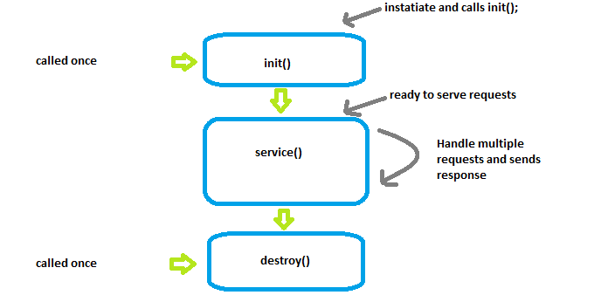
Lifecycle of a Servlet

Slide 6
HTTPServletRequest and HTTPServletResponse
Allow us to get information contained in the request and set information to include in the response
ServletRequest:
getParameter(“name_of_parameter”)
Returns a String
getParameterNames()
Returns an Enumeration of String values- Enumeration<String>
getParameterMap()
Returns Map<String, String[]>
getHeader("NAME_OF_HEADER")
Returns the value of the specified header
ServletResponse:
setHeader("NAME_OF_HEADER", "VALUE_OF_HEADER");
get…
getWriter
getOutputStream
sendRedirect(“path”);

Slide 7
Forward vs Redirect
Redirect
Client
/here
Server
You need to go to /there
/there
Can also redirect to another server
Forward
Client
/here
Server
/there
Resources must be in same server

Slide 8
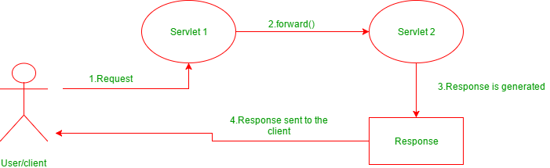
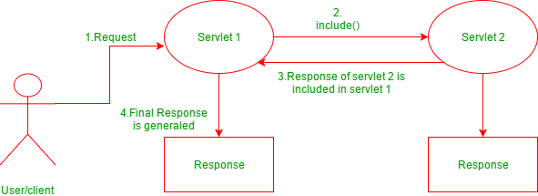
Request Dispatcher interface
forward(ServletRequest request, ServletResponse response)
passes a request from one servlet to another resource on the server
request and response are forwarded to the next resource which processes the data and returns the response to the client
include(ServletRequest request, ServletResponse response)
does not entirely transfer full control to the next resource (cannot change header)
includes the content of the original resource in the response returned to the client

Slide 9
Examples
// "request" is a HttpServletRequest Object and "hello.html" is a resoure name
RequestDispatcher rd = request.getRequestDispatcher("hello.html");
//includes the response of "hello.html" page in current servlet response
rd.include(request,response);
Example of using includes
// "request" is a HttpServletRequest Object and "hello.html" is a resoure name
RequestDispatcher rd = request.getRequestDispatcher("hello.html");
//forward the request and response to “hello.html" page
rd.forward(request,response);
Example of using forward

Slide 10
ServletConfig and Context
ServletConfig is a way to pass initialization parameters defined in the web.xml file into a servlet
After init() is called on the specific servlet, it gets its servletConfig object with any parameters
ServletContext is a way to pass initialization parameters defined in the web.xml file to all servlets
There should only be one per application

