Slide 1
Foundations

Slide 2
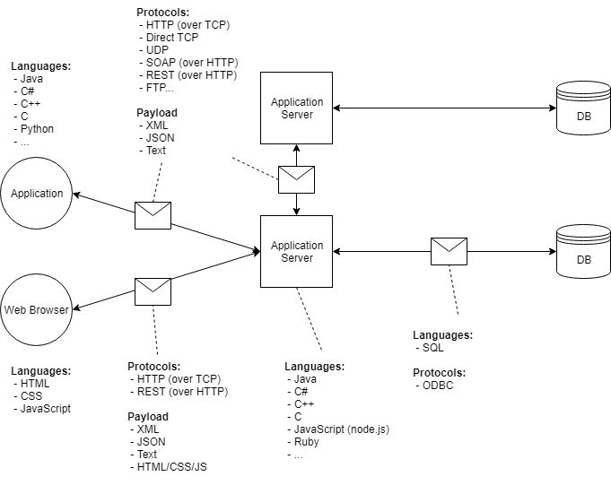
Client-Server-Database Architecture

Slide 3
Broad Categories of Languages
Binary
“0’s and 1’s”, lowest level language, not actually written
Assembly
Language used by the processor (CPU) to generate binary.
Compiled Languages
Written in plain text, so need to be transformed into another form that can be directly used by the CPU (Assembly) or another application (interpreted language)
Interpreted / Scripting Languages
Treated as a series of instructions by other software which in turn generates Assembly from it.
Interpreted languages are generally not human-readable, scripting languages are.
Markup Languages
Used by another application to give context to or describe static content. Not “programming” languages

Slide 4
Decimal Number System
Thousands | Hundreds | Tens | Ones
10³ | 10² | 10¹ | 10⁰
¹⁰⁰⁰ | ¹⁰⁰ | ¹⁰ | ¹

Slide 5
Binary Number System
2⁷ | 2⁶ | 2⁵ | 2⁴ | 2³ | 2² | 2¹ | 2⁰
¹²⁸ | ⁶⁴ | ³² | ¹⁶ | ⁸ | ⁴ | ² | ¹

Slide 6
Converting Between Them
3
0
6
8
7
Each non-zero digit represents a particular value
Add up those values and you get the total value
8 bits = 1 Byte
4 bits = nibble
0
9
1000 + 10 + 10
2
0
1
4
0
5
10³
10²
10¹
10⁰
1000
100
10
1
0
1
0
1
1
1
0
2⁷
2⁶
2⁵
2⁴
2³
2²
2¹
2⁰
128
64
32
16
8
4
2
1
256 total values
0 - 255

Slide 7
Signed Binary
1
1
266 total values:
Unsigned 0 to 255
1
Unsigned Binary
0
0
1
0
1
0
1
0
1
1
1
128
64
32
16
8
4
2
1
Values add up to 255
1
1
266 total values:
signed -128 to 127
1
1
0
1
1
0
1
0
1
signed Binary
Signing bit
64
32
16
8
4
2
1
Values add up to 127
https://www.exploringbinary.com/twos-complement-converter/

Slide 8
Computer Memory Structure
CPU
Temporary Storage
CPU Cache
RAM
Permanent Storage- Hard Disk

Slide 9
Why Use Java?
“Write Once, Run Anywhere”
JVM compiles Java to bytecode, translates bytecode to machine code
Java is “safe”
No memory management in Java
Java is free
Java has an incredibly rich library and frameworks

Slide 10
Source Code:
.java
javac command
JDK: Java Development Kit
JRE: Java Runtime Environment
Bytecode:
.class
JVM: Java Virtual Machine
JiT compilation
What the OS, operating system,
can actually understand
9

Slide 11
Hello World Program
HelloWorld.java
public class HelloWorld {
//This is a comment!
public static void main(String[] args) {
/* so is this */
System.out.println("Hello world!");
}
}
> cd FolderContainingProgram
> javac HelloWorld.java
> java HelloWorld
Find your program
Compile your program
Run your program
Cat and error

Slide 12
Classes and Objects
Classes either…
Serve the role of software module (collections of related methods and their necessary variables)
Represent real-world things
As software module:
Generally, only one instance created at a time (multiple instances for simultaneous work)
As real-world representation:
Each instance directly represents a single “thing”
Two cars of the same make/model, but different VINs, colors, etc.
POJO – Plain Ol’ Java Object

Slide 13
Executable Classes
A class with a specifically-declared main() method is “executable”
The JVM can invoke that method without creating an instance of the class first
public class HelloWorld { public static void main(String[] args) { System.out.println(“Hello World!”); } }
An application usually only has 1 executable class. This is the “entry point” where processing starts.

Slide 14
Categories of Variables
All variables only hold a single value
Primitives reserve a fixed amount of memory to hold a single value of a specific type
and then everything else are Reference variables…
Primitive types
Whole Numbers
byte
short
***char
int
long
Decimal Numbers
float
double
Other
boolean

Slide 15
What about converting between variables?
Most conversions must be done explicitly- we cast from one type into a variable of another
Technically only down casting must be explicit– if we are going up in size or up the inheritance tree we can do it cast implicitly
long l = 9l;
int s = (int)l;

Slide 16
More on Variables and Naming Things
You can declare multiple variables in one statement
You can initialize zero or all of them in the same statement as well
There must only be 1 type declaration
Legal identifiers:
Must start with a letter, $, or _
Can contain numbers (but cannot start with a number)
Cannot be a single underscore
camelCase and SNAKE_CASE are preferred in Java
SNAKE_CASE is used with constants or enums
camelCase is used with methods or variables
CamelCase is used with class names or constructor name

