Slide 1
DESTINATION: OHIO
CYNTHIA RODRIGUEZ DSI-822

Slide 2

PROBLEM STATEMENT
I work for TourismOhio, where our mission statement is to “aggressively position Ohio as a relevant travel destination and support Ohio’s tourism industry to drive economic prosperity throughout the state.” We saw a 21% drop in visitor spending in 2020, but rebounded in 2021, and we are now trying to continue the growth momentum with more relevant ads and offers.
To do this, I’ve first been asked to scrape social media sites and find out what people are saying about our state and why they may or may not visit so that we can adapt our advertisements to our target audiences. I am starting on Reddit, with what I believe to be two relevant subreddit pages:

Slide 3
PROBLEM STATEMENT
I work for TourismOhio, where our mission statement is to “aggressively position Ohio as a relevant travel destination and support Ohio’s tourism industry to drive economic prosperity throughout the state.” We saw a 21% drop in visitor spending in 2020, but rebounded in 2021, and we are now trying to continue the growth momentum with more relevant ads and offers.
To do this, I’ve first been asked to scrape social media sites and find out what people are saying about our state and why they may or may not visit so that we can adapt our advertisements to our target audiences. I am starting on Reddit, with what I believe to be two relevant subreddit pages:
- Ohio: Created on October 4, 2008, with 342k members
- IHateOhio: Created on September 28, 2018, with 4.6k members

Slide 4
PROBLEM STATEMENT
I work for TourismOhio, where our mission statement is to “aggressively position Ohio as a relevant travel destination and support Ohio’s tourism industry to drive economic prosperity throughout the state.” We saw a 21% drop in visitor spending in 2020, but rebounded in 2021, and we are now trying to continue the growth momentum with more relevant ads and offers.
To do this, I’ve first been asked to scrape social media sites and find out what people are saying about our state and why they may or may not visit so that we can adapt our advertisements to our target audiences. I am starting on Reddit, with what I believe to be two relevant subreddit pages:
- Ohio: Created on October 4, 2008, with 342k members
- IHateOhio: Created on September 28, 2018, with 4.6k members
Before I can analyze the messages or make any recommendations, I need to be able to pull posts from each of these threads into an aggregated data frame. My goal is to build a classification model that can predict, with at least 85% accuracy, which subreddit each post is from.

Slide 5
PREPROCESSING
Undersampling

Slide 6
PREPROCESSING
Undersampling
Null replacement

Slide 7
PREPROCESSING
Undersampling
Null replacement
URL removal

Slide 8
PREPROCESSING
Undersampling
Null replacement
URL removal
Features created

Slide 9
PREPROCESSING
Undersampling
Null replacement
URL removal
Features created
Stop words added

Slide 10
PREPROCESSING
Undersampling
Null replacement
URL removal
Features created
Stop words added
Lemmatization

Slide 11
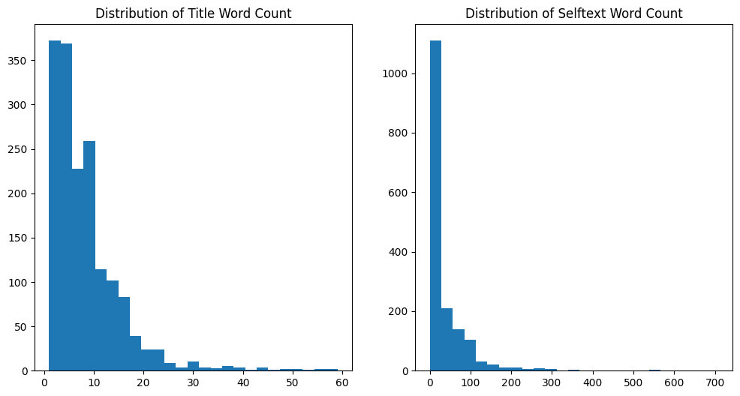
WORD COUNT DISTRIBUTION

Slide 12
QUICK STATS
Mean r/Ohio title word count: 8.75
Mean r/IHateOhio title word count: 8.06

Slide 13
QUICK STATS
Mean r/Ohio title word count: 8.75
Mean r/IHateOhio title word count: 8.06
Mean r/Ohio selftext word count: 58.37
Mean r/IHateOhio selftext word count: 9.96

Slide 14
QUICK STATS
Mean r/Ohio title word count: 8.75
Mean r/IHateOhio title word count: 8.06
Mean r/Ohio selftext word count: 58.37
Mean r/IHateOhio selftext word count: 9.96
Users who posted in both subreddits: 1

Slide 15
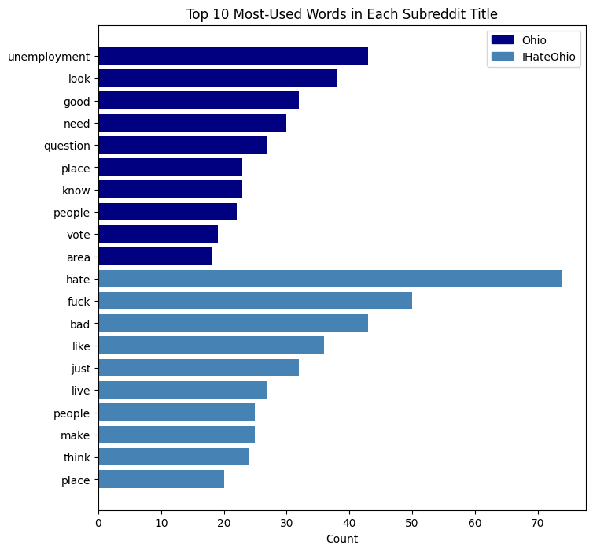
English and custom stop words removed
Ohio words are more information-focused and specific
IHateOhio words are more descriptive
One shared word: people

Slide 16
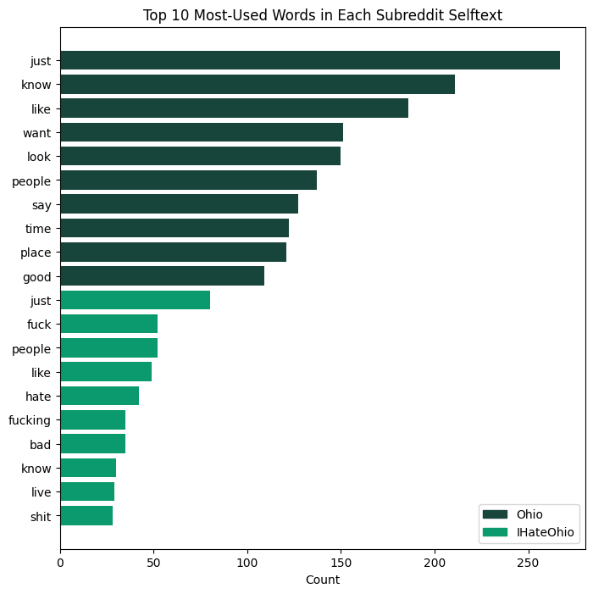
Ohio words are similar to those seen in title chart
IHateOhio words are again more negative
Four shared words: just, know, like, people

Slide 17
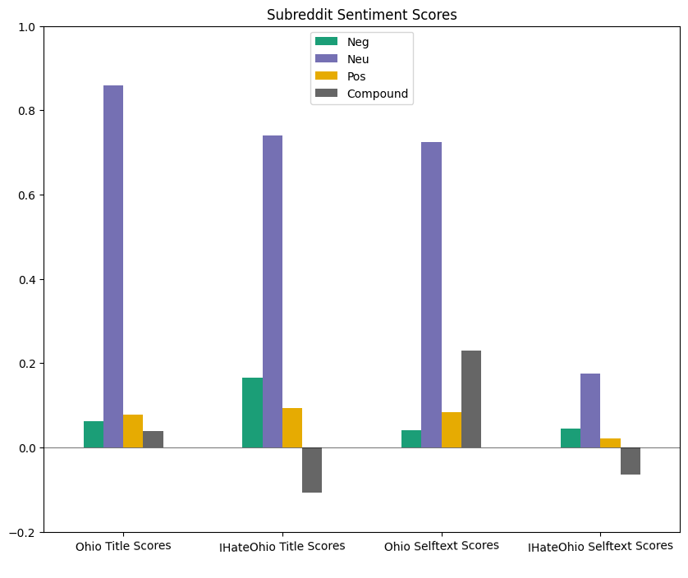
All sections rank highest for neutrality
IHateOhio Title compound score: -0.107
Ohio Selftext compound score: 0.229

Slide 18
MODEL TRIALS
Baseline score: 0.522

Slide 19
MODEL TRIALS
Baseline score: 0.522
No hyperparameters added

Slide 20
MODEL TRIALS
Baseline score: 0.522
No hyperparameters added
18 models built

Slide 21
MODEL TRIALS
Baseline score: 0.522
No hyperparameters added
18 models built
Selftext outscored title in all models except one

Slide 22
MODEL TRIALS
Baseline score: 0.522
No hyperparameters added
18 models built
Selftext outscored title in all models except one
Average train score: 0.8647

Slide 23
MODEL TRIALS
Baseline score: 0.522
No hyperparameters added
18 models built
Selftext outscored title in all models except one
Average train score: 0.8647
Average test score: 0.7500

Slide 24
MODEL TRIALS
Baseline score: 0.522
No hyperparameters added
18 models built
Selftext outscored title in all models except one
Average train score: 0.8647
Average test score: 0.7500
Minimum test score: 0.522

Slide 25
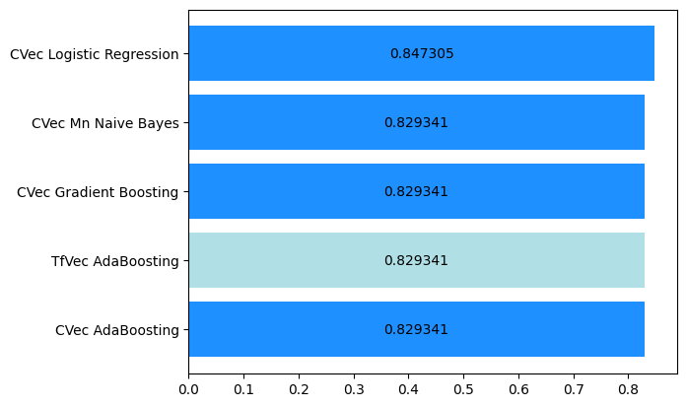
TOP-SCORING MODELS

Slide 26
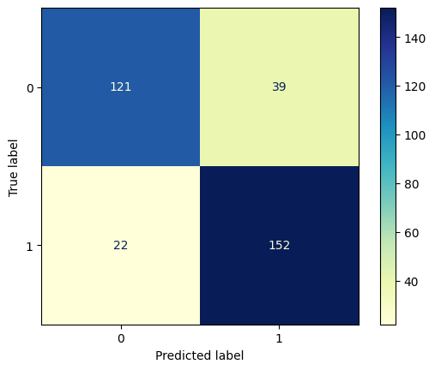


MISCLASSIFICATIONS

Slide 27
MISCLASSIFICATIONS
Empty strings

Slide 28
MISCLASSIFICATIONS
Empty strings
Positive words out of context
Post text | Pred class | True class
for the love of god someone save me the allergens are killing me and it was snowy until april | Ohio | IHateOhio
my wife is from ohio, i'm from eastern pa. multiple times a year i have to drive into that hell hole and pretend that terrible pizza is good pizza. f**k ohio pizza, f**k ohio. | Ohio | IHateOhio

Slide 29
MISCLASSIFICATIONS
Empty strings
Positive words out of context
Post text | Pred class | True class
for the love of god someone save me the allergens are killing me and it was snowy until april | Ohio | IHateOhio
my wife is from ohio, i'm from eastern pa. multiple times a year i have to drive into that hell hole and pretend that terrible pizza is good pizza. f**k ohio pizza, f**k ohio. | Ohio | IHateOhio

Slide 30
MISCLASSIFICATIONS
Empty strings
Positive words out of context
Locations
Post text | Pred class | True class
hey i’m born and raised in ohio its f**king awful here we have nothing but corn and cleveland | Ohio | IHateOhio
i absolutely hate ohio. that stupid state. it's shaped like a f**king deformed square, doesn't even have anything special about it compared to chad states like texas | Ohio | IHateOhio

Slide 31
MISCLASSIFICATIONS
Empty strings
Positive words out of context
Locations
Post text | Pred class | True class
hey i’m born and raised in ohio its f**king awful here we have nothing but corn and cleveland | Ohio | IHateOhio
i absolutely hate ohio. that stupid state. it's shaped like a f**king deformed square, doesn't even have anything special about it compared to chad states like texas | Ohio | IHateOhio

Slide 32
MODEL TUNING SUMMARY
GridSearchCV used to test hyperparameters

Slide 33
MODEL TUNING SUMMARY
GridSearchCV used to test hyperparameters
26 trial and 3 stacked models built

Slide 34
MODEL TUNING SUMMARY
GridSearchCV used to test hyperparameters
26 trial and 3 stacked models built
Average train score: 0.89367

Slide 35
MODEL TUNING SUMMARY
GridSearchCV used to test hyperparameters
26 trial and 3 stacked models built
Average train score: 0.89367
Average test score: 0.82381

Slide 36
MODEL TUNING SUMMARY
GridSearchCV used to test hyperparameters
26 trial and 3 stacked models built
Average train score: 0.89367
Average test score: 0.82381
Best-scoring model: CountVectorizer Multinomial Naïve Bayes, 0.86228 test score

Slide 37
MODEL CONCLUSIONS
Minimum threshold score of 0.85 was met
Feature importance did not provide any valuable information
Reddit is not useful for identifying places or experiences in Ohio that an advertisement team could build on
Overall, full project statement goal was not achieved

Slide 38
NEXT STEPS
Pull data from websites like TripAdvisor or Yelp

Slide 39
NEXT STEPS
Pull data from websites like TripAdvisor or Yelp
Add in more custom stop words to filter the data

Slide 40
NEXT STEPS
Pull data from websites like TripAdvisor or Yelp
Add in more custom stop words to filter the data
Further model trials with a focus on decreasing variance

Slide 41
NEXT STEPS
Pull data from websites like TripAdvisor or Yelp
Add in more custom stop words to filter the data
Further model trials with a focus on decreasing variance
Implementation of best-scoring model

Slide 42
NEXT STEPS
Pull data from websites like TripAdvisor or Yelp
Add in more custom stop words to filter the data
Further model trials with a focus on decreasing variance
Implementation of best-scoring model
Advise the marketing team

