Slide 1
REMOTE WORK LOCATION RECOMMENDER
Cynthia Rodriguez

Slide 2
AGENDA
01
02
DATA WRANGLING
EXPLORATORY DATA ANALYSIS
03
04
FUNCTION BUILDING
STREAMLIT APPLICATION
Collecting, cleaning, and combining the data.
Looking for notable features and similarities between datasets.
Converting user input to values that can be fed into a recommender system.
Creating a usable app with multiple functions implemented.

Slide 3
PROBLEM STATEMENT
I work at ABC Marketing, Inc. and we just signed Airbnb as our latest client.
They’ve asked us to build a web application that is easy to use and will drive repeat traffic to their website.

Slide 4
PROBLEM STATEMENT
I work at ABC Marketing, Inc. and we just signed Airbnb as our latest client.
They’ve asked us to build a web application that is easy to use and will drive repeat traffic to their website.
Given that Forbes has projected 25% of all professional jobs in North America will be remote by the end of 2022, our goal is to create a ready-for-launch remote work location recommendation system that drives users directly to Airbnb’s page.

Slide 5
01
DATA WRANGLING

Slide 6
COLLECTING THE DATA
Datasets used:
Airbnb Listings
Airbnb data for listings in 30 US locations.
Restaurant Chains
Mapped data of 705,621 independent and chain restaurants across the US.
Cost of Living/Socioeconomic Stats
Cost of living compared the US average (overall and specific spending categories), population, median age, political lean in 2020 election.
Temperature Trends
Average monthly temperature for each location.
Rain Trends
Average monthly rain for each location.
Walkability
Walkability index, auto and transit access indices, and percent of people who do not own a vehicle.

Slide 7
CLEANING THE DATA
Airbnb Price Outliers
Removed listings with prices greater than 99th percentile or less than 1st percentile

Slide 8
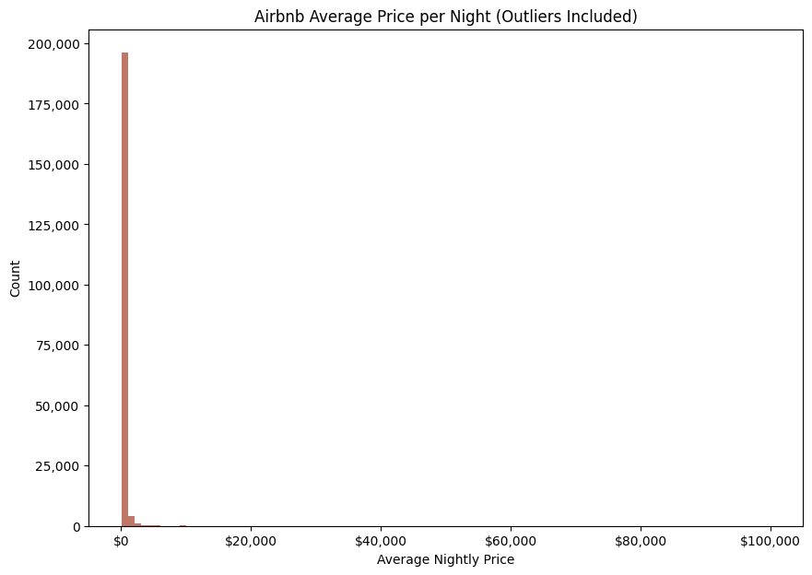

Slide 9
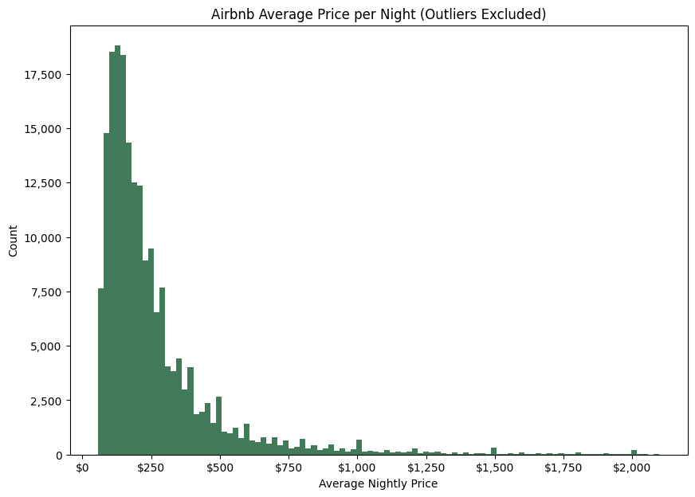

Slide 10
CLEANING THE DATA
Airbnb price outliers
Removed listings with prices greater than 99th percentile or less than 1st percentile
Airbnb listing types
Working under the assumption that users looking for long-term WFH stays would be looking at ‘entire home/apartment’ listings only

Slide 11
CLEANING THE DATA
Airbnb price outliers
Removed listings with prices greater than 99th percentile or less than 1st percentile
Airbnb listing types
Working under the assumption that users looking for long-term WFH stays would be looking at ‘entire home/apartment’ listings only
Converting datasets to same scale
The Airbnb, walkability, and chain datasets were neighborhood-specific, while all others were city-specific; some imputing required

Slide 12
CLEANING THE DATA
Airbnb price outliers
Removed listings with prices greater than 99th percentile or less than 1st percentile
Airbnb listing types
Working under the assumption that users looking for long-term WFH stays would be looking at ‘entire home/apartment’ listings only
Converting datasets to same scale
The Airbnb, walkability, and chain datasets were neighborhood-specific, while all others were city-specific; some imputing required
Removed pre-filled nulls
Some nulls had been imputed by the data providers; dropped these observations or replaced the values

Slide 13
02
EXPLORATORY DATA ANALYSIS

Slide 14
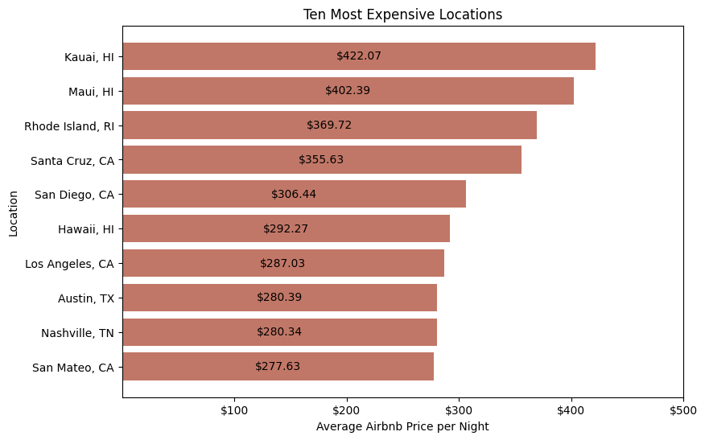
WHICH LOCATIONS HAVE THE MOST EXPENSIVE AIRBNB LISTINGS?

Slide 15
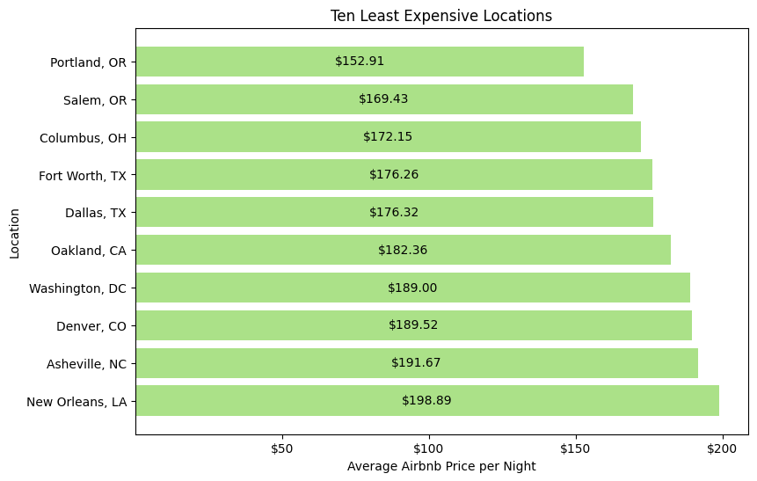
WHICH LOCATIONS HAVE THE LEAST EXPENSIVE AIRBNB LISTINGS?

Slide 16
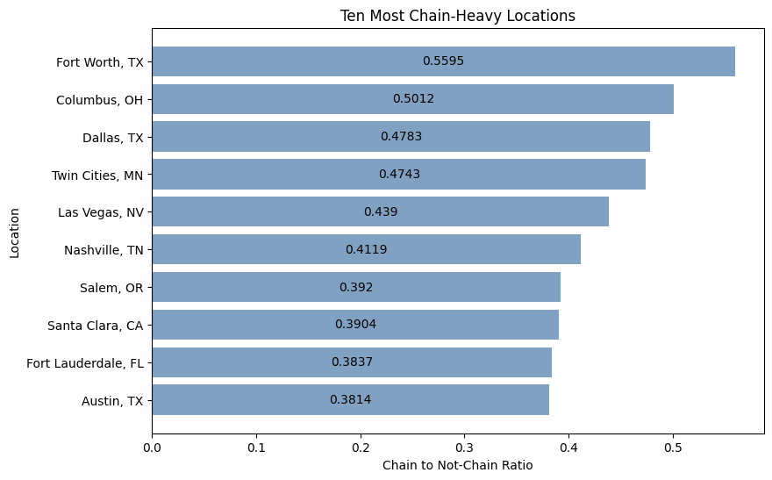
WHICH LOCATIONS HAVE THE HIGHEST RATIOS OF CHAIN RESTAURANTS?

Slide 17
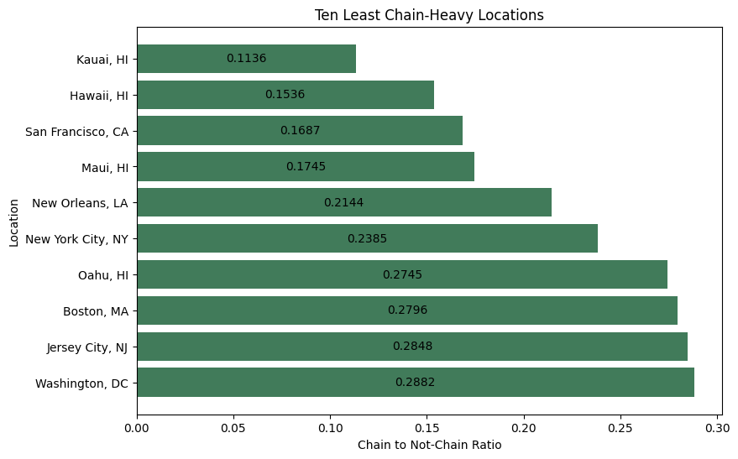
WHICH LOCATIONS HAVE THE LOWEST RATIOS OF CHAIN RESTAURANTS?

Slide 18
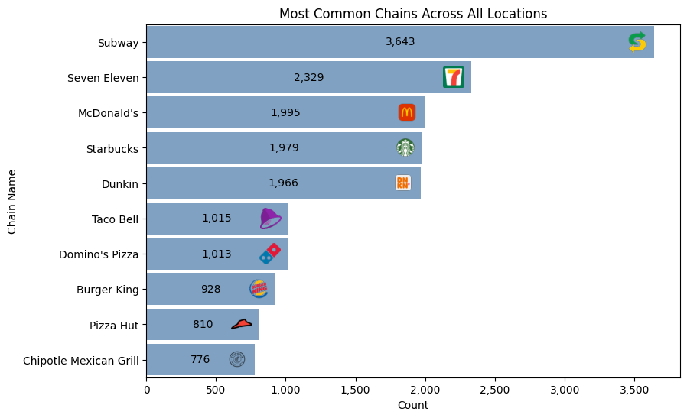
WHAT ARE THE MOST COMMON CHAINS ACROSS ALL LOCATIONS?

Slide 19
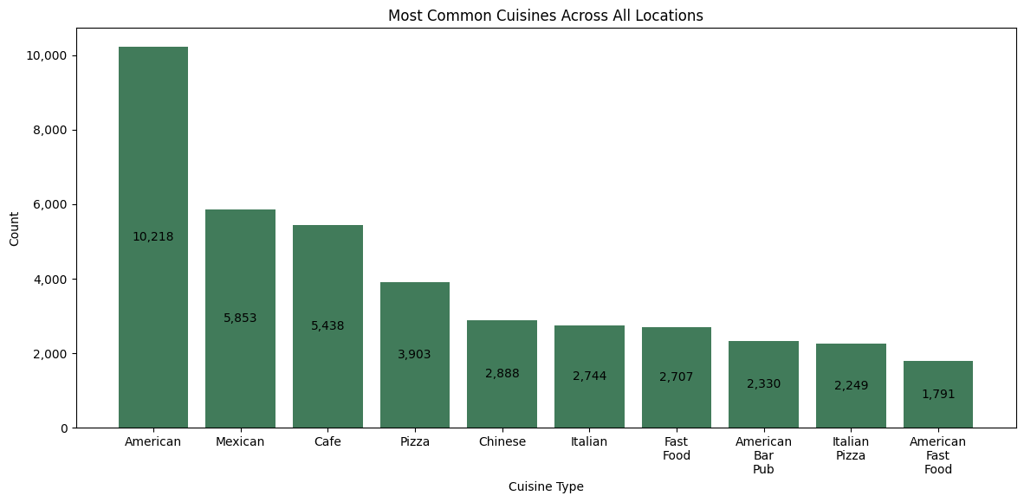
WHAT ARE THE MOST COMMON CUISINES ACROSS ALL LOCATIONS?

Slide 20
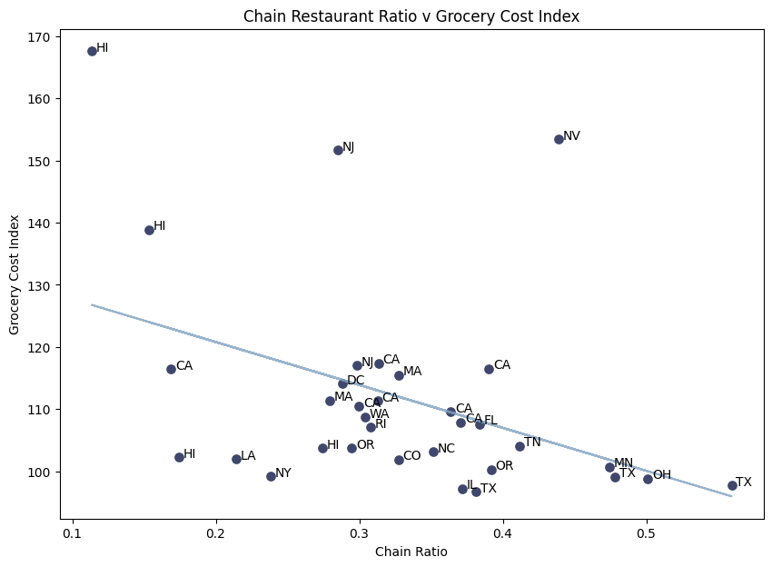
ARE THERE MORE CHAINS IN LOCATIONS WHERE THE GROCERY COST INDEX IS HIGHER?

Slide 21
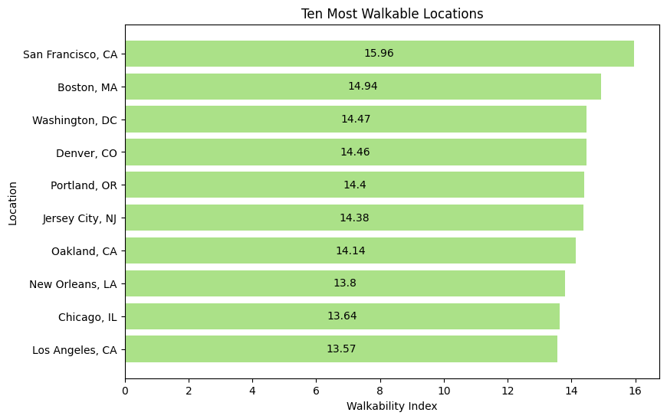
WHICH LOCATIONS HAVE THE HIGHEST WALKABILITY INDICES?

Slide 22
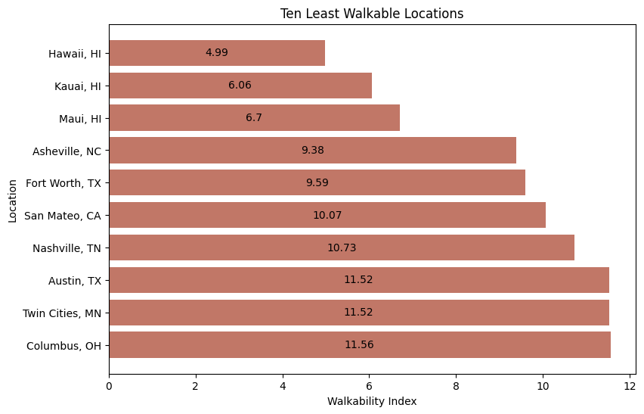
WHICH LOCATIONS HAVE THE LOWEST WALKABILITY INDICES?

Slide 23
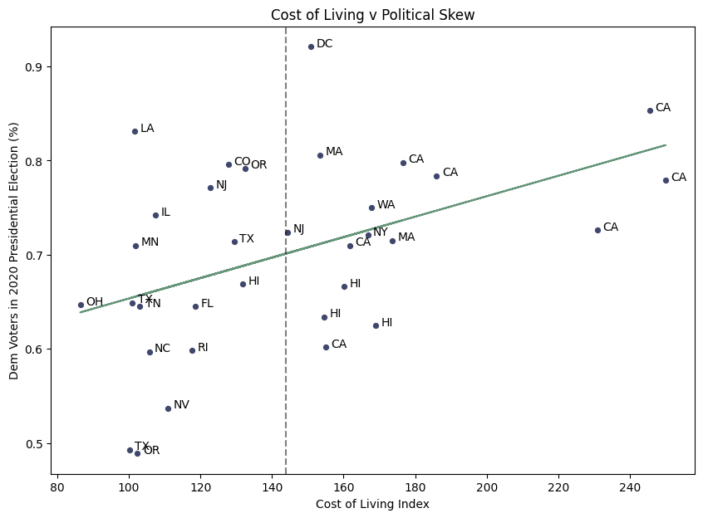
DO WE SEE A RELATIONSHIP BETWEEN COST OF LIVING AND POLITICAL LEAN?

Slide 24
03
FUNCTION BUILDING

Slide 25
FUNCTION BUILDING
User Input Conversion
Meant to take in responses from a live user and convert into usable metrics.

Slide 26
FUNCTION BUILDING
User Input Conversion
Meant to take in responses from a live user and convert into usable metrics.
Cosine Similarity for Single Recommendation
Finds the single location with the nearest cosine similarity and returns as a recommendation.

Slide 27
FUNCTION BUILDING
User Input Conversion
Meant to take in responses from a live user and convert into usable metrics.
Cosine Similarity for Single Recommendation
Finds the single location with the nearest cosine similarity and returns as a recommendation.
Cosine Similarity for Multiple Recommendations
Finds the five locations with nearest cosine similarity and returns all five in recommendation.

Slide 28
FUNCTION BUILDING
User Input Conversion
Meant to take in responses from a live user and convert into usable metrics.
Cosine Similarity for Single Recommendation
Finds the single location with the nearest cosine similarity and returns as a recommendation.
Cosine Similarity for Multiple Recommendations
Finds the five locations with nearest cosine similarity and returns all five in recommendation.
KMeans Cluster for Randomized Recommendation
Uses KMeans to group the locations, then returns a random recommendation from the list of locations that were in the same cluster.

Slide 29
FUNCTION BUILDING
User Input Conversion
Meant to take in responses from a live user and convert into usable metrics.
Cosine Similarity for Single Recommendation
Finds the single location with the nearest cosine similarity and returns as a recommendation.
Cosine Similarity for Multiple Recommendations
Finds the five locations with nearest cosine similarity and returns all five in recommendation.
KMeans Cluster for Randomized Recommendation
Uses KMeans to group the locations, then returns a random recommendation from the list of locations that were in the same cluster.

Slide 30
04
STREAMLIT APPLICATION

Slide 31
STREAMLIT APP BUILDING
What was helpful?

Slide 32
STREAMLIT APP BUILDING
What was helpful?
A lot of features are templatized

Slide 33
STREAMLIT APP BUILDING
What was helpful?
A lot of features are templatized
Easy importing of dataframes and functions

Slide 34
STREAMLIT APP BUILDING
What was helpful?
A lot of features are templatized
Easy importing of dataframes and functions
Different ways of collecting user input

Slide 35
STREAMLIT APP BUILDING
What was helpful?
A lot of features are templatized
Easy importing of dataframes and functions
Different ways of collecting user input
Syntax is intuitive

Slide 36
STREAMLIT APP BUILDING
What was helpful?
What were the obstacles?
A lot of features are templatized
Easy importing of dataframes and functions
Different ways of collecting user input
Syntax is intuitive

Slide 37
STREAMLIT APP BUILDING
What was helpful?
What were the obstacles?
A lot of features are templatized
Easy importing of dataframes and functions
Different ways of collecting user input
Syntax is intuitive
A lot of features are templatized

Slide 38
STREAMLIT APP BUILDING
What was helpful?
What were the obstacles?
A lot of features are templatized
Easy importing of dataframes and functions
Different ways of collecting user input
Syntax is intuitive
A lot of features are templatized
Page reloads after any value modification by user

Slide 39
STREAMLIT APP BUILDING
What was helpful?
What were the obstacles?
A lot of features are templatized
Easy importing of dataframes and functions
Different ways of collecting user input
Syntax is intuitive
A lot of features are templatized
Page reloads after any value modification by user
Clearing page after submission

Slide 40
STREAMLIT APP BUILDING
What was helpful?
What were the obstacles?
A lot of features are templatized
Easy importing of dataframes and functions
Different ways of collecting user input
Syntax is intuitive
A lot of features are templatized
Page reloads after any value modification by user
Clearing page after submission
Adding personalization

Slide 41
05
CONCLUSIONS AND NEXT STEPS

Slide 42
CONCLUSIONS
Combining multiple datasets comes with challenges
Some datasets were pulled at the neighborhood-specific level of each location, while others were pulled at the city level
This does slightly diminish the interpretability of our findings

Slide 43
CONCLUSIONS
Combining multiple datasets comes with challenges
Some datasets were pulled at the neighborhood-specific level of each location, while others were pulled at the city level
This does slightly diminish the interpretability of our findings
There are likely patterns in the data that were overlooked
Unable to fully explore each dataset due to timeline and scope of project
Probable that trends exist within the data that could be useful in web app/functions

Slide 44
CONCLUSIONS
Combining multiple datasets comes with challenges
Some datasets were pulled at the neighborhood-specific level of each location, while others were pulled at the city level
This does slightly diminish the interpretability of our findings
There are likely patterns in the data that were overlooked
Unable to fully explore each dataset due to timeline and scope of project
Probable that trends exist within the data that could be useful in web app/functions
The app works, but could be improved
While we were able to build an application that provides and recommendation and directs users toward the Airbnb website, there are a few necessary revisions before presenting to the client and going to market

Slide 45
NEXT STEPS
Additional locations
Ideally, there would be various cities recommended from every state and eventually, international locations
NLP on the Airbnb listing names and descriptions
Run the words used in each listing name and description through Count Vectorizer/Tfidf, and from there, generate a list of selected words the user can choose from that match their preferences
More data
Local communities and activities (e.g. music scene if user wants to live somewhere that has multiple venues or more opportunities to see live music), nightlife, population diversity, etc.

