Slide 1
WFH RECOMMENDER TITLE PLACEHOLDER
Cynthia Rodriguez

Slide 2
AGENDA
01
02
DATA WRANGLING
EXPLORATORY DATA ANALYSIS
03
04
FUNCTION BUILDING
STREAMLIT APPLICATION
Collecting, cleaning, and combining the data.
Looking for notable features and similarities between datasets.
Converting user input to values that can be fed into a recommender system.
Creating a usable app with multiple functions implemented.

Slide 3
BACKGROUND
SOME BACKGROUND

Slide 4
PROBLEM STATEMENT
SOME TEXT

Slide 5
01
DATA WRANGLING

Slide 6
COLLECTING THE DATA
Datasets used:
Airbnb Listings
Airbnb data for listings in 30 US locations.
Restaurant Chains
Mapped data of 705,621 independent and chain restaurants across the US.
Cost of Living/Socioeconomic Stats
Cost of living compared the US average (overall and specific spending categories), population, median age, political lean in 2020 election.
Temperature Trends
Average monthly temperature for each location.
Rain Trends
Average monthly rain for each location.
Walkability
Walkability index, auto and transit access indices, and percent of people who do not own a vehicle.

Slide 7
CLEANING THE DATA
Airbnb Price Outliers
Removed listings with prices greater than 99th percentile or less than 1st percentile

Slide 8
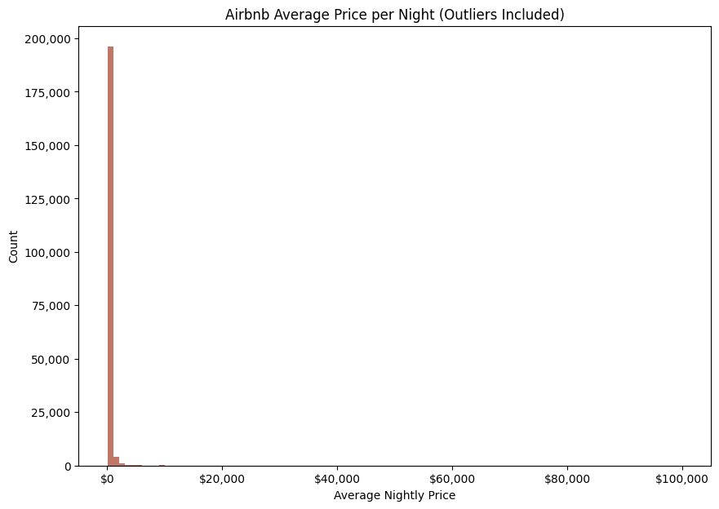

Slide 9
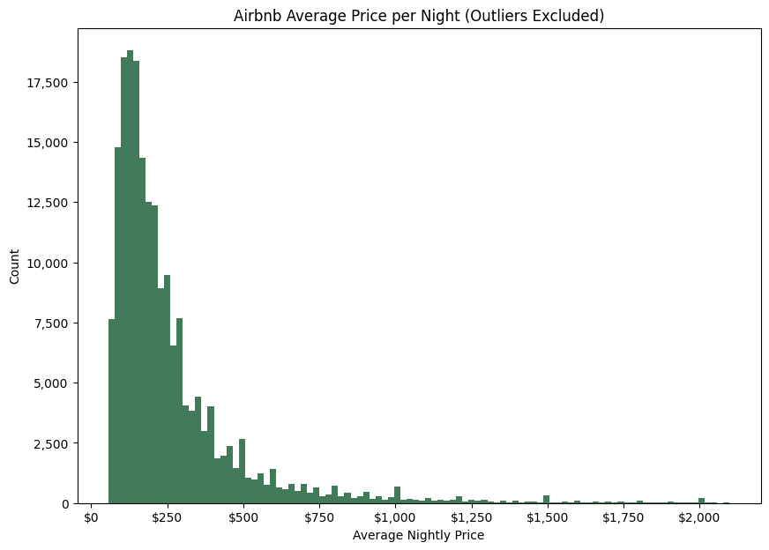

Slide 10
CLEANING THE DATA
Airbnb price outliers
Removed listings with prices greater than 99th percentile or less than 1st percentile
Airbnb listing types
Working under the assumption that users looking for long-term stays would be looking at ‘entire home/apartment’ listings only

Slide 11
CLEANING THE DATA
Airbnb price outliers
Removed listings with prices greater than 99th percentile or less than 1st percentile
Airbnb listing types
Working under the assumption that users looking for long-term stays would be looking at ‘entire home/apartment’ listings only
Converting datasets to same scale
The Airbnb and walkability datasets were neighborhood-specific, while all others were city-specific; some imputing required

Slide 12
CLEANING THE DATA
Airbnb price outliers
Removed listings with prices greater than 99th percentile or less than 1st percentile
Airbnb listing types
Working under the assumption that users looking for long-term stays would be looking at ‘entire home/apartment’ listings only
Converting datasets to same scale
The Airbnb and walkability datasets were neighborhood-specific, while all others were city-specific; some imputing required
Removed pre-filled nulls
Some nulls had been imputed by the data providers; dropped these observations or replaced the values

Slide 13
COLLECTING DATA
What worked
What didn’t work
Finding data for all neighborhoods in each location

Slide 14
02
EXPLORATORY DATA ANALYSIS

Slide 15
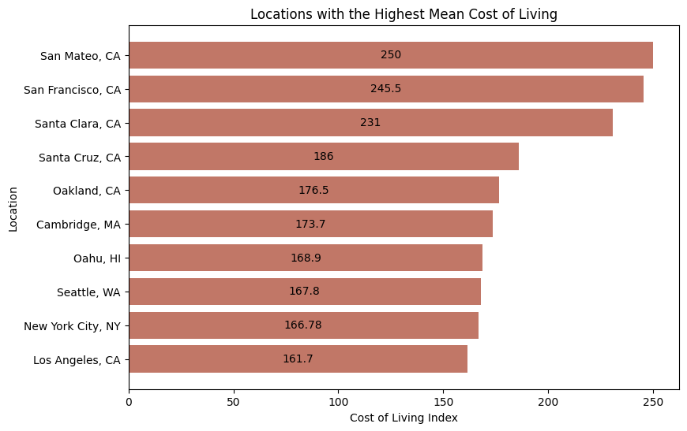
WHICH LOCATIONS HAVE THE HIGHEST COST OF LIVING?

Slide 16
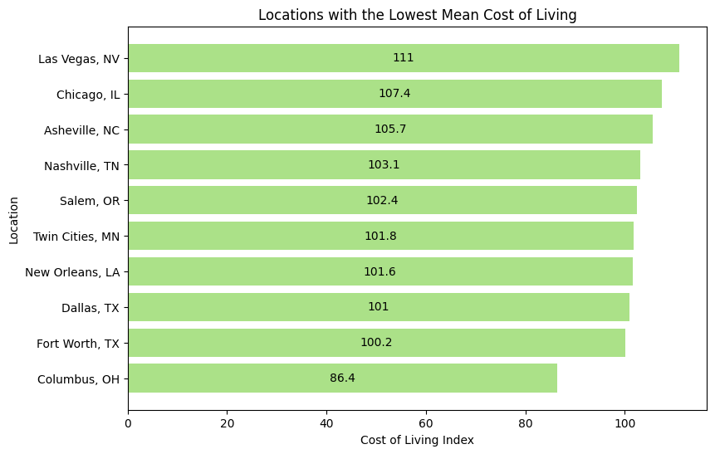
WHICH LOCATIONS HAVE THE LOWEST COST OF LIVING?

Slide 17
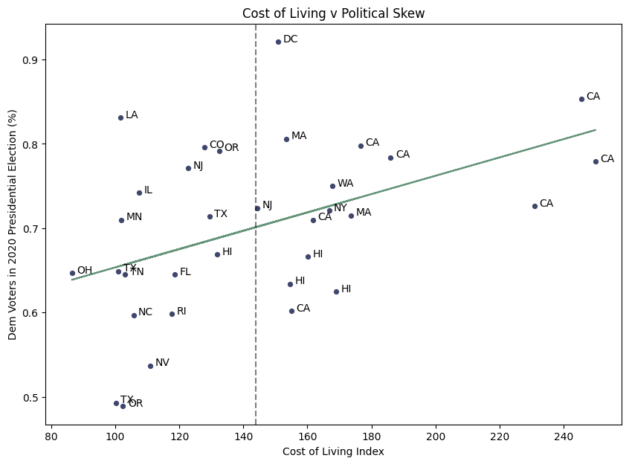
DO WE SEE A RELATIONSHIP BETWEEN COST OF LIVING AND POLITICAL LEAN?

Slide 18
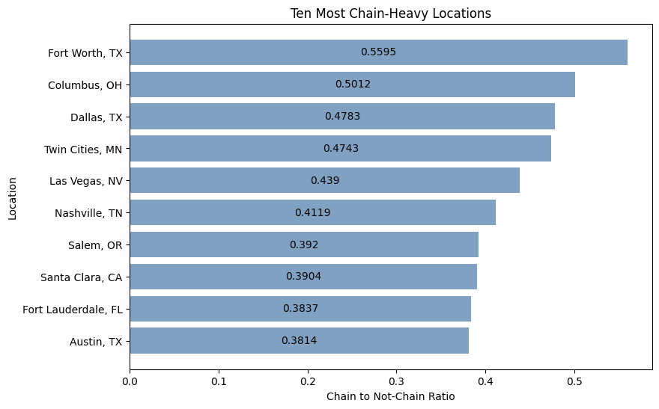
WHICH LOCATIONS HAVE THE HIGHEST RATIOS OF CHAIN RESTAURANTS?

Slide 19
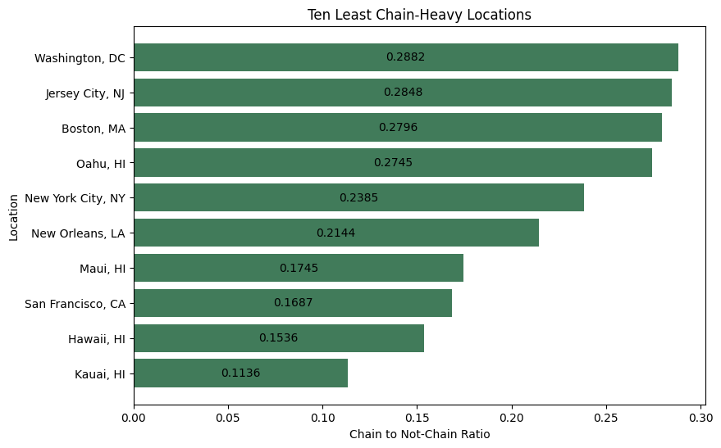
WHICH LOCATIONS HAVE THE LOWEST RATIOS OF CHAIN RESTAURANTS?

Slide 20
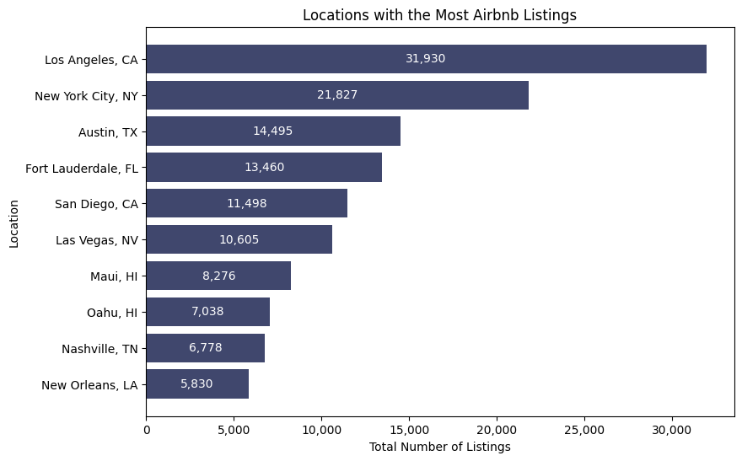
WHICH LOCATIONS HAD THE MOST AIRBNB LISTINGS OVERALL?

Slide 21
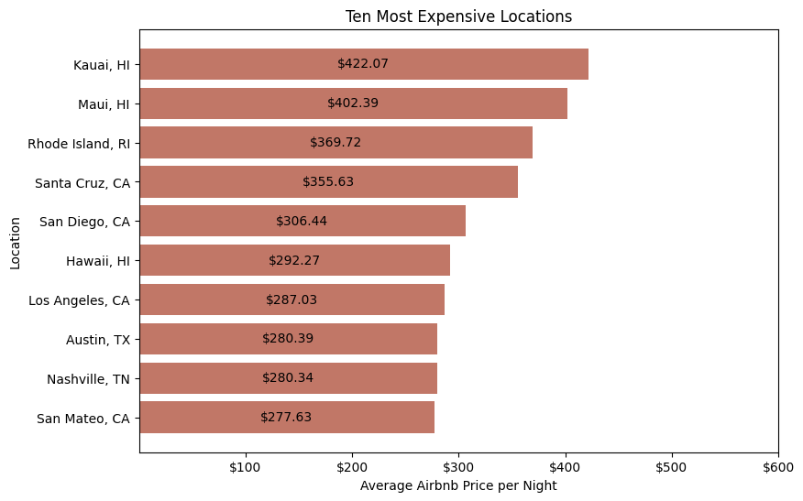
WHICH LOCATIONS HAD THE MOST EXPENSIVE AIRBNB LISTINGS?

Slide 22
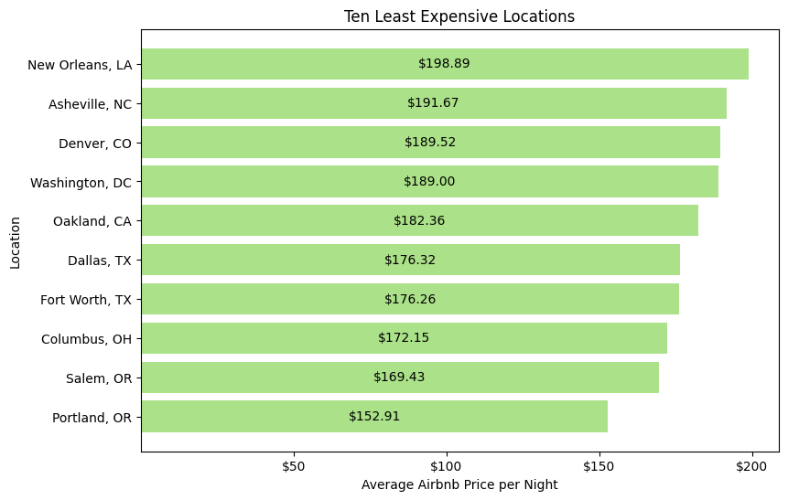
WHICH LOCATIONS HAD THE LEAST EXPENSIVE AIRBNB LISTINGS?

Slide 23
03
FUNCTION BUILDING

Slide 24
FUNCTION BUILDING
What worked

Slide 25
04
STREAMLIT APPLICATION

Slide 26
STREAMLIT APP BUILDING
What was helpful?

Slide 27
STREAMLIT APP BUILDING
What was helpful?
A lot of features are templatized

Slide 28
STREAMLIT APP BUILDING
What was helpful?
A lot of features are templatized
Easy importing of dataframes and functions

Slide 29
STREAMLIT APP BUILDING
What was helpful?
A lot of features are templatized
Easy importing of dataframes and functions
Different ways of collecting user input

Slide 30
STREAMLIT APP BUILDING
What was helpful?
A lot of features are templatized
Easy importing of dataframes and functions
Different ways of collecting user input
Syntax is intuitive

Slide 31
STREAMLIT APP BUILDING
What was helpful?
What were the obstacles?
A lot of features are templatized
Easy importing of dataframes and functions
Different ways of collecting user input
Syntax is intuitive

Slide 32
STREAMLIT APP BUILDING
What was helpful?
What were the obstacles?
A lot of features are templatized
Easy importing of dataframes and functions
Different ways of collecting user input
Syntax is intuitive
A lot of features are templatized

Slide 33
STREAMLIT APP BUILDING
What was helpful?
What were the obstacles?
A lot of features are templatized
Easy importing of dataframes and functions
Different ways of collecting user input
Syntax is intuitive
A lot of features are templatized
Page reloads after any value modification by user

Slide 34
STREAMLIT APP BUILDING
What was helpful?
What were the obstacles?
A lot of features are templatized
Easy importing of dataframes and functions
Different ways of collecting user input
Syntax is intuitive
A lot of features are templatized
Page reloads after any value modification by user
Clearing page after submission

Slide 35
STREAMLIT APP BUILDING
What was helpful?
What were the obstacles?
A lot of features are templatized
Easy importing of dataframes and functions
Different ways of collecting user input
Syntax is intuitive
A lot of features are templatized
Page reloads after any value modification by user
Clearing page after submission
Adding personalization

Slide 36
05
CONCLUSION AND NEXT STEPS

Slide 37
CONCLUSIONS
Combining multiple datasets comes with challenges
Interpretation can be diminished, and difficult to ensure consistency
All data was needed for this project, but combining several seems to have added a lot of time and allowed more room for inconsistencies (easy to validate the credibility of one dataset, difficult to evaluate multiple against each other)
Pros and cons of unsupervised learning
Functions are evaluated mostly on whether they run properly, but this makes it difficult to know if and where there may be room for improvement
The app works, but could be improved
Did I achieve the problem statement???

Slide 38
NEXT STEPS
Added locations
Ideally, there would be a recommended city in every state and eventually, international locations
NLP on the Airbnb listing names and descriptions
Run the words used in each listing name and description through Count Vectorizer/Tfidf, then have a list of selected words that the user can choose from that match their preferences
More data to provide more tailored recommendations
Local communities and activities (e.g. music scene if user wants to live somewhere that has multiple venues or more opportunities to see live music), nightlife, population diversity, etc.

