Slide 1
Magnetic Resonance Imaging homework 1 Adviser : JTENG-YI Hwang Reporter ：HSIN-YU CHEN
講師 課程

Slide 2
Outline
Software
Introduction to FSLView
FSLView – 3D mode

Slide 3
Software
VMware Player 12.0.0
Ubuntu 15.04
FSL

Slide 4
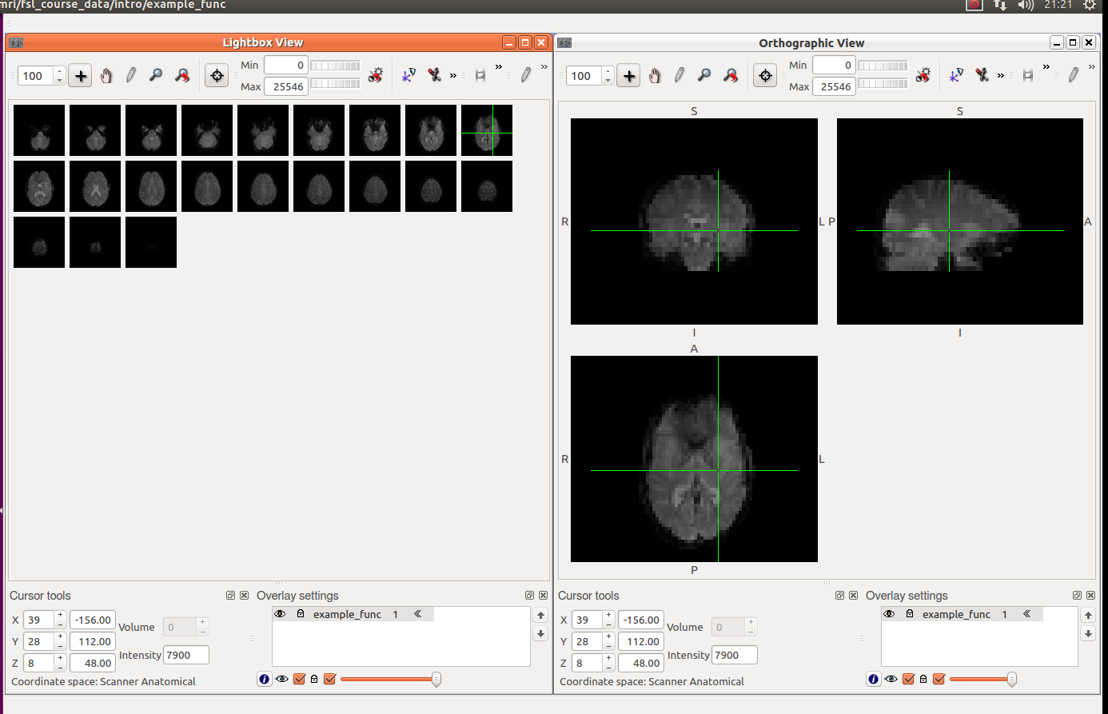
Introduction to FSLView

Slide 5
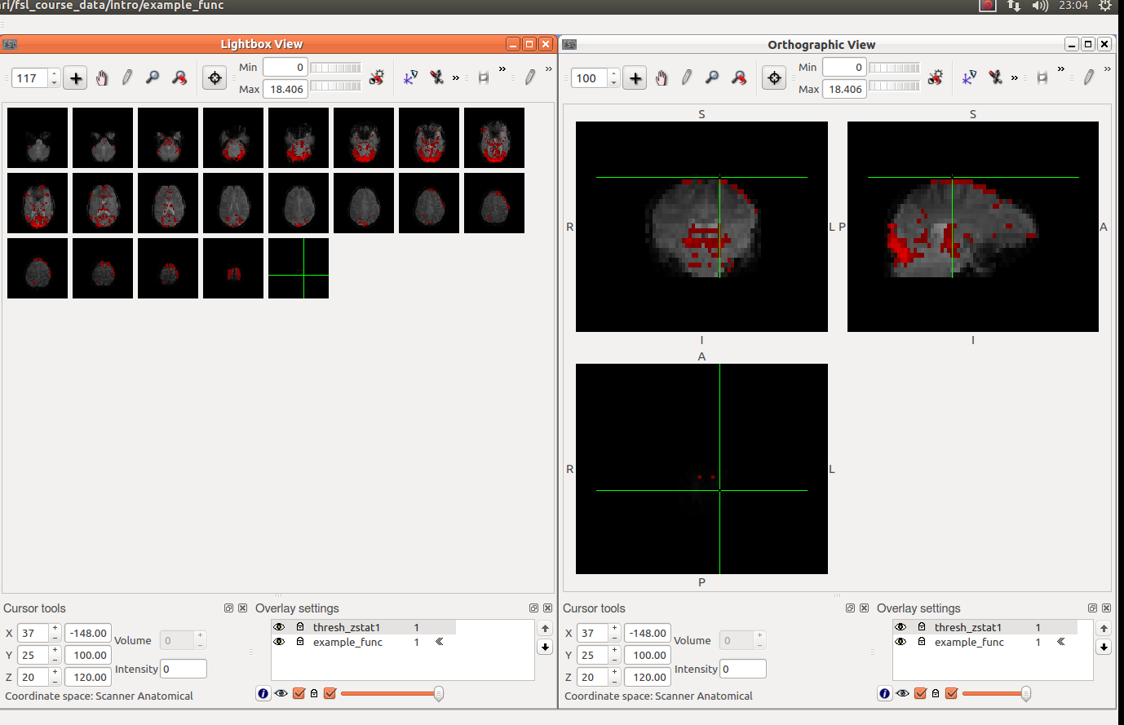
Introduction to FSLView

Slide 6
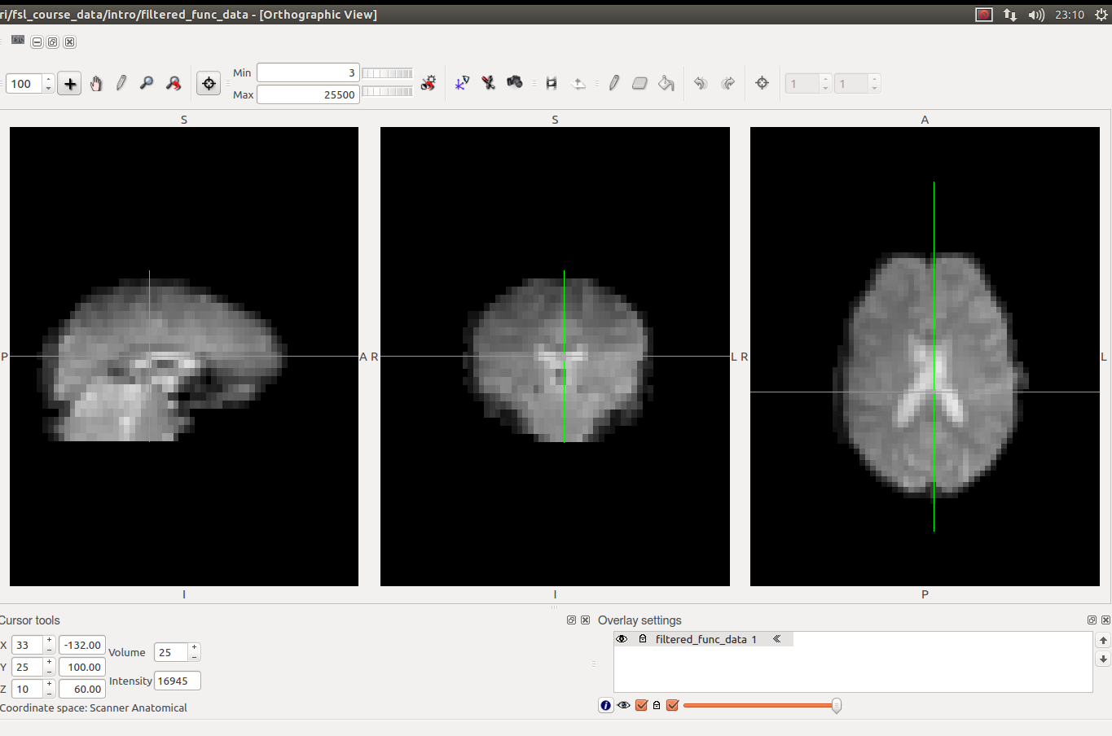
Introduction to FSLView

Slide 7
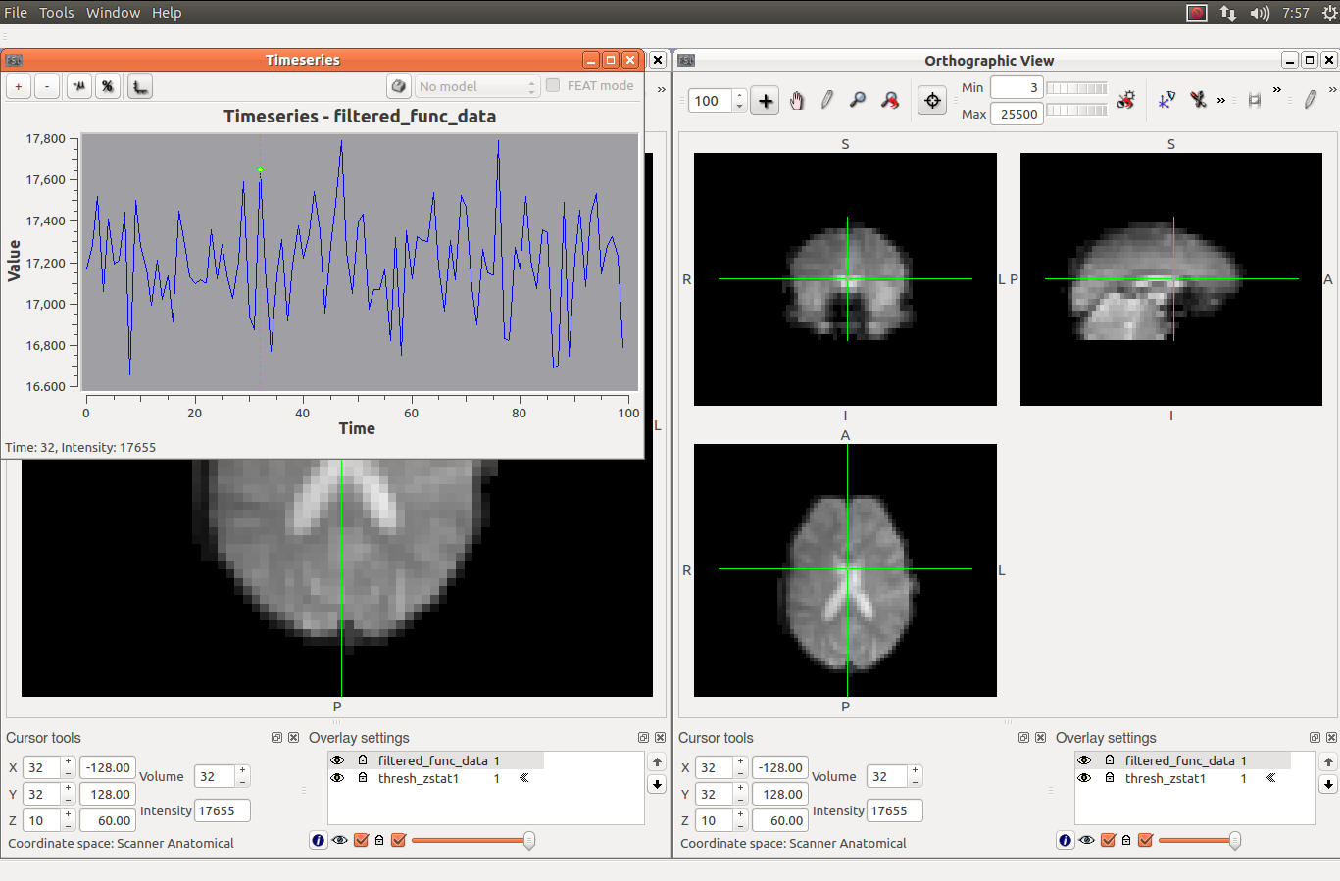
Introduction to FSLView

Slide 8
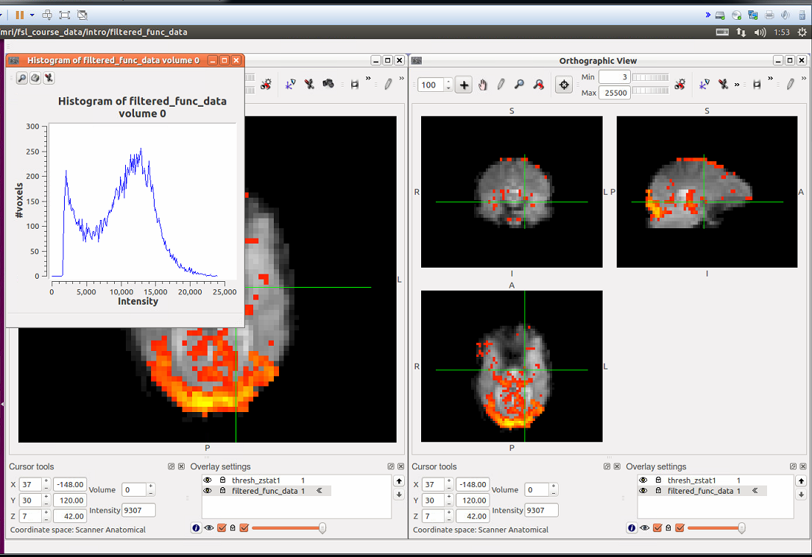
Introduction to FSLView

Slide 9
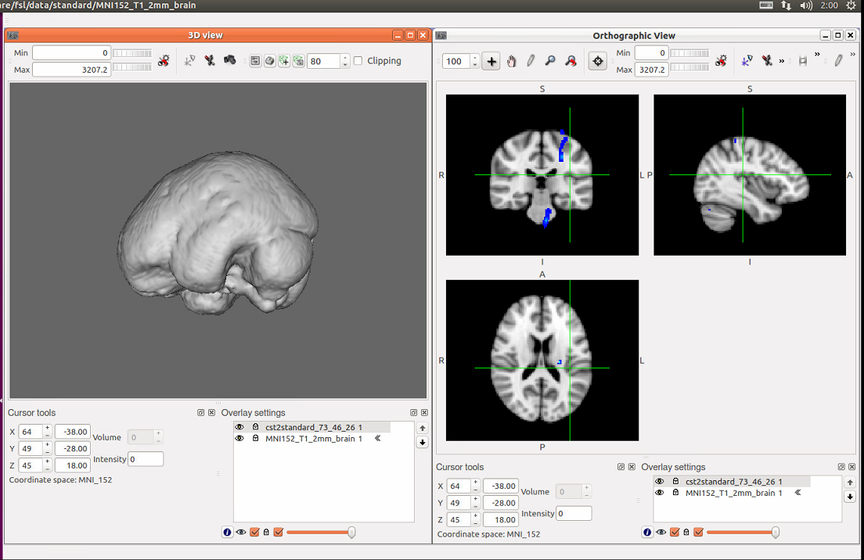
FSLView – 3D mode

Slide 10
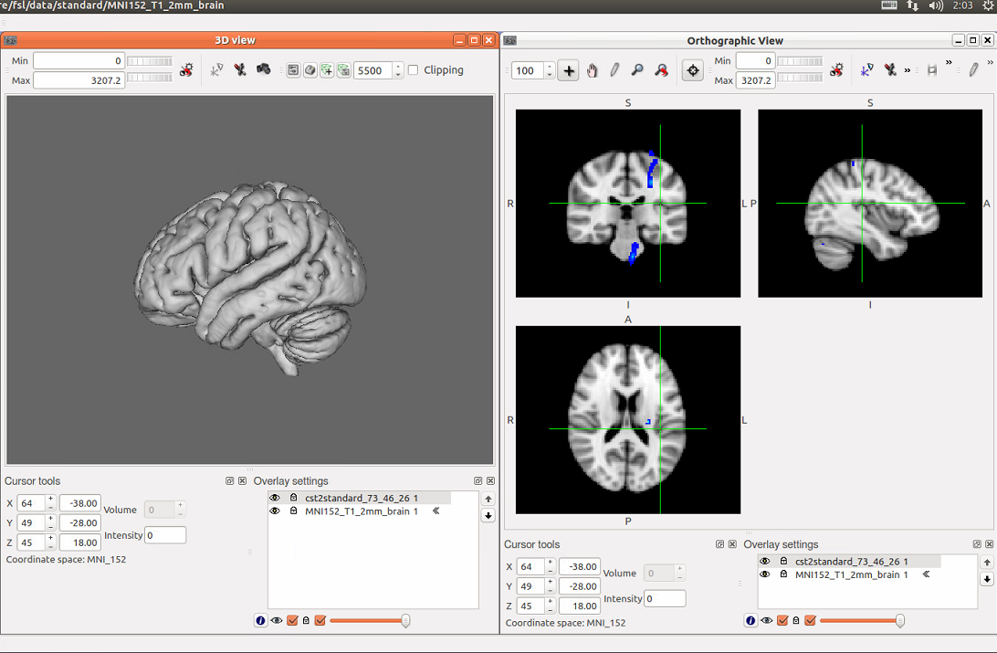
FSLView – 3D mode

Slide 11
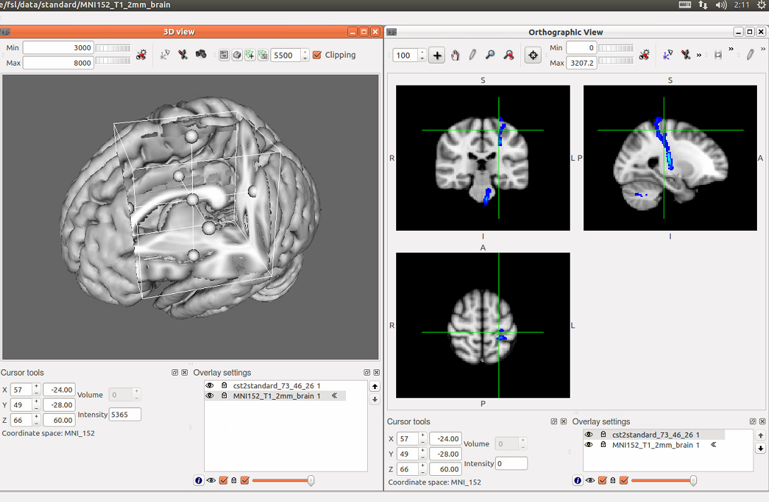
FSLView – 3D mode

Slide 12
Thanks for your attention

