Slide 1
Reuse your custom ggplot2 with transparent helper functions!
Cynthia A. Huang

Slide 2
ggplot2 & calendars?

Slide 3
❤️

Slide 4
Notes:
So when I wanted to procrasti-plot a calendar of an upcoming research trip across Europe and USA two years ago instead of working on my thesis, I naturally searched for a ggplot2 extension

Slide 5
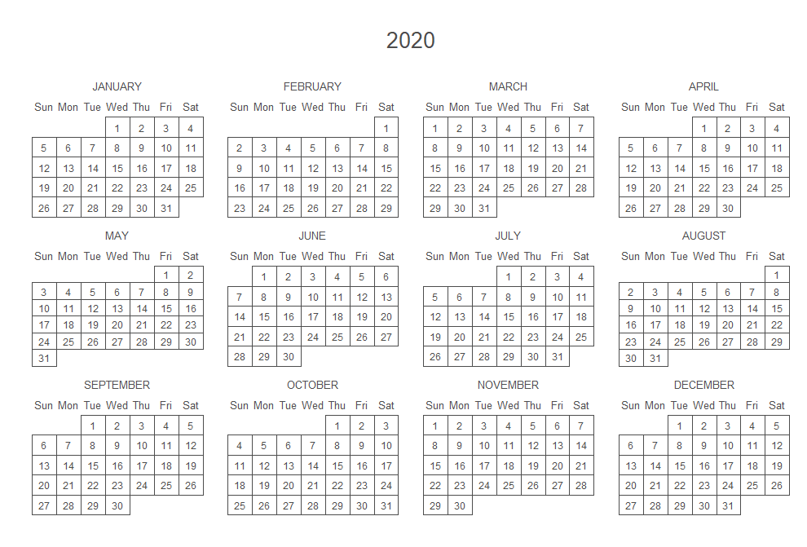
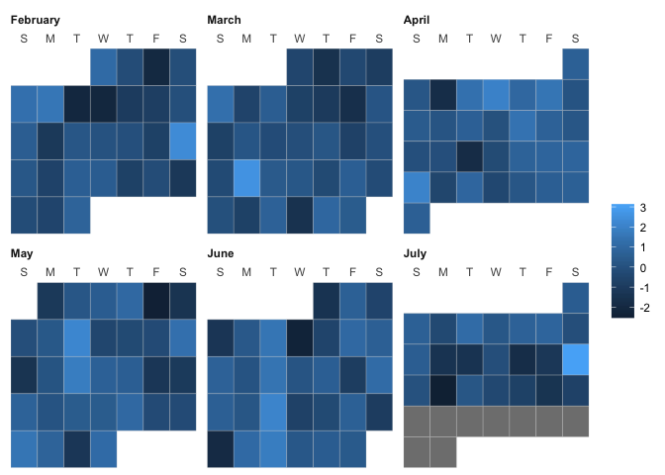
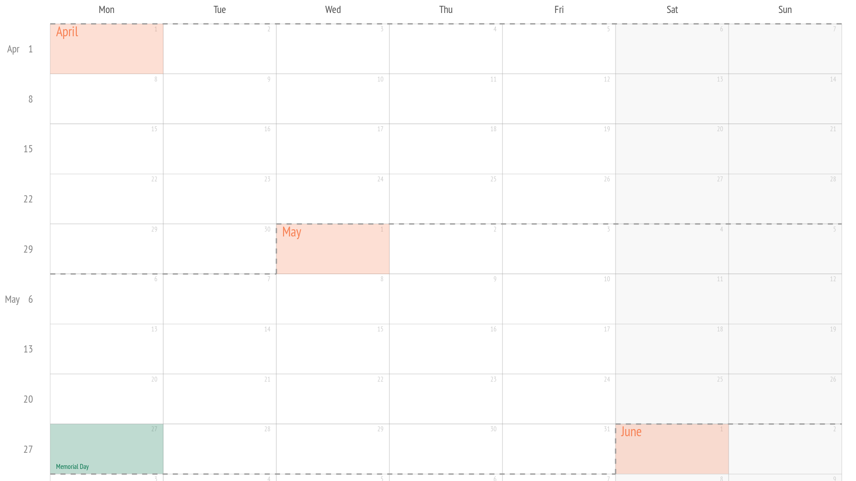
{calendR}
{ggweekly}
{ggcal}

Slide 6
{calendR}
calendR(
year = format(Sys.Date(), "%Y"),
month = NULL,
from = NULL,
to = NULL,
start = c("S", "M"),
orientation = c("portrait", "landscape"),
title,
title.size = 20,
title.col = "gray30",
subtitle = "",
subtitle.size = 10,
subtitle.col = "gray30",
text = NULL,
text.pos = NULL,
text.size = 4,
text.col = "gray30",
special.days = NULL,
special.col = "gray90",
gradient = FALSE,
low.col = "white",
col = "gray30",
lwd = 0.5,
lty = 1,
font.family = "sans",
font.style = "plain",
day.size = 3,
days.col = "gray30",
weeknames,
weeknames.col = "gray30",
weeknames.size = 4.5,
week.number = FALSE,
week.number.col = "gray30",
week.number.size = 8,
monthnames,
months.size = 10,
months.col = "gray30",
months.pos = 0.5,
mbg.col = "white",
legend.pos = "none",
legend.title = "",
bg.col = "white",
bg.img = "",
margin = 1,
ncol,
lunar = FALSE,
lunar.col = "gray60",
lunar.size = 7,
pdf = FALSE,
doc_name = "",
papersize = "A4"
)
{ggweekly}
ggweek_planner(
start_day = lubridate::today(),
end_day = start_day +
lubridate::weeks(8) - lubridate::days(1),
highlight_days = NULL,
week_start = c("isoweek", "epiweek"),
week_start_label = c("month day", "week", "none"),
show_day_numbers = TRUE,
show_month_start_day = TRUE,
show_month_boundaries = TRUE,
highlight_text_size = 2,
month_text_size = 4,
day_number_text_size = 2,
month_color = "#f78154",
day_number_color = "grey80",
weekend_fill = "#f8f8f8",
holidays = ggweekly::us_federal_holidays,
font_base_family = "PT Sans",
font_label_family = "PT Sans Narrow",
font_label_text = NULL
)

Slide 7
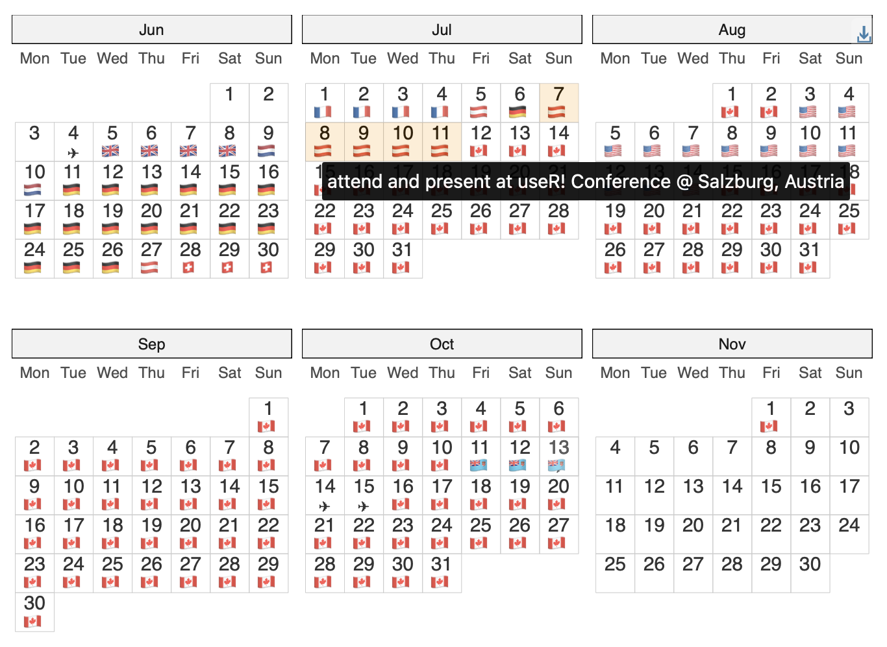
# source(here::here("_utilities/travel_dates_load.R"))
library(ggplot2)
library(ggiraph)
## ---- daily-loc-prep ----
## expand dates: https://stackoverflow.com/a/54728153
travel_days <- travel_dates |>
mutate(nights = interval(startDate, endDate) / days(1)) |>
arrange(startDate, desc(nights)) |>
rowid_to_column() |>
rowwise() |>
reframe(rowid, location, details, nights,
date = seq(startDate, endDate, by = "day")
) |>
group_by(date) |>
slice_min(order_by = nights, n = 1) |>
ungroup() |>
mutate(country = countrycode::countryname(location, "iso2c"))
away_days <- travel_days |>
summarise(
startDate = min(date),
endDate = max(date)
) |>
mutate(rowid = 0, location = "TBC") |>
reframe(rowid, location, date = seq(startDate, endDate, by = "day"))
daily_loc <- away_days |>
anti_join(travel_days, by = "date") |>
bind_rows(travel_days) |>
mutate(
flag = countrycode::countrycode(country, "iso2c", "unicode.symbol"),
continent = countrycode::countrycode(country, "iso2c", "continent")
) |>
mutate(flag = case_when(
location == "en route" ~ "\u2708",
location == "TBC" ~ "❔",
TRUE ~ flag
))
## ---- prep-full-calendar-data ----
# based on: https://github.com/nrennie/tidytuesday/blob/9dbe69d696f6c1edad41a72d157a42f3b5a63a81/2023/2023-03-07/20230307.R
# calculate extra months to make plot rectangular
cal_ncol <- 3
startMonth <- month(floor_date(min(travel_days$date), "month"))
endMonth <- month(ceiling_date(max(travel_days$date), "month") - 1)
n_extra_month <- cal_ncol - ((endMonth - startMonth + 1) %% cal_ncol)
padding_days <- summarise(
travel_days,
startDate = floor_date(min(date), "month"),
endDate = ceiling_date(max(date) %m+% months(n_extra_month), "month") - 1
) |>
reframe(date = seq(startDate, endDate, by = "day"))
# prepare calendar data
full_calendar <- padding_days |>
anti_join(daily_loc, by = "date") |>
bind_rows(daily_loc) |>
mutate(
Year = year(date),
Month = month(date, label = TRUE),
Day = wday(date, label = TRUE, week_start = 1),
mday = mday(date),
Month_week = (5 + day(date) +
wday(floor_date(date, "month"), week_start = 1)) %/% 7
)
## ---- travel-dates-calendar-display ----
base_data_aes <- full_calendar |>
ggplot(aes(x = Day, y = Month_week))
layers_geom_text <- list(
geom_text(aes(label = mday), nudge_y = 0.25),
geom_text(aes(label = flag), nudge_y = -0.25)
)
layers_scale_coord <- list(
scale_y_reverse(),
coord_fixed(expand = TRUE)
)
layers_facet_labs <- list(
facet_wrap(vars(Month),
ncol = cal_ncol
),
labs(y = NULL, x = NULL)
)
layers_theme <- list(
theme_bw(),
theme(
plot.margin = margin(0, 0, 0, 0),
panel.grid.major = element_blank(),
panel.grid.minor = element_blank(),
# panel.spacing = unit(0, "lines"),
panel.border = element_blank(),
axis.ticks = element_blank(),
axis.text.y = element_blank(),
strip.background = element_rect(fill = "grey95"),
strip.text = element_text(hjust = 0)
)
)
## ---- tooltip-travel-calendar ----
p_cal_girafe <- base_data_aes +
geom_tile_interactive(
aes(
tooltip = paste(details, "@", location),
data_id = location
),
alpha = 0.2,
fill = "transparent",
colour = "grey80"
) +
layers_geom_text +
layers_scale_coord +
coord_fixed(expand = FALSE) +
layers_facet_labs +
layers_theme
# girafe(ggobj = p_cal_girafe)
Notes:
so, I did end up procrasti-plotting an interactive calendar, that looks like this

Slide 8
Down the design rabbit hole…

Slide 9
🤔

Slide 10
From procrasti-plotting to procrasti-packaging

Slide 11
A reuseable-enough helper should:
Convenient and quick ‘autoplotting’
Keep ggplot flexibility & error messages
Play nice with compatible ggplot2 extensions
Minimise plot-specific arguments

Slide 12
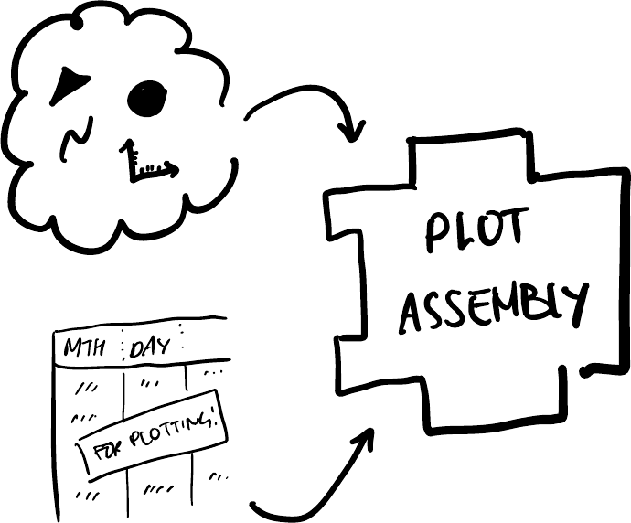
SEPARATE
# source(here::here("_utilities/travel_dates_load.R"))
library(ggplot2)
library(ggiraph)
## ---- daily-loc-prep ----
## expand dates: https://stackoverflow.com/a/54728153
travel_days <- travel_dates |>
mutate(nights = interval(startDate, endDate) / days(1)) |>
arrange(startDate, desc(nights)) |>
rowid_to_column() |>
rowwise() |>
reframe(rowid, location, details, nights,
date = seq(startDate, endDate, by = "day")
) |>
group_by(date) |>
slice_min(order_by = nights, n = 1) |>
ungroup() |>
mutate(country = countrycode::countryname(location, "iso2c"))
away_days <- travel_days |>
summarise(
startDate = min(date),
endDate = max(date)
) |>
mutate(rowid = 0, location = "TBC") |>
reframe(rowid, location, date = seq(startDate, endDate, by = "day"))
daily_loc <- away_days |>
anti_join(travel_days, by = "date") |>
bind_rows(travel_days) |>
mutate(
flag = countrycode::countrycode(country, "iso2c", "unicode.symbol"),
continent = countrycode::countrycode(country, "iso2c", "continent")
) |>
mutate(flag = case_when(
location == "en route" ~ "\u2708",
location == "TBC" ~ "❔",
TRUE ~ flag
))
## ---- prep-full-calendar-data ----
# based on: https://github.com/nrennie/tidytuesday/blob/9dbe69d696f6c1edad41a72d157a42f3b5a63a81/2023/2023-03-07/20230307.R
# calculate extra months to make plot rectangular
cal_ncol <- 3
startMonth <- month(floor_date(min(travel_days$date), "month"))
endMonth <- month(ceiling_date(max(travel_days$date), "month") - 1)
n_extra_month <- cal_ncol - ((endMonth - startMonth + 1) %% cal_ncol)
padding_days <- summarise(
travel_days,
startDate = floor_date(min(date), "month"),
endDate = ceiling_date(max(date) %m+% months(n_extra_month), "month") - 1
) |>
reframe(date = seq(startDate, endDate, by = "day"))
# prepare calendar data
full_calendar <- padding_days |>
anti_join(daily_loc, by = "date") |>
bind_rows(daily_loc) |>
mutate(
Year = year(date),
Month = month(date, label = TRUE),
Day = wday(date, label = TRUE, week_start = 1),
mday = mday(date),
Month_week = (5 + day(date) +
wday(floor_date(date, "month"), week_start = 1)) %/% 7
)
## ---- travel-dates-calendar-display ----
base_data_aes <- full_calendar |>
ggplot(aes(x = Day, y = Month_week))
layers_geom_text <- list(
geom_text(aes(label = mday), nudge_y = 0.25),
geom_text(aes(label = flag), nudge_y = -0.25)
)
layers_scale_coord <- list(
scale_y_reverse(),
coord_fixed(expand = TRUE)
)
layers_facet_labs <- list(
facet_wrap(vars(Month),
ncol = cal_ncol
),
labs(y = NULL, x = NULL)
)
layers_theme <- list(
theme_bw(),
theme(
plot.margin = margin(0, 0, 0, 0),
panel.grid.major = element_blank(),
panel.grid.minor = element_blank(),
# panel.spacing = unit(0, "lines"),
panel.border = element_blank(),
axis.ticks = element_blank(),
axis.text.y = element_blank(),
strip.background = element_rect(fill = "grey95"),
strip.text = element_text(hjust = 0)
)
)
## ---- tooltip-travel-calendar ----
p_cal_girafe <- base_data_aes +
geom_tile_interactive(
aes(
tooltip = paste(details, "@", location),
data_id = location
),
alpha = 0.2,
fill = "transparent",
colour = "grey80"
) +
layers_geom_text +
layers_scale_coord +
coord_fixed(expand = FALSE) +
layers_facet_labs +
layers_theme
# girafe(ggobj = p_cal_girafe)
Notes:
data wrangling:
reshaping via reframe()
creating new variables
fill in missing days
calculating facet and layout (e.g. Month, Month_week)
ggplot2 components:
scale, coord and facet to layout the calendar
theme modification to style the plot as a calendar
interactive geom from {ggiraph}

Slide 13
SEPARATE into modular internals
gg_facet_wrap_months <- function(...){
## Data Prep
cal_data <- .events_long |>
fill_missing_units({{ date_col }}) |>
calc_calendar_vars({{ date_col }})
## Plot Assembly
base_plot <- cal_data |>
ggplot2::ggplot(mapping = aes_string(
x = "TC_wday_label",
y = "TC_month_week",
label = "TC_mday"
)) +
facet_wrap(c("TC_month_label"), axes = "all_x", nrow = nrow, ncol = ncol) +
labs(y = NULL, x = NULL) +
.geom +
.scale_coord +
.theme +
.others
base_plot
}

Slide 14
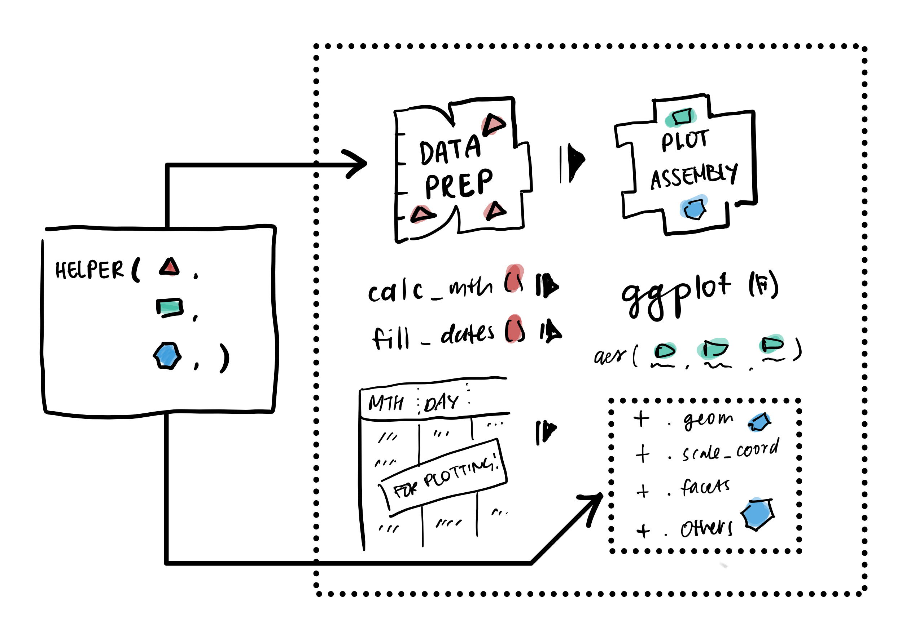
EXPOSE

Slide 15
EXPOSE defaults as list arguments
gg_facet_wrap_months(
## --- data ----
.events_long,
date_col,
locale = NULL,
## --- facets / layout ----
week_start = NULL,
nrow = NULL,
ncol = NULL,
## --- default layers ---
.geom = list(
geom_tile(color = "grey70", fill = "transparent"),
geom_text(nudge_y = 0.25)
),
.scale_coord = list(
scale_y_reverse(),
scale_x_discrete(position = "top"),
coord_fixed(expand = TRUE)),
.theme = list(theme_bw_tilecal()),
.other = list()
)

Slide 16
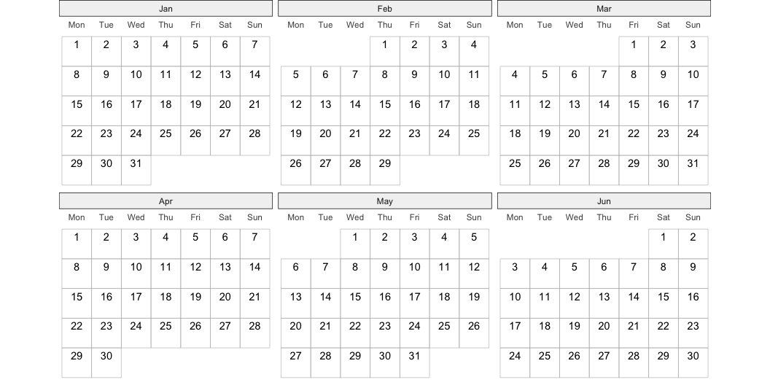
From autoplot()
library(ggtilecal)
library(ggplot2)
dates <- make_empty_month_days(
c("2024-01-05", "2024-06-30"))
gg_facet_wrap_months(
dates,
unit_date)

Slide 17
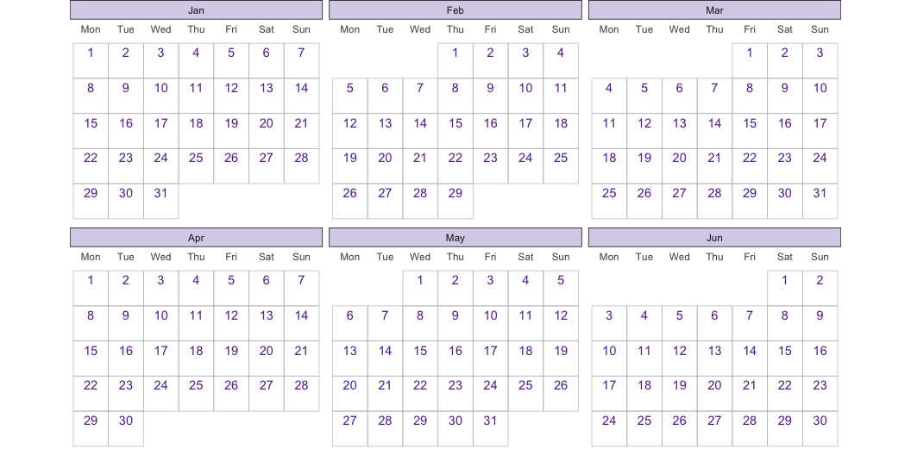
From autoplot() to customisation!
library(ggtilecal)
library(ggplot2)
dates <- make_empty_month_days(
c("2024-01-05", "2024-06-30"))
gg_facet_wrap_months(dates, unit_date,
.geom = list(
geom_tile(color = "grey70", fill = "transparent"),
geom_text(nudge_y = 0.25,
color = "#6a329f")),
.theme = list(theme_bw_tilecal(),
theme(
strip.background = element_rect(fill = "#d9d2e9")))
)

Slide 18
DOCUMENT
Data preparation steps
Fixed variables and aesthetics
Customisation via arguments

Slide 19
#' Make Monthly Calendar Facets
#'
#' Generates calendar with monthly facets by:
#' - Padding event list with any missing days via `fill_missing_units()`
#' - Calculating variables for calendar layout via `calc_calendar_vars()`
#' - Returning a ggplot object as per Details.
#'
#' Returns a ggplot with the following fixed components
#' using calculated layout variables:
#' - `aes()` mapping:
#' - `x` is day of week,
#' - `y` is week in month,
#' - `label` is day of month
#' - `facet_wrap()` by month
#' - `labs()` to remove axis labels for calculated layout variables
#'
#' and default customisable components:
#' - `geom_tile()`, `geom_text()` to label each day which inherit calculated variables
#' - `scale_y_reverse()` to order day in month correctly
#' - `scale_x_discrete()` to position weekday labels
#' - `coord_fixed()` to square each tile
#' - `theme_bw_tilecal()` to apply sensible theme defaults
#'
#' for the month facets:
#' - `nrow` the number of month facet rows
#' - or `ncol` the number of month facet columns
#' - a labeller function for the monthly facet strip labels, see `label_yearmonth()`
#'
#' To modify components alter the `.geom` and `.scale_coord`,
#' which inherit the calculate layout mapping by default
#' (via the ggplot2 `inherit.aes` argument).
#'
#' To additional components use the ggplot `+` function as normal,
#' or pass components to the `.other` argument.
#' This can be used to add interactive geoms (e.g. from `ggiraph`)
#'
#' To modify the theme, use the ggplot `+` function as normal,
#' or add additional elements to the list in `.theme`.
#'
#' To remove any of the optional components, set the argument to any empty `list()`
#'
#' @inheritParams ggplot2::facet_wrap
#' @inheritParams fill_missing_units
#' @inheritParams calc_calendar_vars
#' @param labeller A facet labeling function, for the calendar month titles, defaults to `label_yearmonth()`
#' @param .geom,.scale_coord,.theme,.other
#' Customisable lists of ggplot2 components to add to the plot.
#' An empty `list()` leaves the plot unmodified.
#'
#' @return ggplot
#' @export
#'
#' @examples
#' \dontrun{
#' library(dplyr)
#' library(ggplot2)
#' demo_events_gpt |>
#' reframe_events(startDate, endDate) |>
#' group_by(unit_date) |>
#' slice_min(order_by = duration) |>
#' gg_facet_wrap_months(unit_date,
#' labeller=label_yearmonth("%b %Y")) +
#' geom_text(aes(label = event_emoji), nudge_y = -0.25, na.rm = TRUE) }
#' @importFrom ggplot2 geom_tile geom_text facet_wrap labs aes
#' scale_y_reverse scale_x_discrete coord_fixed vars

Slide 20
Reusing ggplot2 happily ever after?

Slide 21
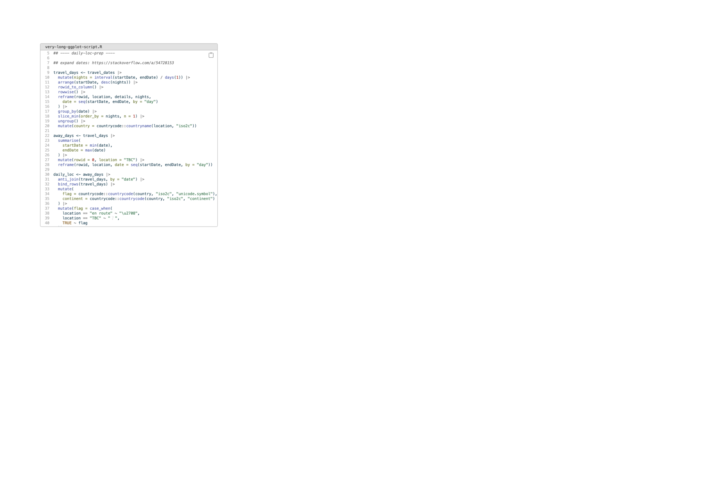
From custom code…

Slide 22
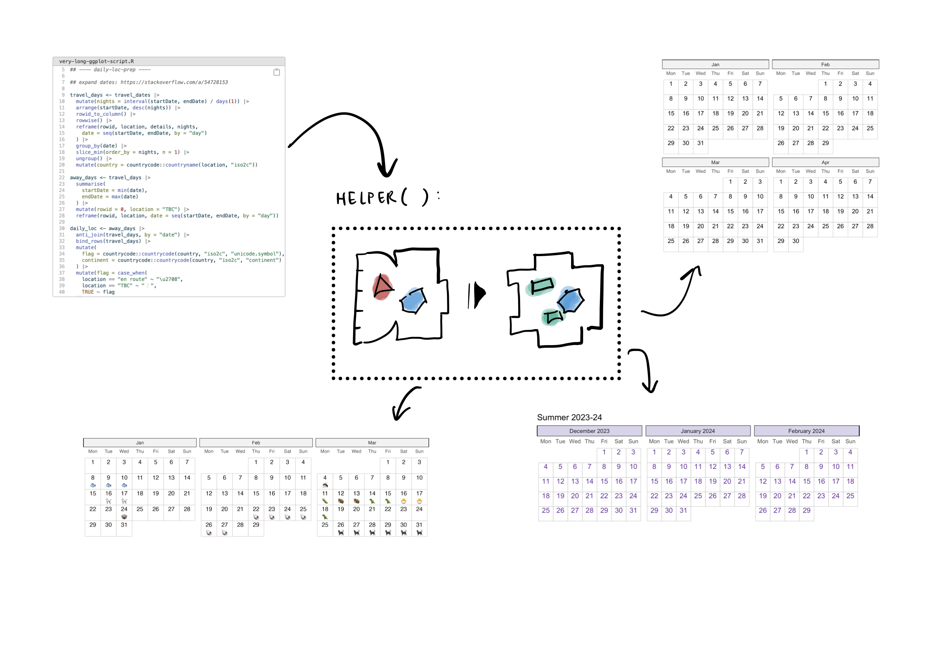
to transparent helpers…

Slide 23
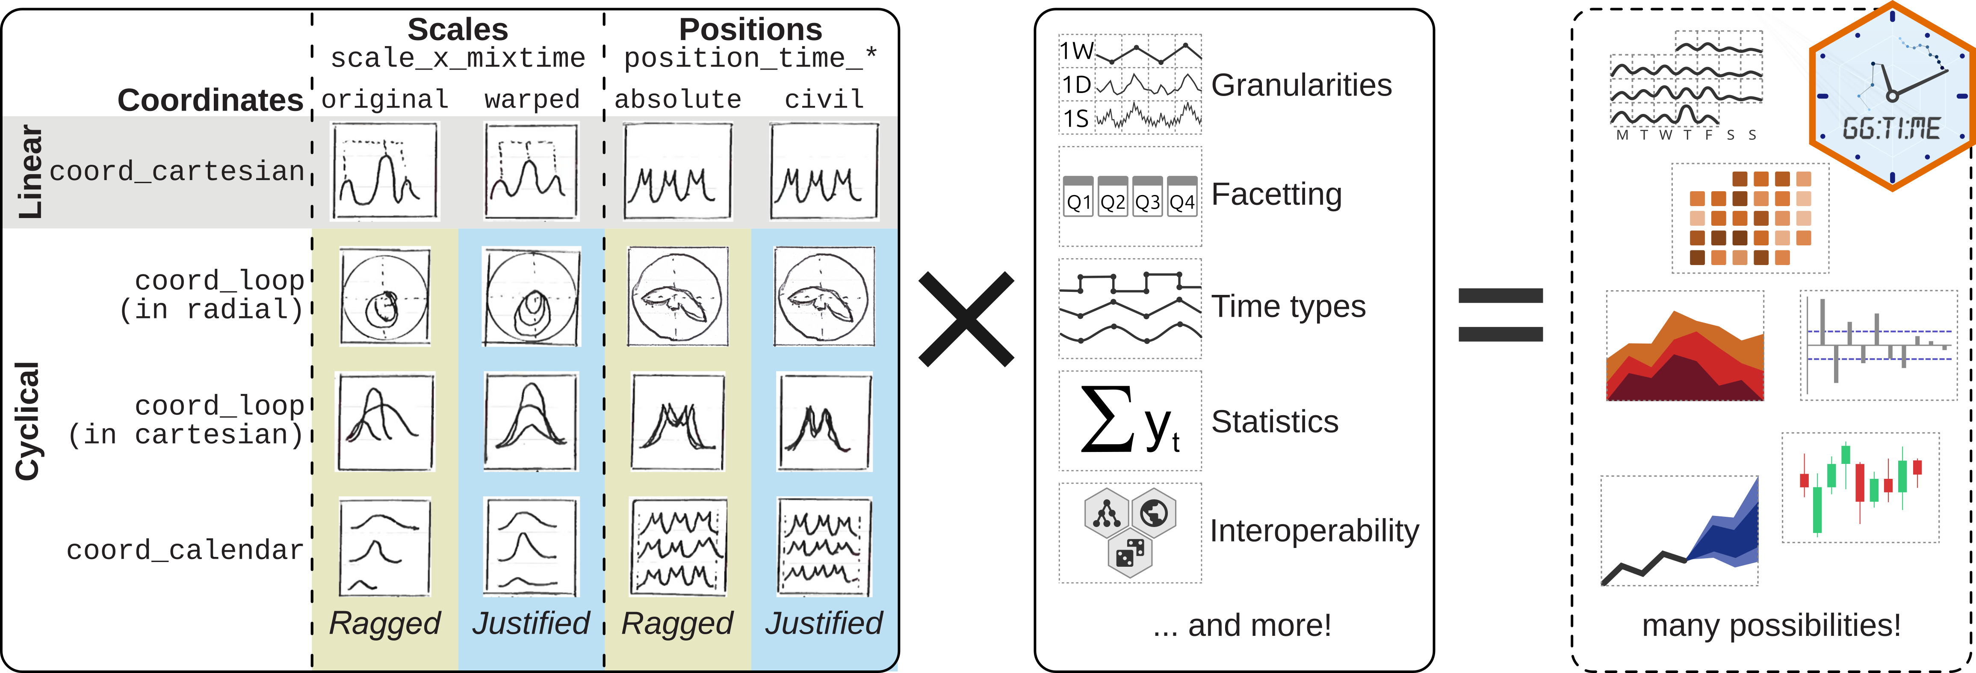
and beyond?

Slide 24
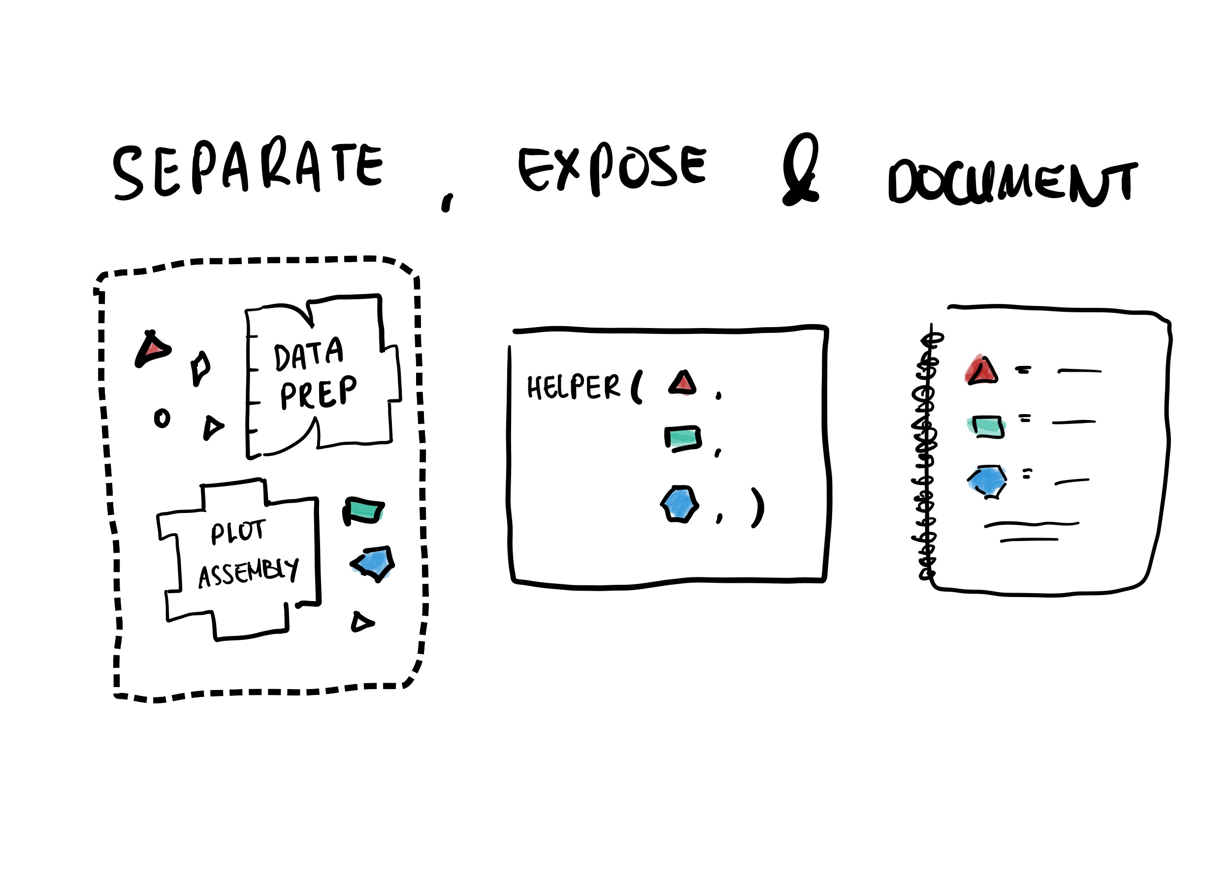
Keep calm, and…

Slide 25

Thanks for listening!
📣 Tell me about your ggplot2 reuse experiences!
cynthiahqy.com/survey

