Slide 1
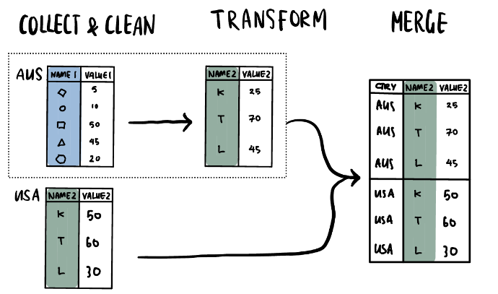
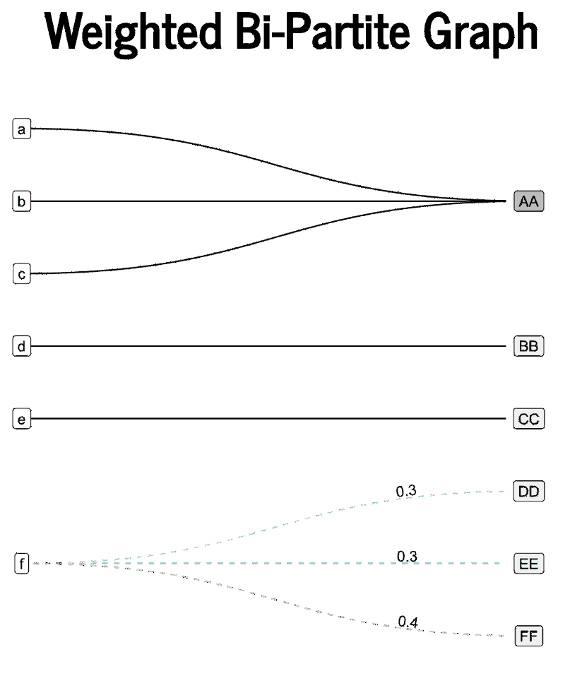

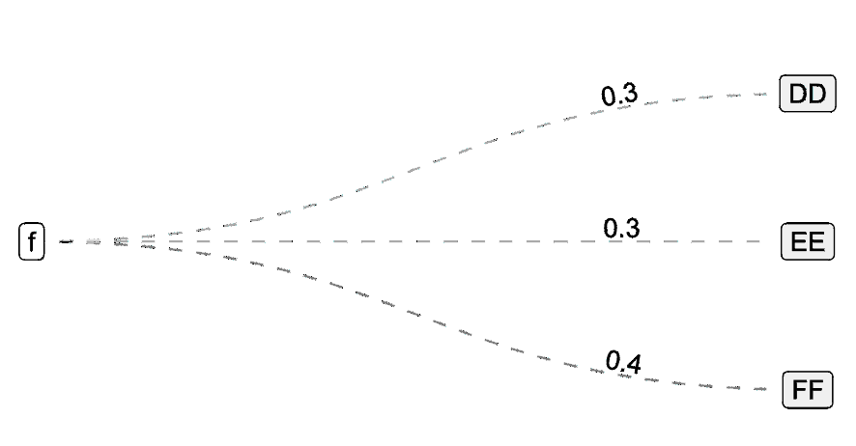
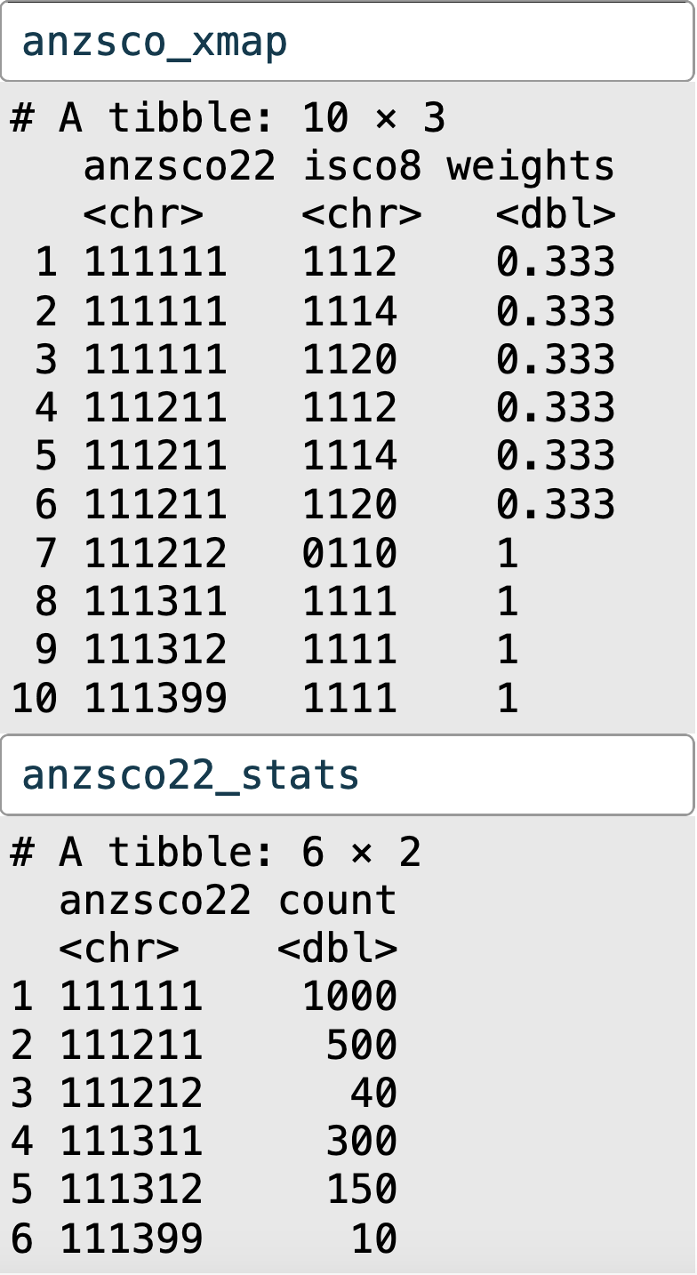
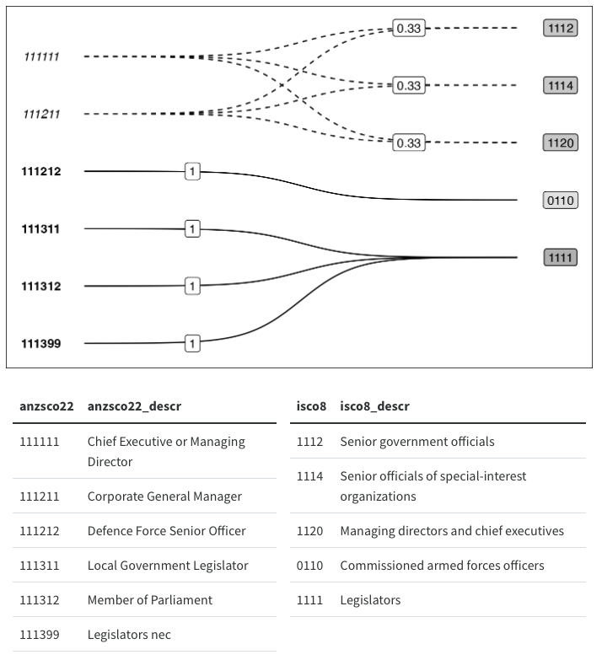
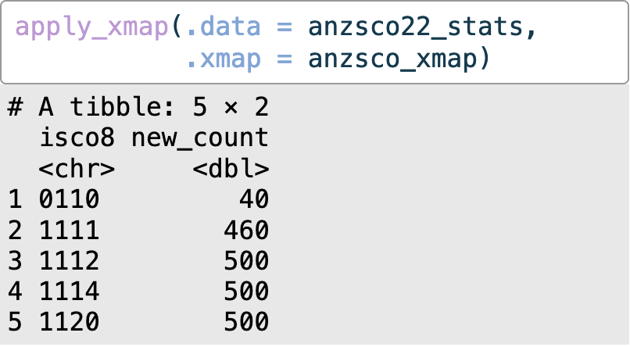
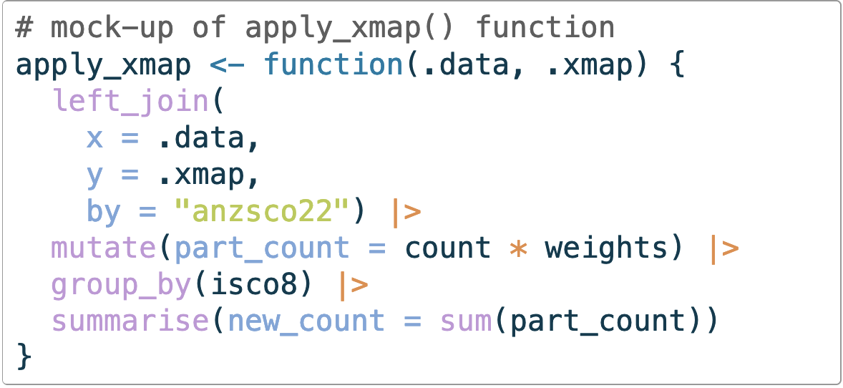
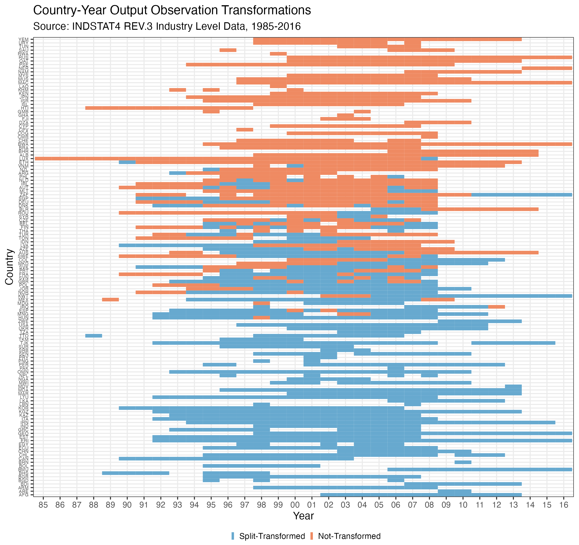


Using Graphs, Matrices and Edge Lists to investigate, illuminate and improve
Ex-Post Data Harmonisation
Crossmaps: A principled approach to ex-post data harmonisation and dataset integration
Harmonising and merging data collected under different statistical classifications, taxonomies or nomenclatures is often required to analyse and compare social, political and economic phenomena across time or countries. Procedures used to achieve comparability are broadly known as Ex-Post Harmonisation, and include the transformation of data collected under a source taxonomy into harmonised data classified according to a target taxonomy. We refer to this sub-task as a Cross-Taxonomy Transformation, and encapsulate the transformation logic in a new information structure: the Crossmap.
v
v
Cross-Taxonomy Transformation is an imputation from source to target data
Crossmaps is a unified framework for specifying, validating, implementing, documenting and analysing cross-taxonomy transformations
`
v
v
v
Transformation logic can be validated via graph properties instead of ad-hoc assertions or
line-by-line code review
Data transformation can be implemented using validated crossmaps via matrix multiplication [1] performed as database operations on the edge list [2]
Bi-graph visualisation and summary techniques can be used to design data provenance documentation [3]
+
+
=
100%
Condition for preserving numeric totals
v
Crossmaps integrates multiple complementary perspectives from graph theory, matrix algebra and relational databases to explore properties of ex-post harmonised datasets and unify related cross-taxonomy transformation workflows.
Metrics based on crossmap properties can be used to quantify and compare:
How does the degree and extent of imputation differ between crossmaps?
How robust are downstream results to alternative harmonisation designs?
How much imputation has been performed on a given dataset with a given crossmap?
Which observations in a harmonised dataset have undergone the most (or least) transformation?
References
[1] Hulliger, Beat. 1998. “Linking of Classifications by Linear Mappings.” Journal of Official Statistics 14 (January): 255–66.
[2] Zhou, Xiantian, and Carlos Ordonez. 2020. “Matrix Multiplication with SQL Queries for Graph Analytics.” In 2020 IEEE International Conference on Big Data (Big Data), 5872–73. Atlanta, GA, USA IEEE https://doi.org/10.1109/BigData50022.2020.9378275.
[3] Huang, Cynthia A. 2023. “Visualising Category Recoding and Numeric Redistributions.” August 12, 2023 http://arxiv.org/abs/2308.06535.
Acknowledgements
Thank you to Laura Puzzello for her ongoing support and funding of earlier iterations of this work. Many thanks also to Rob Hyndman, Sarah Goodwin, Simon Angus, Emi Tanaka, Patrick Li, Mitch O’Hara-Wild and my other colleagues at Monash EBS and Monash SoDa Labs for their helpful guidance, feedback and suggestions. The author is supported in part by top-up scholarships from Monash Data Futures Institute and the Statistical Society of Australia.
Cynthia A. Huang
Department of Econometrics and Business Statistics, Monash University
Supervised by Prof. Rob J Hyndman, Dr. Sarah Goodwin and Assoc. Prof. Simon Angus

