Slide 1
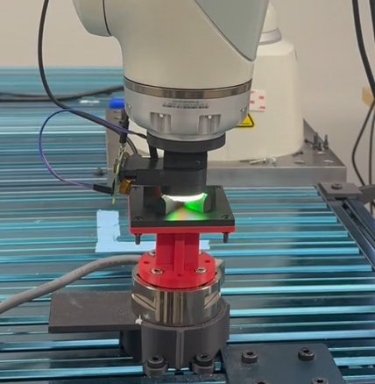
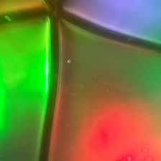

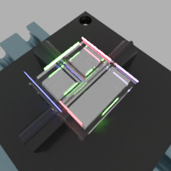
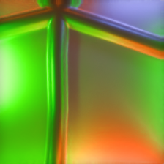
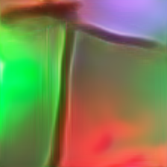
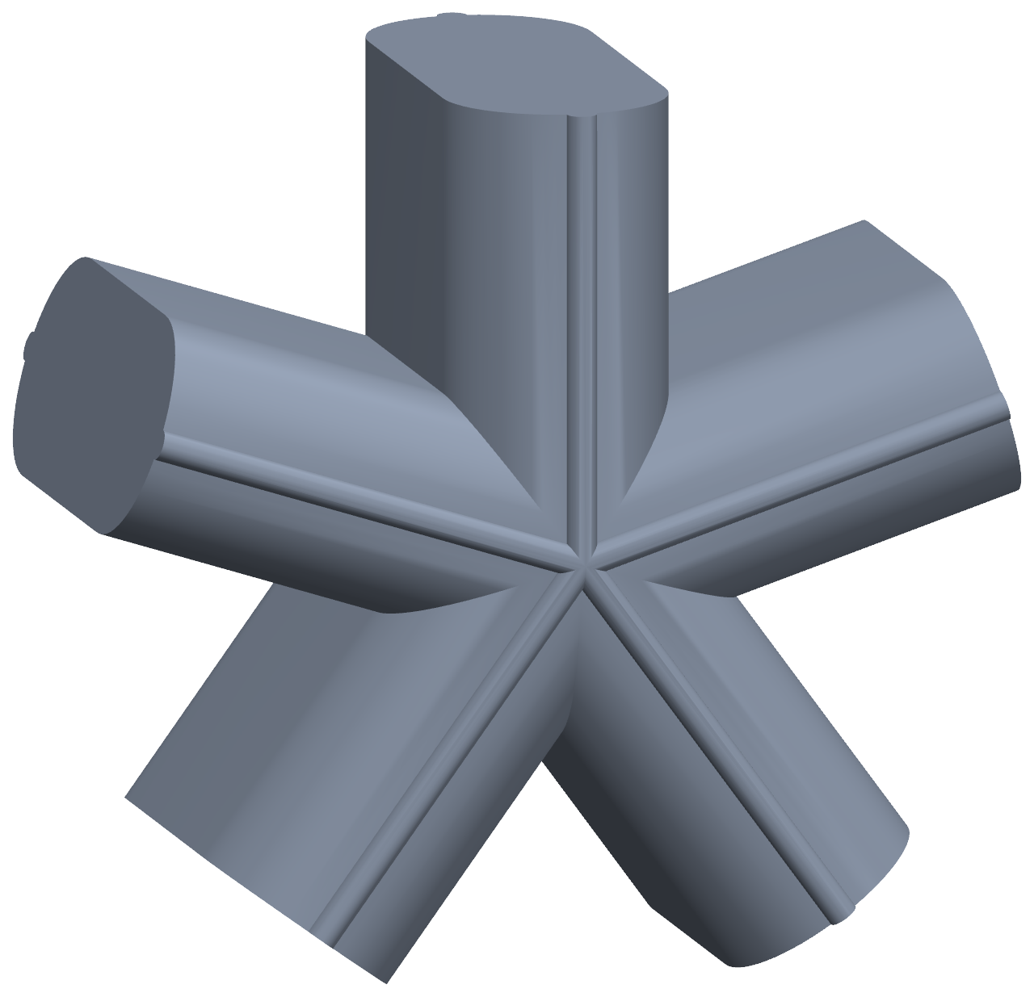


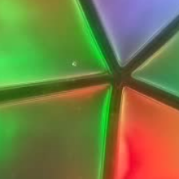

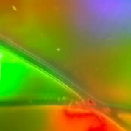

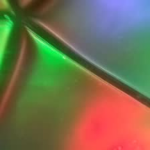

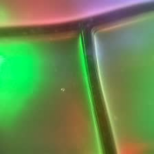

(a) Register real contacts
One registered pose per label
+
Registered press
Real image
Registered depth
(b) Simulate contacts
Renderer fitting + appearance gap
render
Simulated contact
Depth target
PBR
Learned
(c) AlignTac: real appearance + aligned geometry
Unlabeled
real image
Known simulated
geometry
Initial geometry
Aligned geometry
AlignTac
Few registered touches
Many pseudo-labeled contacts for supervision

