Slide 1
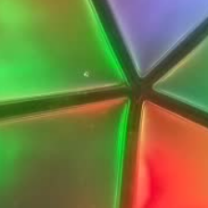


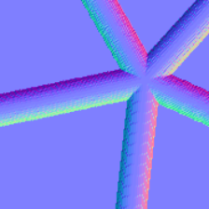
(a) Training
Registered contacts
Image–geometry alignment
Aligned pseudo-labels
Perturb + project
Correction target
Geometric targets
train
Unlabeled
Object mesh
Projection
Update
Iterative refinement
Depth
Normals
Pose
Geometric supervision
+
All real images
Registered labels
Pseudo-labels
(b) Inference
Pose refinement (optional)
Refined pose
Depth
Normals
Pose

