Slide 1
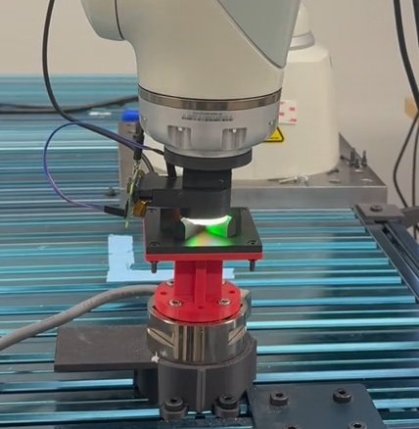
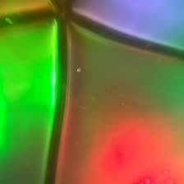

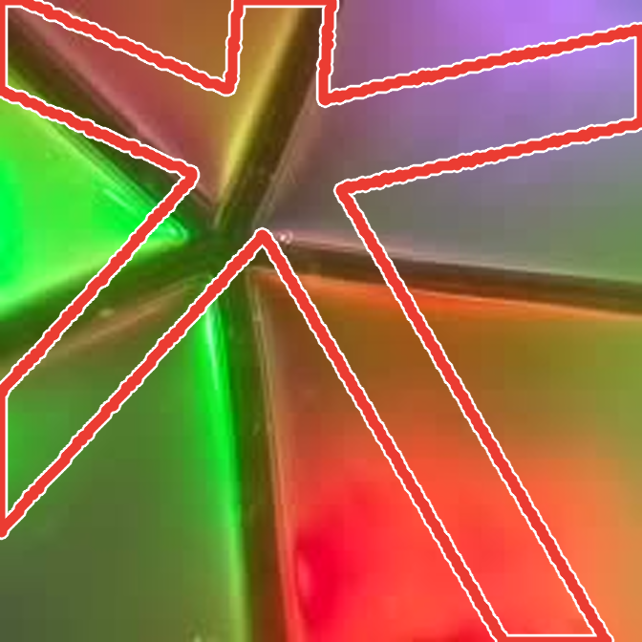
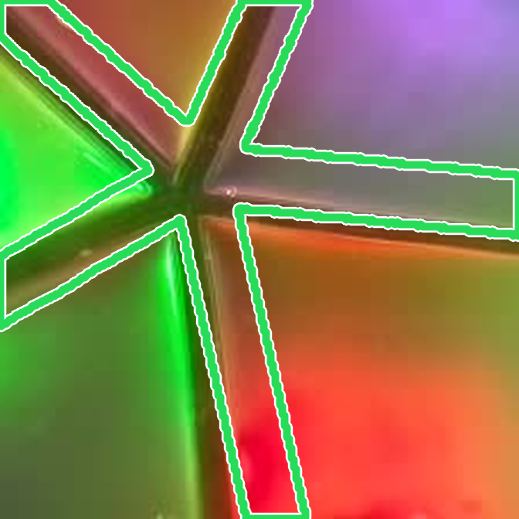
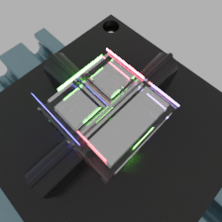
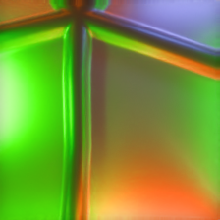

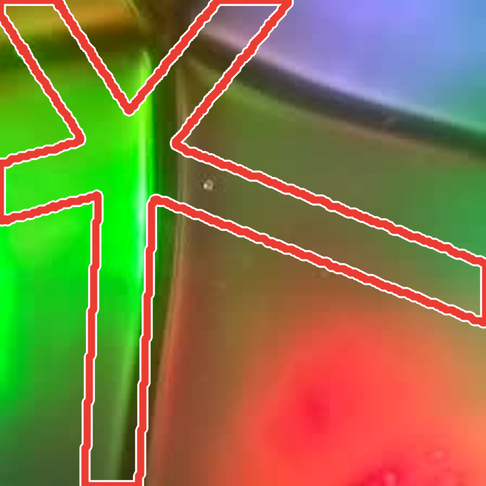
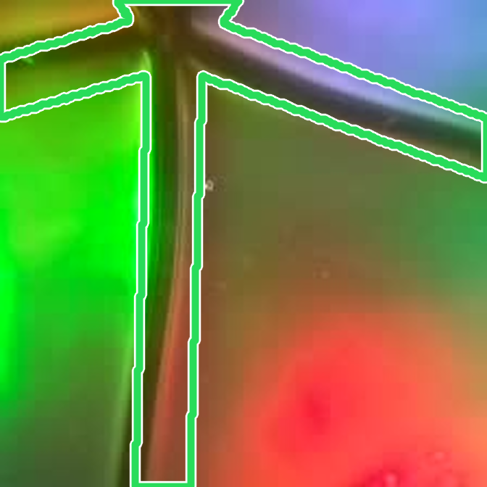

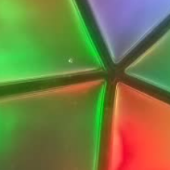

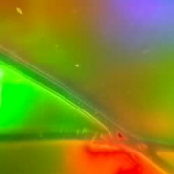

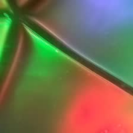

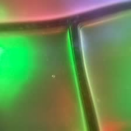

(a) Register real contacts
Labels need calibration and verification
q* from the robot pose
after re-placing the object
Registered press
Real image
GT label
old calibration
re-calibrated, verified
(b) Simulate contacts
Synthetic RGB needs sensor-response modeling
render RGB
≠
Simulated contact
GT label (free)
PBR
Learned
(fitted on real pairs)
Real image
(c) AlignTac: real appearance + aligned geometry
unlabeled real image + known mesh
Learned
aligner 𝒜
q ← q + Δq
mesh at teacher estimate
train
mesh after alignment
Pseudo-label
K=25 with AlignTac ≈
real-only K=50
(contact metrics)
K registered contacts
pseudo-labels for the remaining real images

