Slide 1
AlignTac:
Aligning Real Tactile Images with Simulated Geometry
for Label-Efficient Contact Learning
Anonymous submission to RoboSoft 2027 · no audio
Notes:
8 | AlignTac: aligning real tactile images with simulated geometry for label-efficient contact learning.

Slide 2
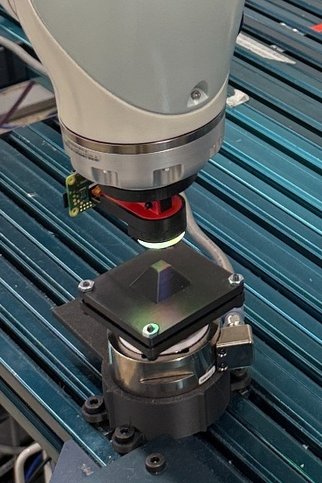
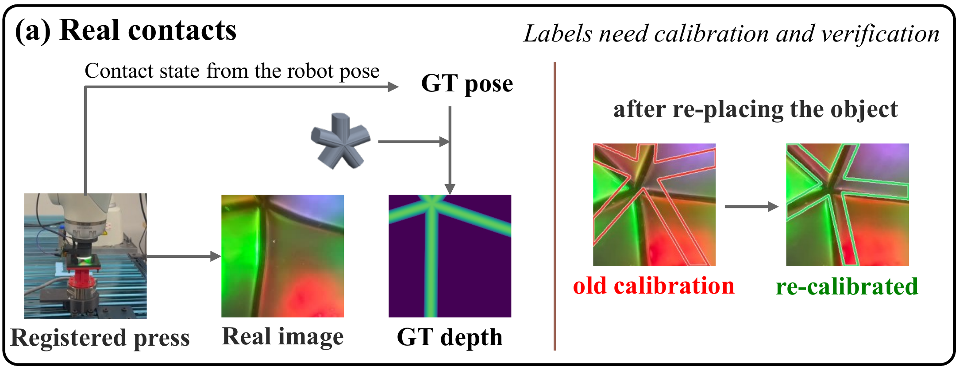
Tactile images are easy to collect, their geometric labels are not
[ robot video clip here ]
Every labeled contact requires calibration and verification of the robot pose
Notes:
14 | Tactile sensors turn contact into detailed images, but learning geometry from them needs dense labels. Each label is the object mesh projected at a calibrated, verified robot pose, redone whenever the object moves. Images are cheap; labels are not.

Slide 3
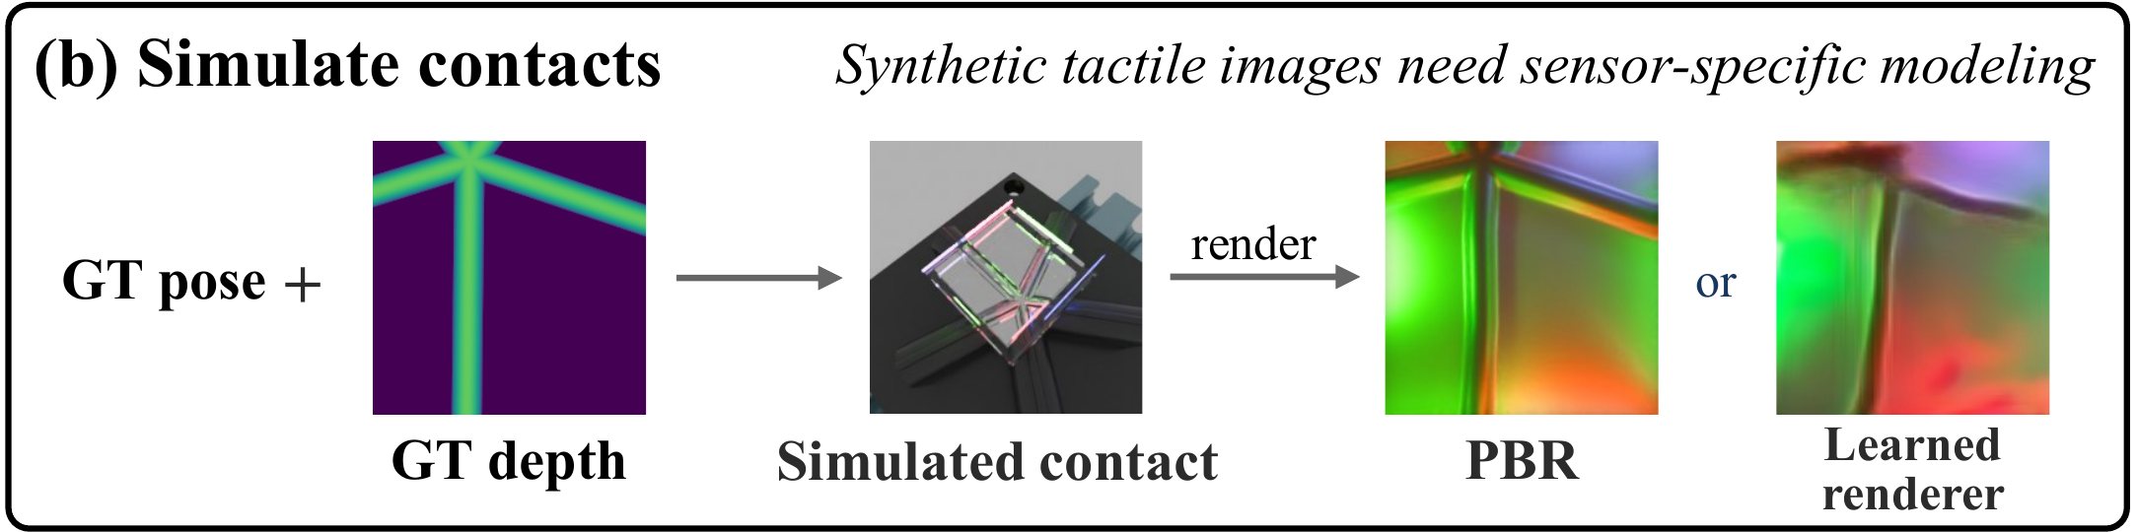
Simulation and self-training each pay a different price
Synthetic images need sensor-specific modeling, fitted on labeled real pairs
Self-training labels with the teacher's own predictions and inherits its errors
Notes:
12 | Simulation gives geometry for free, but its renderer must be fitted to the sensor with labeled real pairs. Self-training reuses the predictor's own outputs and inherits its errors.

Slide 4
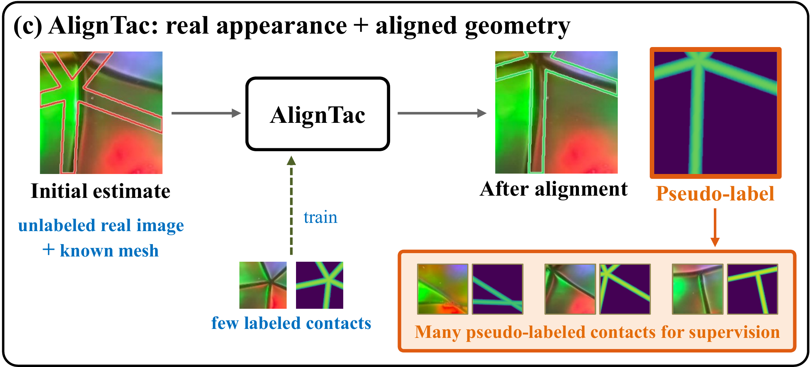
AlignTac: keep the real appearance, align the known geometry
Only a 4-D contact state (θ, x, y, z) separates a real image from its dense label
Notes:
14 | Our insight: the real image already holds the appearance, and the known mesh already holds the geometry. Only a four-dimensional contact state is missing. AlignTac learns to align the mesh with each real image.

Slide 5
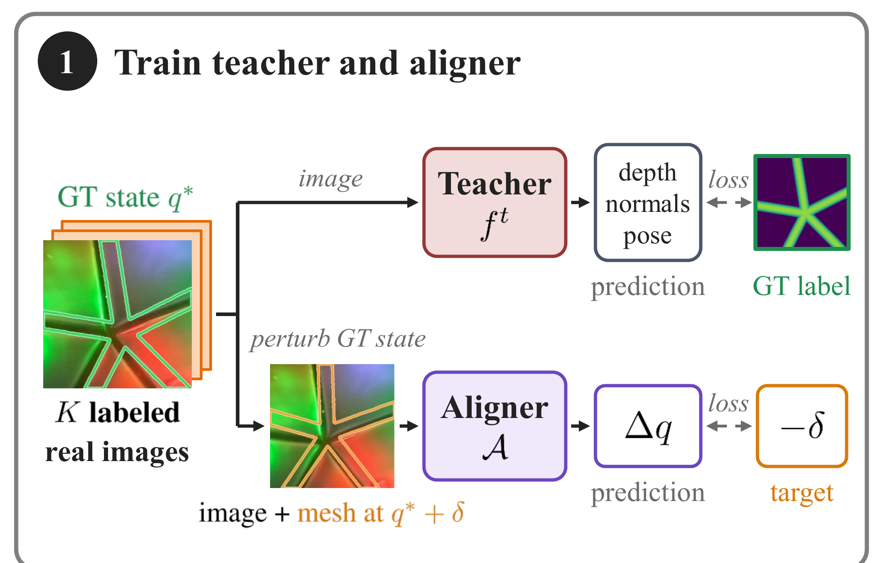
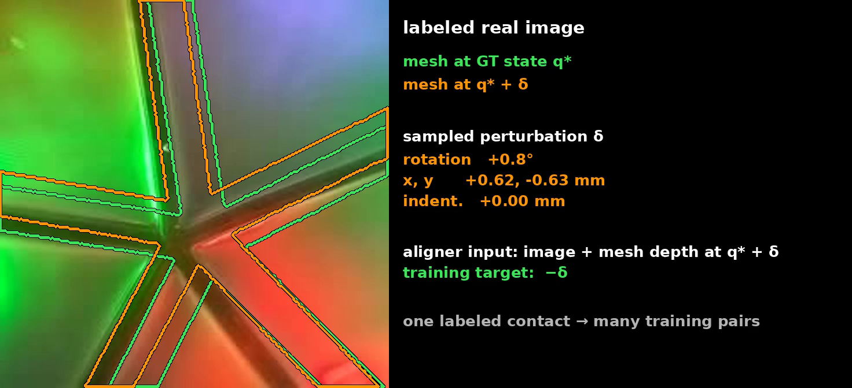
Step 1: a teacher and an aligner from K labeled contacts
Teacher: K labeled contacts → depth, normals, pose
Aligner: perturb the known state, project the mesh, learn to undo the perturbation
One labeled contact gives many (image, perturbed mesh depth → −δ) training pairs
Notes:
16 | From K labeled contacts per object, twenty-five here, we train a teacher for depth, normals and pose, and an aligner: perturb the known contact state, project the mesh there, and learn to recover the perturbation from the image and the candidate depth.

Slide 6
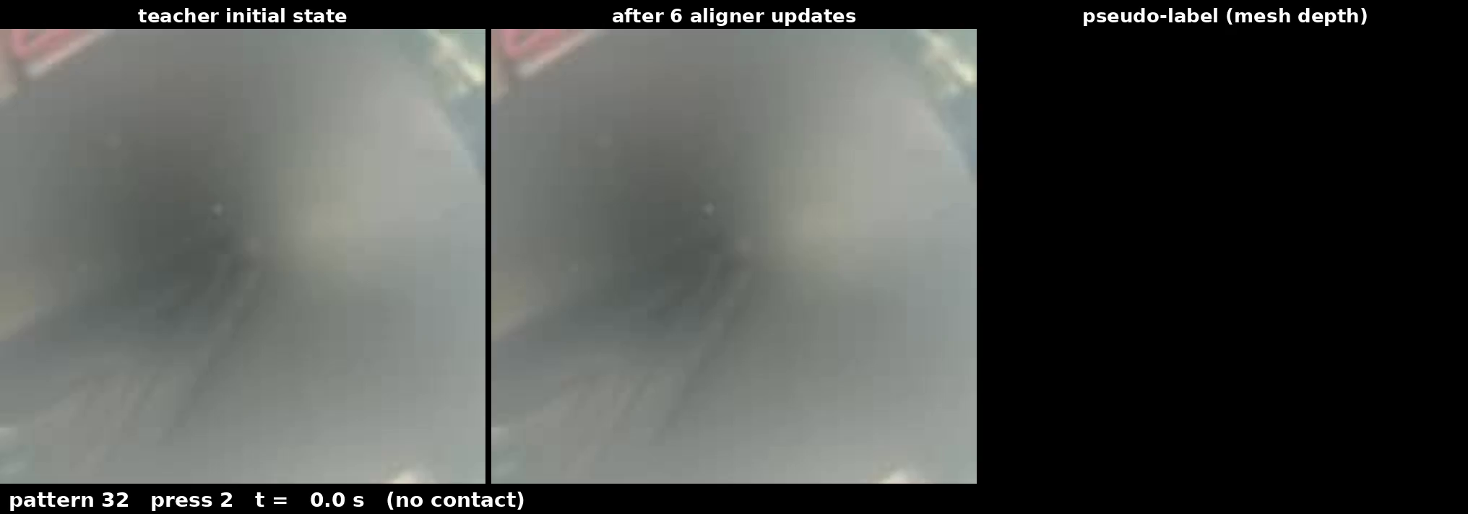
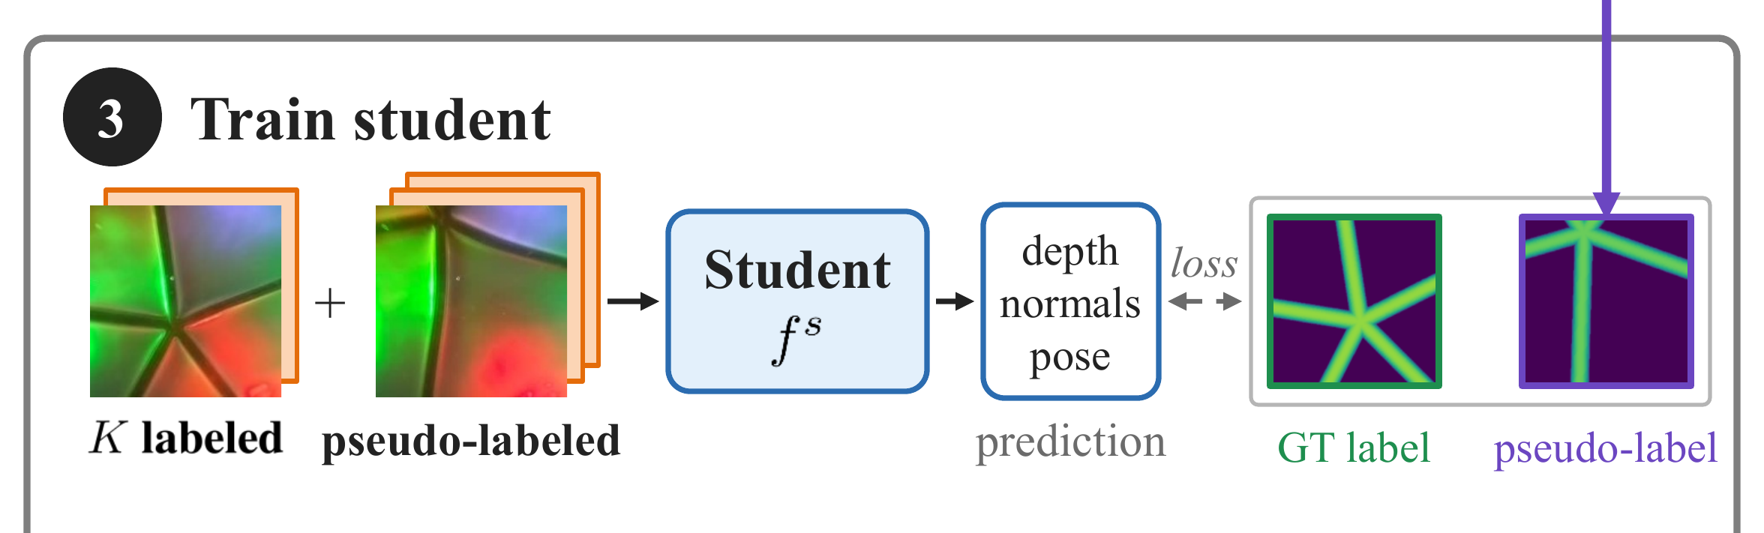
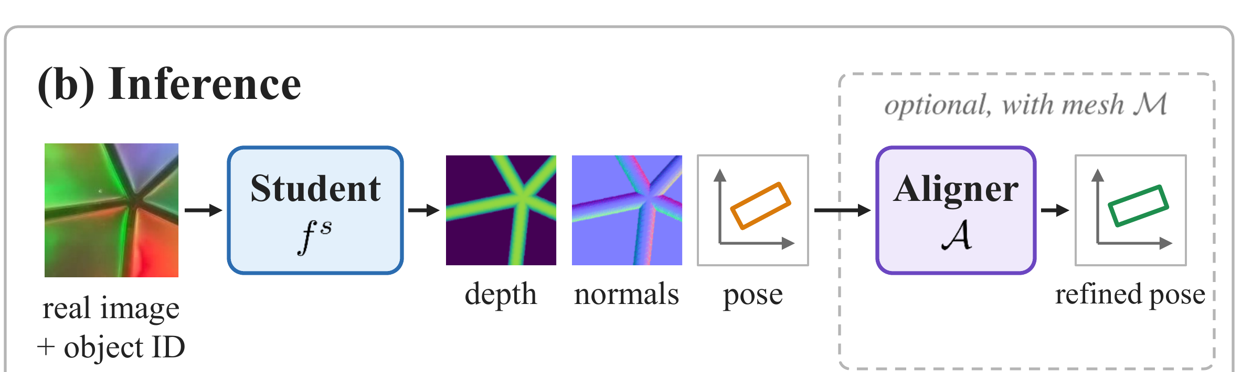
Steps 2 and 3: pseudo-label the unlabeled images, train the student
Unlabeled stream from a second session: teacher state (red) → six aligner updates (green) → mesh depth as the pseudo-label
Student: labeled + pseudo-labeled images
Inference needs only the image and the object identity; mesh-assisted pose refinement is optional
Notes:
16 | For each unlabeled image, the teacher gives an initial state and the aligner refines it in six updates. The mesh at the final state is the pseudo-label. A student trains on both sets and predicts from the image and object identity alone.

Slide 7
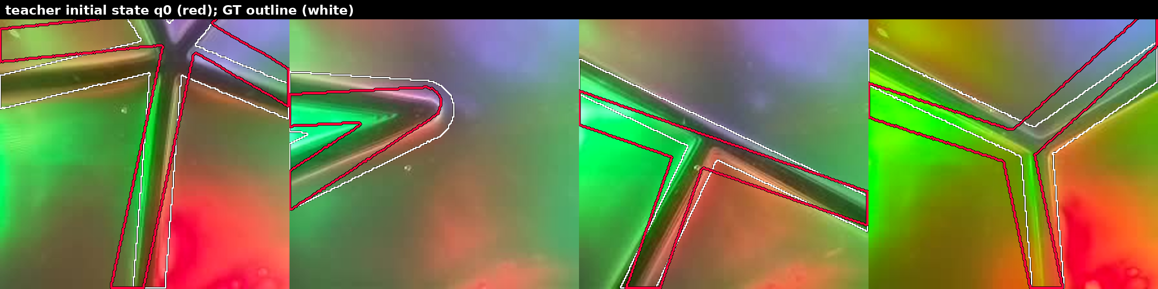
Alignment in action: six updates on held-out real contacts
red: teacher initial state q0 green: after six aligner updates white: ground-truth contact region
Rotation error on these four frames: 6–8° → 0.0–0.4°; translation: 0.2–1.3 mm → 0.1–0.3 mm
(video embedded; align_anim_small.gif is the same sequence as an animated GIF)
Notes:
16 | On held-out frames, red is the mesh at the teacher's state, several degrees off the ridges. Each update moves it; after six, the green outline matches the ground-truth region in white, with errors below half a degree.

Slide 8
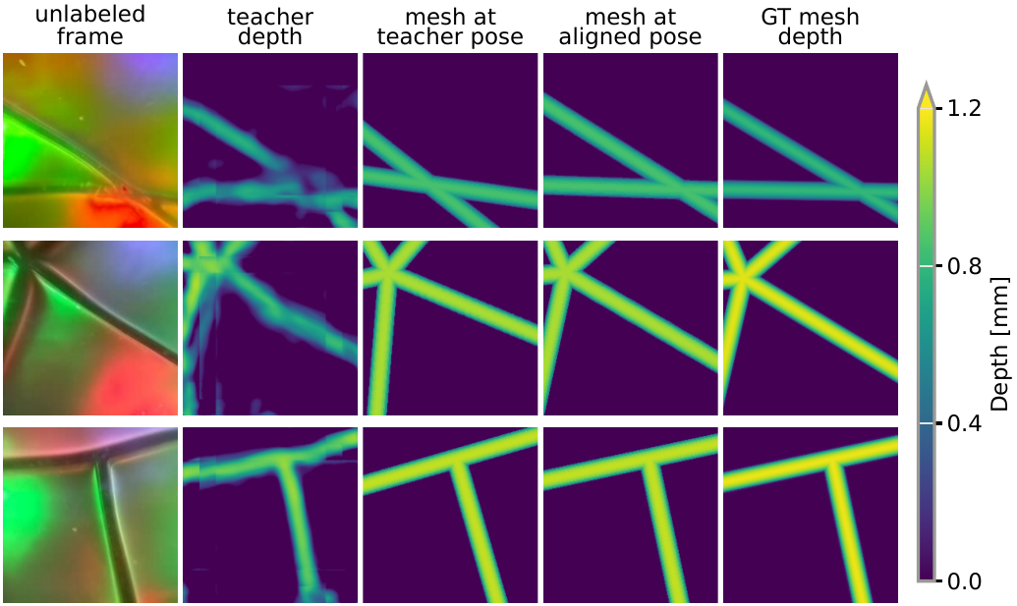
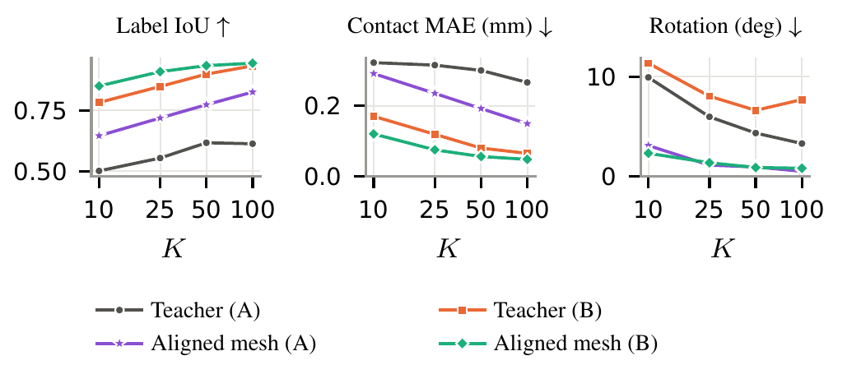
Accurate alignment turns known geometry into accurate labels
Same teacher, K = 25: label IoU 0.47 (mesh at teacher pose) → 0.72 (aligned mesh); label rotation error 6.0° → 1.1°
Right: teacher vs. aligned-mesh label quality across budgets on both GelSlim 4.0 variants
Notes:
14 | Alignment is what makes geometry useful. With the same teacher, the mesh at the teacher's pose gives labels with IoU 0.47, worse than teacher depth. Aligned, the IoU is 0.72 and rotation error falls from six degrees to one.

Slide 9
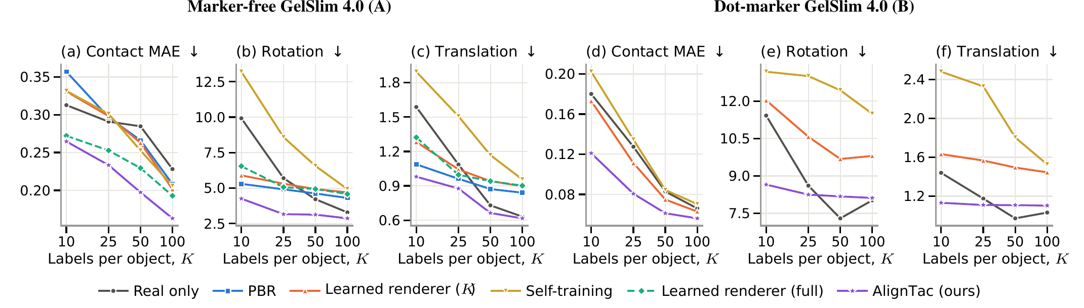
Label efficiency on two GelSlim 4.0 variants
K = 25: contact MAE −20% (marker-free) and −36% (dot-marker) vs. real-only training
Matches real-only accuracy obtained with 2× the labels; pose error also falls (3.2° vs. 5.7° at K = 25)
Learned renderer (K) and self-training use the same K labels / the same unlabeled images
Notes:
16 | The student trained on aligned geometry has the lowest contact error at every budget on both variants. With 25 labels per object, error drops twenty and thirty-six percent on the two sensors, matching real-only training with twice the labels.

Slide 10
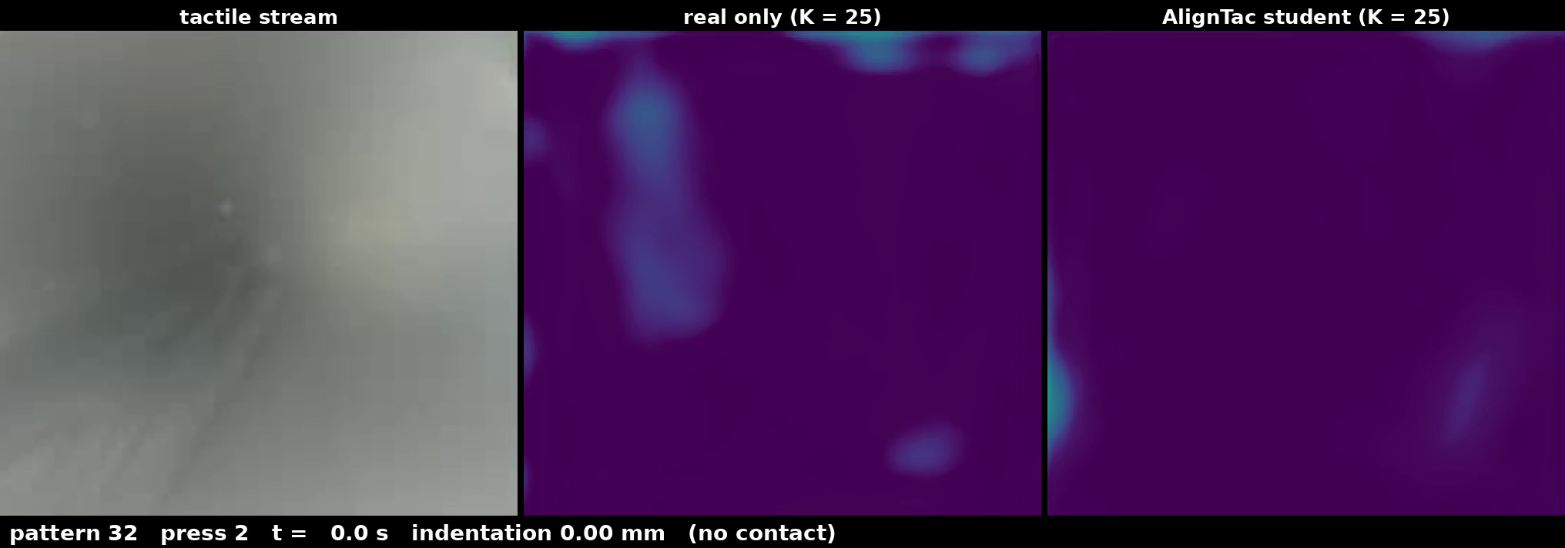
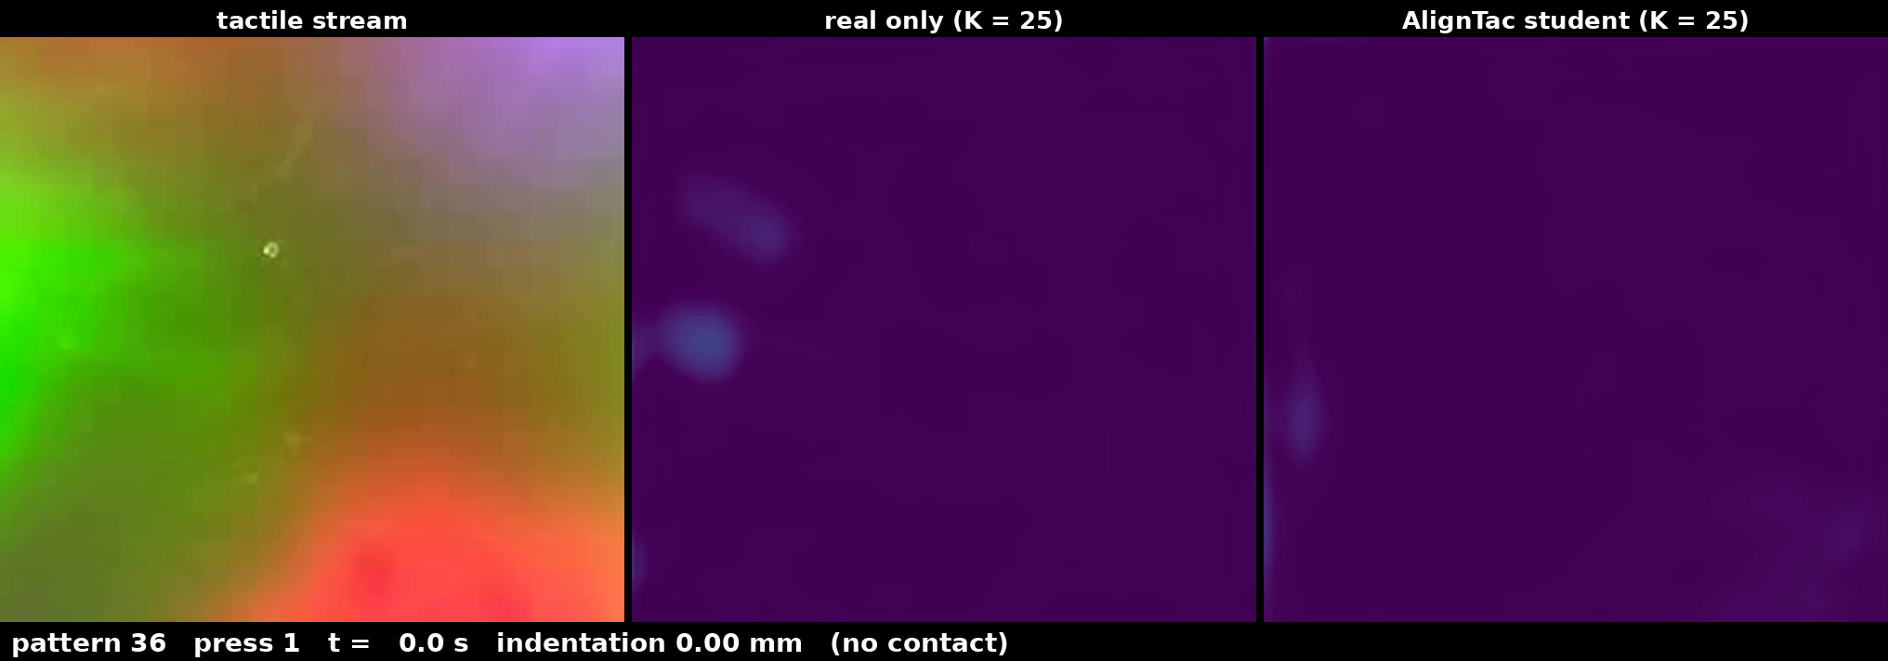
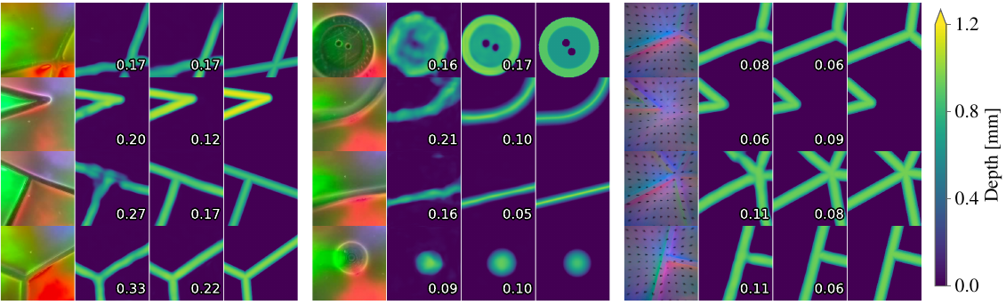
Contact-depth predictions on held-out frames
top: live predictions on a second-session stream (approach, press, lift); arrow: AlignTac planar pose
bottom: held-out frames — real image | real only | AlignTac | ground truth; numbers: contact MAE (mm)
Notes:
12 | The real-only model blurs or breaks thin ridges and misplaces junctions; the AlignTac student recovers them, also on everyday shapes: a button, a hex key, an edge and a marble.

Slide 11
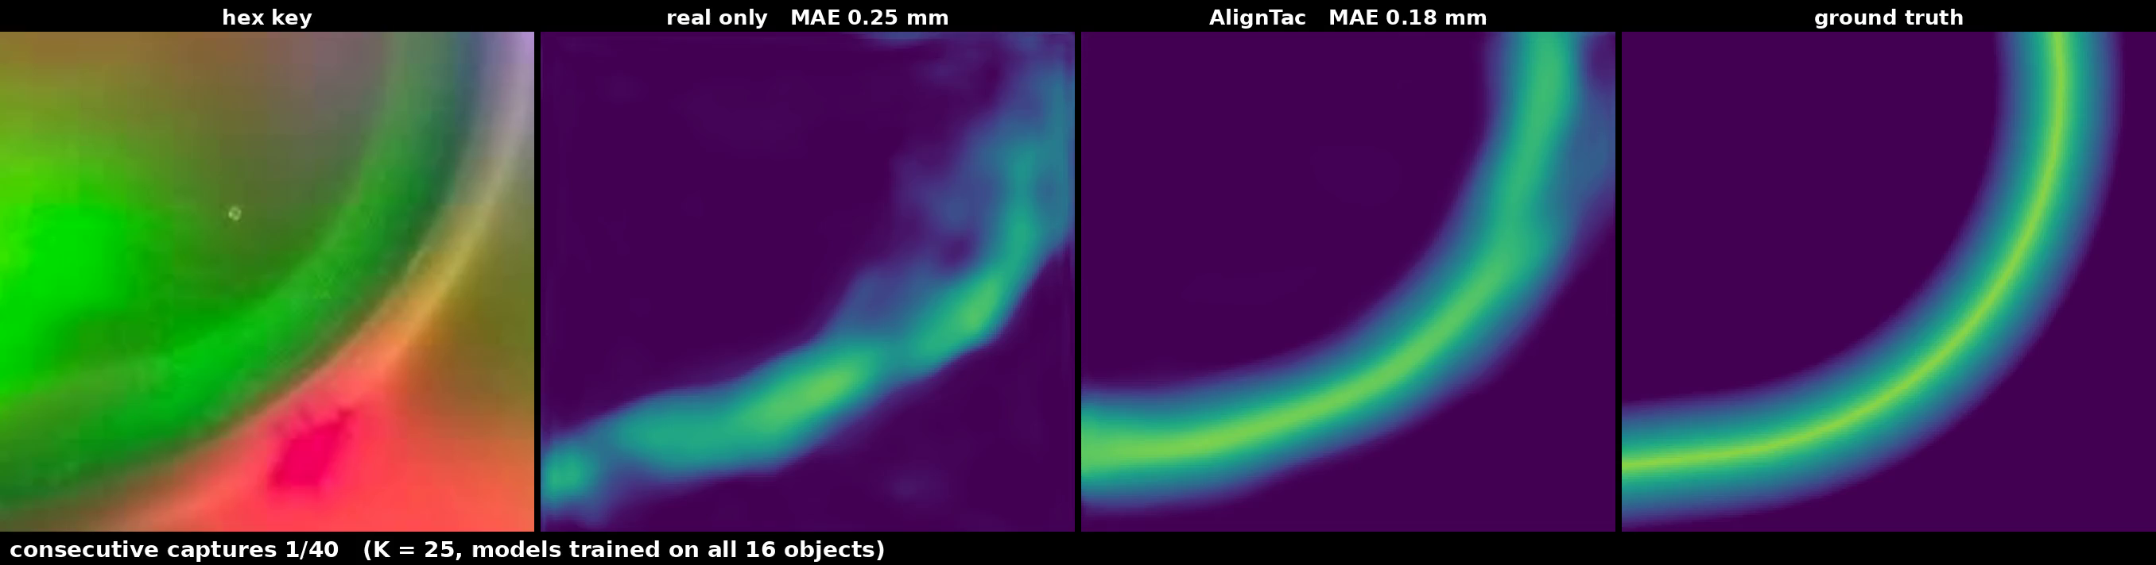
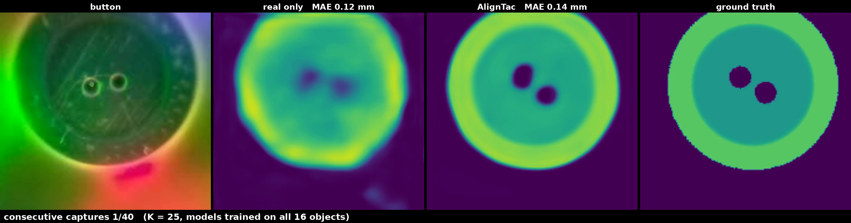
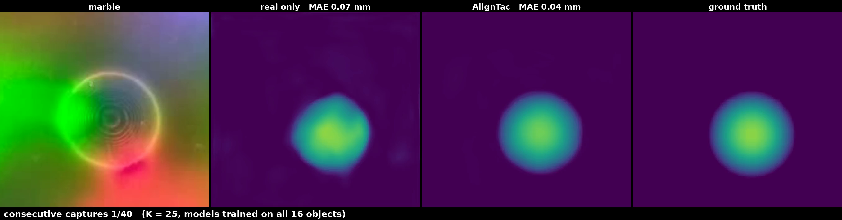
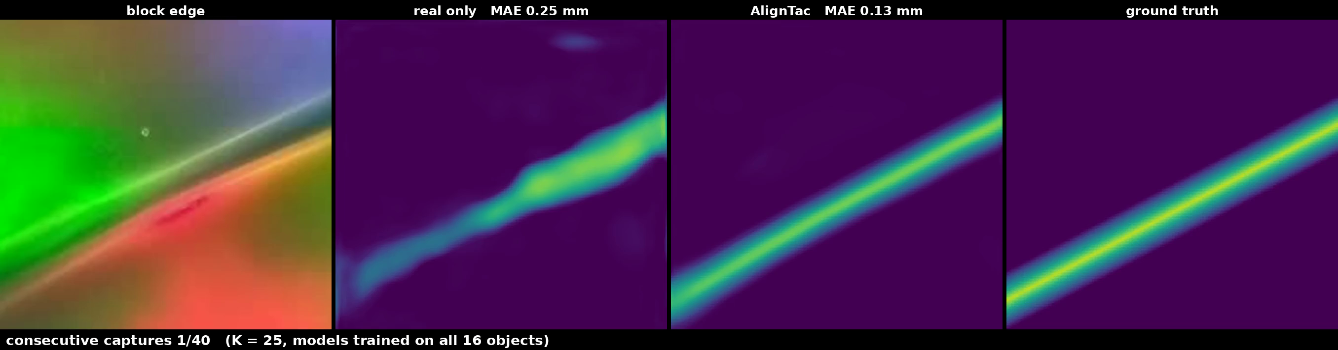
Robust across sessions, sensor variants and objects
Second session, zero-shot
Label-free adaptation
Dot-marker variant
objects re-placed, no retraining
contact MAE −14 to −21%
vs. real-only training
unlabeled session-2 images,
pseudo-labeled by the same aligner
a further −5% contact MAE
rotation 10.4° → 7.9°
retrained, same aligner settings
contact MAE −36% at K = 25
−15 to −33% at other budgets
Four additional objects, consecutive captures: real image | real only | AlignTac | ground truth — contact MAE 0.235 → 0.204 mm (−13%, three seeds)
Notes:
16 | On a second session with re-placed objects, error stays fourteen to twenty-one percent lower. Pseudo-labeling the new images with the same aligner, with no poses, lowers it a further five percent; on four new objects the gain is thirteen percent.

Slide 12
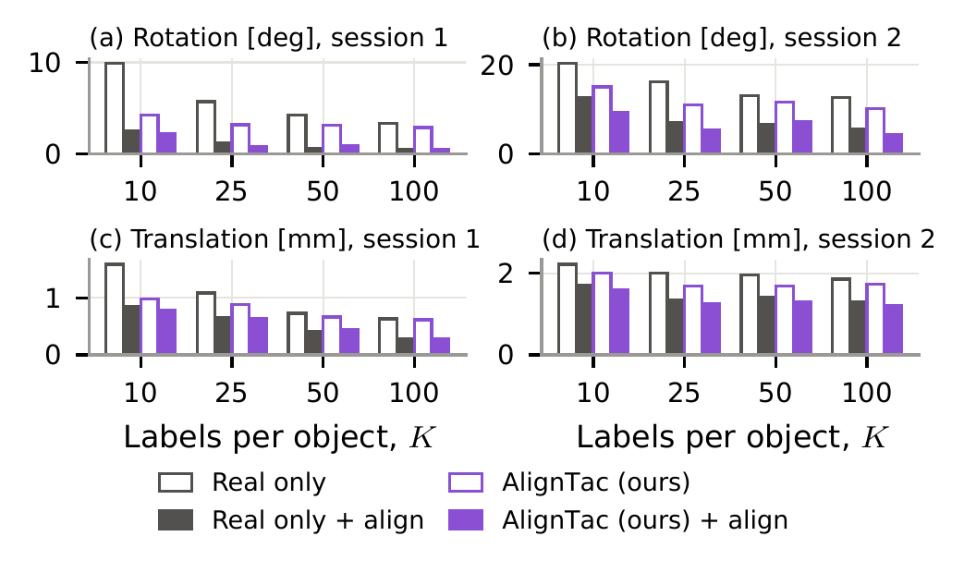
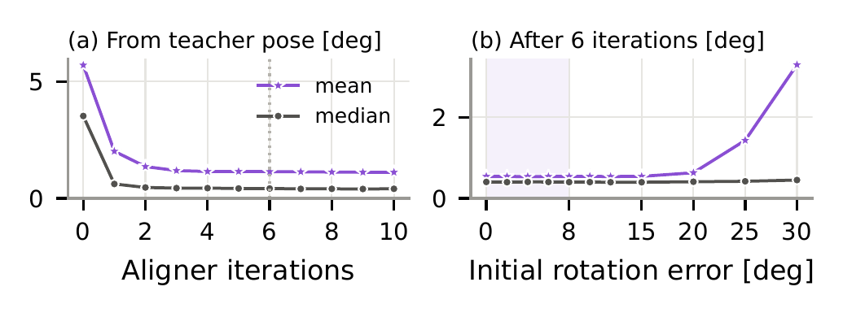
The aligner also refines pose at test time
From the teacher pose: 5.7° → 1.2° after three updates; 15° perturbations → 0.5°
Optional: standard inference needs only the image and the object identity
Notes:
12 | The same aligner also refines pose at inference: from the teacher's pose, rotation error drops from 5.7 to 1.2 degrees in three updates, and fifteen-degree perturbations shrink to half a degree.

Slide 13
Takeaways
• Real images supply appearance; a known mesh supplies geometry; AlignTac learns the contact state that connects them
• K = 25 labeled contacts per object: contact MAE −20% / −36% on two GelSlim 4.0 variants, matching real-only with 2× the labels
• Alignment, not geometry alone, makes the labels accurate (label IoU 0.47 → 0.72 with the same teacher)
• The same aligner pseudo-labels a new session without re-calibration and refines pose at inference
• Code will be released
Notes:
14 | In short: real images provide appearance, aligned geometry provides supervision. A few labeled contacts learn the alignment, which labels many more images, transfers to a new session, and refines pose at test time. Code will be released. Thank you.

