Slide 1
GelSlim 5.0:
Unifying Vision and Touch with a Single Fingertip Camera
Notes:
8

Slide 2


Vision and Touch Resolve Different Ambiguities
Before Contact
At Contact
Proximity vision provides global object context but does not directly measure contact geometry
Touch captures local contact structure, but similar contact patches may correspond to different object poses.
Notes:
10

Slide 3
GelSlim 5.0 can combine these complementary cues directly at the fingertip.
Notes:
3

Slide 4
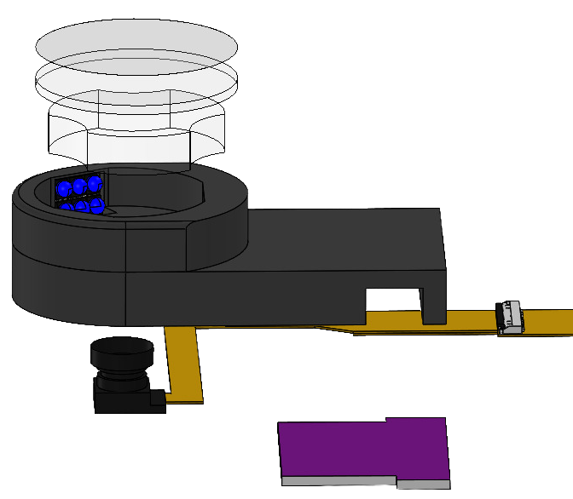
A single fixed camera captures both observation modes
UV-responsive Layer
Transparent Elastomer
Lens
UV LED
Sensor Body
Camera
LED Driver PCB
Notes:
8

Slide 5
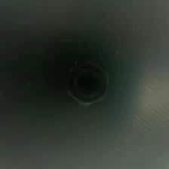
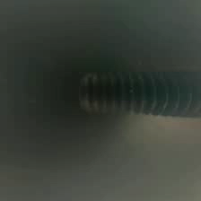
UV illumination switches the observation modality
Hex Nut
Screw
Notes:
10.5

Slide 6
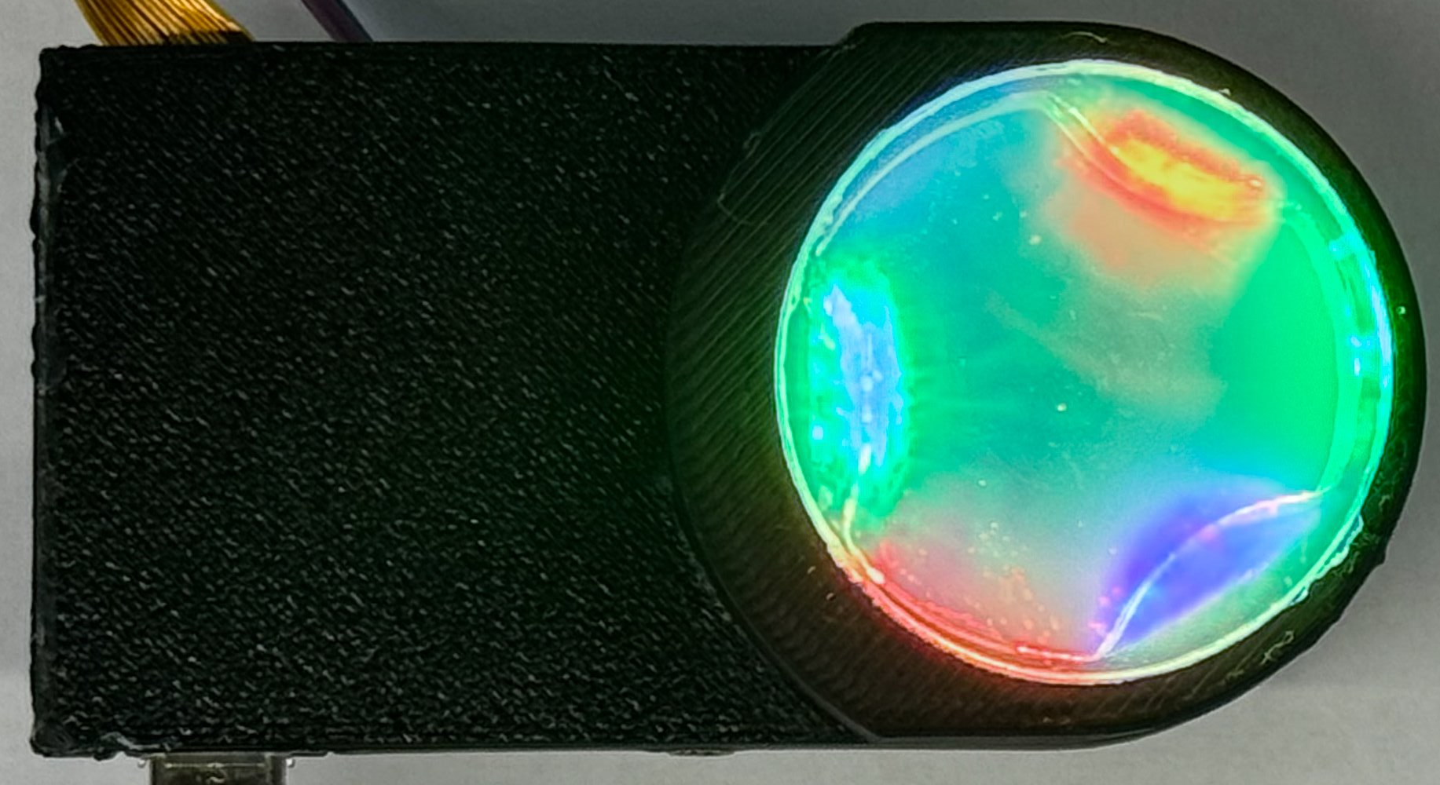
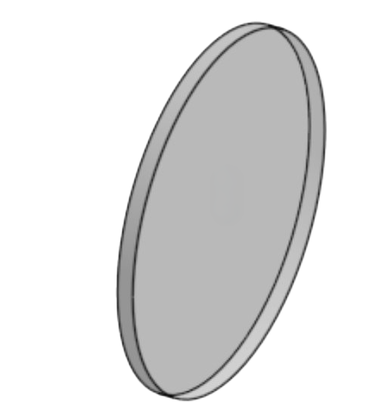

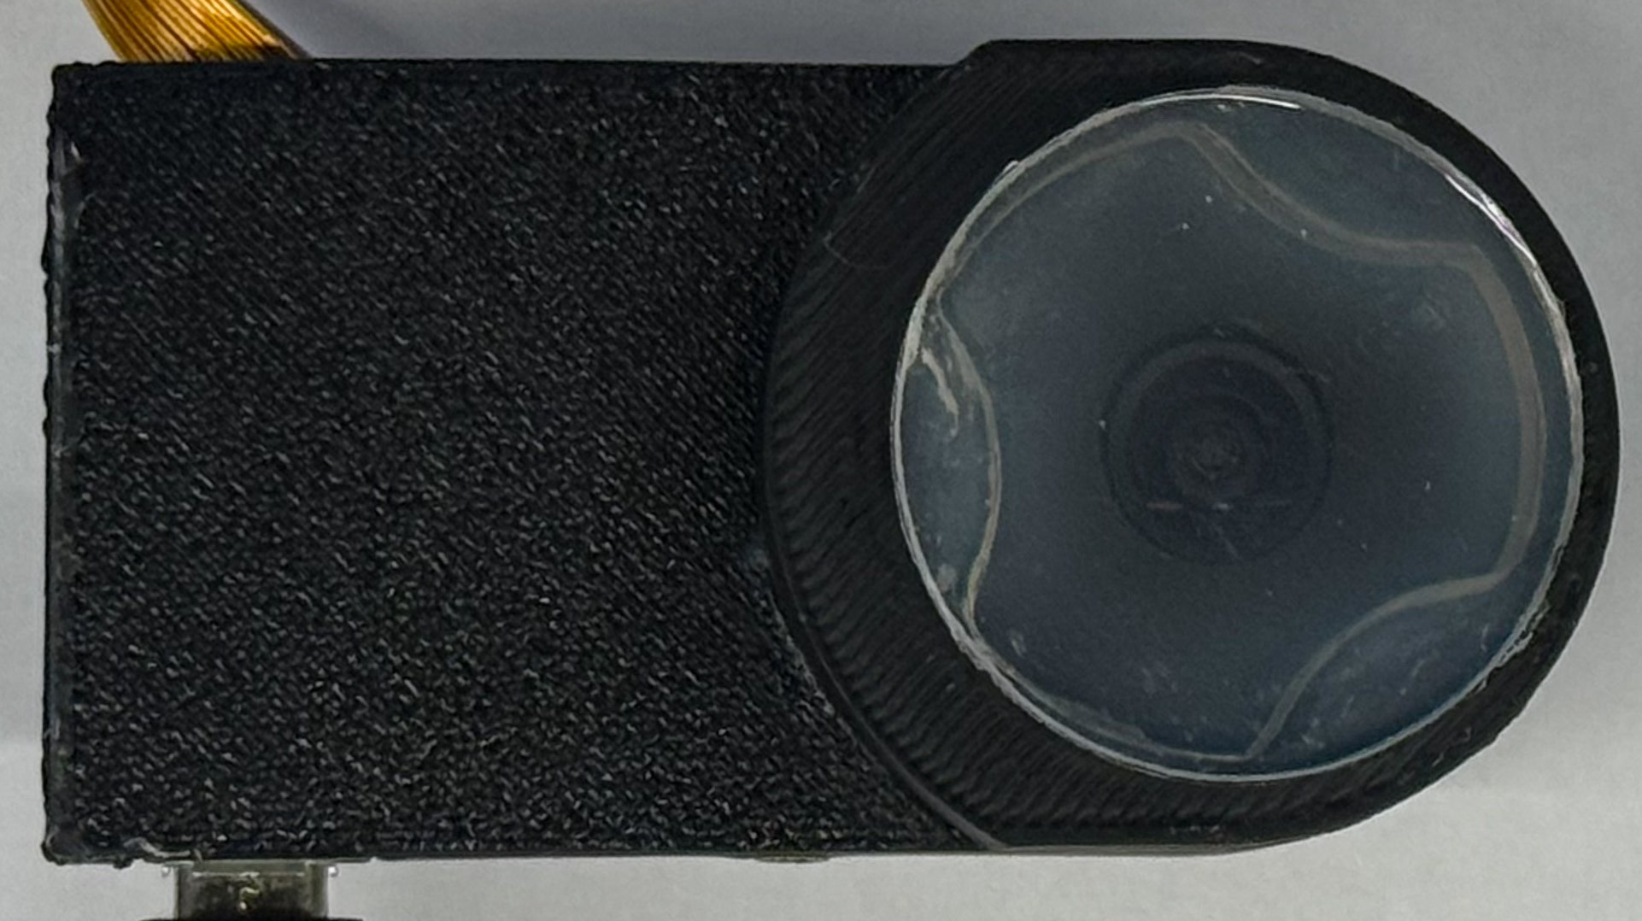
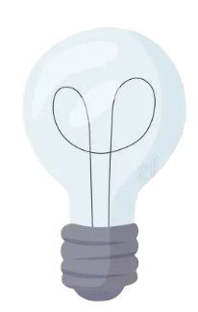
UV illumination switches the observation modality
UV LED
Transparent Elastomer
UV-responsive
Layer
Tactile Mode
UV on
Opaque
Opaque
UV off
Transparent
Proximity Mode
Switching illumination changes the observed modality while the camera and lens remain fixed.
Notes:
9

Slide 7
Real-World Data Acquisition
Sequential capture provides paired observations from a shared viewpoint.
Notes:
14.5

Slide 8
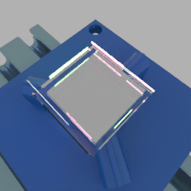
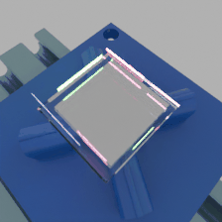
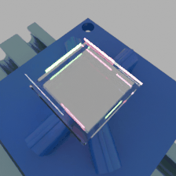
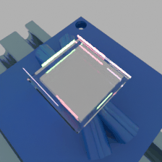
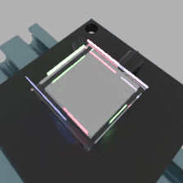

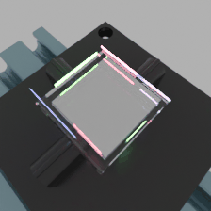

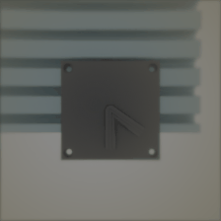
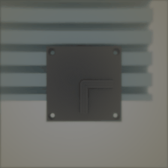
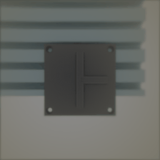

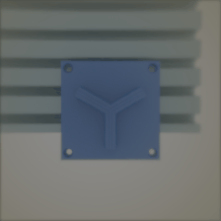
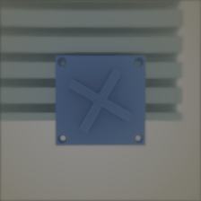
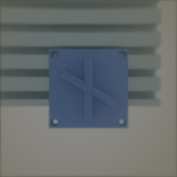
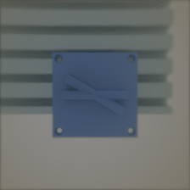
Simulation Data Generation
Sample pose and contact → Render visual/depth/normal → Generate tactile appearance → Export paired sample
Tactile Image
Visual Image
Notes:
5

Slide 9

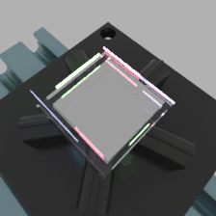



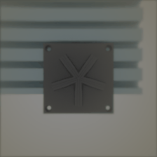

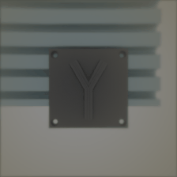
Simulation Data Generation
Sample pose and contact → Render visual/depth/normal → Generate tactile appearance → Export paired sample
Tactile Image
Visual Image
Notes:
5

Slide 10
Simulation Data Generation
Sample pose and contact → Render visual/depth/normal → Generate tactile appearance → Export paired sample
Tactile Image
Visual Image
Notes:
5

Slide 11
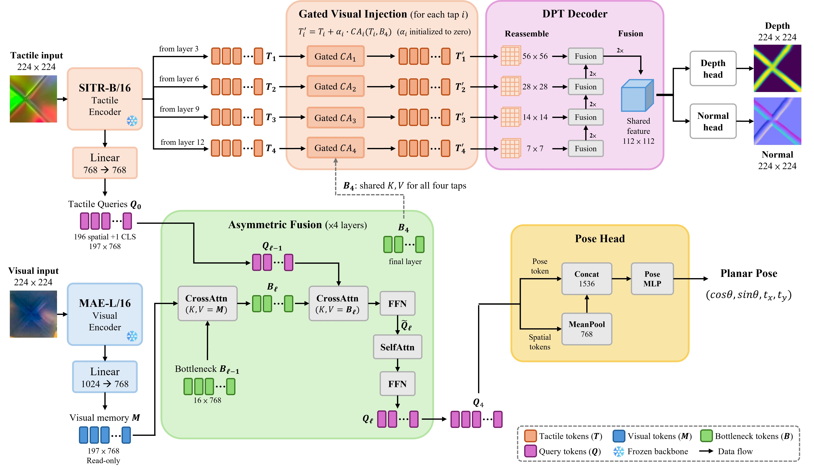
VisTacFusion jointly estimates contact geometry and planar pose
Cross-attention associates the modalities without requiring exact pixelwise correspondence.
Notes:
8

Slide 12
Touch recovers local geometry while vision constrains global pose
Depth Map
Normal Map
Tactile Image
Notes:
10

Slide 13
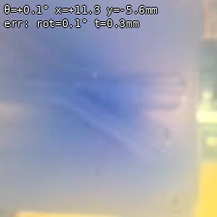
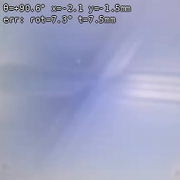
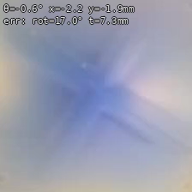
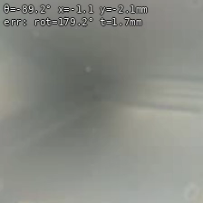
Touch recovers local geometry while vision constrains global pose
SE(2) Pose
Notes:
11

Slide 14
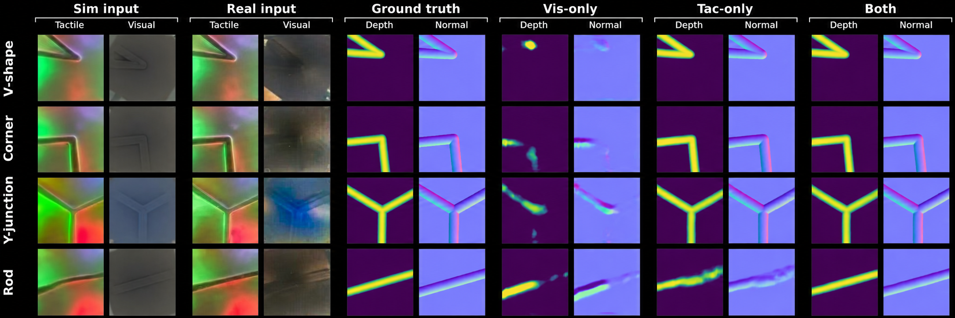
Paired vision and touch improve both geometry and pose
Paired vision and touch outperform either modality alone
Vision supplies global object context; touch supplies direct local contact evidence.
Notes:
8

Slide 15
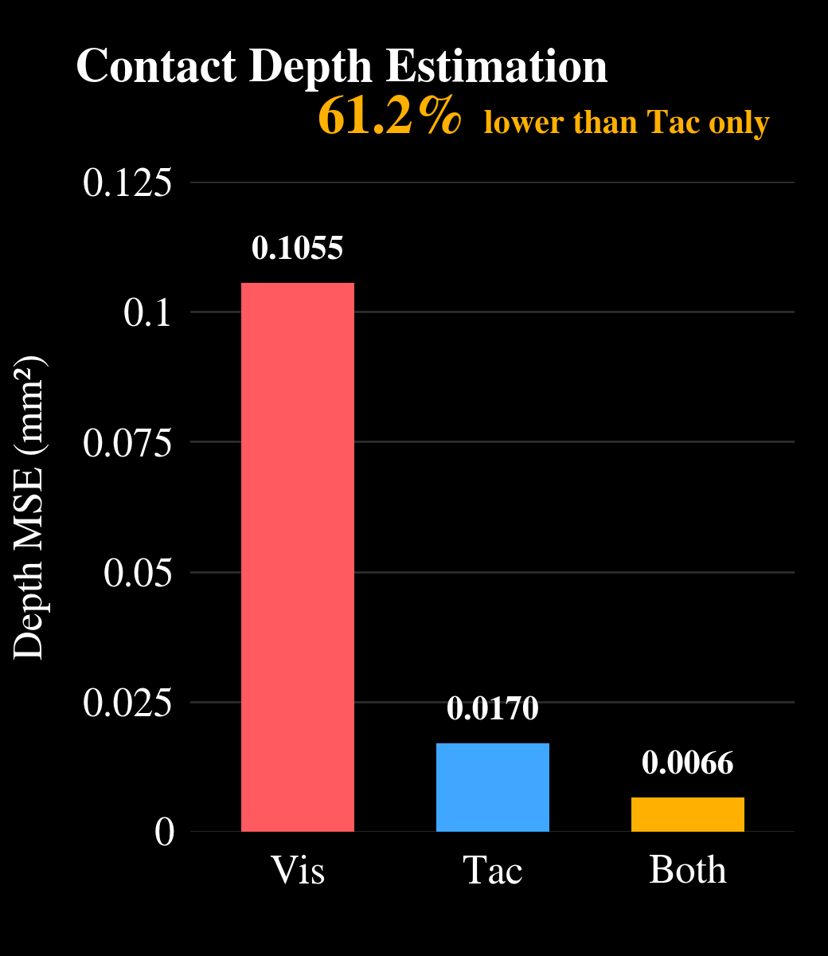
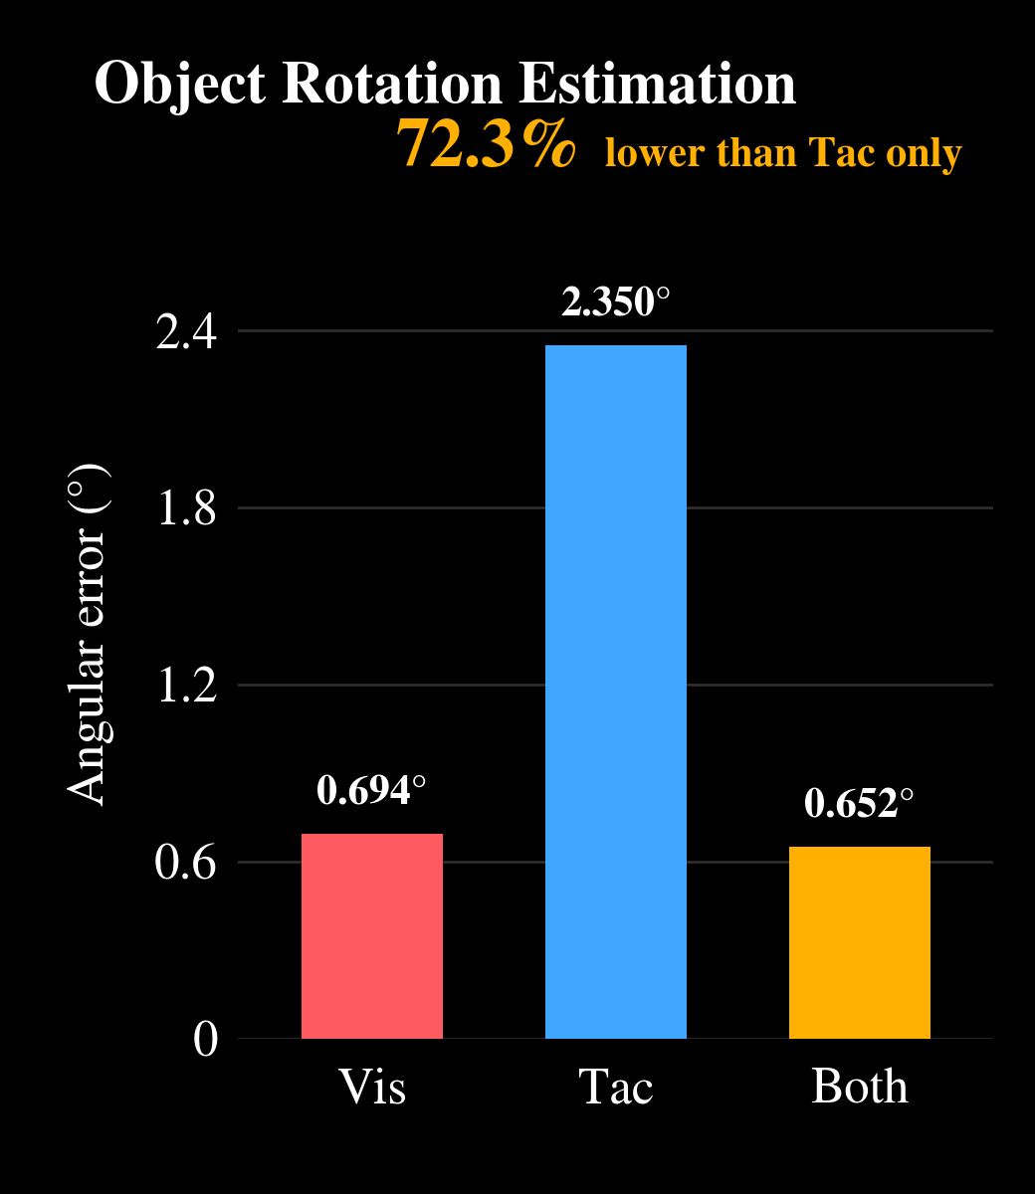
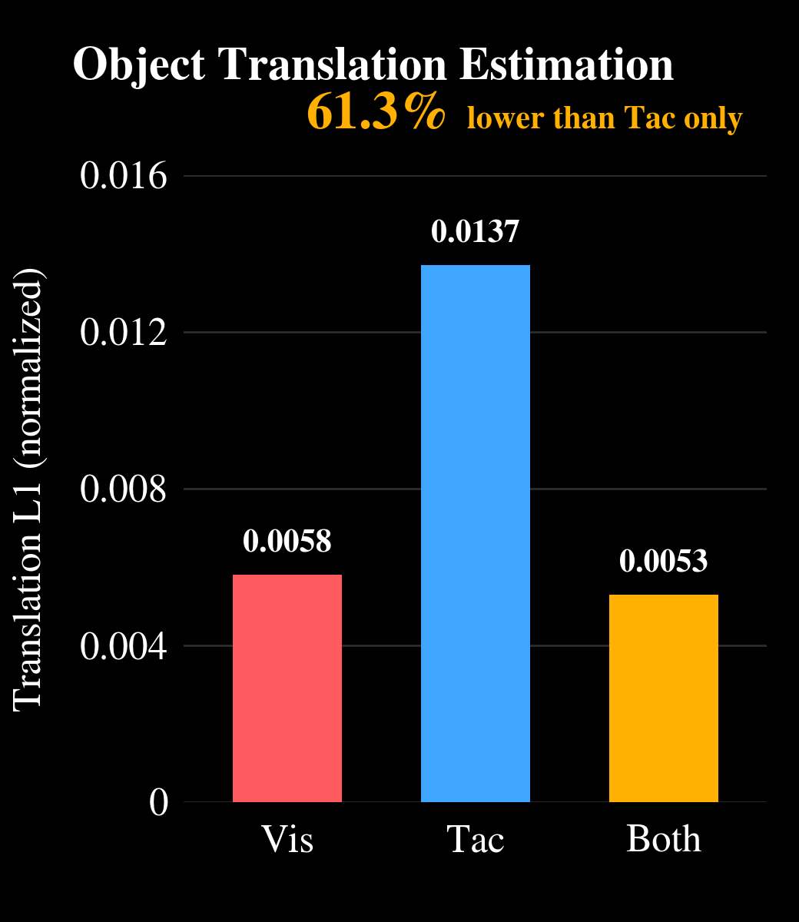
Paired input achieves the lowest error across all five metrics
The largest cross-modal gains occur when tactile-only inference lacks global pose context and visual-only inference lacks direct contact geometry.
Notes:
8

Slide 16
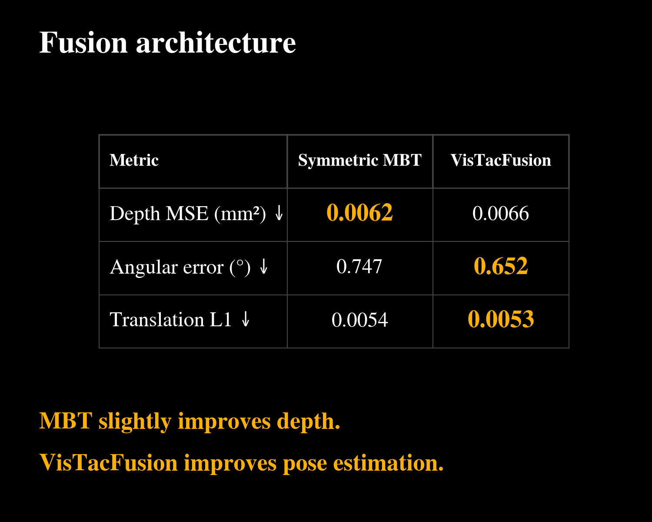
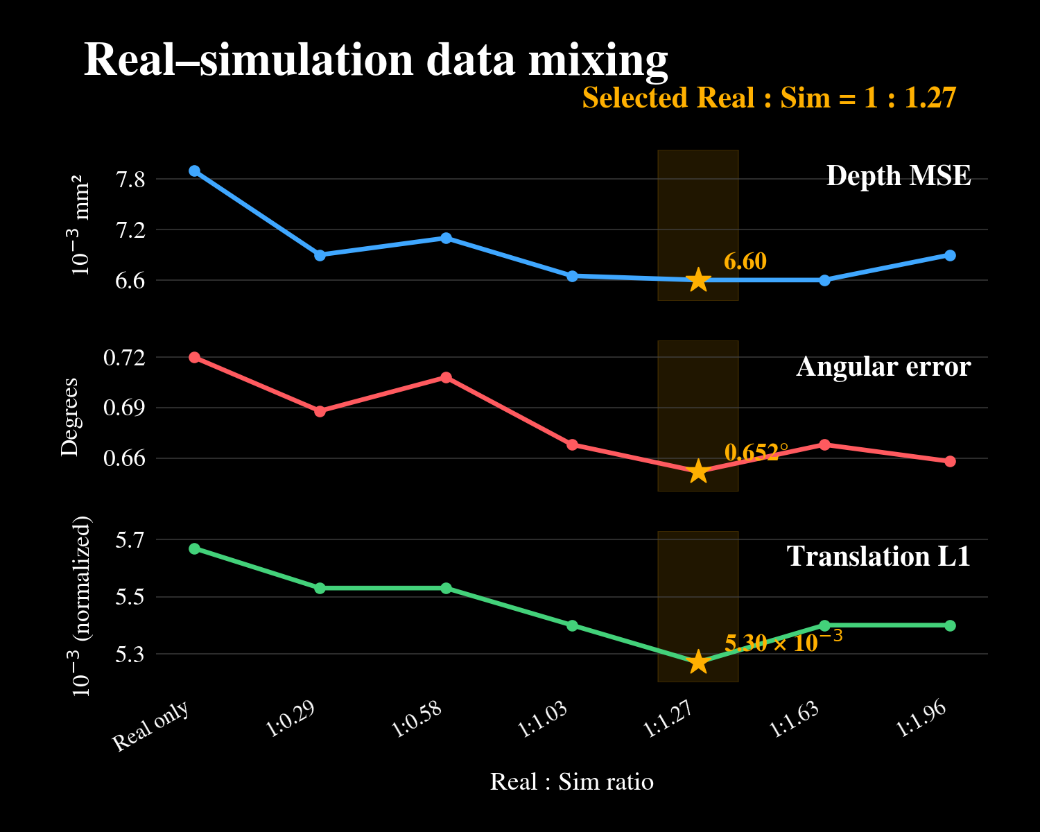
Fusion design and data balance affect different outputs
Symmetric MBT slightly improves depth, while VisTacFusion improves pose estimation.
Moderate simulation improves real validation, but additional synthetic data does not produce monotonic gains.
Notes:
8

Slide 17
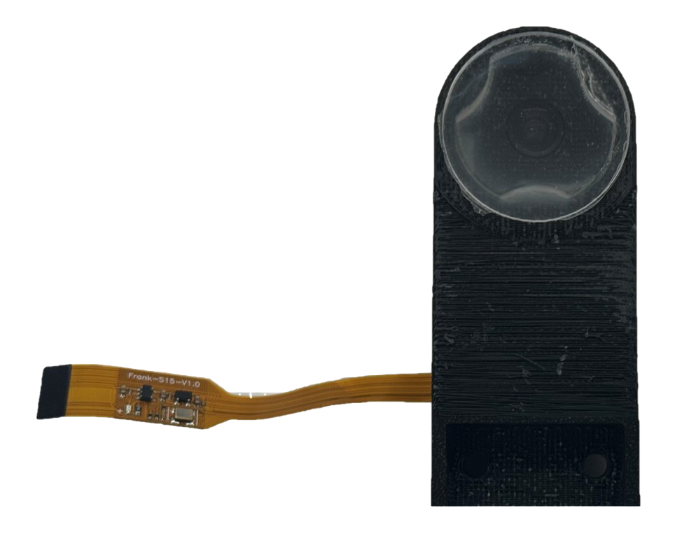
One camera supports complementary vision and touch
Shared-view sensing
UV illumination switches between proximity and tactile observations while the camera remains fixed.
Complementary fusion
Paired inputs improve both contact geometry and planar pose over Vis-only and Tac-only inputs.
Balanced simulation
Real-simulation co-training improves real validation, with the best overall balance at 1:1.27.
Notes:
8

