Slide 1

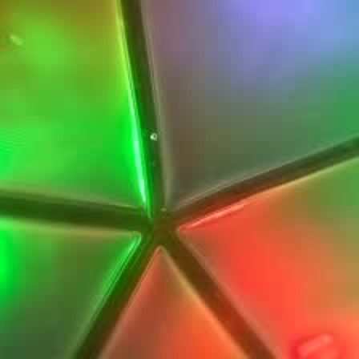

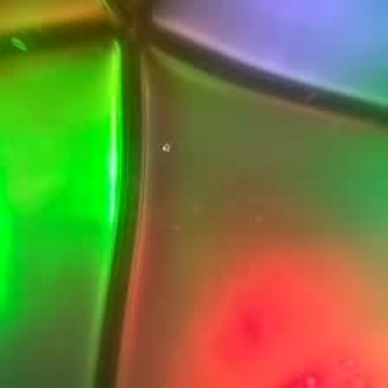
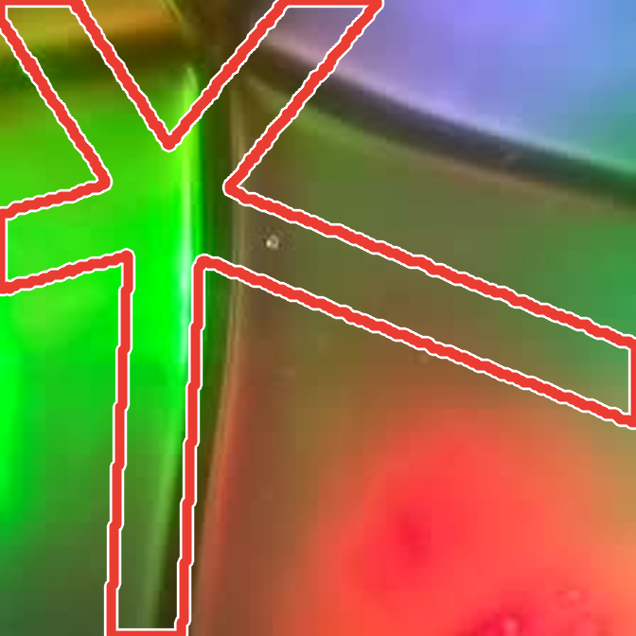
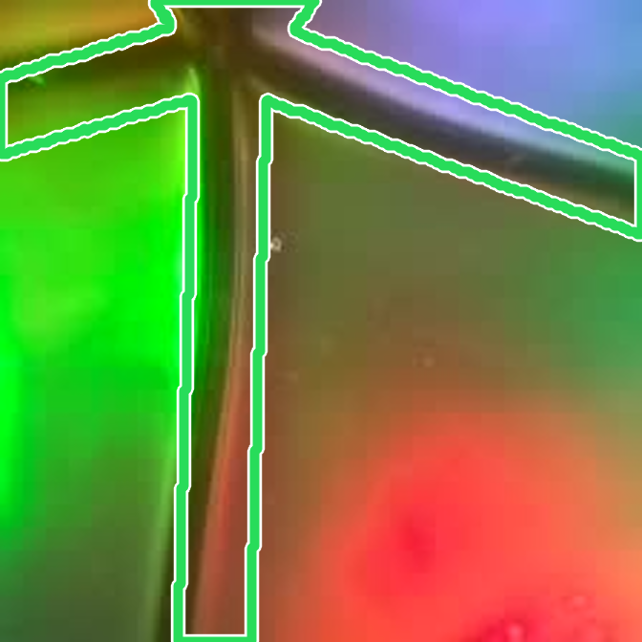
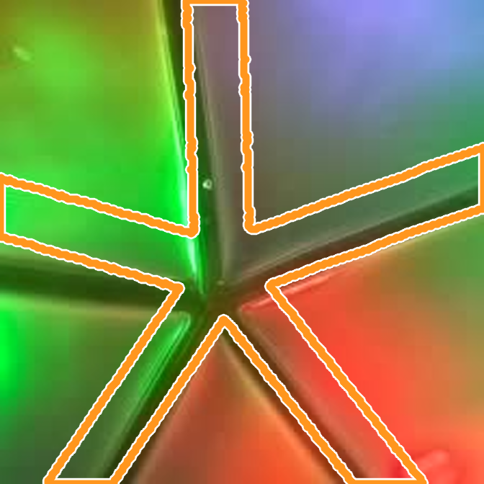

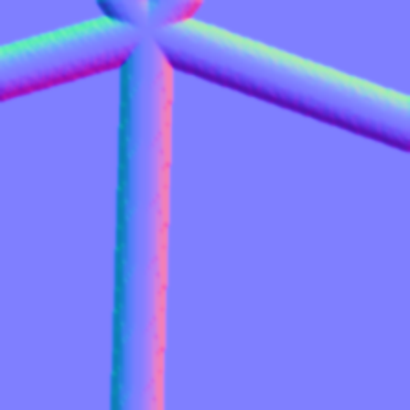
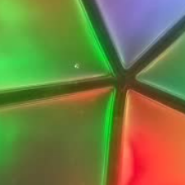

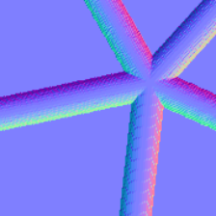
(a) Training
1
Train teacher and aligner
2
Align the mesh to each unlabeled image
3
Train student
on K GT-labeled contacts per object
mesh ℳ
on all real images
Teacher
f^{t}
K GT-labeled
Teacher
f^{t}
Aligner
𝒜
image I
GT label at q*
same image, mesh moved by a known δ:
↻ 6 updates
Student
f^{s}
unlabeled image
initial state q₀
aligned state q_{T}
Aligner
𝒜
pseudo-labeled
−δ
Pseudo-label
= mesh projected at q_{T}
mesh at q* + δ
correction
outlines: mesh contact region at the state
depth
normals
pose
(b) Inference
Optional: pose refinement when the mesh is available
Student
f^{s}
pose as q₀
Aligner
𝒜
refined pose
+ image I, mesh ℳ
image I + object ID o
depth
normals
pose

