Slide 1
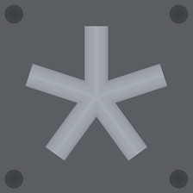



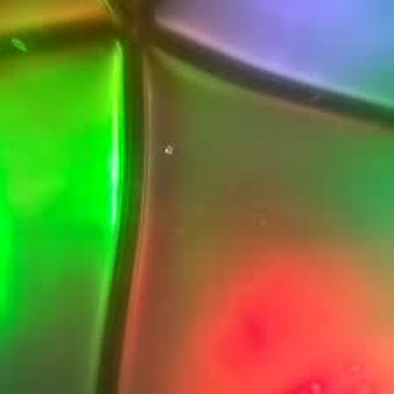
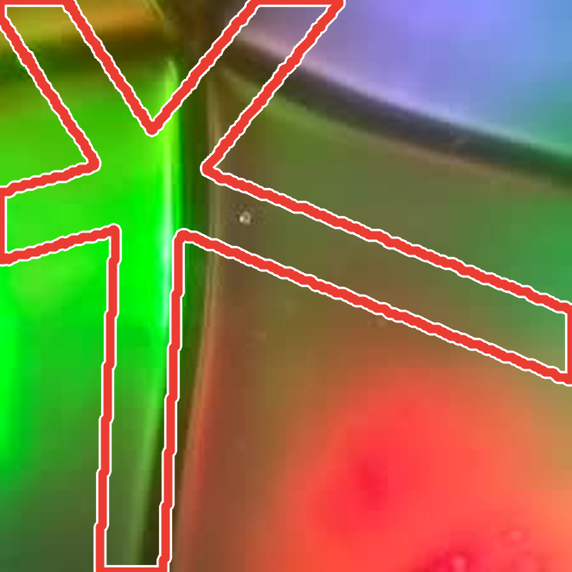
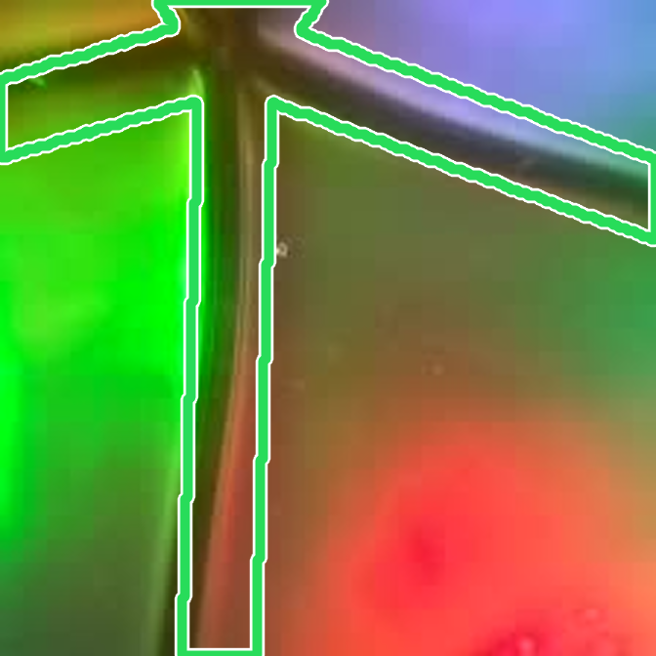
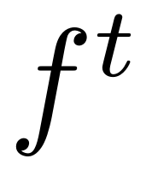
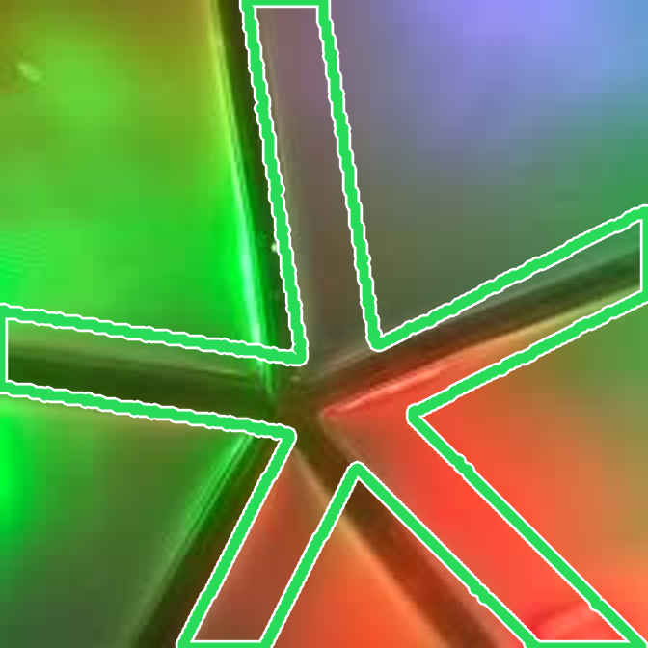
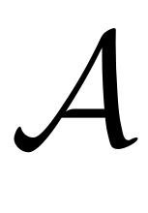
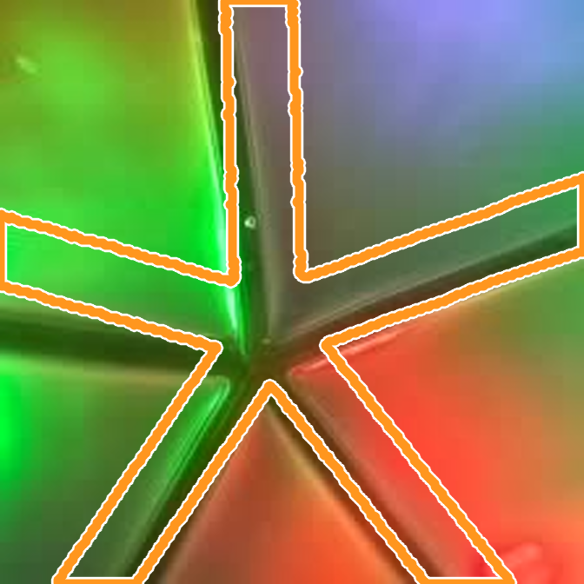



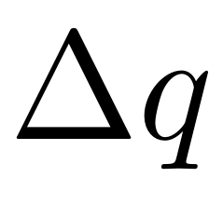
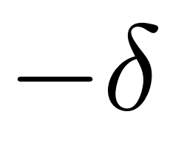

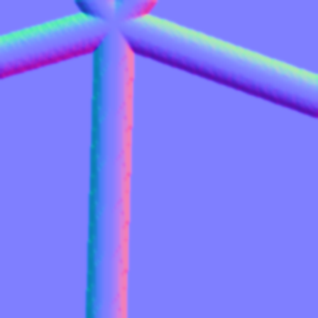


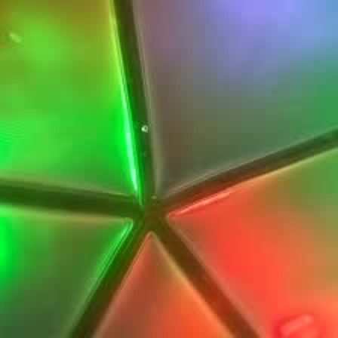
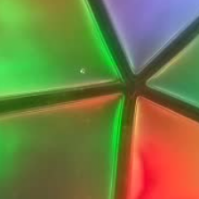

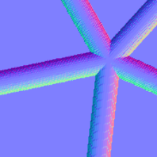
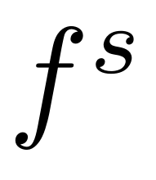
(a) Training
1
Train teacher and aligner
2
Pseudo-label the unlabeled real images
image
Teacher
depth
normals
pose
loss
Teacher
predict
Aligner
prediction
GT label
perturb GT state
↻ 6 updates
unlabeled real images
Aligner
loss
real images
prediction
target
outlines: mesh contact region at each state
depth
normals
pose
3
Train student
(b) Inference
Student
depth
normals
pose
loss
Student
Aligner
+
pseudo-labeled
prediction
GT label
pseudo-label
real image
+ object ID
depth
normals
pose
refined pose

