Slide 1
THE
BUILDERS'
OPS STUDIO
A LIVE BUILD SESSION
Beyond
Prompting
Building with AI for small business. Not the prompts. The machine that runs the back office while you sleep.
CYNTHIA JONES
THEBUILDERSOPSSTUDIO.COM

Slide 2
START HERE
There's a gap between using AI
and AI doing the work.
Most people have used AI to write a caption, an email, a post. Far fewer have an AI tool that actually ran a part of their business for them, while they slept.
That gap is the whole reason for tonight.
THE BUILDERS' OPS STUDIO
01 · THE GAP

Slide 3
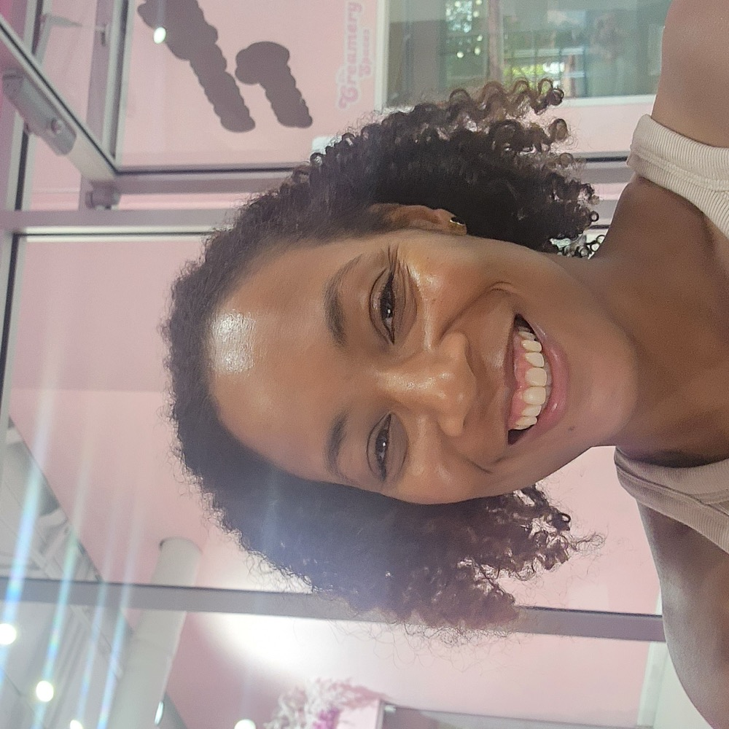
WHY ME
Fifteen years building
other people's operations.
Multimillion-dollar budgets. Teams across five continents. Then a course teaching software engineers how AI systems actually work, the real machinery behind the tools. Now that same infrastructure, built for small businesses.
CYNTHIA JONES · FOUNDER
01
I build it
Not slideware. Real systems that ship.
02
Enterprise ops
For businesses our size.
03
I taught the AI
No guessing on what it can do.
THE BUILDERS' OPS STUDIO
02 · WHY ME

Slide 4
THE REFRAME
Most AI talk is about the front of your business. More followers. More leads. More customers at the door.
My work starts the moment they walk through it.
“She fills the top of the funnel. I build the machine that keeps the bottom from leaking.”
CYNTHIA JONES
03 · FRONT VS. BACK

Slide 5
THE STAKES
More customers without a system underneath isn't growth.
It's just a bigger fire.
THE BUILDERS' OPS STUDIO
04

Slide 6
SHOW, DON'T TELL
Two real
businesses.
Not demos. Not mockups. Systems running right now for a Georgia bakery and a wellness coach.
CYNTHIA JONES
05 · THE BUILDS

Slide 7
BUILD ONE · THE BAKER
Twenty years of demand.
No system.
Orders in her DMs. Capacity in her head. Turning away business she couldn't track.
01
A live order form with a capacity tracker
She never over-commits her oven again. The system says when she's full.
02
Standing orders that run themselves
Her regulars get a text every Thursday, the order processes automatically. Guaranteed weekly revenue on autopilot.
03
No monthly subscription
She owns it. The software and the data are hers.
THE BUILDERS' OPS STUDIO
06 · THE BAKER

Slide 8
BUILD TWO · THE WELLNESS COACH
Real brand. Real following.
All of it in her head.
Everything ran on her phone and her memory.
01
A client portal
Her whole coaching relationship in one place: intake, sessions, progress, contracts.
02
One-click enroll
An application comes in, the right emails go out automatically. Turning an applicant into a client takes one click instead of a week.
03
She got her hours back
From running her practice in her head to running it from a dashboard.
THE BUILDERS' OPS STUDIO
07 · THE COACH

Slide 9
WHAT THIS MEANS FOR YOU
Built, not rented.
And finally affordable.
These aren't apps they rented. They were built for the specific business, the owner owns them, and they're designed to run without her touching every piece.
Custom software used to cost fifty thousand dollars and a development team. AI is what makes building this for a small business affordable now. That's the real headline. You can finally own infrastructure that used to be only for big companies.
CYNTHIA JONES
08 · WHY NOW

Slide 10
WHERE TO START
You don't need all of it at once.
It starts with one question:
where is your business breaking?
We find that first. Then we build the one thing that fixes it.
THE BUILDERS' OPS STUDIO
09 · ONE QUESTION

Slide 11
AN IDEA I'M TESTING
A small hands-on series.
A few of us, building one real system together over a few weeks. Not a lecture. A build.
If that sounds useful, find me after and tell me. I'm listening for whether there's appetite for it.
THE BUILDERS' OPS STUDIO
10 · THE SERIES

Slide 12

THE ASK
If your business is
running you,
let's fix that.
A free 45-minute discovery call. We sit down, I help you see where the gaps are. No pitch.
SCAN TO BOOK YOUR CALL
thebuildersopsstudio.com
The code books it. Grab a slot tonight.
cynthia@thebuildersopsstudio.com
CYNTHIA JONES
11 · BOOK A CALL

Slide 13
THE
BUILDERS'
OPS STUDIO
STRATEGY · SYSTEMS · STRUCTURE
I build the systems
your business runs on.
Cynthia Jones · The Builders' Ops Studio. Thank you.
CYNTHIA@THEBUILDERSOPSSTUDIO.COM
THEBUILDERSOPSSTUDIO.COM

