Slide 1

Maldives
MALDIVES · 5 DAYS 4 NIGHTS
5 Days · 4 Nights Itinerary
Hulhumalé → Maafushi → Kurumba Resort
A complete guide to daytime activities, restaurants, accommodation and costs
Prepared November 2026 · Prices are estimates
Notes:
This presentation outlines a five-day, four-night Maldives itinerary: Night 1 in Hulhumalé, Nights 2–3 on Maafushi, and Night 4 at Kurumba Resort. Prices are reference estimates from booking and travel platforms in 2026.

Slide 2
A city stay, a local island and a five-star resort in one trip
Itinerary Overview
Four nights across three stays, all within an hour by boat from the airport. November marks the start of the dry-season high season, with generally stable sea conditions.
Night 1
Nights 2–3
Night 4
Budget per person
Hulhumalé
Maafushi
Kurumba
US$570–870
A reclaimed island town with a long beach and Central Park, about 10 minutes from the airport
A popular local island with guesthouses, restaurants and snorkeling excursions
The Maldives’ first resort, with a private white-sand beach and alcohol available on the island
Based on two people sharing a room; international flights excluded
Budget option: approx. US$410–600
From US$108 / night
From US$55 / night
US$441–666 / night
D1 Arrive in Hulhumalé
D2 Malé → Maafushi
D3 Snorkeling and island-hopping
D4 Upgrade to a resort
D5 Return journey
Maldives · 5 days / 4 nights · 2026 reference prices; reconfirm before booking
Notes:
Each stay offers a different experience: convenient arrival in Hulhumalé, affordable accommodation and excursions on Maafushi, and a resort stay at Kurumba. The estimated budget is US$570–870 per person, excluding flights.

Slide 3
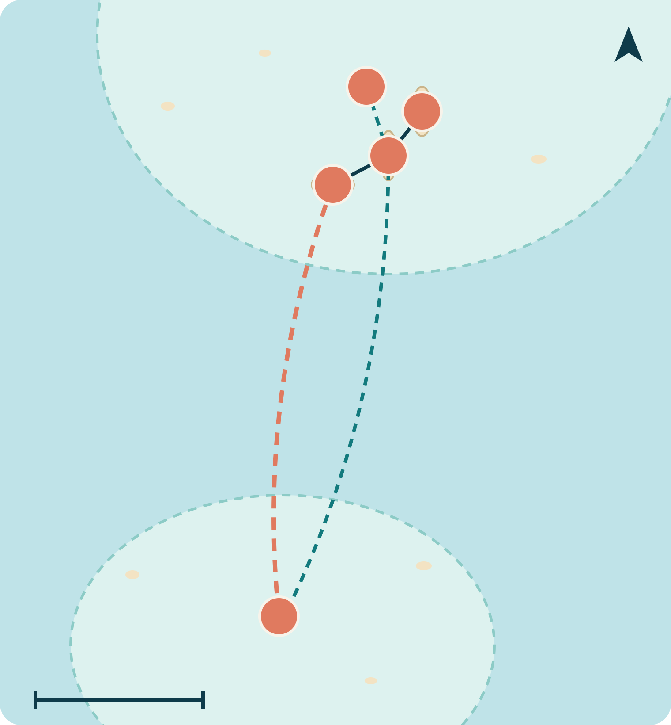
All within one hour by boat from the airport
Map Information
North Malé Atoll
5
N
2
1
1
Velana International Airport
3
Hulhulé Island · Arrival/departure point and speedboat terminal; the hub for all transfers
2
Hulhumalé
Night 1 · About 10 minutes by road from the airport
Day 2: Ferry 90 min
Speedboat 45 min
Day 4: Speedboat
Return to the airport
3
Malé
Day 2 morning · The capital, connected to the airport island by a bridge
4
Maafushi
South Malé Atoll
Nights 2–3 · Ferry approx. 90 minutes; speedboat approx. 45 minutes
4
5
Kurumba Resort
Approx. 10 km
Night 4 · About 10 minutes by resort speedboat
Schematic map; locations and distances are approximate
Notes:
This schematic map marks five locations. The airport is the transfer hub: Hulhumalé and Kurumba are each within about 10 minutes, while Maafushi is in South Malé Atoll, about 90 minutes by ferry or 45 minutes by speedboat.

Slide 4
Arrival
Hulhumalé Beach
DAY 1 · Day One
Arrival
Velana Airport → Hulhumalé
A few US dollars by taxi
Taxi or bus, approx. 10 minutes
Lunch
Cafe Hive
Budget-friendly
Well-reviewed chicken biryani and fresh watermelon juice
Reach this beachside town just 10 minutes after landing. Take it easy and adjust to the time difference on day one.
Afternoon
Hulhumalé Beach and Central Park
Free
Walk and watch the sunset; dress modestly on the beach
Tonight’s Stay
Amber Beach Hotel
Red Snapper & Coffee Beans
From approx. US$108 / night · Sea view, near the bus stop
Dinner
Budget-friendly
10710 Kaani Magu · Rooftop views of the beach and arriving/departing aircraft
DAY 1 / 5 · 2026 reference prices; reconfirm before booking
Notes:
第一天抵達後直接到胡魯馬累，離機場很近。午餐 Cafe Hive，下午逛海灘與中央公園，晚餐到 Red Snapper 頂樓看飛機起降，住 Amber Beach Hotel。

Slide 5
Explore Malé
Continue to Maafushi
DAY 2 · Day Two
Morning
Half-day walking tour of Malé
Museum: US$7–10
Old Friday Mosque, fish market, Sultan Park and National Museum
Lunch
Salt Café & Restaurant
Approx. £23 per person
Floors 6–7, Shinetree Building · Views over the harbour and fish market
Explore the capital in the morning, then take a boat to the local island in the afternoon. Public ferries do not operate on Fridays; avoid Friday or take a speedboat.
Afternoon
15:00 ferry or shared speedboat
US$2–3 / 20–30
Ferry: approx. 90 minutes; speedboat: approx. 45 minutes
Tonight’s Stay
Coco Grill（Arena Beach）
Sunrise Beach
Dinner
Affordable seafood
Right on Bikini Beach; well-reviewed grilled reef fish
From approx. US$55 / night · About 200 m from Bikini Beach
DAY 2 / 5 · 2026 reference prices; reconfirm before booking
Notes:
上午在馬累步行看清真寺、魚市場和博物館，午餐在 Salt Café。下午三點搭公營渡輪，或改搭快艇到馬富士，晚餐在比基尼海灘上的 Coco Grill。

Slide 6
Snorkeling and Island-Hopping
Turtles and Sandbanks
DAY 3 · Day Three
Breakfast
Sunrise Beach Restaurant
Breakfast included with selected room rates
Restaurant at the accommodation
Morning
Coral Garden and Turtle Snorkeling Tour
From £45 per person
Little Sea Maldives, equipment included; or a half-day tour with lunch on a sandbank
Set out from Maafushi for a morning of coral and turtle spotting, followed by a picnic on a sandbank.
Afternoon
Bikini Beach, kayaking and stand-up paddleboarding
US$10–20 / hour
For more excitement, try parasailing, approx. US$70–100
Tonight’s Stay
Sunrise Beach
Stingray Cafe
From approx. US$55 / night · Second night of stay
Dinner
Affordable seafood
Tuna fried rice, prawns and seafood platters
DAY 3 / 5 · 2026 reference prices; reconfirm before booking
Notes:
第三天是整趟的海上日：上午參加浮潛團看珊瑚與海龜，午餐可在沙洲野餐；下午在比基尼海灘玩水上活動，晚餐到 Stingray Cafe 吃海鮮。

Slide 7
Upgrade to Five-Star Luxury
Kurumba
DAY 4 · Day Four
Morning
Speedboat to the airport → Resort speedboat
Speedboat: US$20–30
About 10 minutes from the airport to Kurumba; confirm transfer fees with the resort in advance
Lunch
Kurumba Cafe
À la carte
Open 24 hours by the pool: pizza, burgers and Maldivian snacks
Return near the airport and stay at the Maldives’ first resort. Spend the afternoon enjoying the beach and spa.
Afternoon
White-sand beach, snorkeling, pool and Veli Spa
Some activities cost extra
Alcohol is available on the resort island; dress is more relaxed
Tonight’s Stay
Kurumba Maldives
Thila、Khing Thai、Al Qasr
Approx. US$441–666 / night · Check-out at 12:00
Dinner
+US$50 per person and up
Half-board includes breakfast and dinner; 50% off at selected specialty restaurants
DAY 4 / 5 · 2026 reference prices; reconfirm before booking
Notes:
第四天從馬富士搭快艇回機場，再轉度假村快艇到 Kurumba。午餐在泳池旁的 Kurumba Cafe，晚餐可選島上的特色餐廳，加購半膳方案每人每天約 50 美元起。

Slide 8
Breakfast
The Journey Home
DAY 5 · Day Five
Breakfast
Vihamanaa Buffet Breakfast
Included in the room rate
Kurumba’s main restaurant
Morning
Last snorkeling session → Resort speedboat to the airport
Transfer charged separately
Arrive at the airport 3 hours before departure
The resort is only a 10-minute boat ride from the airport, leaving time for one last swim in the morning.
Budget Alternative
Stay in Maafushi for the fourth night and take a resort day trip instead
An all-inclusive day trip to Adaaran Club Rannalhi costs approx. US$65, including boat transfers, lunch and unlimited drinks.
Save approx. US$400 per person, reducing the total budget to US$410–600
DAY 5 / 5 · 2026 reference prices; reconfirm before booking
Notes:
最後一天在 Kurumba 吃完早餐，上午還能浮潛，再搭度假村快艇回機場。如果預算有限，可以第四晚續住馬富士，改參加 Adaaran Club Rannalhi 全包一日遊，每人約省 400 美元。

Slide 9
Three Stays, One Trip
Accommodation Overview
Night | Accommodation | Features | Per Room / Night
Night 1 | Amber Beach Hotel | Hulhumalé Beach Road; sea view, near the bus stop | US$103–145
Nights 2–3 | Sunrise Beach | Maafushi; approx. 200 m from Bikini Beach | From US$55
Night 4 | Kurumba Maldives | Private island, 7 restaurants, spa; alcohol available | US$441–666
Green Tax Paid Separately
Booking Links
US$6 for guesthouses; US$12 for hotels and resorts, per person per night
Amber Beach · Sunrise Beach · Kurumba
Rates are recent ranges found on booking platforms and often exclude 17% tourism tax and 10% service charge
Notes:
三個住宿依序是方便的城市飯店、平價的在地島民宿、五星度假村。房價會依日期浮動，訂房時要看含稅總價，綠色稅另外依人頭與晚數計。

Slide 10
US$570–870
Item | Low Estimate (US$) | High Estimate (US$)
Accommodation | 330 | 506
Green Tax | 30 | 36
Transport | 22 | 60
Activities | 62 | 70
Meals | 125 | 200
Total | Approx. 570 | Approx. 870
Estimated Budget · Per Person
Based on two people sharing a room; excludes international flights and Kurumba transfers. One night at Kurumba accounts for about two-thirds of accommodation costs.
Budget option: approx. US$410–600
Accommodation is based on the listed room-rate ranges divided by two; meals are estimated at US$25–40 per day on the local island, plus Kurumba half-board
Notes:
每人約 570 到 870 美元，不含機票。住宿占最多，其中 Kurumba 一晚就占大部分；如果改成第四晚續住馬富士加度假村一日遊，每人約 410 到 600 美元。

Slide 11






Six Things to Know Before You Go
Practical Information
No Public Ferry on Fridays
No Alcohol on Local Islands
Dress Code
Malé → Maafushi ferry departs daily at 15:00, with an additional 10:00 service on Sundays, Tuesdays and Thursdays. On Fridays, take a speedboat.
Alcohol is not sold on Maafushi. To drink, visit a resort or join a resort day trip that serves alcohol.
Swimwear is permitted only at Bikini Beach on local islands. Cover your shoulders and knees in villages and mosques.
Check the Total Price Including Taxes
Traveller Declaration
Best Season
Room rates often exclude 17% tourism tax, 10% service charge and green tax.
Complete the IMUGA online traveller declaration within 96 hours before departure; check the latest official requirements.
November to April is the dry-season high season, with more stable sea conditions and higher room rates.
Ferry schedules and entry requirements may change. Confirm with your accommodation or official sources before departure.
Notes:
六個提醒：渡輪週五停駛、在地島禁酒、服裝規定、訂房看含稅總價、出發前填 IMUGA，以及 11 月到 4 月是乾季旺季。

Slide 12
Sources for Prices and Business Information
Sources
Accommodation and Transport
Activities and Restaurants
Booking.com: Hotels in Hulhumalé
Expedia: Turtle Snorkeling Tours
Booking.com: Sunrise Beach
Maldives Traveller: Resort Day Trips
KAYAK: Kurumba Room Rates
Travelocity: Malé Tours and Tickets
LuxAtolls: Kurumba Meal Plans
Love the Maldives: Restaurants in Malé
Maafushi Dive: Ferry Schedules
Love the Maldives: Restaurants in Maafushi
PSM News: Green Tax Rates
aMaldives: Maafushi Guide 2026
Prices are 2026 reference values found on booking platforms. Actual prices are subject to the booking page.
Notes:
所有價格與店家資訊都來自這些頁面，查詢時間為 2026 年。房價與行程價格會隨日期變動，預訂前請再確認。

