Slide 1
Project Conception and Initiation
Project Definition and Planning
Project Execution and Control
Project Close

Slide 2
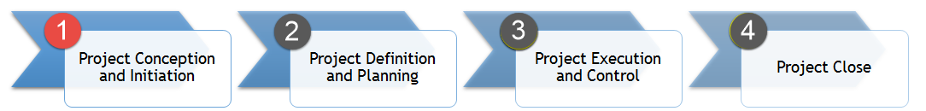
Initiate the Project
Define the project at a high level and determine feasibility
Write a Business Case
Create a Project Charter
Identify stakeholders and assign responsibilities

Slide 3
Create a Project Charter

Slide 4
Project Charter Basics
A document that:
Introduces the project
Aligns everyone’s thinking
Obtain approval to proceed
Not very detailed
Should be 5 pages or less

Slide 5
Project Charter Sections
Background information
Anything a person would need to know why the project is a good idea
Scope
Describe high level details of the end result
Ensure full understanding of the boundaries
Objectives
Measurable goals that can validate the project’s success
Governance
List all of the project team members, sponsor, and the project manager

Slide 6
Project Charter Sections
Schedule
Any key dates or milestone targets
Budget
One time cost to execute the project
Ongoing support costs
C.A.R.D.
List the constraints, assumptions, risks, and dependencies

Slide 7
Project Charter Creation
Meet with full project team
Facilitate the meeting to ask probing questions about each section
Communication should bring out different views on the project and the discussion will help them to align
Discussions increase chance of risks and assumptions being identified
Project Manager drafts the Project Charter and sends out for project team feedback.
After making necessary edits, Project Manager sends out final Project Charter

Slide 8

Project Charter Activity #1
Create a project charter template based on the key sections discussed
Background information
Scope
Objectives
Governance
Schedule
Budget
C.A.R.D.

Slide 9
Project Charter Activity #2
Think about a future project at home
Putting in that new window
Creating a new budgeting spreadsheet
Painting that room
Developing that application
Document the project details in the project charter template you created
Extra points for those that can facilitate a meeting with the “project team” and probe for project details to complete charter

Slide 10
Understanding the Business Objective

Slide 11
Understanding the Business Objective
What is the purpose of the project?
What are the goals and objectives of this project?
In the eyes of this project, what is success, and how will it be measured?

Slide 12
Writing and Presenting a Business Case

Slide 13
Business Case Basics
What is a Business Case?
Why is it used?
When is it used?
Who creates it?

Slide 14
What is a Business Case?
A decision-making tool used to determine the effects a particular decision will have on profitability.

Slide 15
Why is a Business Case Used?
Intended to convince key decision-makers of the merits of a particular course of action.

Slide 16
When is a Business Case Used?
A business case is done on nearly every action, but not always in a written format.
The business case is created prior to the project being started. This frames up the return on investment prior to taking the action.

Slide 17
Who Creates a Business Case?
A business case is generally created by a business executive, a business manager, or a business analyst.

Slide 18
5 Phases to an Effective Business Case
Phase 1 - Initial Analysis
Phase 2 – Determine Potential Solutions
Phase 3 – Write the Business Case
Phase 4 – Review Business Case
Phase 5 – Present the Business Case

Slide 19

Initial Analysis
Thoroughly understand the problem or opportunity
Determine high level requirements
Identify data needed to support the business case (ROI)
Validate with decision makers the high level return is worth the potential investment
Analyze likelihood project will be approved and if you should continue

Slide 20

Determine Potential Solutions
Identify all possible solutions to the problem.
Benefits
Costs
Timetable of project
Time before a return on investment is realized
Risks
*One of your solutions should be to do nothing

Slide 21
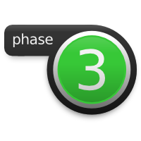
Writing the Business Case
Executive Summary
Problem Statement
Analysis
Solution Options
Cost-Benefit Analysis
Recommendation

Slide 22

Review Business Case
Validate problem statement justifies a call to action
Ensure all valid solutions are given
Double check cost-benefit analysis calculations
Objectively dissect your recommendation
Correct any spelling or grammatical mistakes
Ask another person to closely review the document
Get project buy-in of two key stakeholders

Slide 23
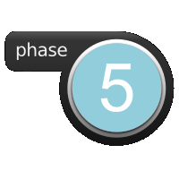
Present the Business Case
Remind yourself, they haven’t seen this before
Clearly define the problem and business need to act
Give your recommendation
Explain the return on investment (ROI)
Touch on each risk, but unless asked, don’t dive in deep
Mention your stakeholder backers
Close the presentation summarizing the benefits and ROI

