Slide 1
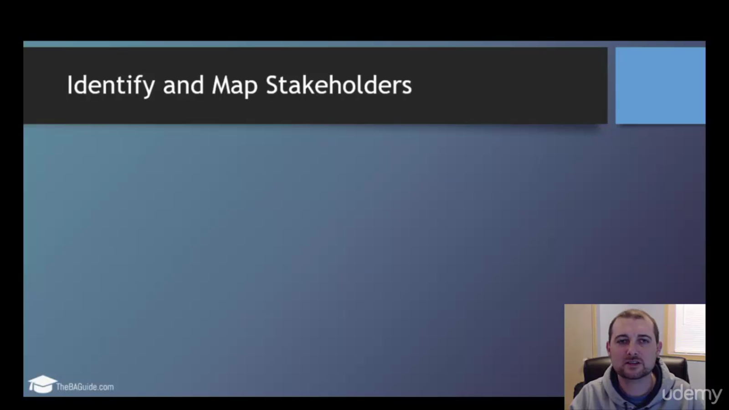

Slide 2
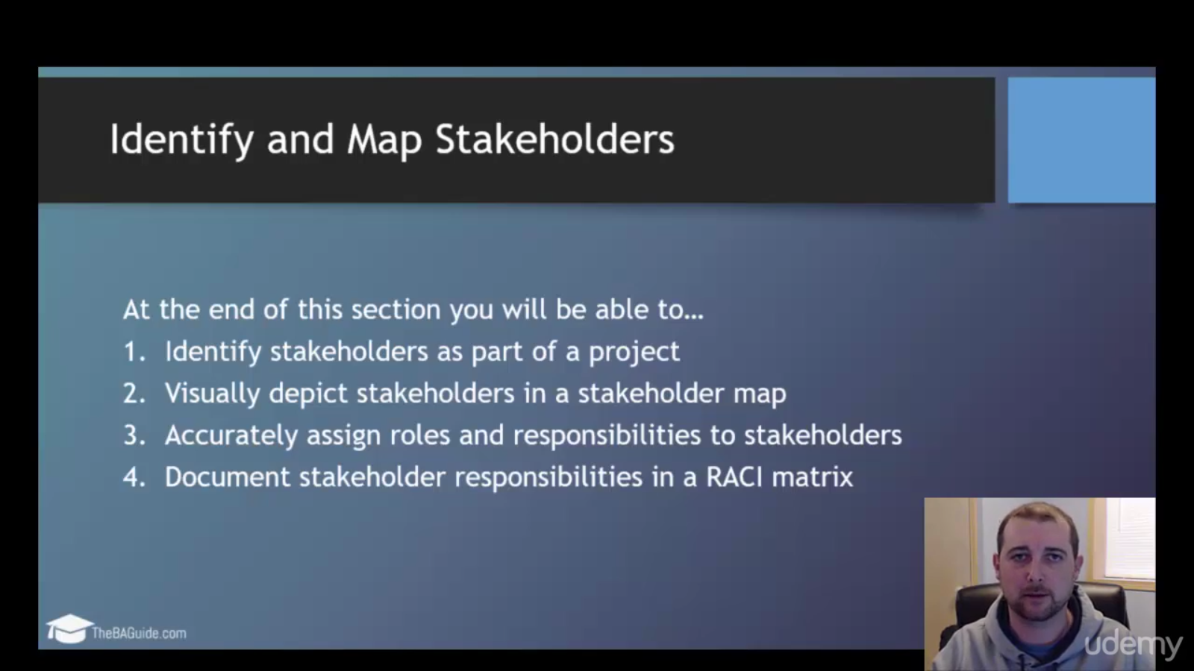

Slide 3
Stakeholder Map
Notes:
As with all companies, there are individuals or groups who are directly or indirectly affected by activities done by that company, called stakeholders. Stakeholders have an interest or are involved in the company’s decisions and can both positively and negatively impact their projects. This presentation identifies the stakeholders for BT and helps to identify and understand the different views and decision making power these stakeholders have.
Stakeholder analysis is a key tool for companies and their projects to be successful. Without fully mapping out those that are affected by a project, requirements can be missed or assumptions can be made that cause the project to fail. This causes rework to be done and projects to go above their anticipated budget, as well as outside their anticipated timeline.

Slide 4
Identifying Stakeholders
What is a stakeholder?
Project team members
Customer
Suppliers
Employees
City/Community
Professional organizations
Any individual impacted by the project
Any individual to support the project

Slide 5
Identifying Stakeholders
Why identify stakeholders?
It increases the chances for success
Additional ideas
Varied perspectives
Gains buy-in
Increases credibility

Slide 6
Identifying Stakeholders
How to identify stakeholders to my project?
Walk through anticipated scope/process
Beneficiaries of the effort
Directly involved with the beneficiaries of the effort
Jobs that may be affected by project or results
Government officials
Influencers
Interest in outcome
Get ideas from stakeholders as you identify them

Slide 7
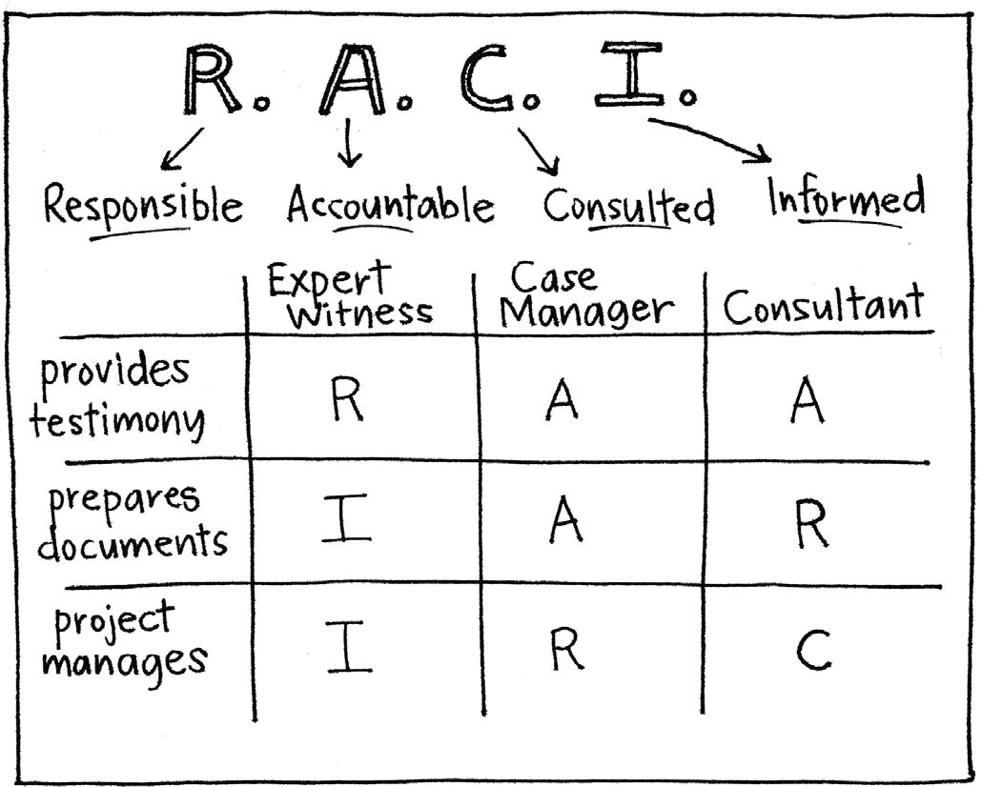
RACI Matrix

Slide 8

RACI Matrix: Why is it used?
Critical tool to understand and align the responsibilities of stakeholders.

Slide 9

RACI Matrix: Why is it used?
Alleviates power struggles

Slide 10
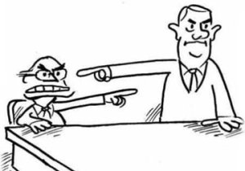
RACI Matrix: Why is it used?
Reduces lack of ownership

Slide 11

RACI Matrix: Why is it used?
Sets clear expectations!

Slide 12
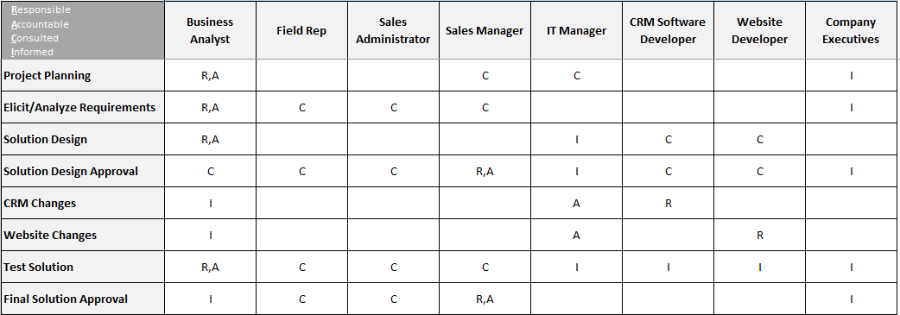
RACI Matrix: An Overview

Slide 13
RACI Matrix: R.A.C.I.
Responsible
Accountable
Consulted
Informed

Slide 14
RACI Matrix: R.A.C.I.
Who is/will be doing this task?
Who is assigned to work on this task?
Responsible
Accountable
Consulted
Informed

Slide 15
RACI Matrix: R.A.C.I.
Responsible
Accountable
Consulted
Informed
Who’s head will roll if this goes wrong?
Who has the authority to sign off the work?

Slide 16
RACI Matrix: R.A.C.I.
Responsible
Accountable
Consulted
Informed
Who can tell me more about this task?
Who are the Subject Matter Experts?

Slide 17
RACI Matrix: R.A.C.I.
Responsible
Accountable
Consulted
Informed
Who’s work depends on this task?
Who has to be kept update about the progress?

Slide 18
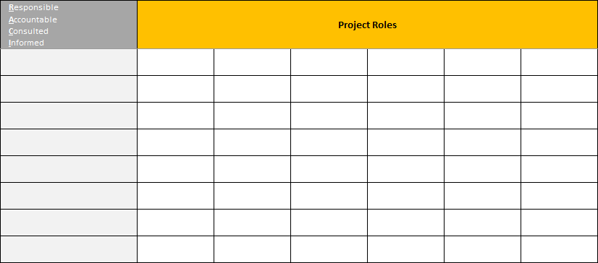
RACI Matrix: Breakdown

Slide 19
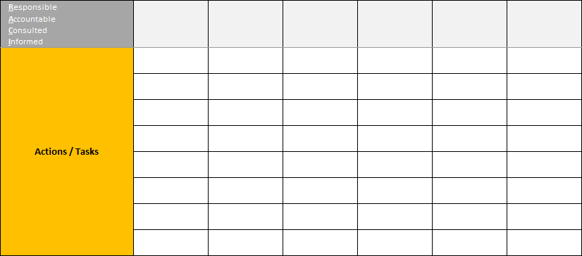
RACI Matrix: Breakdown

Slide 20
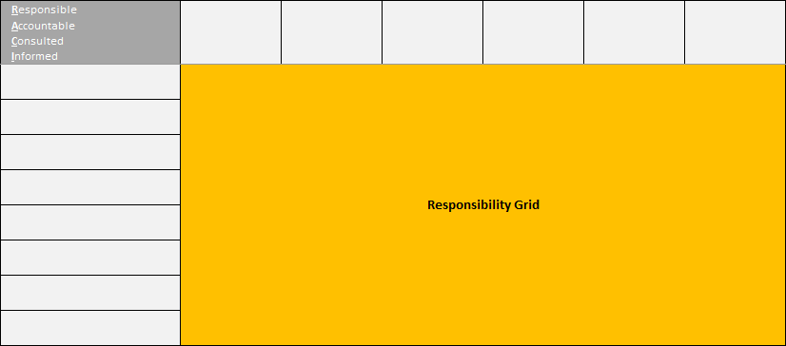
RACI Matrix: Breakdown

Slide 21
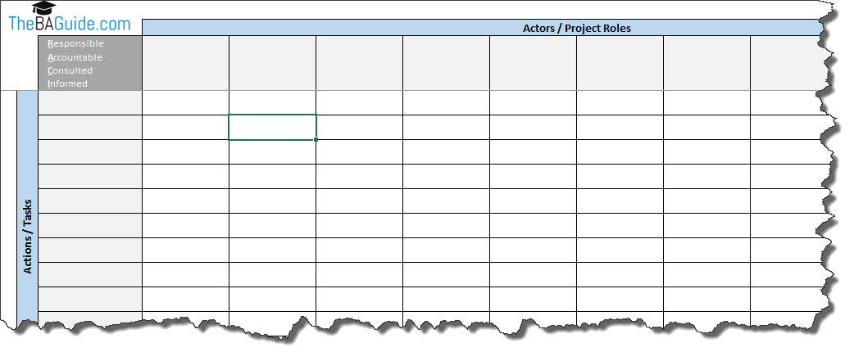
RACI Matrix: TheBAGuide.com Template

Slide 22
RACI Matrix: A Practical Example

Slide 23
RACI Matrix: Final Validation

Slide 24
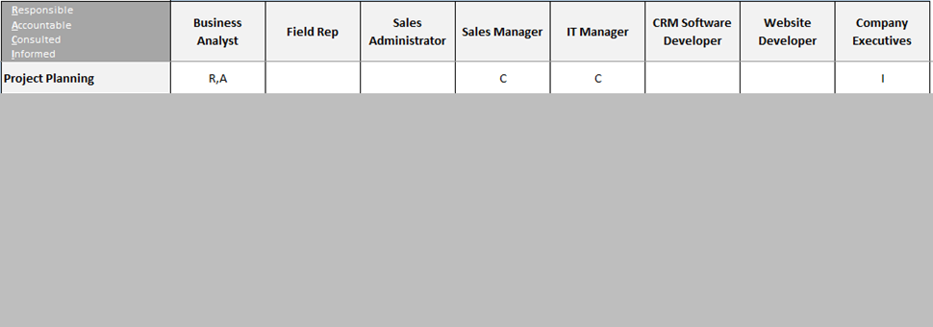
RACI Matrix: Final Validation

Slide 25

RACI Matrix: Final Validation
At least one person Responsible (R) per task

Slide 26
RACI Matrix: Final Validation
At least one person Responsible (R) per task
At least one person Accountable (A) per task

Slide 27
RACI Matrix: Final Validation
At least one person Responsible (R) per task
At least one person Accountable (A) per task
Only one person Responsible (R) per task

Slide 28
RACI Matrix: Final Validation
At least one person Responsible (R) per task
At least one person Accountable (A) per task
Only one person Responsible (R) per task
Only one person Accountable (A) per task

Slide 29
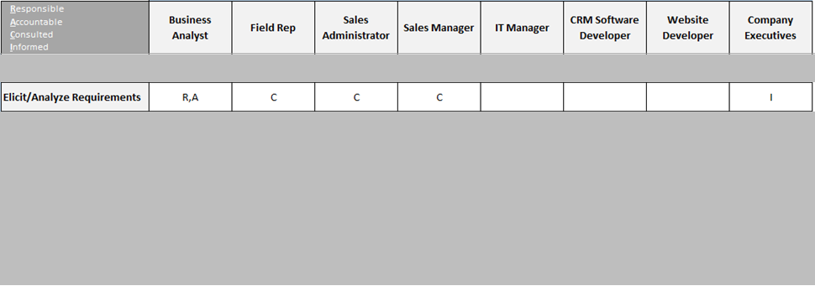

RACI Matrix: Final Validation
Rinse and repeat for each task

Slide 30

RACI Matrix: Final Step
Gain agreement from your stakeholders before your project starts

