Slide 1
Project Conception and Initiation
Project Definition and Planning
Project Execution and Control
Project Close

Slide 2
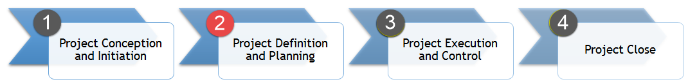
Initiate the Project
Develop a plan to conduct a successful project
Create a project schedule
Plan your communication
Identify assumptions and risks
Determine quality plan
Plan for go live

Slide 3
Create a Project Schedule

Slide 4

Project Schedule Basics
What?
A timetable for a project
Lists project’s milestones, activities, and deliverables
Shows assigned resources that will perform the work
Why?
Gives realistic expectation for completion of the project
Reduces the chance for cost overruns
Shows task assignments

Slide 5
Steps to Create a Project Schedule
Understand project deliverables
Define activities and organize into sequence
Define milestones
Assign available resources to activities
Determine and document activity durations
Outline resource availability and constraints
Set and analyze schedule

Slide 6

Project Schedule Example
Replacing a door knob

Slide 7
#1) Understand project deliverables
Projects have one to many deliverables that need to be met in order for the project to be deemed complete and successful.
Deliverables:
1.0 - Door knob

Slide 8
#2) Define activities and organize sequence
Activities show what needs to be completed in order to achieve the deliverables.
Activities:
1.1 – Determine door knob needs
1.2 – Conduct research
1.3 – Purchase door knob
1.4 – Remove old door knob
1.5 – Install new door knob
1.6 – Validate installation

Slide 9
#3) Define milestones
Milestones are achievements of the project. Used to understand how the project is advancing.
Milestones:
Project Kickoff
Needs Identified
Installation
Project Close
Activities:
1.1 – Determine door knob needs
1.2 – Conduct research
1.3 – Purchase door knob
1.4 – Remove old door knob
1.5 – Install new door knob
1.6 – Validate installation

Slide 10
#4) Assign available resources to activities
Resources need to be allocated to complete the activities
Activities:
1.1 – Determine door knob needs →
1.2 – Conduct research →
1.3 – Purchase door knob →
1.4 – Remove old door knob →
1.5 – Install new door knob →
1.6 – Validate installation →
Resource:
Jeremy, Beth
Jeremy
Beth
Jeremy
Jeremy
Jeremy, Beth, Megan

Slide 11
#5) Determine activity durations
Each activity will take time to complete
Activities:
1.1 – Determine door knob needs →
1.2 – Conduct research →
1.3 – Purchase door knob →
1.4 – Remove old door knob →
1.5 – Install new door knob →
1.6 – Validate installation →
Resource:
Jeremy, Beth
Jeremy
Beth
Jeremy
Jeremy
Jeremy, Beth, Megan
Duration (hrs):
4 (2 each)
6
3
2
1
3 (1 each)

Slide 12
#6) Outline resource availability/constraints
Resources are tied up in other projects and have days in which they are unavailable for activities. It is important to take that into account when you create a schedule.
Jeremy
Availability: M-F 6pm-11pm
Constraints:
No availability Sa-Su
7/4
9/16 – 9/26
Beth
Availability: M-F 1pm-5pm, 8pm-10pm
Constraints:
No availability Sa-Su
7/4
Megan
Availability: M-F 6pm-9pm
Sa-Su 10am-4pm
Constraints:
6/27 - 7/4
7/11

Slide 13
#7) Set and analyze schedule
Activity | Duration | Start | End | Resource | Notes
Project Kickoff | 0.5 | 7/1 | 7/1 | All
Determine door knob needs (4) | 2 | 7/2 | 7/2 | Jeremy | Discussion needs to be in tandem
 | 2 | 7/2 | 7/2 | Beth
Conduct research | 6 | 7/3 | 7/4 | Jeremy
Purchase door knob | 3 | 7/5 | 7/5 | Beth
Remove old door knob | 2 | 7/6 | 7/6 | Jeremy
Install new door knob | 1 | 7/6 | 7/6 | Jeremy
Validate installation (3) | 1 | 7/7 | 7/7 | Jeremy
 | 1 | 7/7 | 7/7 | Beth
 | 1 | 7/7 | 7/7 | Megan
Project Close | 0.5 | 7/8 | 7/8 | All

Slide 14
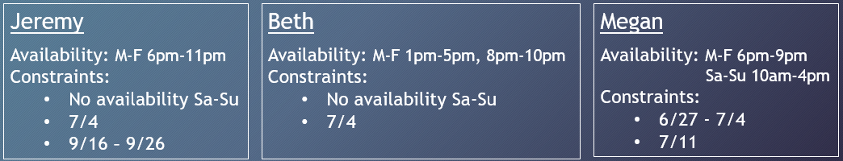
Activity | Duration | Start | End | Resource | Notes
Project Kickoff | 0.5 |  |  | All
Determine door knob needs (4) | 2 |  |  | Jeremy | Discussion needs to be in tandem
 | 2 |  |  | Beth
Conduct research | 6 |  |  | Jeremy
Purchase door knob | 3 |  |  | Beth
Remove old door knob | 2 |  |  | Jeremy
Install new door knob | 1 |  |  | Jeremy
Validate installation (3) | 1 |  |  | Jeremy
 | 1 |  |  | Beth
 | 1 |  |  | Megan
Project Close | 0.5 |  |  | All
7/1
7/1
7/1
7/5
7/1
7/5
7/5
7/7
7/8
7/8
7/8
7/8
7/11
7/11
7/11
7/12
7/11
7/12
7/11
7/12
7/15
7/15

Slide 15

Project Schedule Activity
Create a Project Schedule template
Things to keep in mind:
Schedule should be intuitive to read and understand
Clearly define activities and owners
Include a section to document constraints utilized to assign activities and dates

Slide 16
Plan Your Communication

Slide 17

Plan Your Communication
Defines the general communication requirements for your project
Increases knowledge about the project and why it is important
Helps to gain acceptance of the project among employees and stakeholders
Provides an opportunity for feedback from stakeholder group

Slide 18
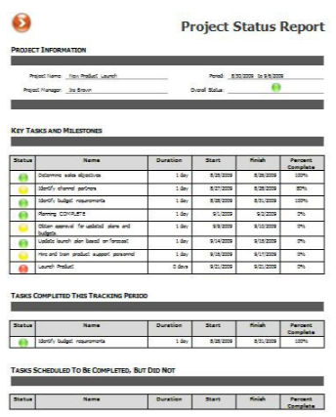
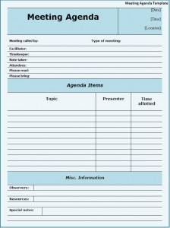

Plan Your Communication
Project Status Reports
Meeting Notes
Kickoff Meeting

Slide 19
Plan Your Communication
Define the key objective, topic of discussion, delivery method, frequency, audience, and role that owns responsibility for making it happen.

Slide 20
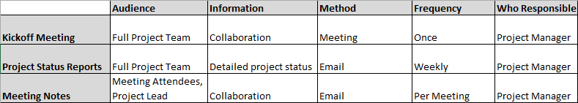
Communication Plan Format
While the details may be slightly different for each project, here is my standard for these three communication items.

Slide 21
Communication Plan Activity
Create a Communication Plan Template
Things to keep in mind:
Keep it simple – overcomplicated plans do not get read
Contain at least the three communications types mentioned
Think through various scenarios that could occur and validate you know how you would communicate that to the project team

Slide 22
Identify Assumptions & Risks

Slide 23
What is an assumption?
Circumstances or events that are expected to occur during the project life-cycle.

Slide 24
Identifying assumptions
All team members have assumptions. The key is to identify the assumptions of the various members, including yourself.
Conduct project plan walk-throughs Review activities and order of execution Discuss what activities entail
Question everything Do I know this for a fact or am I making an assumption? If I believe this is a fact, what was the source of the info?

Slide 25
Assumption examples
Team members will be made available for the project
Business approval of the requirements will take two weeks
Project will have at least one dedicated Quality Assurance tester
Future end users will be available for onsite training

Slide 26
Assumptions – Now you know, but what’s next?
Document and call out each assumption in status reports and meetings
Determine worst case if the assumption is incorrect
If determined costly, validate the assumption
If not possible to validate, treat the assumption as a risk

Slide 27
What is a risk?
An uncertain event or condition that, if it occurs, has an effect on at least one project objective.
Such as:
Scope
Schedule
Budget
Quality
User Adoption
…

Slide 28
Identifying risks
Starts at the beginning of the project and lasts through the closing
Schedule:
Not realistic
One activity delay will cascade
Unfamiliar areas could cause inaccurate estimates
Customer:
Insists on new requirements
Executive sponsor not engaged
Design too complex for users
Limited business testing resources
Requirements:
Poorly defined
Limited user feedback in determining
Notes:
The earlier it is identified the better

Slide 29
Risks – Now you know, but what’s next?
Document and call out each risk in status reports and meetings
Determine ways to eliminate the risk or reduce the effect if it comes true
Schedule:
Not realistic
One activity delay will cascade
Unfamiliar areas could cause inaccurate estimates
Customer:
Insists on new requirements
Executive sponsor not engaged
Design too complex for users
Limited business testing resources
Requirements:
Poorly defined
Limited user feedback in determining

Slide 30
Assumptions and Risks Final Thought
Don’t be complacent as risks and assumptions can completely derail a project.
Identify
Validate
Communicate
Take Action

Slide 31
Determine Quality Plan

Slide 32

Quality Plan
Addresses the quality requirements, standards, and quality assurance mechanisms for a project
Sections:
Testing and Quality Assurance
Defect Management
Training Requirements

Slide 33

Testing and Quality Assurance
Most important section of the Quality Plan
Define who is responsible for testing
Identify quality objectives for the project
Determine quality approach

Slide 34

Defect Management
Defects and bugs will be discovered during testing
Guidelines for what is considered a defect/bug
Details on where to document
Instructions on how to manage the defects

Slide 35

Training Requirements
Defines training for the project team at the onset of the project and the training needed for users at the go live
Identify project team skill gaps to understand training needs
Understand staff training needs to utilize final product
Define steps to get staff trained

Slide 36
Quality Plan Activity
Create a Quality Plan Template
Things to keep in mind:
Keep it simple – overcomplicated plans do not get read
Should at least contain the sections mentioned in the lectures
Always ask yourself, “what problem is this solving?”

Slide 37
Plan for Go Live

Slide 38

Go Live
Plan how…
The system will be rolled out to users
The users will be supported at go live
The system will be turned over to support

Slide 39

System Rollout to Users
All at once
All users utilize the full system on day 1
Phased
All users utilize pieces of the system in staggered phases
Pilot
A subset of users use the full system on day 1
Other users use the full system at a future date

Slide 40
User Support at Go Live
Identify resources available to support the go live
Document for users to reference for go live support
Instructions for defect tracking
Who to contact if issue halts work
Schedule reoccurring meeting with subset of users to discuss issues

Slide 41

System to Support
Procedure manual
Documentation of the design
Instructions to troubleshoot common issues
Escalation contact information

Slide 42
Go Live Plan Activity
Create a Go Live Plan Template
Things to keep in mind:
Keep it simple – overcomplicated plans do not get read
Should at least contain the sections mentioned in the lectures
Format and visual appeal are not important – stick to the facts

