Slide 1
Python Control Flow Statements
There are three control flow statements in Python - if, for and while.
Dept. of CS&E, MSRIT

Slide 2
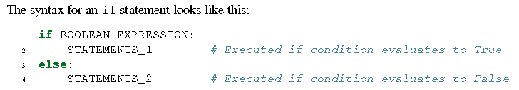
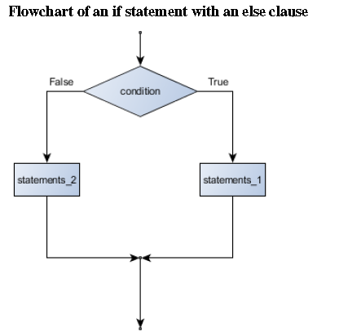
Conditional execution
The simplest form is the if statement:
Dept. of CS&E, MSRIT

Slide 3
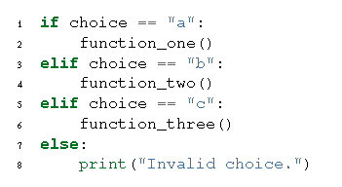
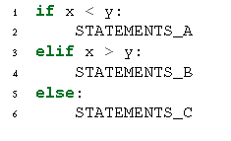
Chained Conditional
Dept. of CS&E, MSRIT

Slide 4
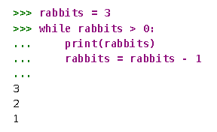
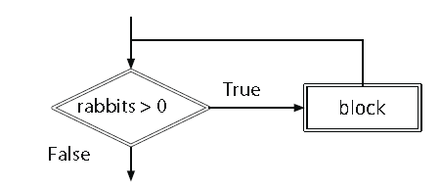
Python for While Statements
while «expression»:
  «block»
Dept. of CS&E, MSRIT

Slide 5
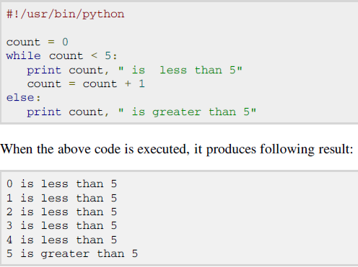
else statements used with loops
Dept. of CS&E, MSRIT

Slide 6
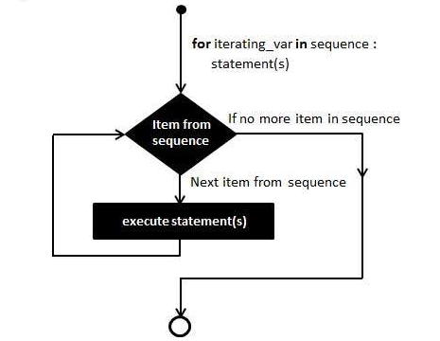
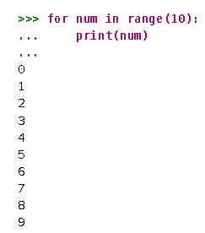
Python for loop Statements
for “iterating_var” in sequence:
    statements(s)
Dept. of CS&E, MSRIT

Slide 7
Python for loop Statements
#!/usr/bin/python
for letter in 'Python': #example1
print (‘Current Letter :', letter )
fruits = ['banana', 'apple', 'mango']
for fruit in fruits: #example2
print (‘Current fruit :', fruit)
print "Good bye!“
for i in range(1,5): #example3
print (i)
else:
print (“The for loop is over”)
Dept. of CS&E, MSRIT

Slide 8
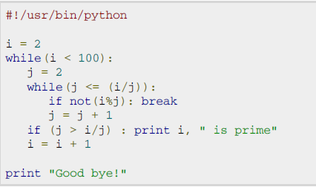
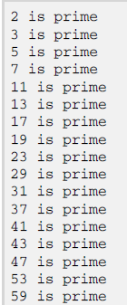
Nested loop example
Dept. of CS&E, MSRIT

Slide 9
Loop Control Statements
break statement: Terminates the loop statement and transfers execution to the statement immediately following the loop.
continue statement: Causes the loop to skip the remainder of its body and immediately retest its condition prior to reiterating.
pass statement: The pass statement in Python is used when a statement is required syntactically but you do not want any command or code to execute.
Dept. of CS&E, MSRIT

Slide 10
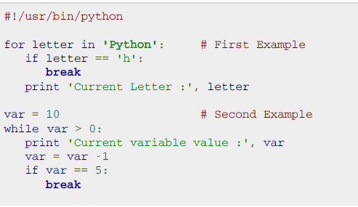
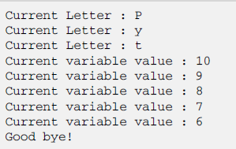
break statement example
Dept. of CS&E, MSRIT

Slide 11
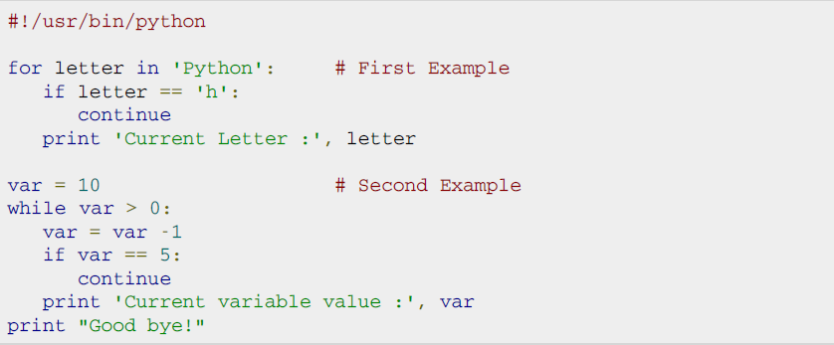
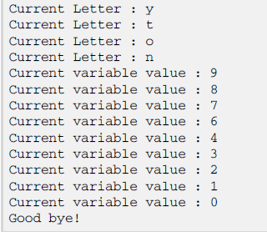
continue statement example
Dept. of CS&E, MSRIT

Slide 12
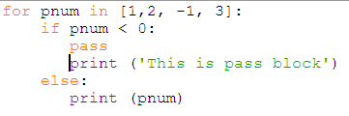
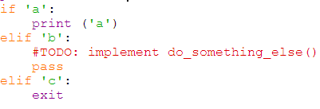
pass statement example
The pass statement is a null operation; nothing happens when it executes.
It's often used as a placeholder for code which will be added later:
Output
1
2
This is pass block
3
Dept. of CS&E, MSRIT

Slide 13
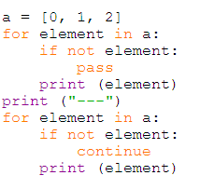

pass versus continue
Dept. of CS&E, MSRIT

Slide 14
Range() in python
The range function has many versions.
  range(a)
  range(a, b, k)
The first number in the sequence is a.
b is the limit.
Each successive number in the sequence will increase by the step value k.
Dept. of CS&E, MSRIT

Slide 15
Range() in python
Suppose the input is 2 3 4 5 0 (one number per line). What is the output of the following code?
  number = 0
  sum = 0
  for count in range(5):
    number = int(input("Enter an integer: "))
    sum += number
  print("sum is", sum)
  print("count is", count)
Dept. of CS&E, MSRIT

Slide 16


Lets start Programming
We will use Pycharm Edu for programming in Python.
Dept. of CS&E, MSRIT

Slide 17
Example programs
Performing basic arithmetic operations
Write a python program to check the eligibility for voting using if-else.
Write a python program to find the factorial of number using while loop.
Python program to display all the prime numbers within an interval.
Python program to display all Armstrong numbers within an interval
Write a python program to print string is a palindrome or not.
Dept. of CS&E, MSRIT

Slide 18
Exercises
Write a script that asks a user for a number. The script adds 3 to that number. Then multiplies the result by 2, subtracts 4, subtracts twice the original number, adds 3, then prints the result.
Write a program that asks users for their favorite color. Create the following output (assuming "red" is the chosen color). Use "+" and "*".
red red red red red red red red red red
red red
red red
red red red red red red red red red red
Dept. of CS&E, MSRIT

Slide 19
Exercises
Write a script that asks someone to input their first name, last name and phone number.
  If the user does not type at least some characters for each of these, print "Do not leave any fields empty" otherwise print "Thank you". (Hint: if a variable is empty, its value will be "false".)
  Change the script so that the script prints "Thank you" if either the first name or the last name or the phone number is supplied. Print "Do not leave all fields empty" otherwise.
  Change the script so that only first name and last name are required. The phone number is optional.
Dept. of CS&E, MSRIT

Slide 20
Exercises
Write a program that asks a user to input a color. If the color is black or white, output "The color was black or white". If it starts with a letter that comes after "k" in the alphabet, output "The color starts with a letter that comes after "k" in the alphabet". (Optional: consider both capitalized and non-capitalized words. Note: the order of the alphabet in Unix and Python is: symbols, numbers, upper case letters, lower case letters.)
Write a program that asks a user to input a number. If the number equals "5", output "My lucky number". If the number is larger than 10, output "What a large number!". In all other cases, output "That's not my lucky number."
Dept. of CS&E, MSRIT

Slide 21
Exercises
Write a program that asks five times to guess the lucky number. Use a while loop and a counter.
  The program asks for five guesses (no matter whether the correct number was guessed or not). If the correct number is guessed, the program outputs "Good guess!", otherwise it outputs "Try again!". After the fifth guess it stops and prints "Game over."
  break: In the previous example, insert "break" after the "Good guess!" print statement. "break" will terminate the while loop so that users do not have to continue guessing after they found the number. If the user does not guess the number at all print "Sorry but that was not very successful" (use "else" for this).
Dept. of CS&E, MSRIT

Slide 22
Exercises
  Counting hits: Modify the program again. This time the program continues even after the correct number was guessed but it counts how often the correct number was guessed. You'll need two counters: one for the while loop and another one for the number of correct guesses. After the while loop is finished, use an if statement to print either "You guessed the number ... times" or "The number was not guessed at all".
Dept. of CS&E, MSRIT

Slide 23
Exercises
  Print all multiples of 13 that are smaller than 100. Use the range function in the following manner: range(start, end, step) where "start" is the starting value of the counter, "end" is the end value and "step" is the amount by which the counter is increased each time.
Dept. of CS&E, MSRIT

