Slide 1

Tripmates
JuiCy buNS
Janice Lee
Cynthia Zhou
Nancy Luong
Sophia Kwon

Slide 2






Notes:
Most of you have probably gone on a vacation before with friends or family. So you’ve probably experienced the struggles of trying to plan a trip with multiple people.
Everyone has different sites they want to see, different activities they want to do, different restaurants they want to eat at. How do you plan everything out?

Slide 3
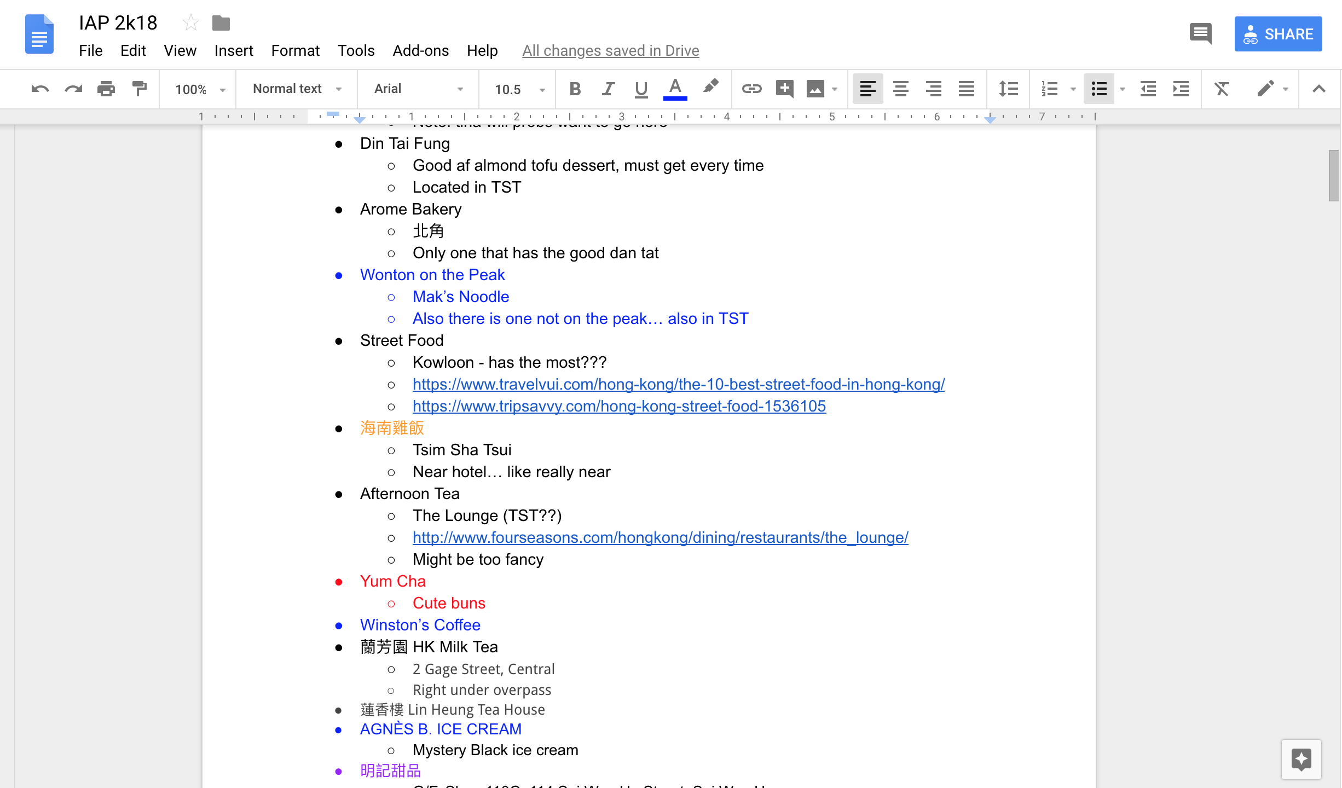
Notes:
Or maybe you’ll use Google Docs, where everyone will list their interests and try to create a schedule. But this can get ugly and disorganized. Trip planning is difficult. But we have a solution, and that’s Tripmates! Tripmates makes collaborative trip planning easy by providing an organized way for everyone to list activities they’re interested in and efficiently create an itinerary.

Slide 4
Things to demo:
Split screen (with refresh)
Create trip, join trip
Adding activity, See it come up in other user’s screen.
Full screen (without refresh):
Try to create event while place closed (drag). Try again while place open. Week view → drag to edit hours
Votes - hover to see voters
Filter by category. Sort by votes
Map - click pin to see associated activity

Slide 5
Design Rationales
easy-to-remember trip code vs. long, hard to guess
adding drag and drop to ways to create event
dragging to add open hours
where to put map

