Slide 1





Slide 2

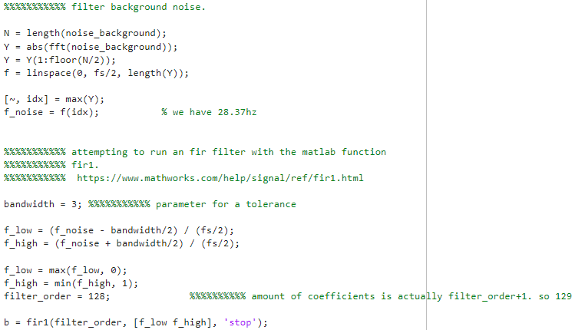
The Quick Brown Fox Jumps Over the Lazy Dog
60 Samples, 10 users with 5 samples each
Intruders had 3 samples collected each. 5 intruders
Recorded in the classroom in a quiet setting. Same computer, software and microphone for consistency.
Audio converted/averaged to L x 1 matrix for all sounds
Background/Quiet noise also recorded and filtered at 28.4hz

Slide 3
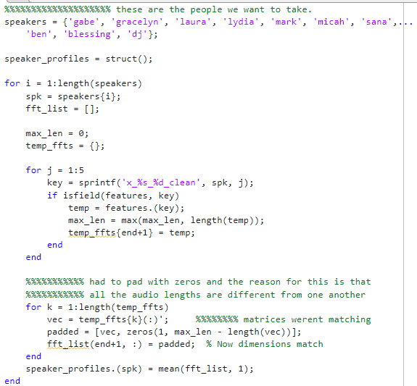
FFT for all cleaned audio samples
Cleaned audio samples were averaged into a struct “speaker_profiles”
Zero-padding occurred so all the matrices were the same length
Audio samples compared with an amplitude average
Accepts or Rejects audio clips and recordings
For FIR filtering, padding all matrices, performing FFTs etc….these were widely used with loops

Slide 4
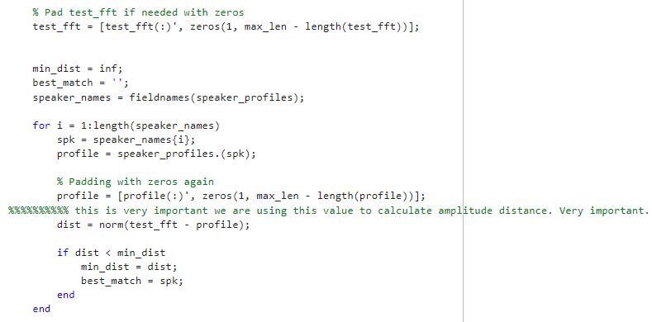
Example of Loop used

Slide 5

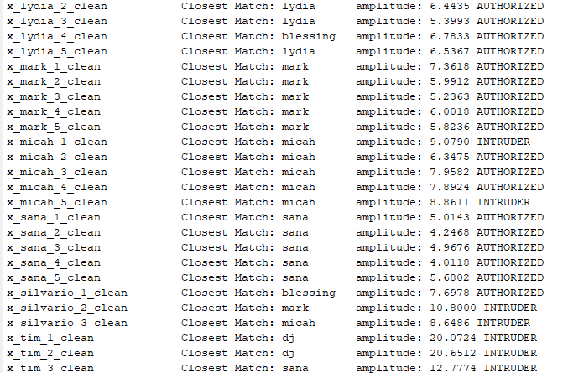
95% accuracy rating for recognizing authorized people
93% accuracy rating in detecting unauthorized people
Debugging console outputs with amplitudes helped
significantly get this as close as possible
If > 8.5 amplitude, it was an intruder.
Otherwise, it was authorized

Slide 6


Slide 7


