Slide 1

crypto currency
Trust and cheating
Notes:
בהרצאה הקרובה נרצה

Slide 2
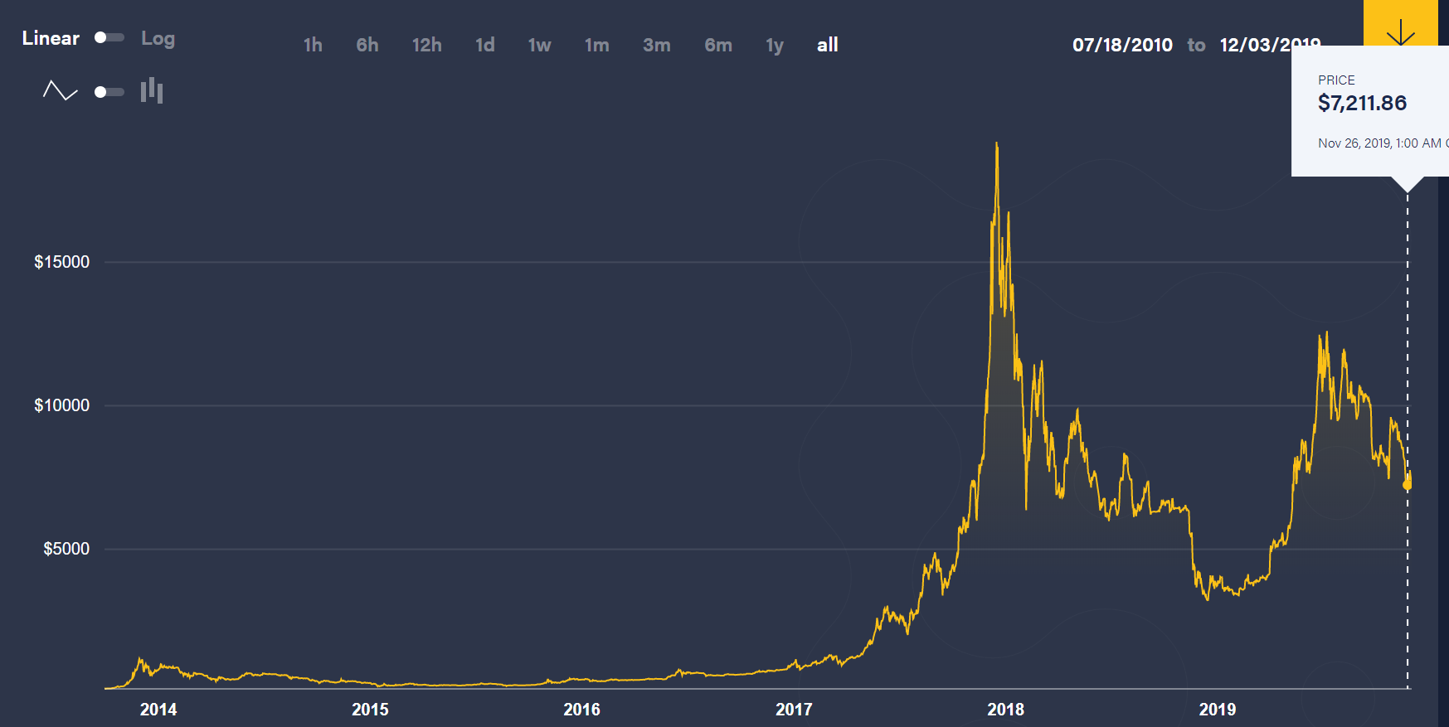
Notes:
כמה שקופיות בנושא:
יש הרבה משתמשים במטבעות קריפטגורפיים, יש הרבה סוגים של מטבעות, אנשים ממירים כסף פיזי תמורת מטבע דיגיטלי (שווי המטבע).

Slide 3
Trust and safety in crypto currency
Part 1:

Slide 4
The main problem of crypto currency
A crypto currency, unlike physical currency, is not stored in a wallet but stored in digital means
It is a distributed digital currency, implemented according to an agreed algorithm, which is based on an agreed history of transactions.
What do you think the main drawback of digital currency is?
Reliability
Notes:
לדעתנו הבעיה העיקרית של מטבע קריפטו: אמינות

Slide 5
What are the concerns about reliability?
A user might rewrite history - making money for himself or delete previous transactions
A user may transfer his money to two buyers
Someone might declare that my money goes to him without my consent
Notes:
פתרון הבעיה הראשונה – בלוקצ'יין.
הבעיה השניה: נדבר באריכות בהמשך
הבעיה השלישית: חתימות דיגיטליות – עליו נסביר ממש עכשיו

Slide 6
Solution: Digital signature
Key generator algorithm generates a private key. Afterwards it generates the public key based on it.
Signature algorithm: given the private key + data the algorithm generates a signature
Verification algorithm
- - - - - - -
Someone might declare that my money goes to him without my consent!
הדגמה
Notes:
צריך להוסיף כאן הדגמה, אני אשתדל לחפש מחר קוד עובד
כדי להעביר כסף מוכרחים להשתמש במפתח פרטי
מי ששכח מהו המפתח הפרטי, אבד את היכולת להעביר את הכספים ששייכים לו. מי יודע כמה כספים אבודים כאלה ישנם כיום.
מסקנה: אף אחד לא יכול להעביר כסף ששייך לי

Slide 7
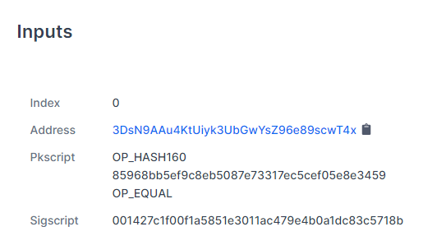
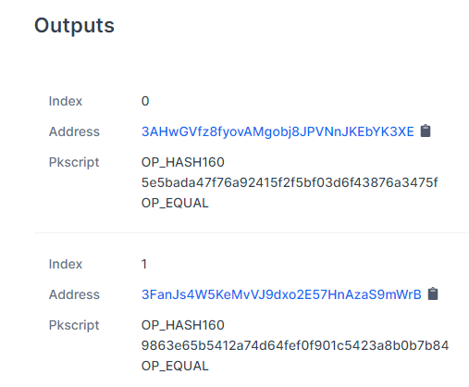
What does a transaction look like?
Notes:
מתוך אתר blockchain.com

Slide 8
Solution: blockchain
The traditional solution: A central body that acquires trust, such as a bank.
Distributed Solution: Agree on all transactions performed so that the community of participants can decide which transfer was made - and get it, and what it is fake - and reject it.
This is the concept of blockchain.
But, how?
- - - - - - -
A user might rewrite history - make money for himself or delete previous transactions
Notes:
השאלה המתבקשת היא: כיצד נסכים על הפעולות שקרו בהיסטוריה?
איך נוכל לממש מערכת, שהזיוף בה כמעט בלתי אפשרי?

Slide 9
Why is it almost impossible to change a block
To answer the question, we need to know what is in each block. Let's take Bitcoin as an example.
Every block contains about 2000 transactions
The block header consists of the following components:
Comments | Description | Field Size (Bytes)
Block version information (note, this is signed) | version | 4
The hash value of the previous | prev_block | 32
Hash of all transactions related to this block | merkle_root | 32
A timestamp recording when this block was created | timestamp | 4
The calculated difficulty target being used for this block | bits | 4
The nonce used to generate this block | nonce | 4
Notes:
כדי שנוכל להבין מה נמצא בכל שדה, נסביר קודם מה זה hash:

Slide 10
hashing!
Hash is an encrypted string that represents a block. The method we encrypt is by SHA-256.
נצטרך כאן שקופית או שתיים כדי להסביר מה זה האש. כולל הדגמה כמובן.
Notes:
הייתי רוצה להכניס כאן הסבר כללי, שלא מדבר על מטבעות. זה אמור להזכיר את ההסברים על חתימה דיגיטלית.
העיקרון: זו פונקציה שמחושבת על קלט, כמו טקסט או סתם רצף ביטים.
לא ניתן לחזות מה הערך שהפונקציה תחזיר. גם אם נדע את ערך הפונקציה על טקסט כמעט זהה, לא ניתן לחזות את ערך הפונקציה על הטקסט שלנו, גם לא בקירוב.
חישוב הפונקציה הוא פעולה קלה (למחשב כמובן...)
מציאת טקסט עבורו הפונקציה תחזיר ערך מסוים – הדרך היחידה היא broth force.

Slide 11

What is a valid block?
Comments | Description | Field Size (Bytes)
Block version information (note, this is signed) | version | 4
The hash value of the previous | prev_block | 32
Hash of all transactions related to this block | merkle_root | 32
A timestamp recording when this block was created | timestamp | 4
The calculated difficulty target being used for this block | bits | 4
The nonce used to generate this block | nonce | 4
$$SHA−256\left(header text+nonce\right)<2^{70}$$
Notes:
בלוק תקין הוא בלוק שהhash על הheader שלו נותן תוצאה תקינה.
כל השדות הראשונים נקבעים בהתאם לבלוקים קודמים, או בהתאם לעיסקאות בבלוק זה.
הרכיב החופשי זה הnonce, שצריך לתת hash תקין בהתאם לרמת הקושי הנדרשת.
חיפוש nonce מתאים נקרא: כריה - mining.

Slide 12
What happens when someone tampers with a block
Tampering with a block changes its hash – making it invalid
The attacker will have to validate the block by finding a correct nonce - which takes a whole lot of time!
להראות מה ההסתברות לקבל באופן אקראי בלוק תקין
Notes:
בשלב ראשון נראה שזה קשה לשנות בלוק יחיד, בשלב הבא נדבר על שינוי של כמה בלוקים.

Slide 13
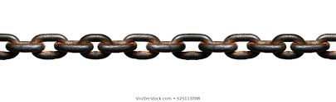
The power of the chain
To create the "chain" effect - each block contains the hash of the block in front of it.
Tampering with a block changes its hash and thus changes the hash of the next blocks after it – making them invalid
The attacker will have to validate (we will talk more about it later) each block by finding a correct nonce which takes a whole lot of time.
Illustration: https://andersbrownworth.com/blockchain
Comments | Description | Field Size (Bytes)
The hash value of the previous | prev_block | 32
The nonce used to generate this block | nonce | 4
Notes:
להסביר מה זה proof-of-work

Slide 14
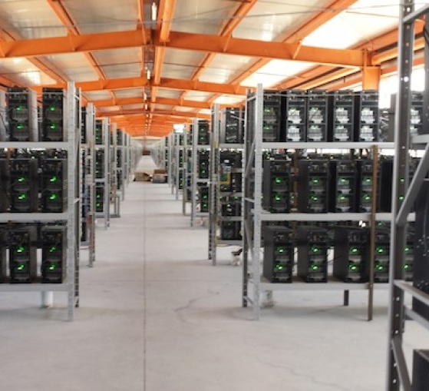
How long does it take to find a nonce?
What factors to consider?
Enough time for all nodes to synchronize
Lots of time for scammers to be hard to tamper
Little time to know quickly that the deal was approved

Slide 15
How long does it take to find a nonce?
In Bitcoin, the target is to mine 2016 blocks every two weeks (= 1 block every 10 minutes)
In Lightcoin (other currency) the target rate is four times faster.
The difficulty level is dynamically updated once every two weeks, depending on the timestamp and difficulty of the previous blocks.
Comments | Description | Field Size (Bytes)
A timestamp recording when this block was created | timestamp | 4
The calculated difficulty target being used for this block | bits | 4

Slide 16
Who does verify transactions and blocks?
Verification is neither through a central authorization nor majority vote
Verification is through the computing power of nodes in the network
Blockchain is based on proof-of-work
צריך לחשוב מה בדיוק להכניס כאן ואיך זה משתלב ברצף
Notes:
מה יקרה אם אדם אחד ישלוט ברוב כח החישוב של מטבע מסוים? זה עלול להיות הרסני, ונדבר על כך בהמשך.
איך בדיוק זה עובד? על זה נדבר בסדרת השקופיות הבאה

Slide 17
So, how does it work?
Part 2:

Slide 18
Communication in blockchain network
New transactions are broadcast to all nodes
Each node collects new transactions into a block.
https://www.blockchain.com/btc/unconfirmed-transactions
Each node works on finding a difficult proof-of-work for its block.
When a node finds a proof-of-work, it broadcasts the block to all nodes.
Nodes accept the block only if all transactions in it are valid and not already spent.
Nodes express their acceptance of the block by working on creating the next block in the chain, using the hash of the accepted block as the previous hash.

Slide 19
Communication problems
What to do if a transaction message does not reach all nodes?
What to do if a message about new block does not reach all nodes?
How can we make sure that the nodes follow the protocol?
Notes:
נענה קודם על השאלה האחרונה, ונבין מדוע גם השאלות הראשונות לא מפריעות

Slide 20
Communication solutions
New transaction broadcasts do not necessarily need to reach all nodes. As long as they reach many nodes, they will get into a block before long.
Block broadcasts are also tolerant of dropped messages. If a node does not receive a block, it will request it when it receives the next block and realizes it missed one.
We cannot force nodes to follow the protocol, but we would like to have no interest in violating it. In most cases, this is indeed the case, but there are special situations where a breach of the protocol can make a profit. This may be a bitcoin's weakness, and we will discuss it later.

Slide 21
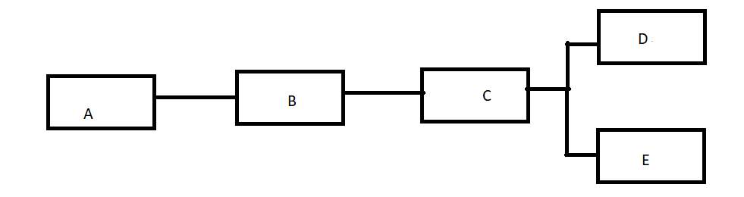
fork
What to do when we get at least two blocks who continue the last block? What block will be the last one?
This scenario is called a fork, as seen in the illustration
We will have to think of a way that will decide what block will be the last in the chain
So others will know what transactions were approved.
To know what branch to continue from.
Notes:
יצרת את האיור בעצמך? יש אפשרות להוסיף חיצים (לאחור) וליישר את התווים?

Slide 22
The protocol of fork
When a node has received two or more blocks continued the last block, the node should behave as follows:
Every node works on the first one he received, but saves the other branch.
The tie will be broken when the next proof-of-work is found and one branch becomes longer
The nodes that were working on the other branch, will then switch to the longer one.
The other branch will be called orphaned and the transactions that it holds will be overturned. The miner's profit will also be retroactively eliminated.

Slide 23
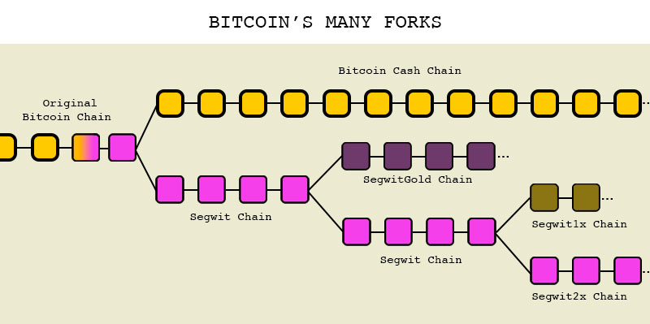
Fork and new coins
There is another type of forks, ones derived from disagreements.
Mostly they are disputes about changing the protocol of the coin
As a result, the two branches will stay active, but they will be independent from one another.
That’s how a new form of a digital coin starts. (i.e Bitcoin Cash)
צריך לפרט על איזה עניין בפרוטוקול הייתה המחלוקת

Slide 24
Incentive
To ensure continuity of blockchain, incentives should be given to miners.
By convention, the first transaction in a block is a special transaction that starts a new coin owned by the creator of the block.
This adds an incentive for nodes to support the network.
It provides a way to initially distribute coins into circulation, since there is no central authority to issue them.
At some point, no new currencies are needed: we will see in the bitcoin open source how this is reflected.

Slide 25
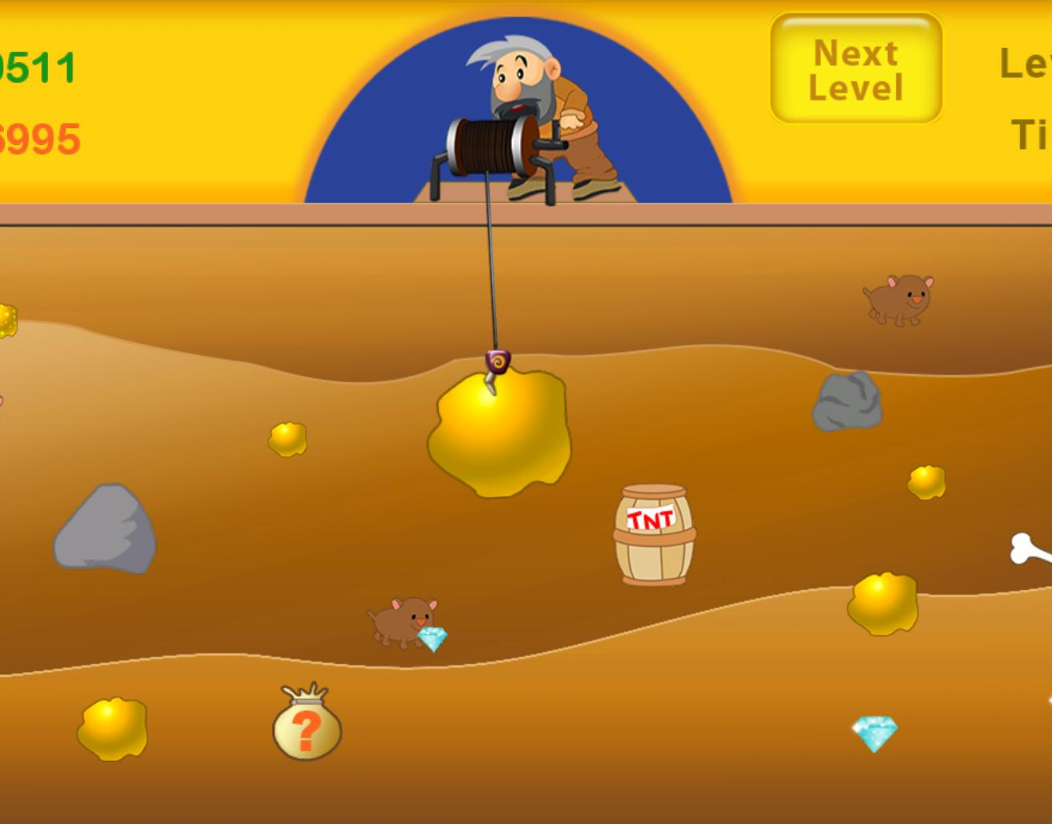
mining
“ The steady addition of a constant of amount of new coins is analogous to gold miners expending resources to add gold to circulation. In our case, it is CPU time and electricity that is expended “
(Satoshi Nakamoto)
Notes:
כעת נוכל להבין, למה חיפוש הnonce נקרא כריה

Slide 26
Fees
The incentive can also be funded with transaction fees.
The difference between the amount paid and the amount received is a fee transferred to the block miner.
Once a all coins have entered circulation, the incentive expected transition entirely to transaction fees.
How high are the fees?
https://bitcoinfees.info/
Notes:
בקישור: טרנזקציות ביטקוין הממתינות לאישור

Slide 27
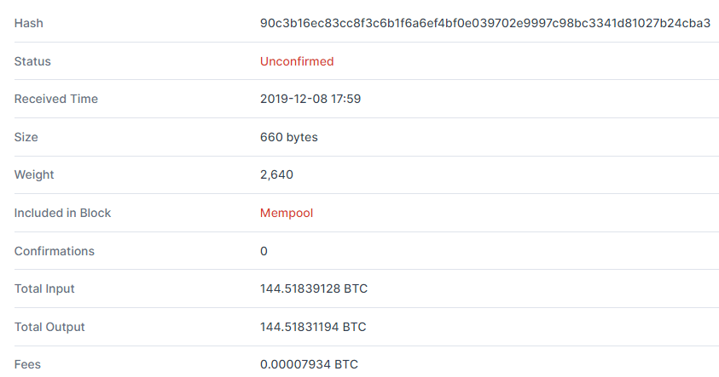
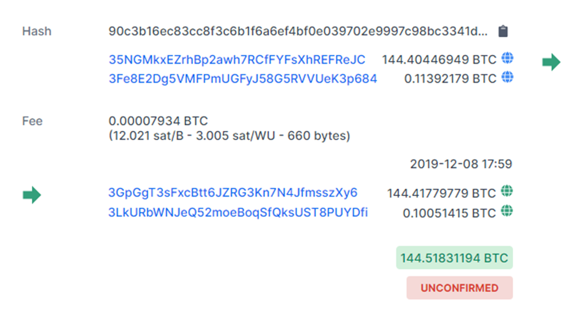
Sample transaction
https://www.blockchain.com/btc/unconfirmed-transactions
Notes:
בטרנזקציה ניתן לכתוב כמה PK שמכניסים כסף, וכמה PK שמקבלים כסף. הצגה כזו יכולה לחסוך בשטח איחסון.

Slide 28
storage
Overtime obsolete data wastes a big amount of storage, but we can’t simply remove it. Removing old blocks will break the chain.
On the other hand, we do not want to keep all the currency transactions forever. It is not necessary that all nodes store old transactions that have been verified many times.
The solution to this problem is by using Merkle trees.
What are Merkle trees?

Slide 29
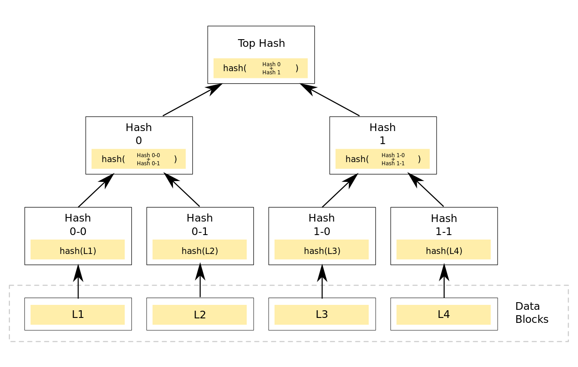
What are merkle trees?
Notes:
כאשר דיברנו על חתימות דיגטליות, אמרנו שלכל טרנזקציה יש האש.
עץ מרקל זהו עץ גיבוב, שלכל שני האשים יוצר אב משותף, שגם הוא האש בעצמו.
בעלים נמצאות הטרנזקציות, והשורש נקרא Merkel root.

Slide 30
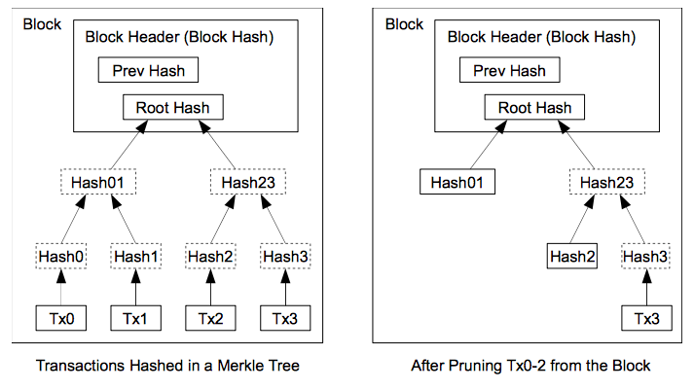
Properties of merkle trees
Any change in transaction information will require updating all of its ancestors.
Therefore, a node that stores the root of the tree can easily verify whether the transactions in the leaves are real or fake.
If node want to prune leaves from the tree, he can do so without changing the root.

Slide 31
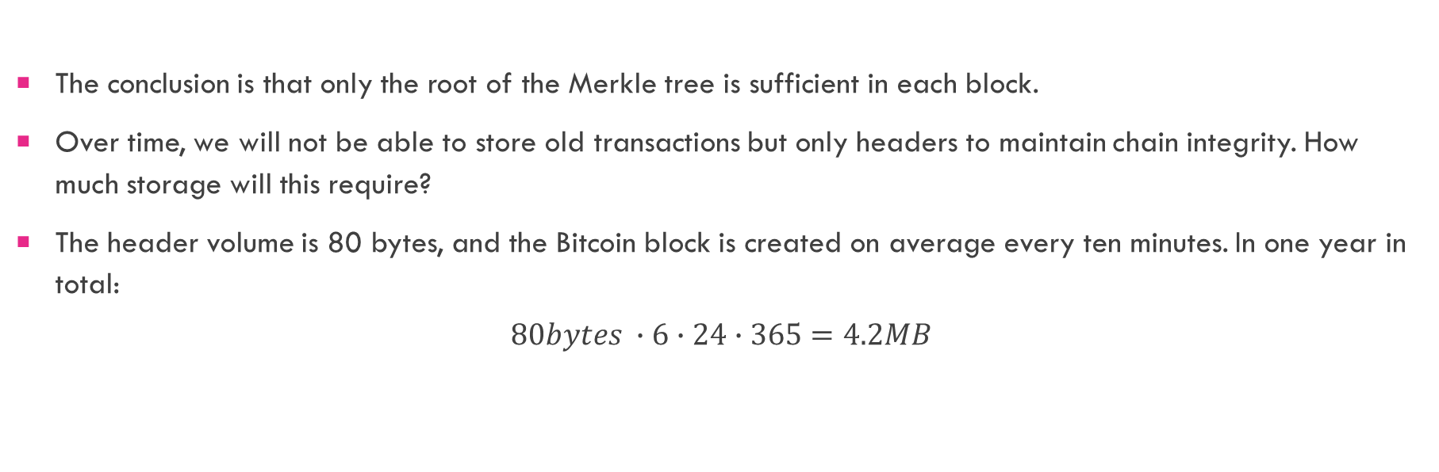
Using merkle trees
The conclusion is that only the root of the Merkle tree is sufficient in each block.
Over time, we will not be able to store old transactions but only headers to maintain chain integrity. How much storage will this require?
The header volume is 80 bytes, and the Bitcoin block is created on average every ten minutes. In one year in total:
$$80bytes ∙6∙24∙365=4.2MB$$
Comments | Description | Field Size (Bytes)
Hash of all transactions related to this block | merkle_root | 32

Slide 32
PRIVACY
Privacy derives from the fact that people don’t want others to know what they do with their money.
In fiat currency banks do not expose your usage to others. In Blockchain privacy does not rely on trust in a central body, but is otherwise achieved:
With this coin, all transactions are open to all, but it is unknown who the person holds the public key.
In addition, users can enhance their privacy by creating more public keys through one private key!
But it’s not enough. Combining some or all the keys in one transaction others can infer those keys belong to one user.

Slide 33
More about bitcoin
Part 3:

Slide 34
What is Bitcoin?
מטבע וירטואלי הראשון שאי פעם יצא
מטבע ללא גוף מרכזי
Limited amount of coins - 21 million
שומר על פרטיות
There are 7.1 million active bitcoin users
מטבע אמין

Slide 35
History of bitcoin
It was developed by unknown person named Satoshi Nakamoto
The first item that was purchased with bitcoin was pizza that cost 10,000 BTC in 2010
…

Slide 36
PRICE HISTORY CHART

Slide 37
What is blockchain?
A chain of blocks
The ledger is spread around nodes in the network
The data within the block is unchangeable.

Slide 38
A problem
Somebody can tamper with the blocks. For instance steal money or cancel a transaction

Slide 39
How are we identified(?) with this coin?
We are identified by our public key
Each user has 2 keys: a private key which he keeps to himself and a public key which is public.

Slide 40
How is the difficulty target determined?
The difficulty is determined by the rate of miners that solve the puzzle.

Slide 41
Mining
What is mining?
What is mining pool?
What is the motivation to mine? (incentives)
How is the difficulty target determined?

Slide 42
mining
Mining is the process of adding transaction records to Bitcoin's public ledger of past transactions. להרחיב
Mining pool is …
In order to mine, every miner must solve the following difficult math equation:
SHA-256(block_text + nonce) < 2^100
which is composed of certain number of 0’s from the right.
The number of 0’s describes the difficulty of the puzzle. In 2016 the number was 70 and today is TODO

Slide 43
Mining – incentives
Every miner that solved the puzzle gets:
A certain number of bitcoin (Today is 12.5 BTC and this number decreases exponentially every 4 years)
The transaction fees

Slide 44
What are the weak points?
Part 4:

Slide 45
Double spending attack
Double spending means spending the same money twice.
The attacker A wants to buy from victim B something. Accordingly they distribute to the network transaction T.
Some miners start working to solve the puzzle in some block numbered N that transaction is there.
The attacker secretly mines a block numbered N that does not include that transaction in it (without distributing it).
After a few blocks that were added to the ledger, B is convinced the money was transferred and ships the item to the attacker.

Slide 46
Double spending attack
The attacker keeps working on his ledger, making it longer
Once his ledger is the longest one, he distributes it to the network and therefore creates fork in block number N
Now everyone ignores the old ledger and starts working on the last block that A just distributed
Consequently A managed to get his money refunded plus having the item.
N (with T)
N+2
N+3
N-1
N (no T)
N+2
N+3
N+4

Slide 47
51% attack
Will it pay off to try to make the double spending attack?
Imagine a situation that the publish chain is z blocks long from the attacker's chain. would it pay him to try to extend his chain in secret? It may waste computational power for nothing.
An answer to this question depends on the attacker's computing power, compared to the computing power of the other miners.

Slide 48
51% attack
If most of the computational power (at least 51%) is held by one group of miners - it can effectively carry out the attack we described in the previous section.
There is a probability 1 that the chain they are miners will be longer at some point, than the chain that the other miners are trying to continue.
Otherwise, the probability that an attacker will be able to produce a longer chain than the known one, is exponentially smaller as z increases, and as the ratio of the attacker's computing power to the rest of the computation power is small. It's a "probable" defense against such an attack.
Similarly, such a dominant group can decide which deals to approve and which never.
It is assumed by users of blockchains that such a situation will never occur.

Slide 49
Selfish mining attack
This attack was theoretically published by an Israeli named Itay Eyal in 2013
This attack is not about stealing items without paying but earning money without following the protocol.

Slide 50
