Slide 1

bitcoin

Slide 2
What is Bitcoin?
מטבע וירטואלי הראשון שאי פעם יצא
מטבע ללא גוף מרכזי
Limited amount of coins - 21 million
שומר על פרטיות
There are 7.1 million active bitcoin users
מטבע אמין

Slide 3
History of bitcoin
It was developed by unknown person named Satoshi Nakamoto
The first item that was purchased with bitcoin was pizza that cost 10,000 BTC in 2010
…

Slide 4
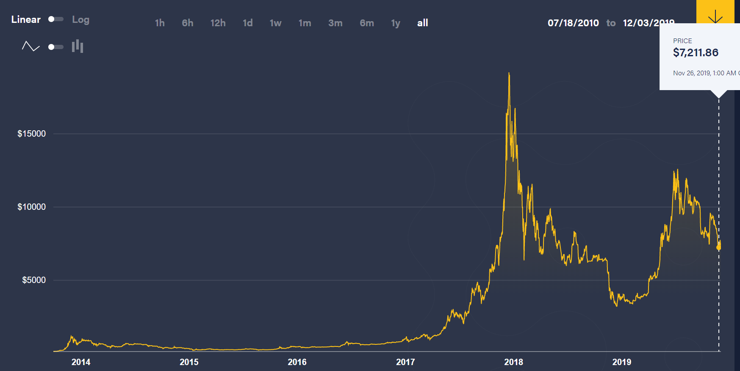
PRICE HISTORY CHART

Slide 5
What is blockchain?
A chain of blocks
Every block contains about 2000 transactions
The ledger is spread around nodes in the network
The data within the block is unchangeable.

Slide 6
A problem
Somebody can tamper with the blocks. For instance steal money or cancel a transaction

Slide 7
The solution: hashing
Hash is an encrypted string that represents a block. The method we encrypt is by SHA-256. (אפשר להרחיב על ההצפנה הזאת)
Every block is composed of:
A hash string
Timestamp
A nonce (it’s a number whose value is adjusted so that the hash of the block will be less than or equal to the current target of the network)
The hash of the previous block
The goal of the current difficulty (We will talk about it later)

Slide 8
What happens when someone tampers with a block
Tampering with a block changes its hash and thus changes the hash of the next blocks after it – making them invalid
The attacker will have to validate(we will talk more about it later) each block by finding a correct nonce which takes a whole lot of time
Illustration: https://andersbrownworth.com/blockchain

Slide 9
How are we identified(?) with this coin?
We are identified by our public key
Each user has 2 keys: a private key which he keeps to himself and a public key which is public.

Slide 10
Digital signature
Key generator algorithm generates a private key. Afterwards it generates the public key based on it.
Signature algorithm: given the private key + data the algorithm generates a signature
Verification algorithm

Slide 11
Who does verify transactions?
Verification is neither through a central authorization nor majority vote
Verification is through nodes in the network (we will talk about it in a moment)

Slide 12
Communication in bitcoin
New transactions are broadcast to all nodes
Each node collects new transactions into a block.
Each node works on finding a difficult proof-of-work for its block.
When a node finds a proof-of-work, it broadcasts the block to all nodes.
Nodes accept the block only if all transactions in it are valid and not already spent.
Nodes express their acceptance of the block by working on creating the next block in the chain, using the hash of the accepted block as the previous hash.

Slide 13
Mining
What is mining?
What is mining pool?
What is the motivation to mine? (incentives)
How is the difficulty target determined?

Slide 14
mining
Mining is the process of adding transaction records to Bitcoin's public ledger of past transactions. להרחיב
Mining pool is …
In order to mine, every miner must solve the following difficult math equation:
SHA-256(block_text + nonce) < 2^100
which is composed of certain number of 0’s from the right.
The number of 0’s describes the difficulty of the puzzle. In 2016 the number was 70 and today is TODO

Slide 15
Mining – incentives
Every miner that solved the puzzle gets:
A certain number of bitcoin (Today is 12.5 BTC and this number decreases exponentially every 4 years)
The transaction fees

Slide 16
How is the difficulty target determined?
The difficulty is determined by the rate of miners that solve the puzzle.

Slide 17
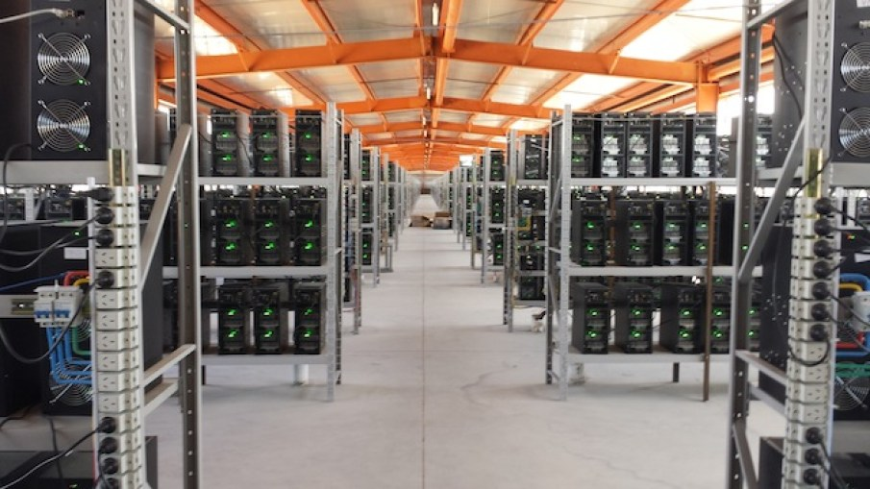

Slide 18
fork
What to do when we get at least two blocks simultaneously? What block will be the last one?
Those blocks point to the last block in the chain

Slide 19
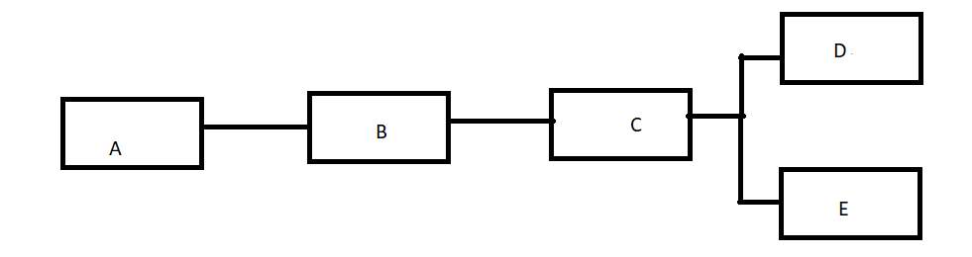
FORK

Slide 20
fork
We will have to think of a way that will decide what block will be the last in the chain
- So others will know what transactions were approved.
- To know what branch to continue from.
The longest chain is the most preferred & secured chain
How can we make sure other nodes will follow this protocol?

Slide 21
The protocol of fork
When a node has received two or more blocks simultaneously the node will wait for mining.
We will add the newest block to that branch where the hash of the block there points to.
Now nodes will notice the longest ledger and will continue it from there.
The other branch will be called orphaned and the transactions that it holds will be overturned. להוסיף שהשני לא יקבל ביטקוינים

Slide 22
More about fork
Often forks are derived from disagreements.
Mostly they are disputes about changing the protocol of the coin
As a result, the two branches will stay active, but they will be independent from one another.
That’s how a new form of a digital coin starts. (i.e Bitcoin Cash)

Slide 23
Fees
The difference between the payed amount to the amount that the payee received
How high are the fees?
Who does get the fees?

Slide 24
storage
Overtime obsolete data wastes a big amount of storage, but we can’t simply remove it
The solution to this problem is by Merkel trees.
What are Merkel trees?

Slide 25
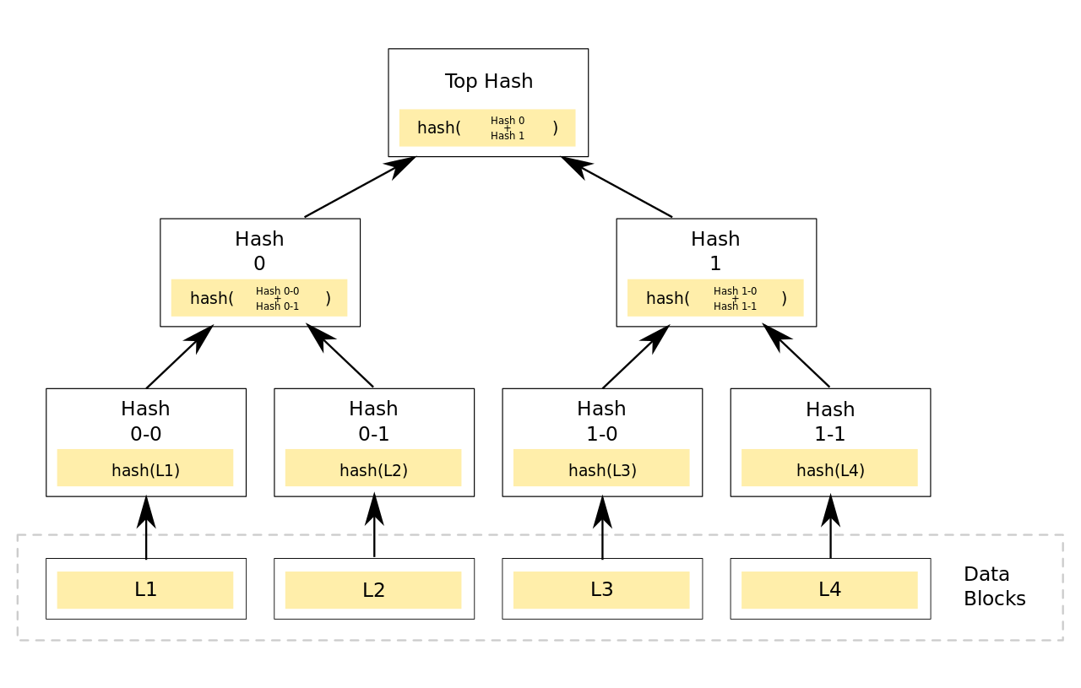
What are merkel trees?

Slide 26
PRIVACY
Privacy derives from the fact that people don’t want others to know what they do with their money.
In fiat currency banks do not expose your usage to others. On the other hand with this coin, it’s different.
With this coin, users can enhance their privacy by creating more public keys through one private key!
But it’s not enough. Combining some or all the keys in one transaction others can infer those keys belong to one user.

Slide 27
Double spending attack
Double spending means spending the same money twice.
The attacker A wants to buy from victim B something. Accordingly they distribute to the network the transaction.
Some miners start working to solve the puzzle in some block numbered N that transaction is there
The attacker secretly mines a block numbered N that does not include that transaction in it(without distributing it).
After a few blocks that were added to the ledger B is convinced the money was transferred and ships the item to the attacker
The attacker keeps working on his ledger, making it longer
Once his ledger is the longest one, he distributes it to the network and therefore creates fork in block number N
Now everyone ignores the old ledger and starts working on the last block that A just distributed
Consequently A managed to get his money refunded plus having the item.

Slide 28
51% attack

Slide 29
Selfish mining attack
This attack was theoretically published by an Israeli named Itay Eyal in 2013
This attack is not about stealing items without paying but earning money without following the protocol.

