Slide 1
THE RISE OF
SECOND-HAND
INTELLIGENCE
How Generative AI Is Reshaping Human Expertise & Original Thought
MBAI 5310G — AI Programming · Quayci Clement-Yorke · June 2026

Slide 2
GITHUB: CYORKE001
End-to-end ML pipeline built across Weeks 2–6.
github.com/cyorke001 · MBAI 5310G — AI Programming
WEEKS 2 & 3 — Loan Default Prediction (Logistic Regression · SVM)
WEEK 4 — Decision Tree Classification (AdVantage · Evergreen Bank)
WEEK 5 — K-Means Clustering: TalentWorks employee segmentation
WEEK 6 — Model Evaluation, Explainability & Fairness (SHAP)

Slide 3
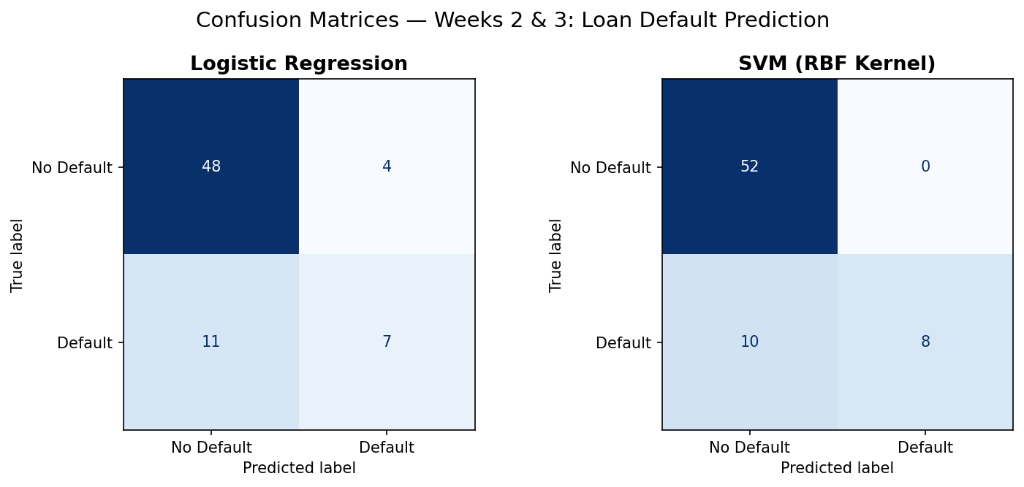
WEEKS 2 & 3 — LOAN DEFAULT PREDICTION
Dataset: Finance Loan Default · 356 rows
Task: Binary classification (Loan_Default: Yes/No)
Pipeline: clean → encode → scale → train → evaluate
LR: 78.6% accuracy · AUC 0.88
SVM RBF: 85.7% accuracy · AUC 0.91
Key finding:
SVM outperformed LR on every metric — but both models struggled to recall actual defaulters due to class imbalance in the dataset.

Slide 4
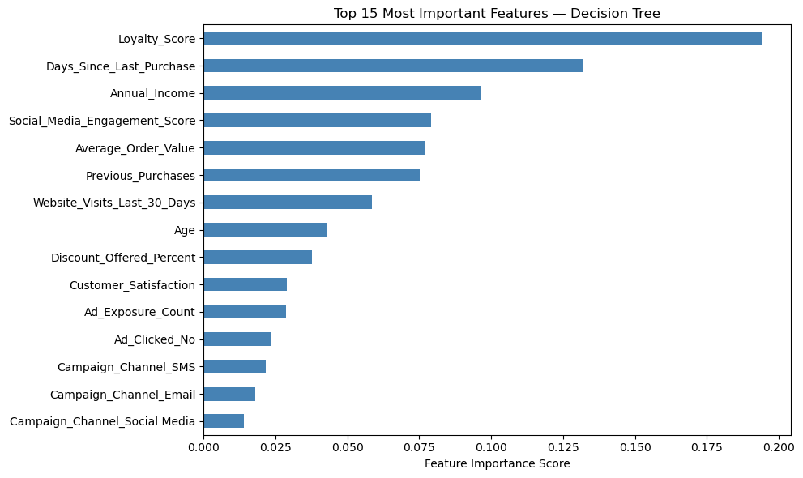
WEEK 4 — DECISION TREE CLASSIFICATION
Datasets: AdVantage Growth Studio · Evergreen Bank
Model: Decision Tree (max_depth=4)
AdVantage: Loyalty_Score is the #1 churn predictor
Evergreen: Credit_Utilization_Pct splits at root node
AdVantage accuracy: 63%
Key finding:
Two completely different businesses, two completely different drivers. The tree surfaced what actually moves the needle in each case.

Slide 5
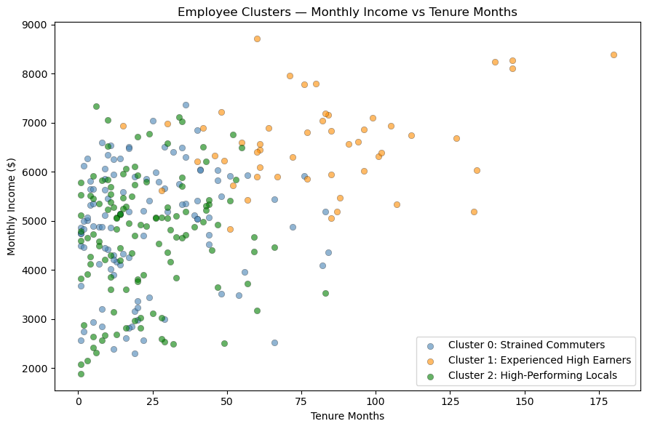
WEEK 5 — K-MEANS CLUSTERING (TALENTWORKS)
Dataset: TalentWorks · 300 employees · 8 features
Method: K-Means (K=3, elbow method)
Features standardized with StandardScaler
3 clusters found:
Strained Commuters · Experienced High Earners
High-Performing Locals
Key finding:
Employees weren't just different in pay — they differed in their whole situation. The clusters revealed natural workforce segments HR can act on.

Slide 6
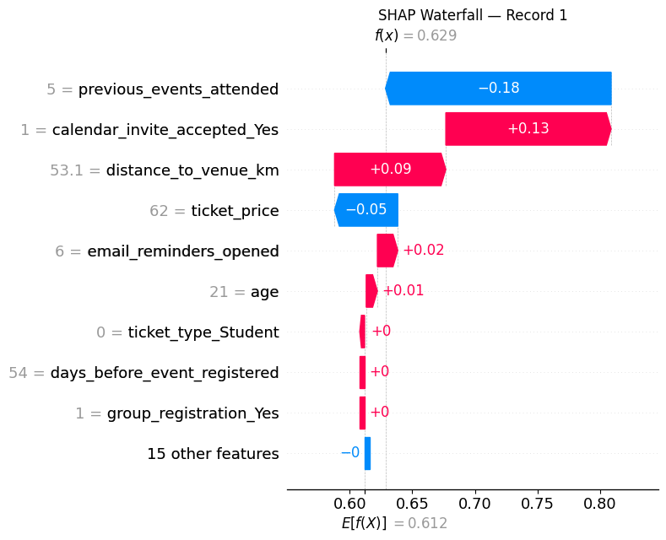
WEEK 6 — EXPLAINABILITY & FAIRNESS
Dataset: Event Attendance · 380 rows · 17 features
Model: Decision Tree + SHAP explainability
Top predictor: previous_events_attended (0.256)
SHAP waterfall: per-record breakdown of
exactly how each feature shifted the prediction.
Key finding:
Past behaviour drove predictions most — not demographics. SHAP confirmed the model wasn't relying on protected attributes.

Slide 7
RESEARCH PROPOSAL
What happens when AI doesn't just assist — but replaces — human thought?

Slide 8
THE PROBLEM — SECOND-HAND INTELLIGENCE (SHI)
01 EPISTEMIC SUBSTITUTION
Users accept AI outputs as their own without independent evaluation.
02 THE ACCURACY PARADOX
Polished AI text appears authoritative while masking epistemic dependency.
03 COGNITIVE EROSION
Repeated AI reliance degrades independent reasoning capacity over time.

Slide 9
METHODOLOGY & CONTRIBUTIONS
STUDY DESIGN: 5 prompts × 3 text types (Human-Written · AI-Generated · Human-Edited AI)
NLP FEATURES: TTR · Hedging Ratio · Semantic Similarity · Readability · Perplexity
ML MODELS: LR · Random Forest · SVM · Neural Network · Metrics: F1 · ROC-AUC
CONTRIBUTIONS:
SHI Construct — First operationalization of Second-Hand Intelligence
NLP Framework — Validated features detecting epistemic substitution
Design Guide — AI principles that preserve epistemic autonomy

Slide 10
THANK YOU!
Quayci Clement-Yorke
MBAI 5310G — AI Programming · June 2026
clementkwesi.yorke@gmail.com · github.com/cyorke001

